Slide 1
Tracking surgical instruments using NCC
Shushan Toneyan, Judith Bergadà, Madleina Caduff

Slide 2
Initial ideas
RANSAC and Harris Corner
RANSAC: track the shaft of the tool
Harris Corner: find the corner of the central tweezer
Notes:
Which training images to use? -> tool moves and rotates -> difficult to have that many training images which cover all possible positions

Slide 3
RANSAC and Harris corner
Notes:
RANSAC and Harris Corner:
- Both worked, but not very robust. Don‘t make use of previous images.

Slide 4
Initial ideas
RANSAC and Harris Corner
RANSAC: track the shaft of the tool
Harris Corner: find the corner central tweezer
Normalized Cross Correlation (NCC)
Template matching
Notes:
Which training images to use? -> tool moves and rotates -> difficult to have that many training images which cover all possible positions

Slide 5
Algorithm: NCC with “memory”
1st image: take “small” patch around starting position → use it as template for 2nd image
for image in images:
take “large” patch in new image centred at the position of previous match
compute NCC between this “large” patch and the templates ( = previous 15 matches)
select “small” patch with maximum NCC
save centre of match
add “small” patch to templates
Notes:
Draw algorithm on the board or add little animation
Extremely smart, because it accounts for little changes in instrument orientation / illumination / reflectance etc. instead of fixed training images

Slide 6

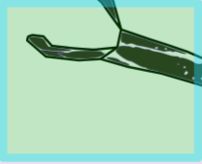



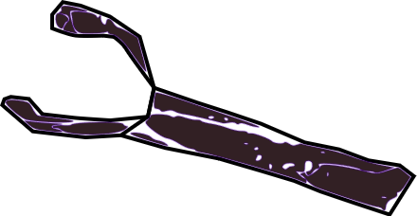

15 Templates
NCC Calculation
Notes:
We start with a previously found point (red small dot that was found in step before) and 15 templates
Put a larger frame around the red dot
The red point disappears and the tool moves slightly but the green larger frame remains as it was
The green frame is cut out and flies to the templates
NCC
A smaller patch from the frame is chosen as the best and an arrow indicates that this is where the new red dot appears (no green frame needed)
The smaller template is added to the 15 templates, all move to the left and the last one is removed

Slide 7
Challenges
Grayscale images
Slight deviations
Instead of using just the previous image, use 15 last images for template matching
Notes:
Grayscale -> less noisy

Slide 8
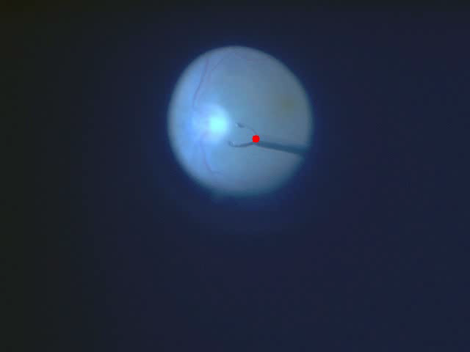
Notes:
Qualities: perfect for A, nearly perfect for B. Very generic, will most probably also work for other image sets. No training images required, uses the information contained in the images itself.
Limitations: First image needs to have a known starting position.

Slide 9
Summary
Very generic method, high accuracy
Could be improved by:
More robust: find back when loosing track (i.e. use Harris Corner and RANSAC)

Slide 10
