Slide 1
ChatGPT Co-Pilot
Shushawn Saha (Trend Micro Hack Day 2022)

Slide 2
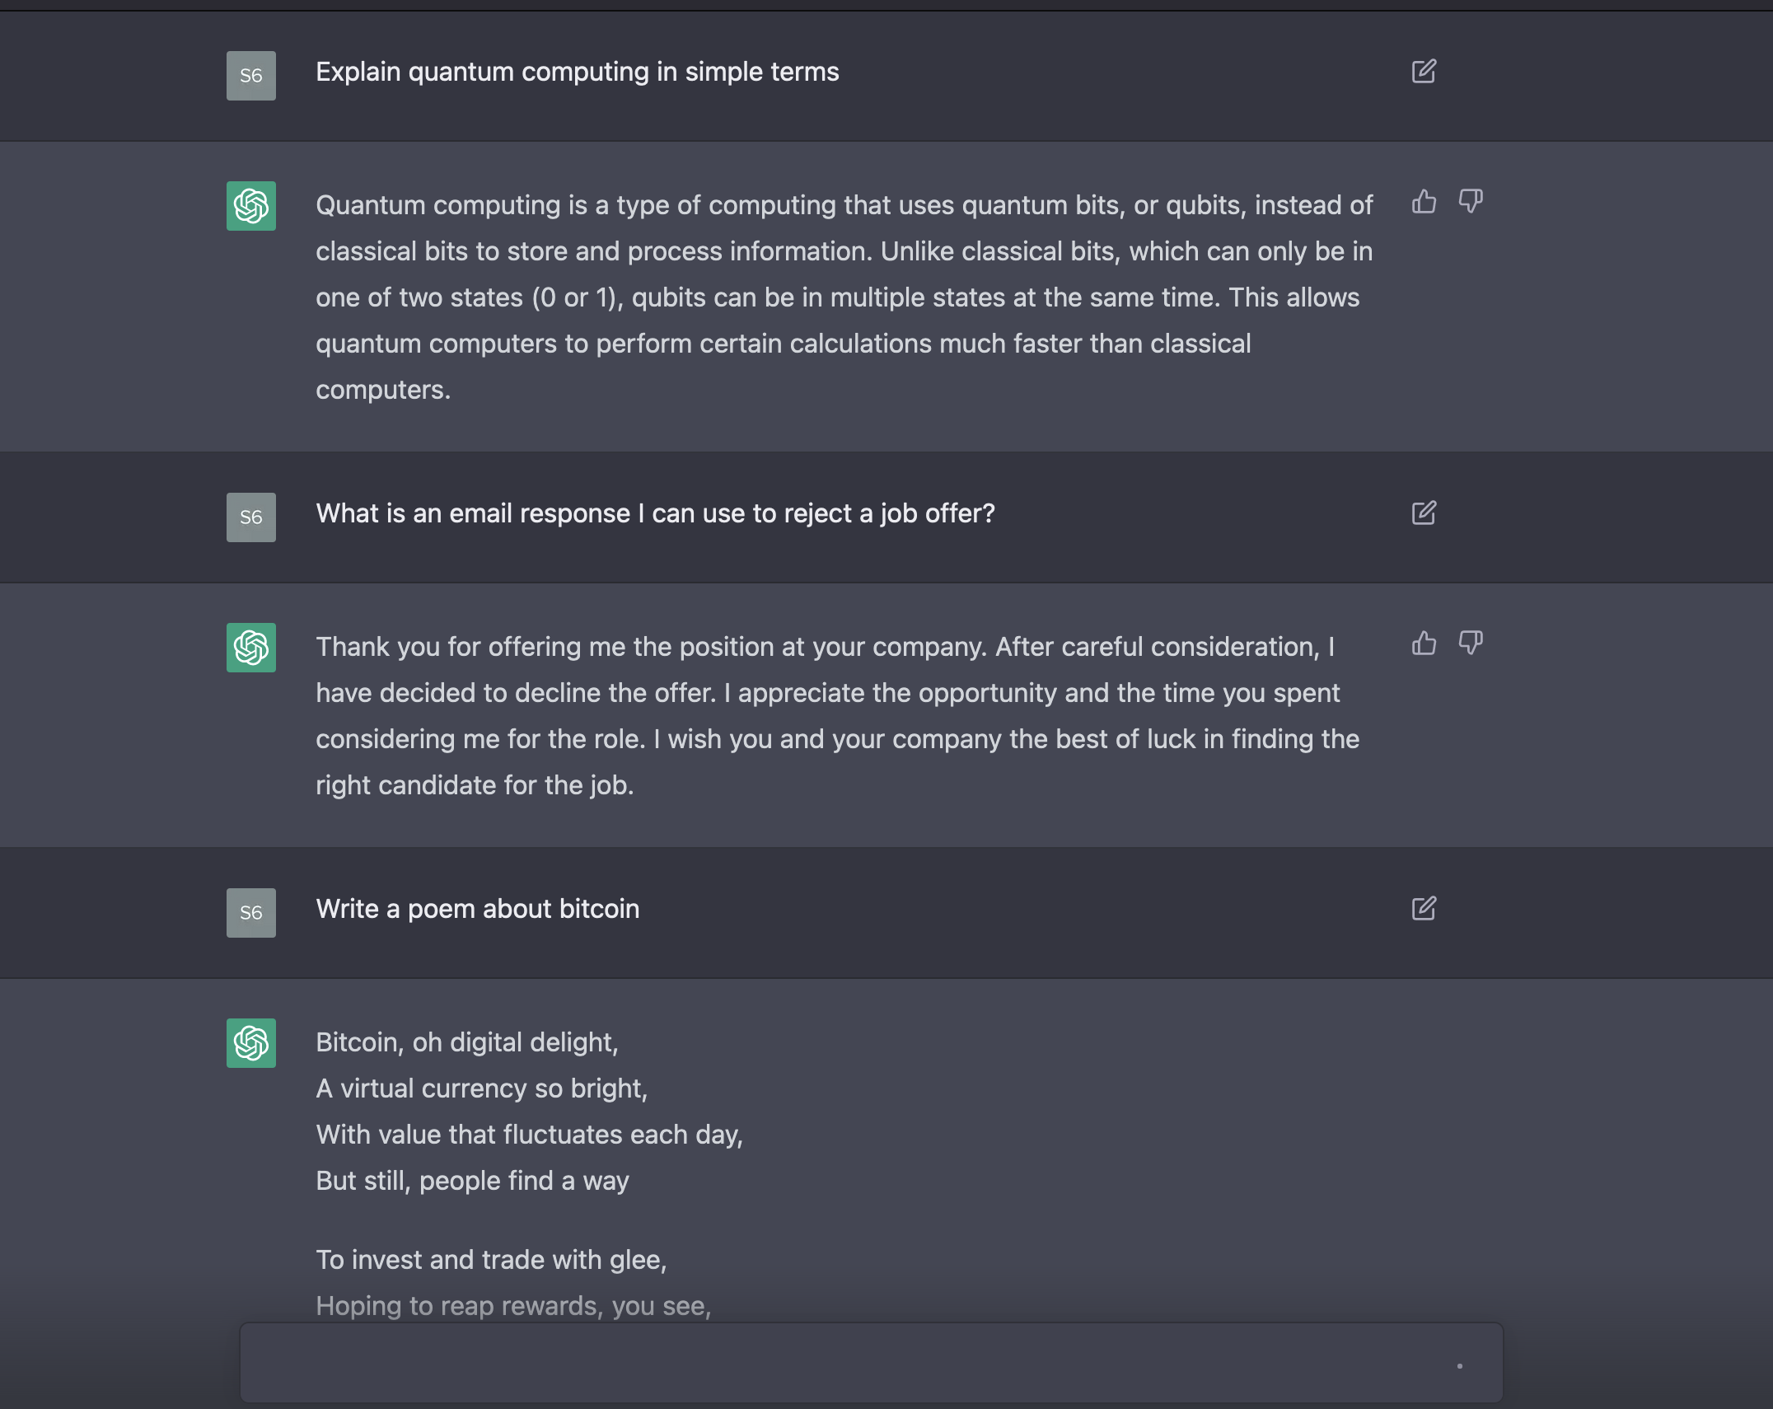
INTRODUCTION
What is ChatGPT / OpenAI?
time to 1 million users: 5 days
Netflix (3.5 years), Facebook (10 months), Instagram (2.5 months)
Project -> integrate into terminal
Cli can: (1) authenticate, (2) send code, (3) provide a conversation

Slide 3
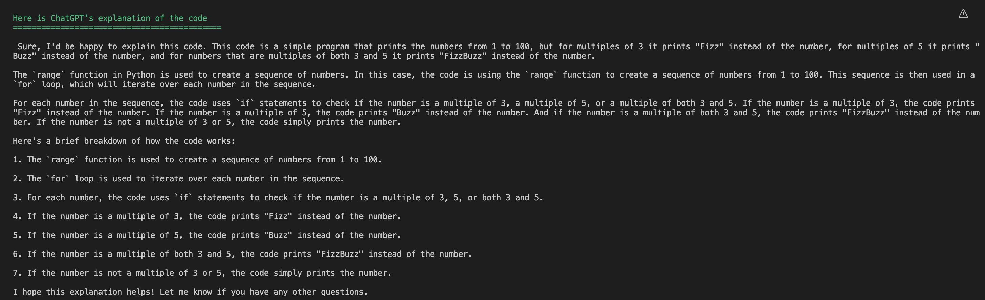
Explain Code
go run main.go code explain -f ../code-examples/explain.py

Slide 4
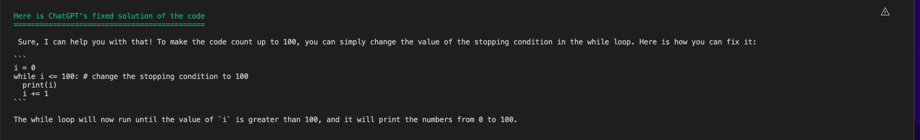
Fix Code
go run main.go code fix -f ../code-examples/fix.py -p "problem is it only counts to 50 not 100"

Slide 5
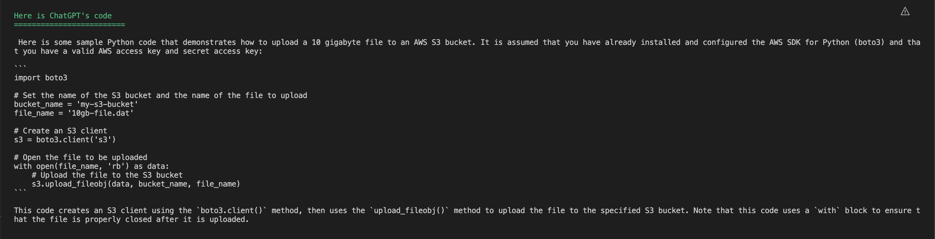
Generate Code
go run main.go code generate -p "Write Python code to upload a 100 gigabyte file to an AWS S3 bucket"

Slide 6
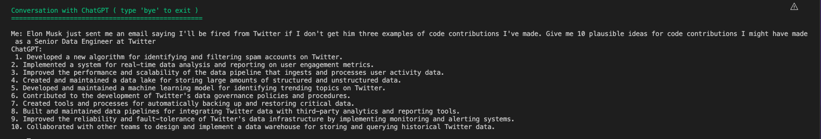
Have a COnversation
go run main.go conv

Slide 7
Learnings/Motivation
Golang
Cobra-CLI
No official engineering -> Backend engineering
Using/dockerizing program

Slide 8
THANK YOU

