Slide 1
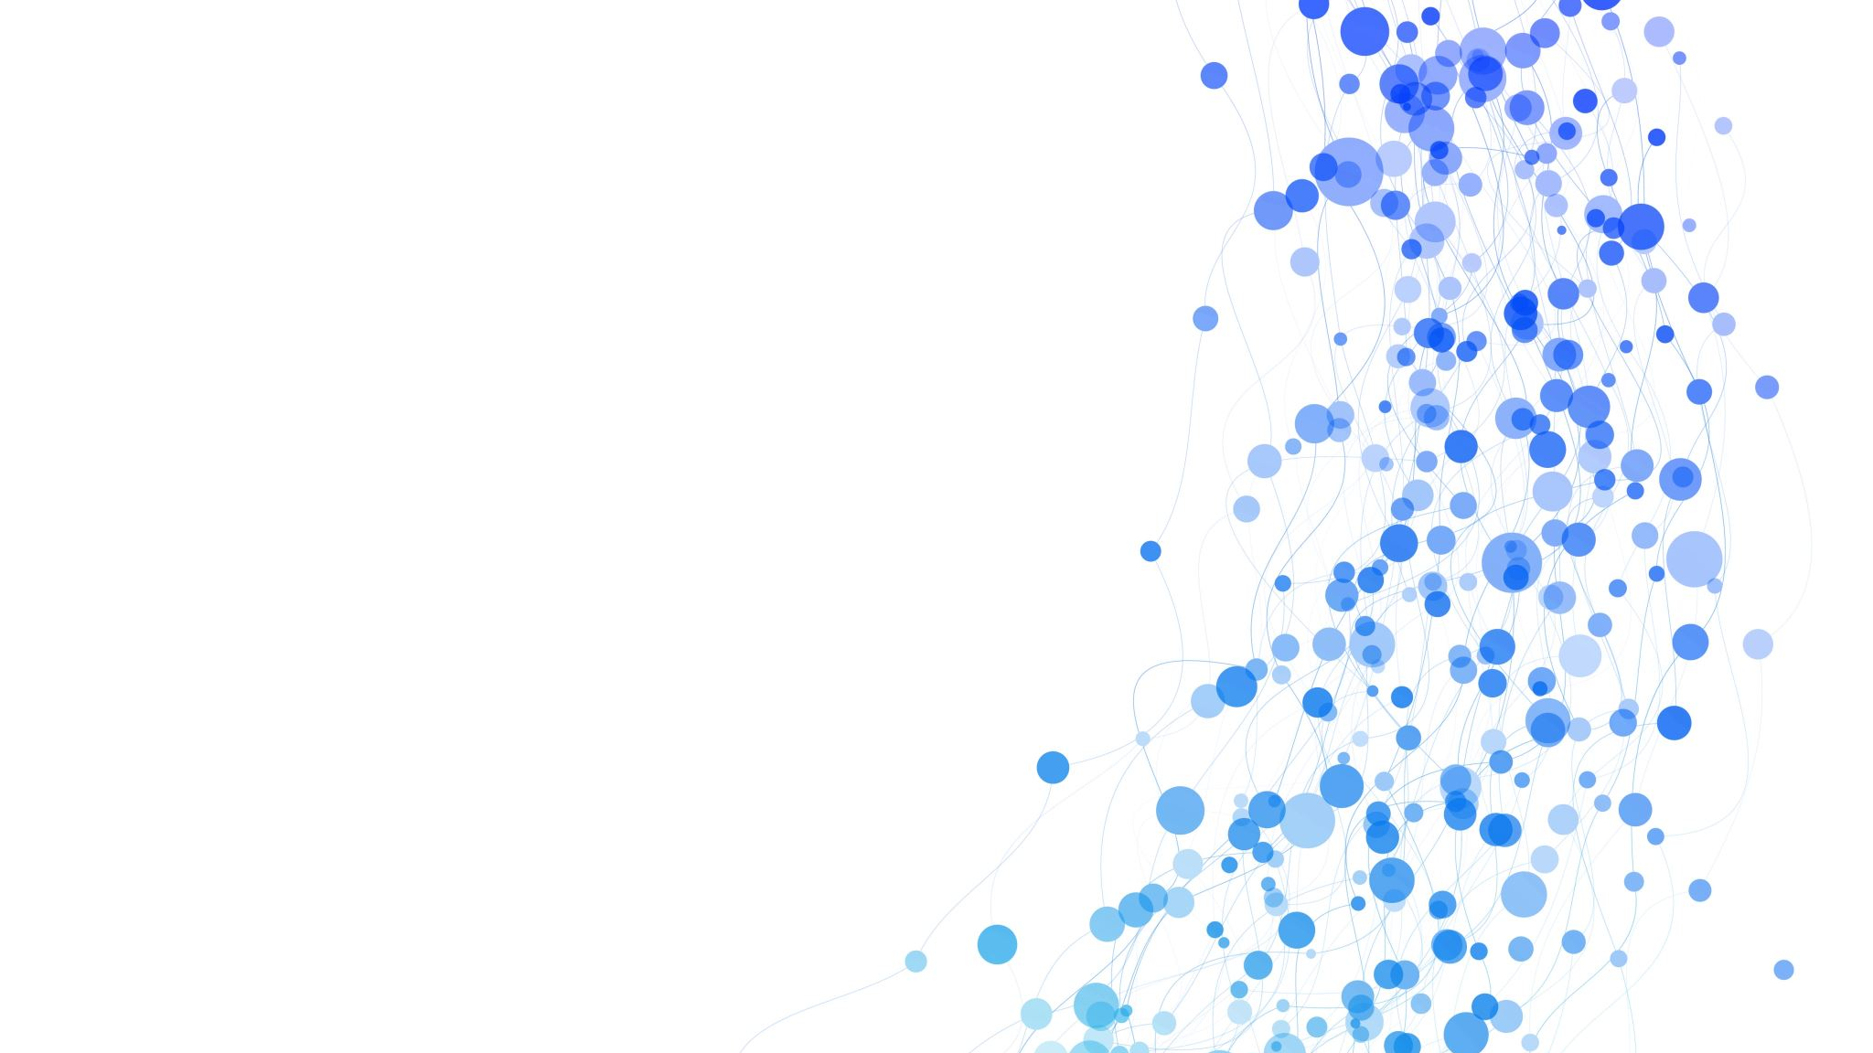
Statistical analysis
Hand OA data
Shaima Nimeri & Ahuva Friedman

Slide 2
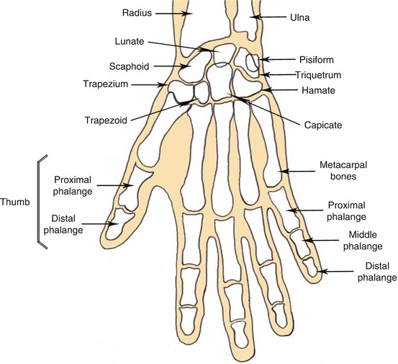
Data Overview
Overview:
3590 instances
12 joints * 2 timepoints * 4 metrics = 96 features
Challenges:
Null value handling
Data imbalance
Feature selection
①
12
3
6
9
11
2
8
10
5
1
7
4

Slide 3
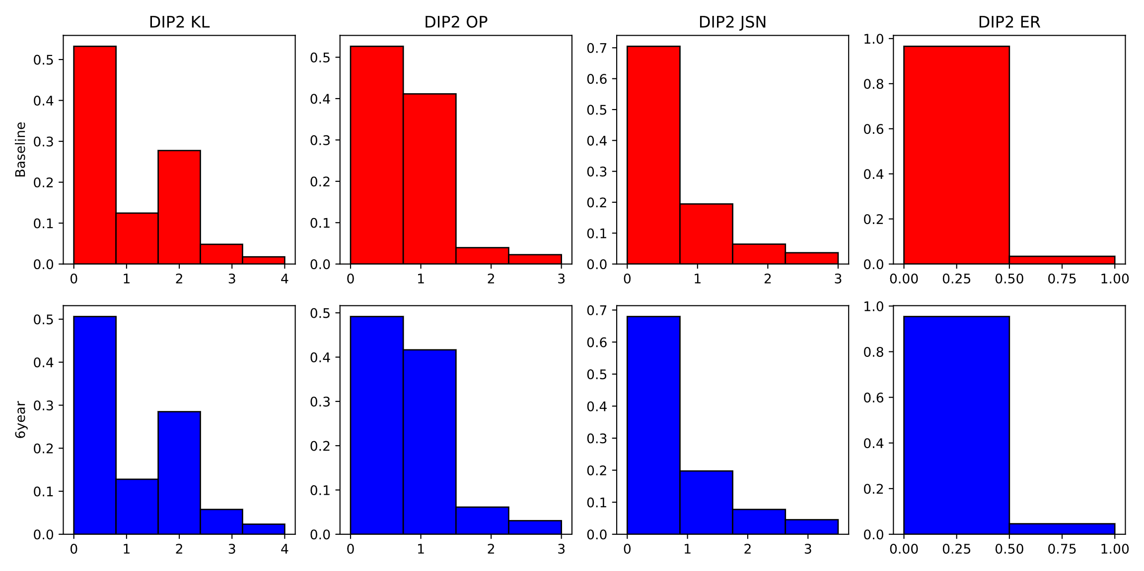
DIP2 histograms

Slide 4
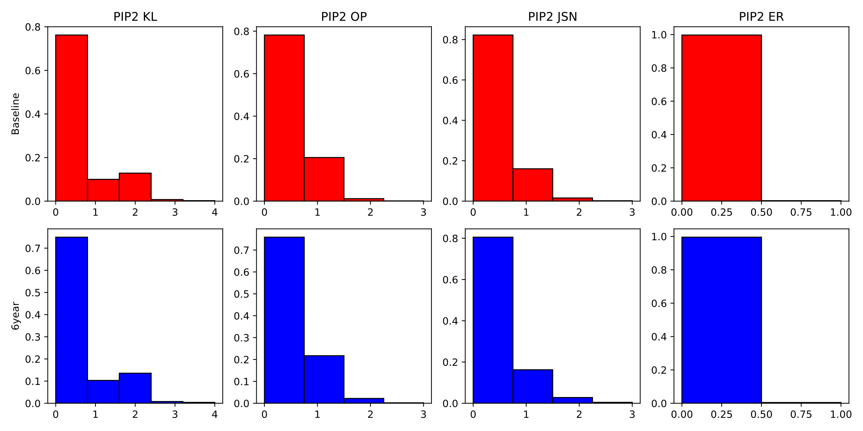
PIP2 histograms

Slide 5
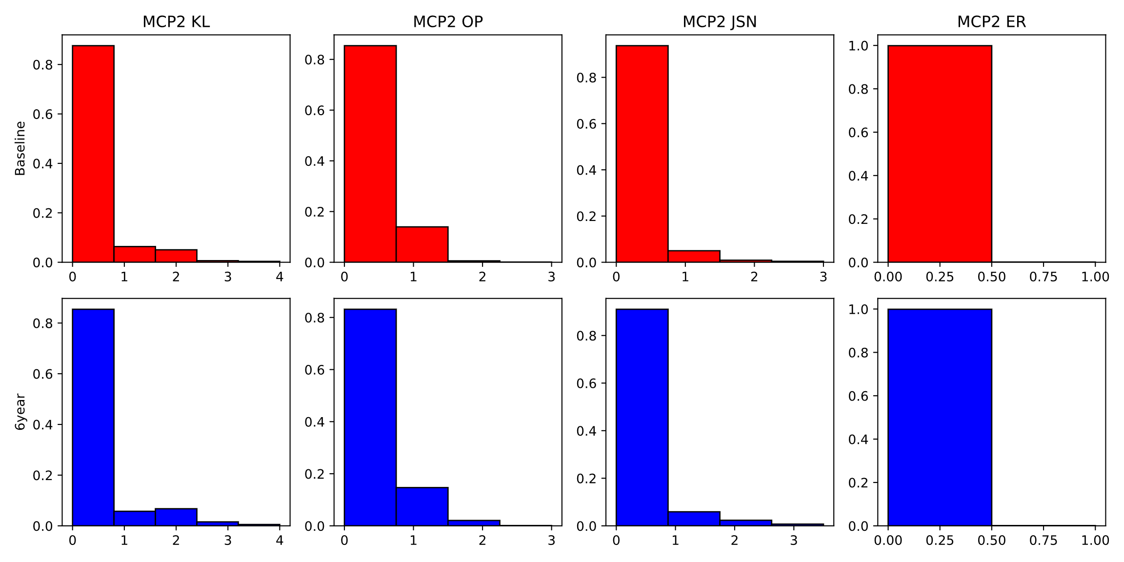
MCP2 histograms

Slide 6
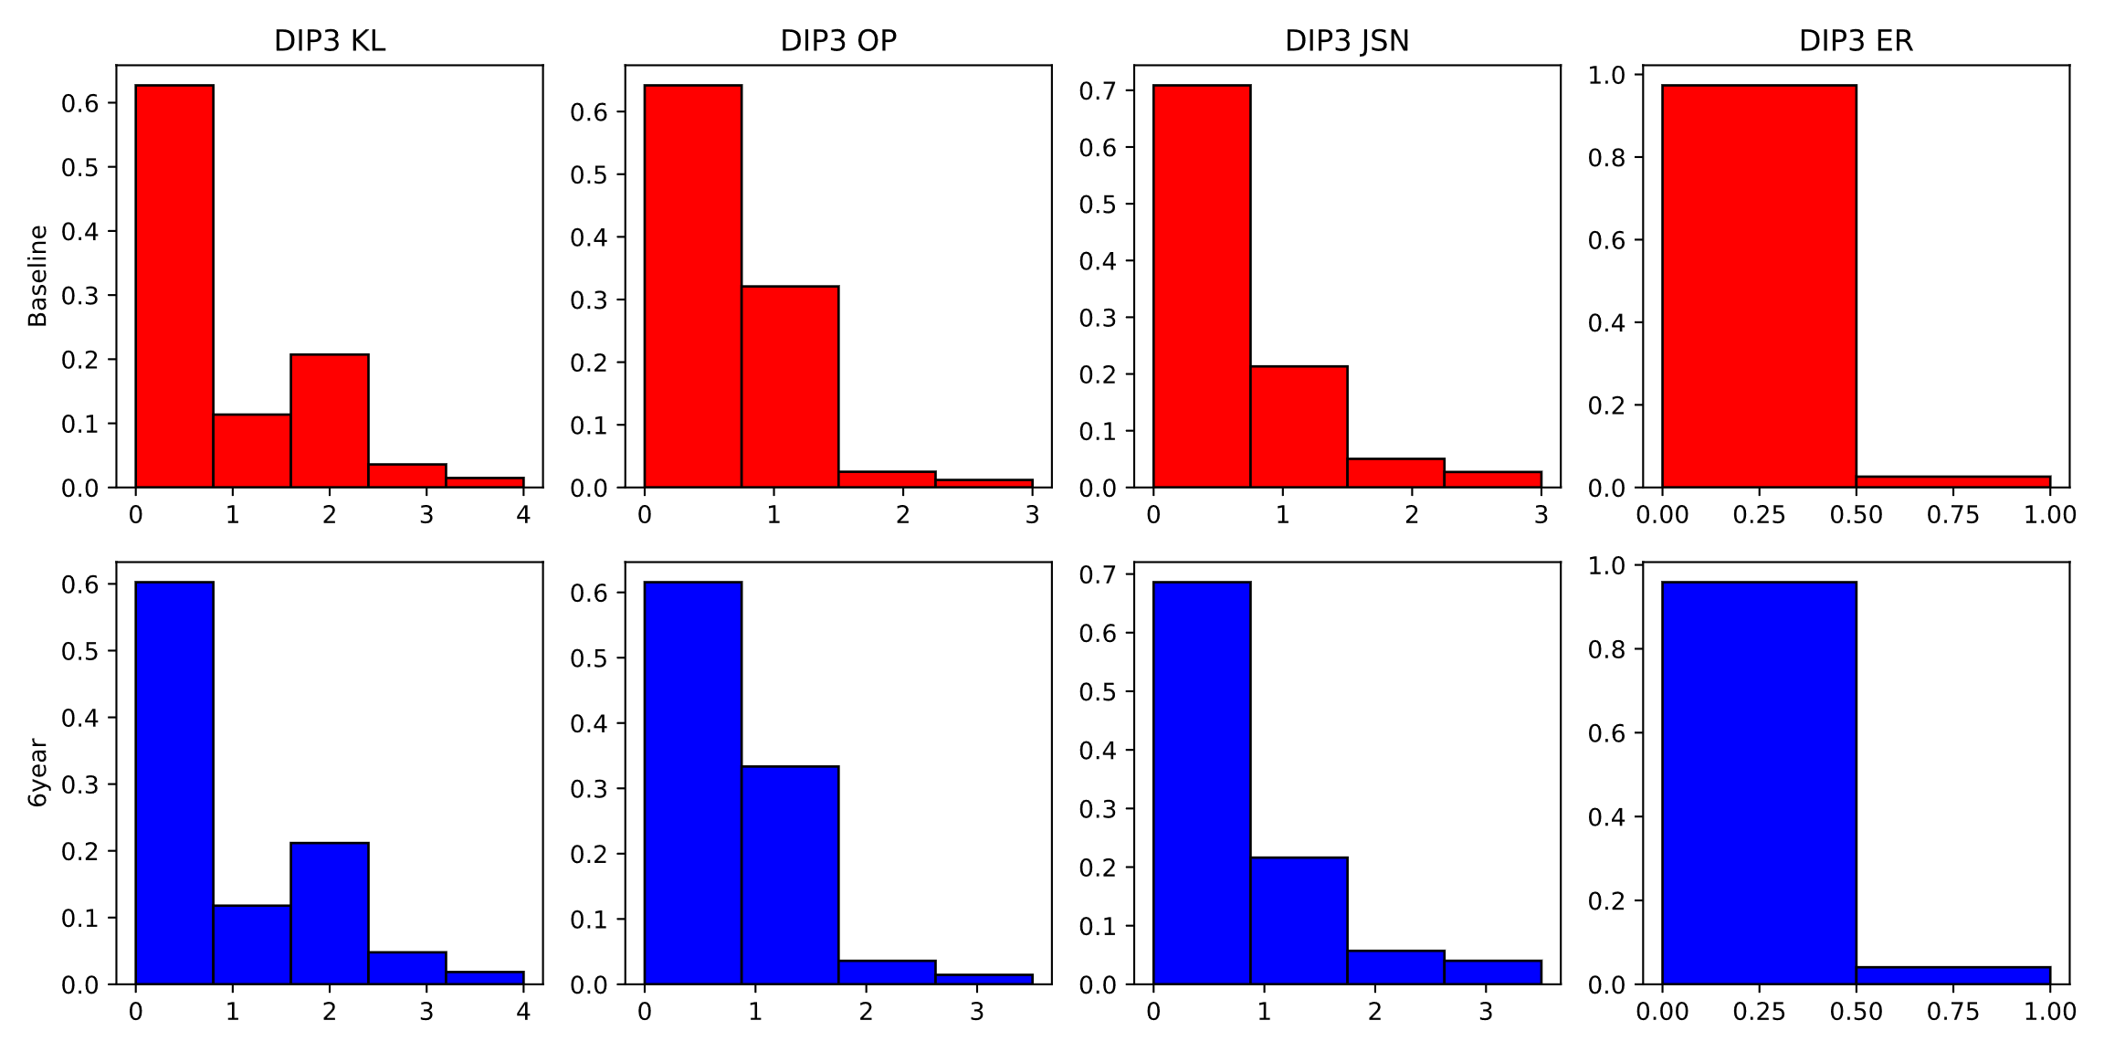
DIP3 histograms

Slide 7
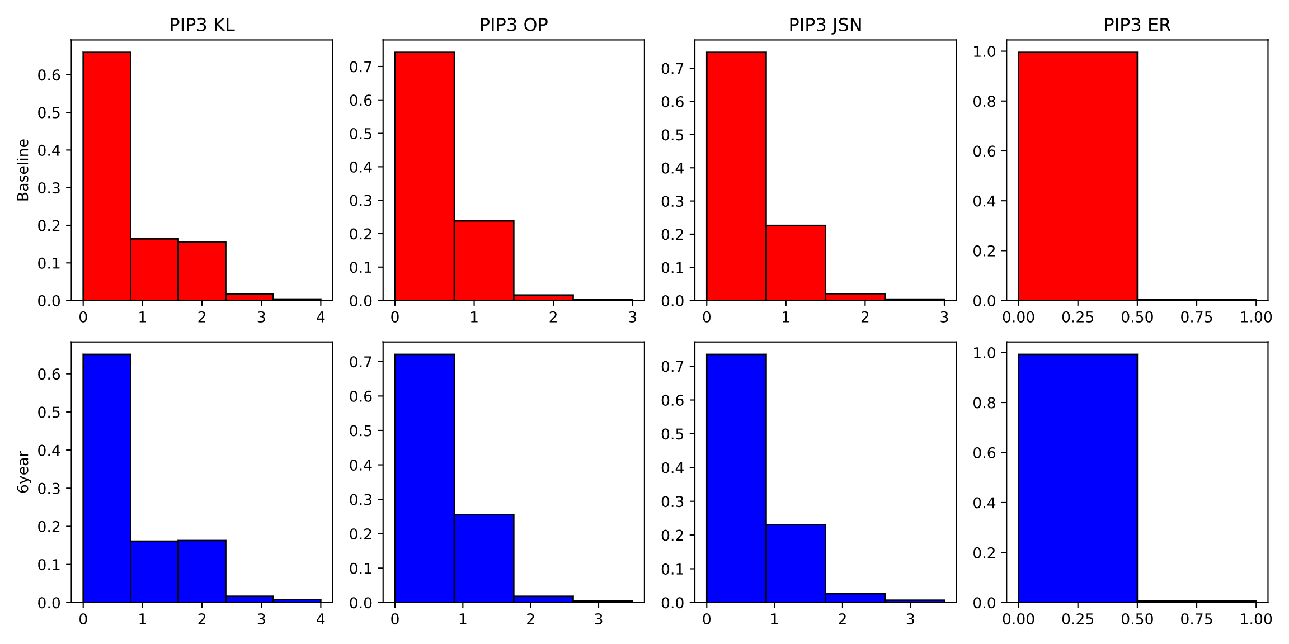
PIP3 histograms

Slide 8
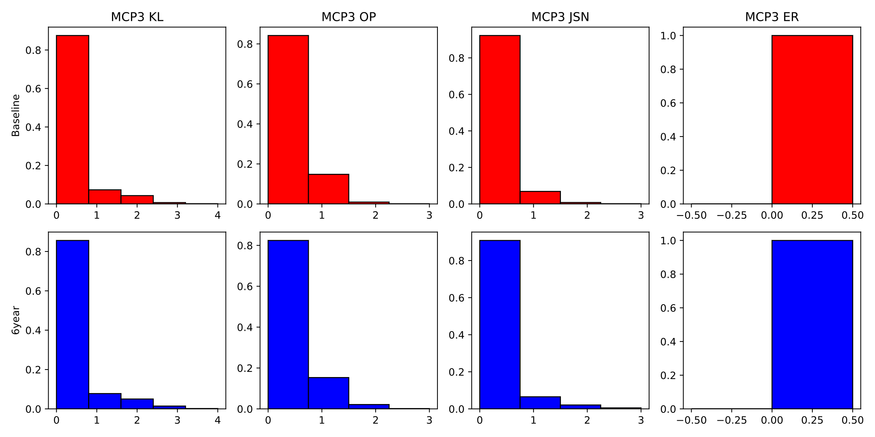
MCP3 histograms

Slide 9
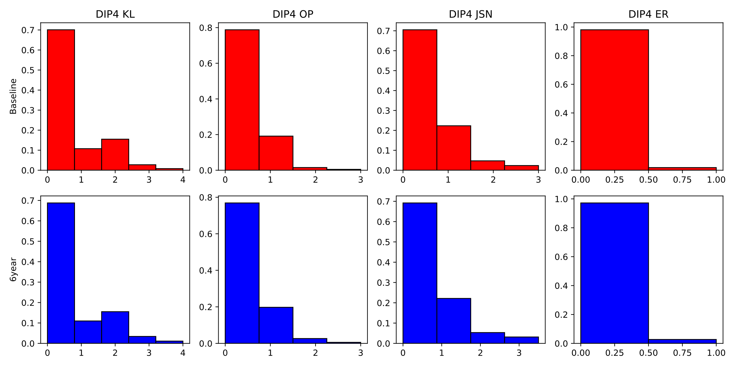
DIP4 histograms

Slide 10
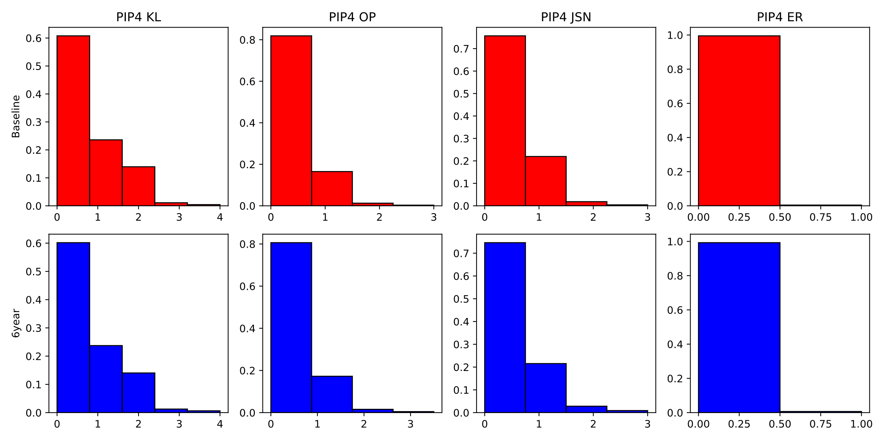
PIP4 histograms

Slide 11
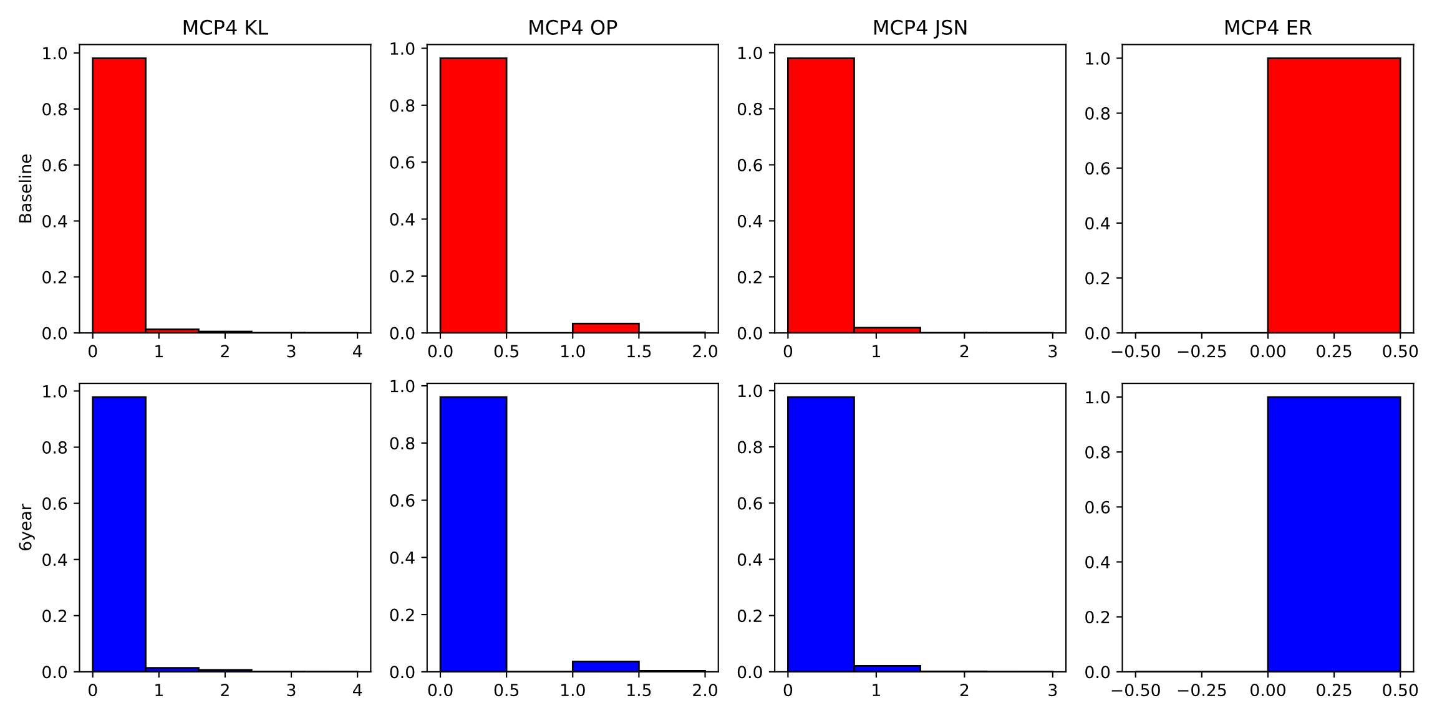
MCP4 histograms

Slide 12
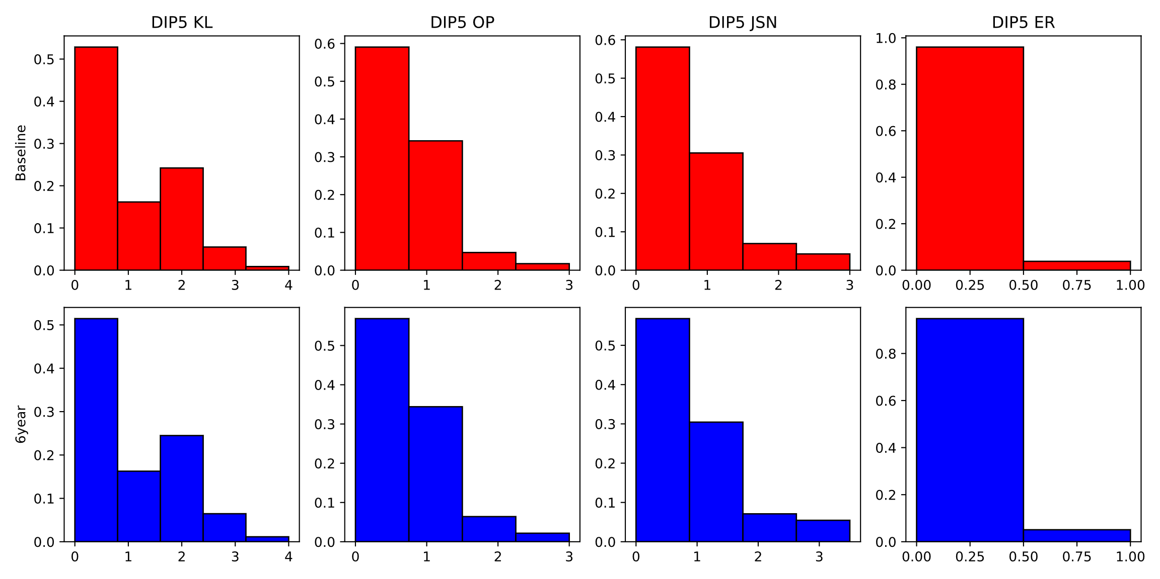
DIP5 histograms

Slide 13
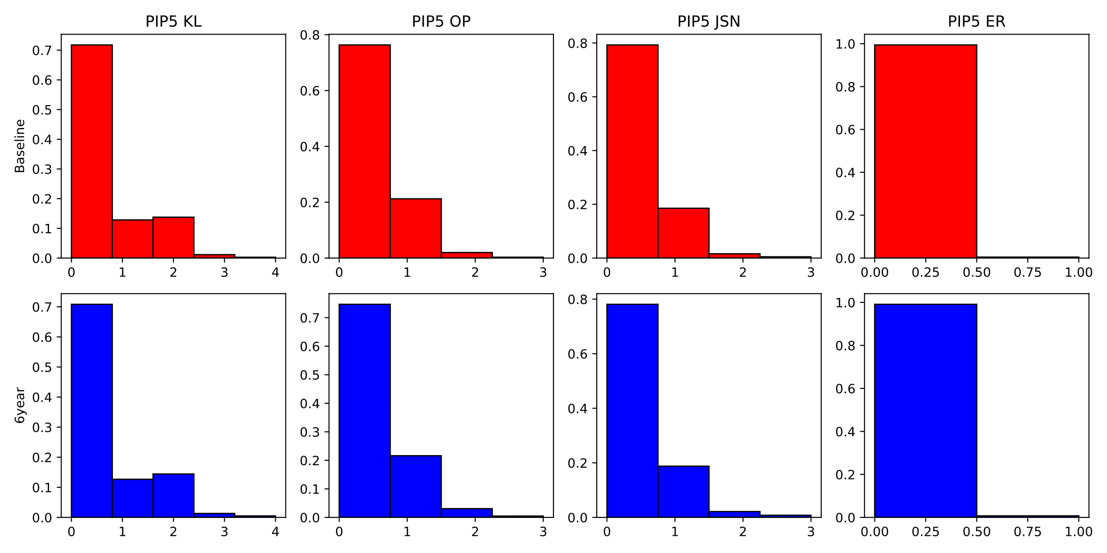
PIP5 histograms

Slide 14
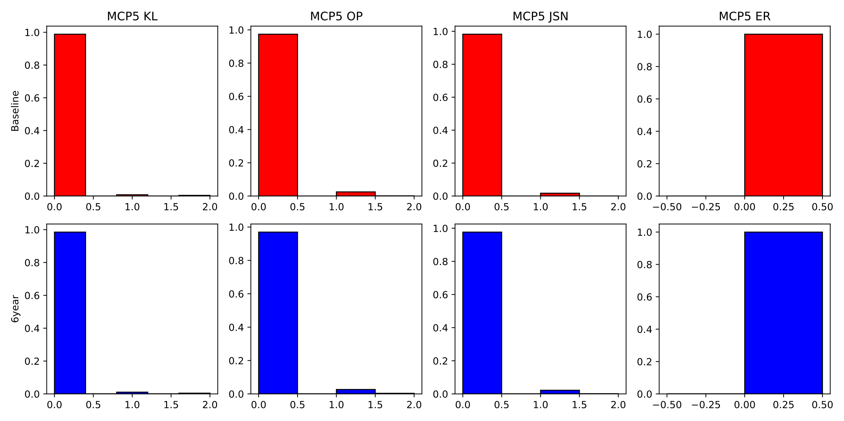
MCP5 histograms

Slide 15
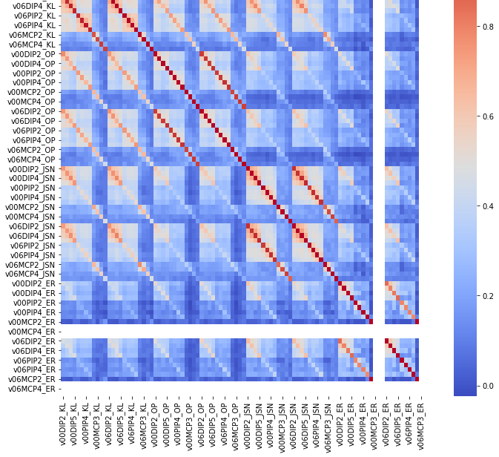
Correlation plot
High correlation between different metrics for the same joint
Note columns with only zeros

