Slide 1
Movie Recommendation System using KNN
Shusmoy Chowdhury
Jayanth Madupalli
Missouri State University
Department of Computer Science

Slide 2
Overview
Movie Recommendation System
K Nearest Neighbor
Distance Metrics
Proposed Methodology
Analysis of Results
Future Work

Slide 3
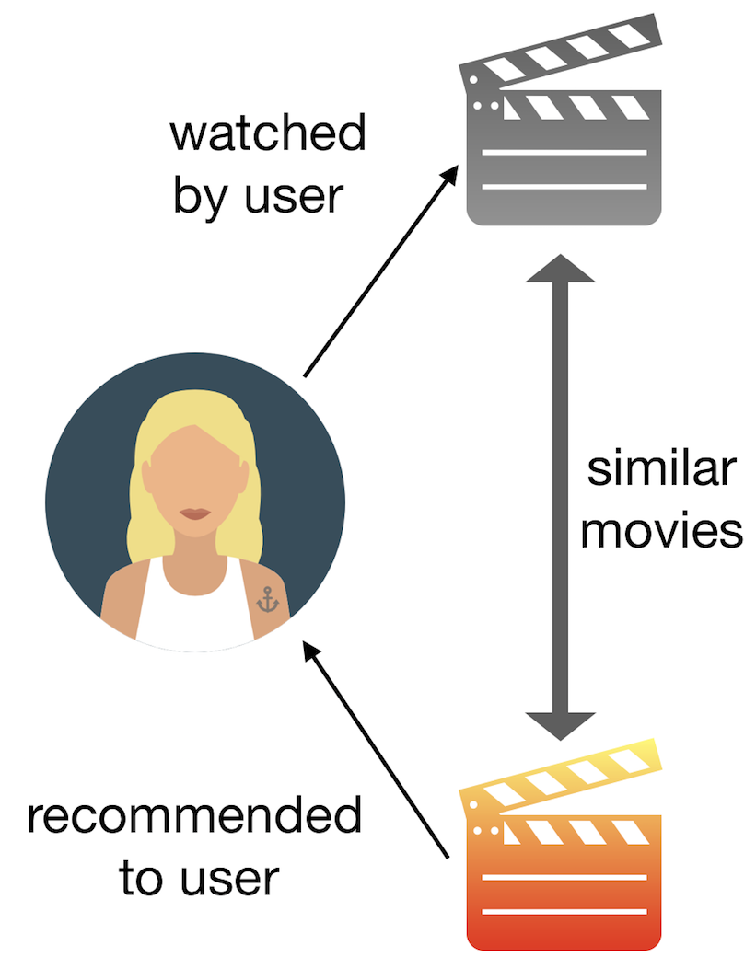
Movie Recommendation System

Slide 4
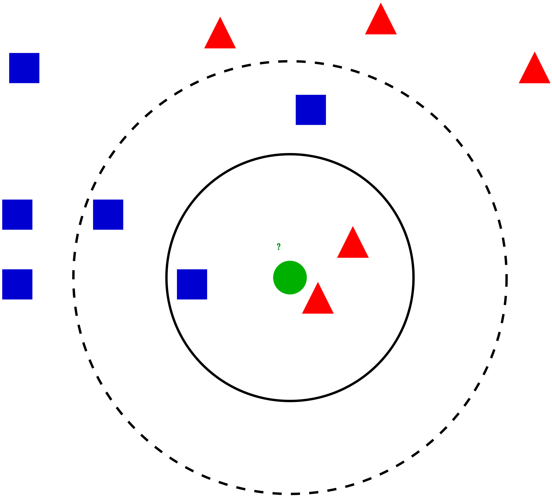
K Nearest Neighbor
Supervised machine learning algorithm
Finding the neighbors of a data point
Predicting results based on the neighbors
Used in both classification and regression problem

Slide 5
KNN in Movie Recommendation System
User will provide a random movie name
KNN will find the nearest neighbors based on the features using a distance metrics
Features can be genres, average ratings and popularity of a movie
These neighbors can be shown as similar movies or recommended movies

Slide 6
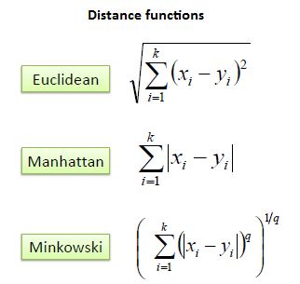
Distance Metrics
Euclidian Distance
Manhattan Distance
Minkowski distance

Slide 7
Proposed Methodology
Extracting features from MovieLens dataset
Prompt the user for movie name to conduct content-based filtering
Train the KNN model with Euclidian distance among the features
Find the nearest neighbors from the models
Display the nearest neighbors as recommended movies

Slide 8
Working with the features
We have used 19 genres, average rating and popularity of a movie.
We used these features and find the Euclidian distance between the user input and movies in dataset
We have used four different variations of Euclidian distance based on these features

Slide 9
Variation of Euclidian Distance
At first we used normal Euclidian distance for all the features
In the Second we prioritize the genres with multiplying some weights with that which gave us genre-based movie recommendation
In the Third we prioritize the average ratings and popularity with multiplying some weights with that which gave us popularity-based movie recommendation
In the Fourth we took the maximum of genre based and pupillarity based Euclidian distance
All four cases gave us different results with some similar movies

Slide 10
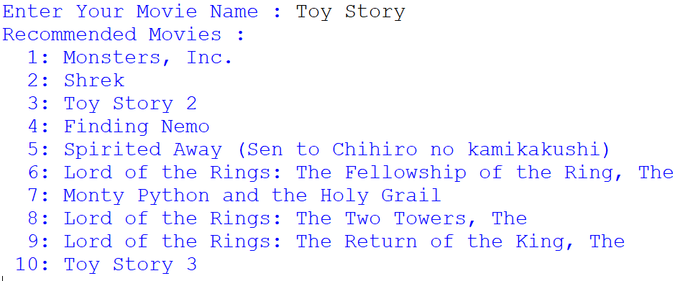
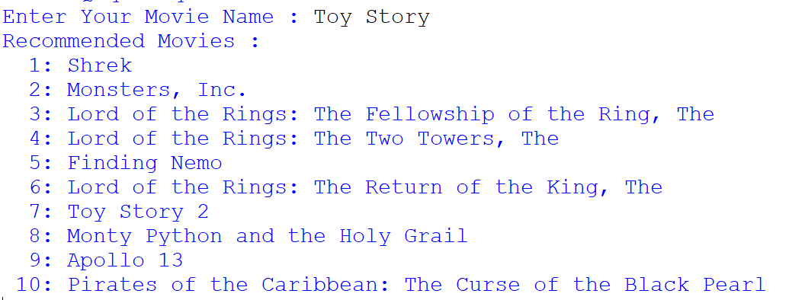
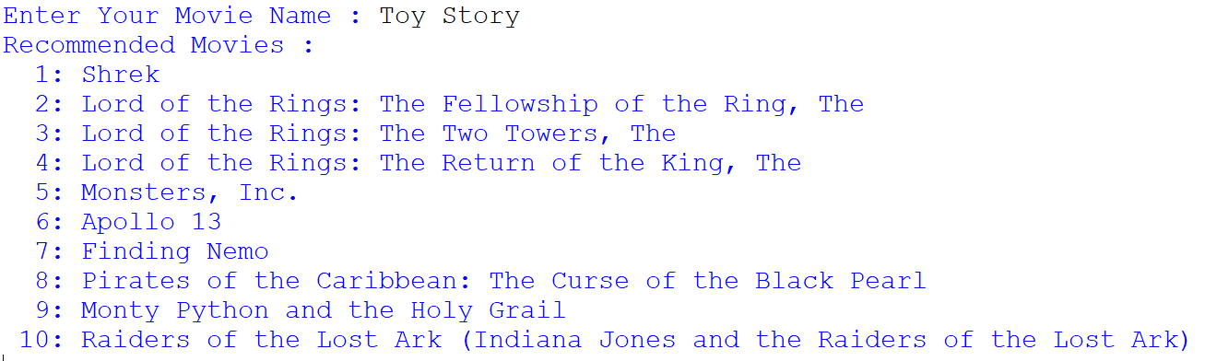

Analysis of Results
Normal Euclidian Distance
Genre Based Euclidian Distance
Popularity Based Euclidian Distance
Max Based Euclidian Distance

Slide 11
Future Plan
Combine the intersection of the results based on the different Euclidian distance
Use other distance metrics and check the results
Write the final report

Slide 12
Thank You

