Slide 1
Bangla Word Segmentation Technique And Bangla OCR Using Convolutional Neural Network and Recurrent Neural Network
Sabab Aosaf(1305019) & Shusmoy Chowdhury(1305108)

Slide 2
What is OCR?
Optical character recognition (also optical character reader, OCR) is the mechanical or electronic conversion of images of typed, handwritten or printed text into machine-encoded text,whether from a scanned document, a photo of a document, a scene-photo or from subtitle textsuperimposed on an image.

Slide 3
Previous work on Bangla OCR and word segmentation
A COMPLETE PRINTED BANGLA OCR SYSTEM
written by B. B. CHAUDHURI & U. PAL
publised in Computer Vision & Pattern Recognition Unit, Elsevier Science Ltd,1998
Indian script character recognition: a survey 0
written by B. B. CHAUDHURI & U. PAL
publised in Computer Vision & Pattern Recognition Unit, Elsevier Science Ltd,2004

Slide 4
Previous work on Bangla OCR
OCR in Bangla: an Indo-Bangladeshi language
written by B. B. CHAUDHURI & U. PAL
publised in Conference C: Signal Processing, Proceedings of the 12th IAPR International Conference on Pattern Recognition,1994
A International Journal of Computer Applications
written by Farjana Yeasmin Omee, Shiam Shabbir Himel, Md. Abu Naser Bikas
Published in IEEE

Slide 5
Word Segmentation
Word Segmentation
Word segmentation is the problem of dividing a string of written language into its component words. In English and many other languages using some form of the Latin alphabet, the space is a good approximation of a word divider (word delimiter), although this concept has limits because of the variability with which languages emically regard collocations and compounds.

Slide 6
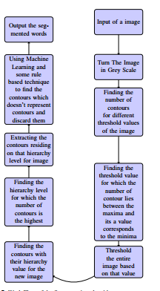
workflow of segmentation

Slide 7
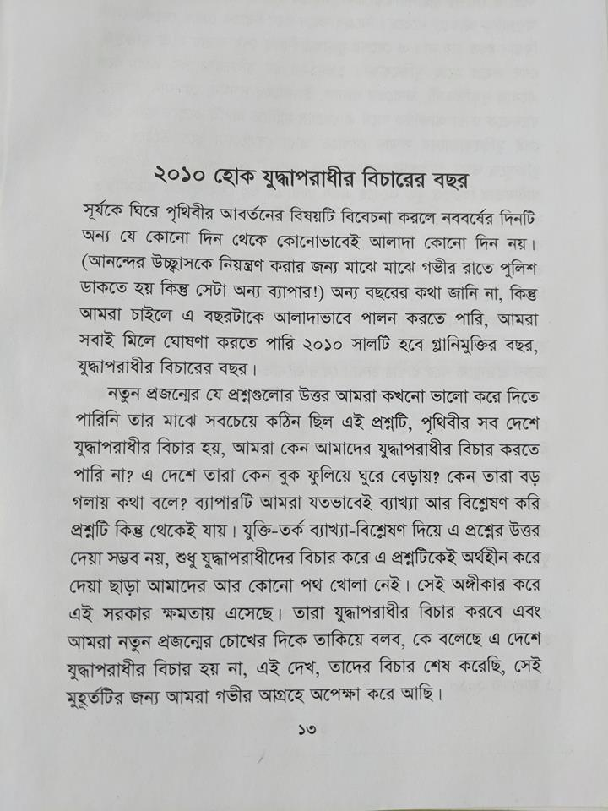
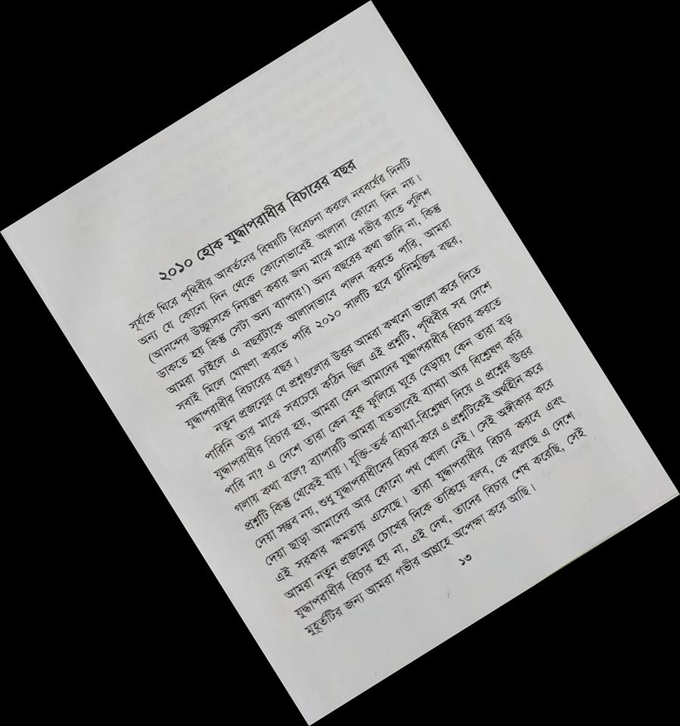
Input Image

Slide 8
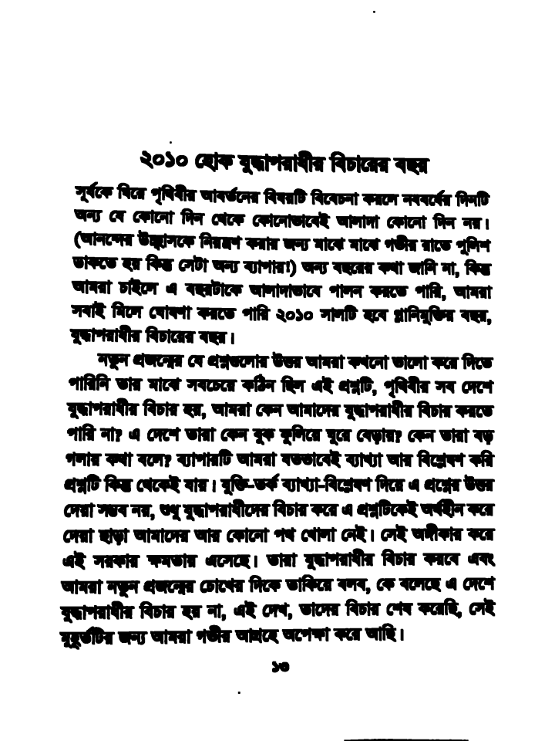
ConverTing Grey Scale

Slide 9
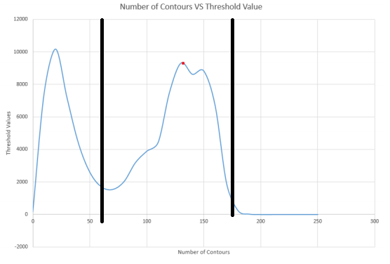
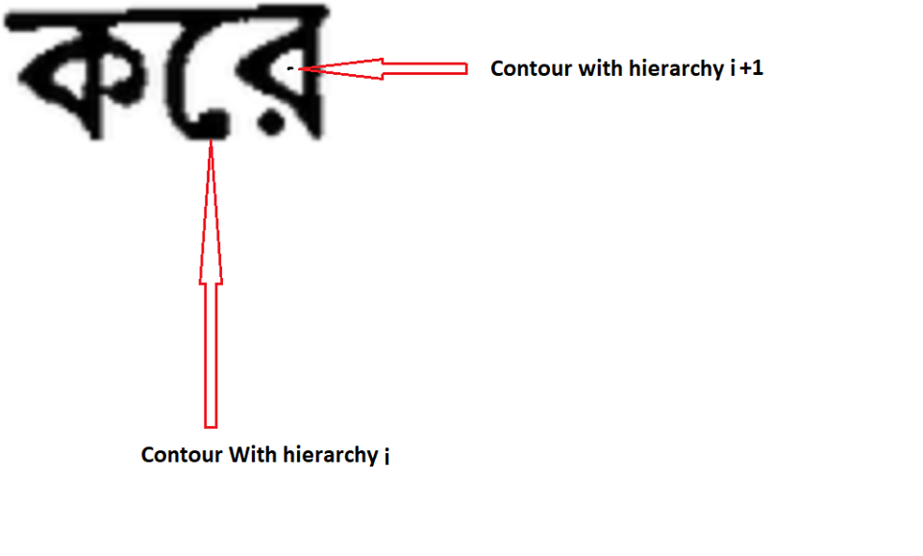
Finding Contours and threshold values

Slide 10
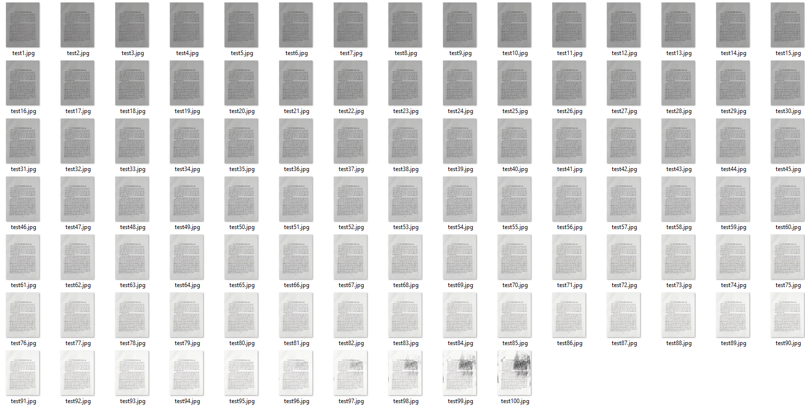
Experiment in segmentation in different brightness
Main Image
Images with different Brightness

Slide 11
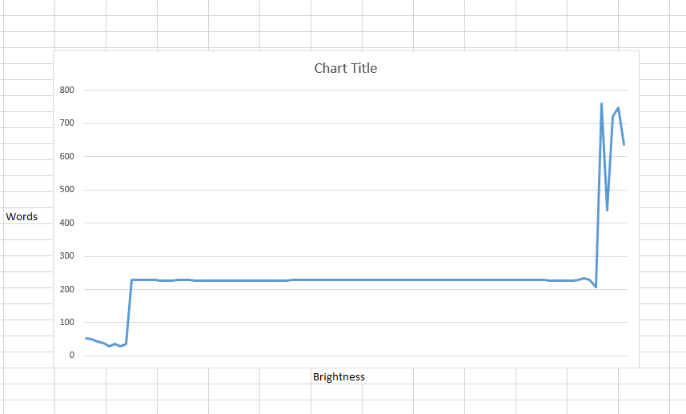
Change of word count when brightness changes

Slide 12


Problems in segmentation

Slide 13
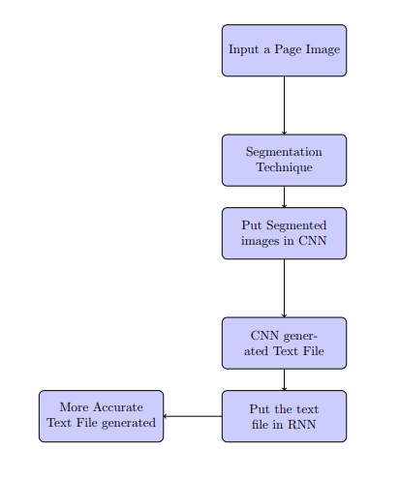
Work Flow Of OCR

Slide 14
Making of the CNN
Approach 1:
First we thought of making OCR on character level .
Making Dataset :
We got a dataset consisting of 500+ classes and each class consisted of 25 images . The images consisted of bangla vowels consonants and consonants with the diacritic form of the vowels .
Training :
This set gave us a very poor accuracy using both binary and greyscale version of the images . And using varied CNN structures .

Slide 15
Making of the CNN
Approach 1:
Testing:
A testset of 1/10 th of the images were generated
Here are our results :
We also augmented them using a sine function (to add ripple in the images) and also skwed and sheered with but improvement was negligible

Slide 16
Making of the CNN
Approach 2:
Making Dataset :
Second approach was to use Bengali word as whole . The words consisted of all kinds of characters . vowels consonants and consonants with the diacritic form of the vowels and also compound characters .We generated the dataset by using 516 bijoy fonts . We used 1020 random words each has a class . So we had a total of almost 500000 images . The size of each image was 32*300 . Since there are so many images augmentation was not needed .

Slide 17
Making of the CNN
Approach 2:
Training :
First We needed take several images into batches and turn each batch into serialized binary data . And than we saved them in SSD . Since it is not possible to keep the in RAM . Since the dataset was large we used a large number of nodes per layer . For the training we used Adam Optimizer . Out cost function was softmax cross entropy . Then used tenfold cross validation for measuring accuracy . Here are the results of the 10 different runs .
84.7% , 83.2% , 70.8% , 76.5% , 77.64%, 82.14% ,78.3% , 87.3% , 73.2% , 87.22%

Slide 18
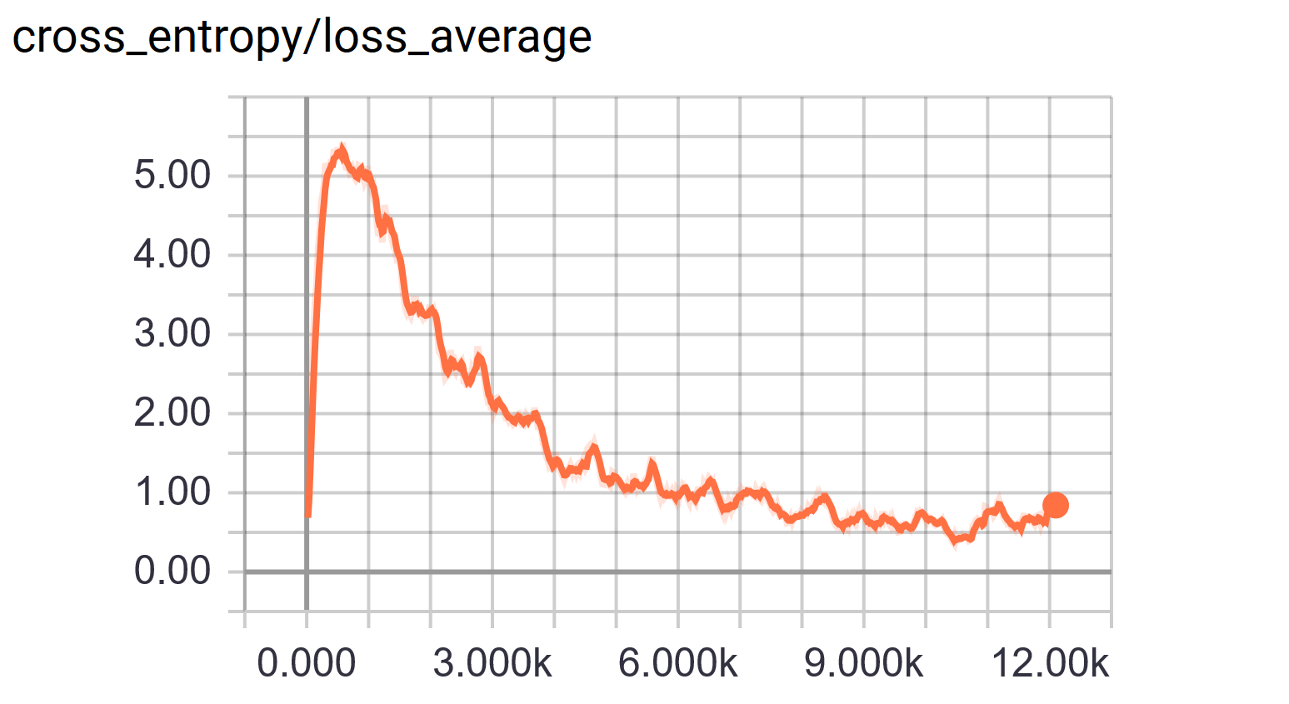
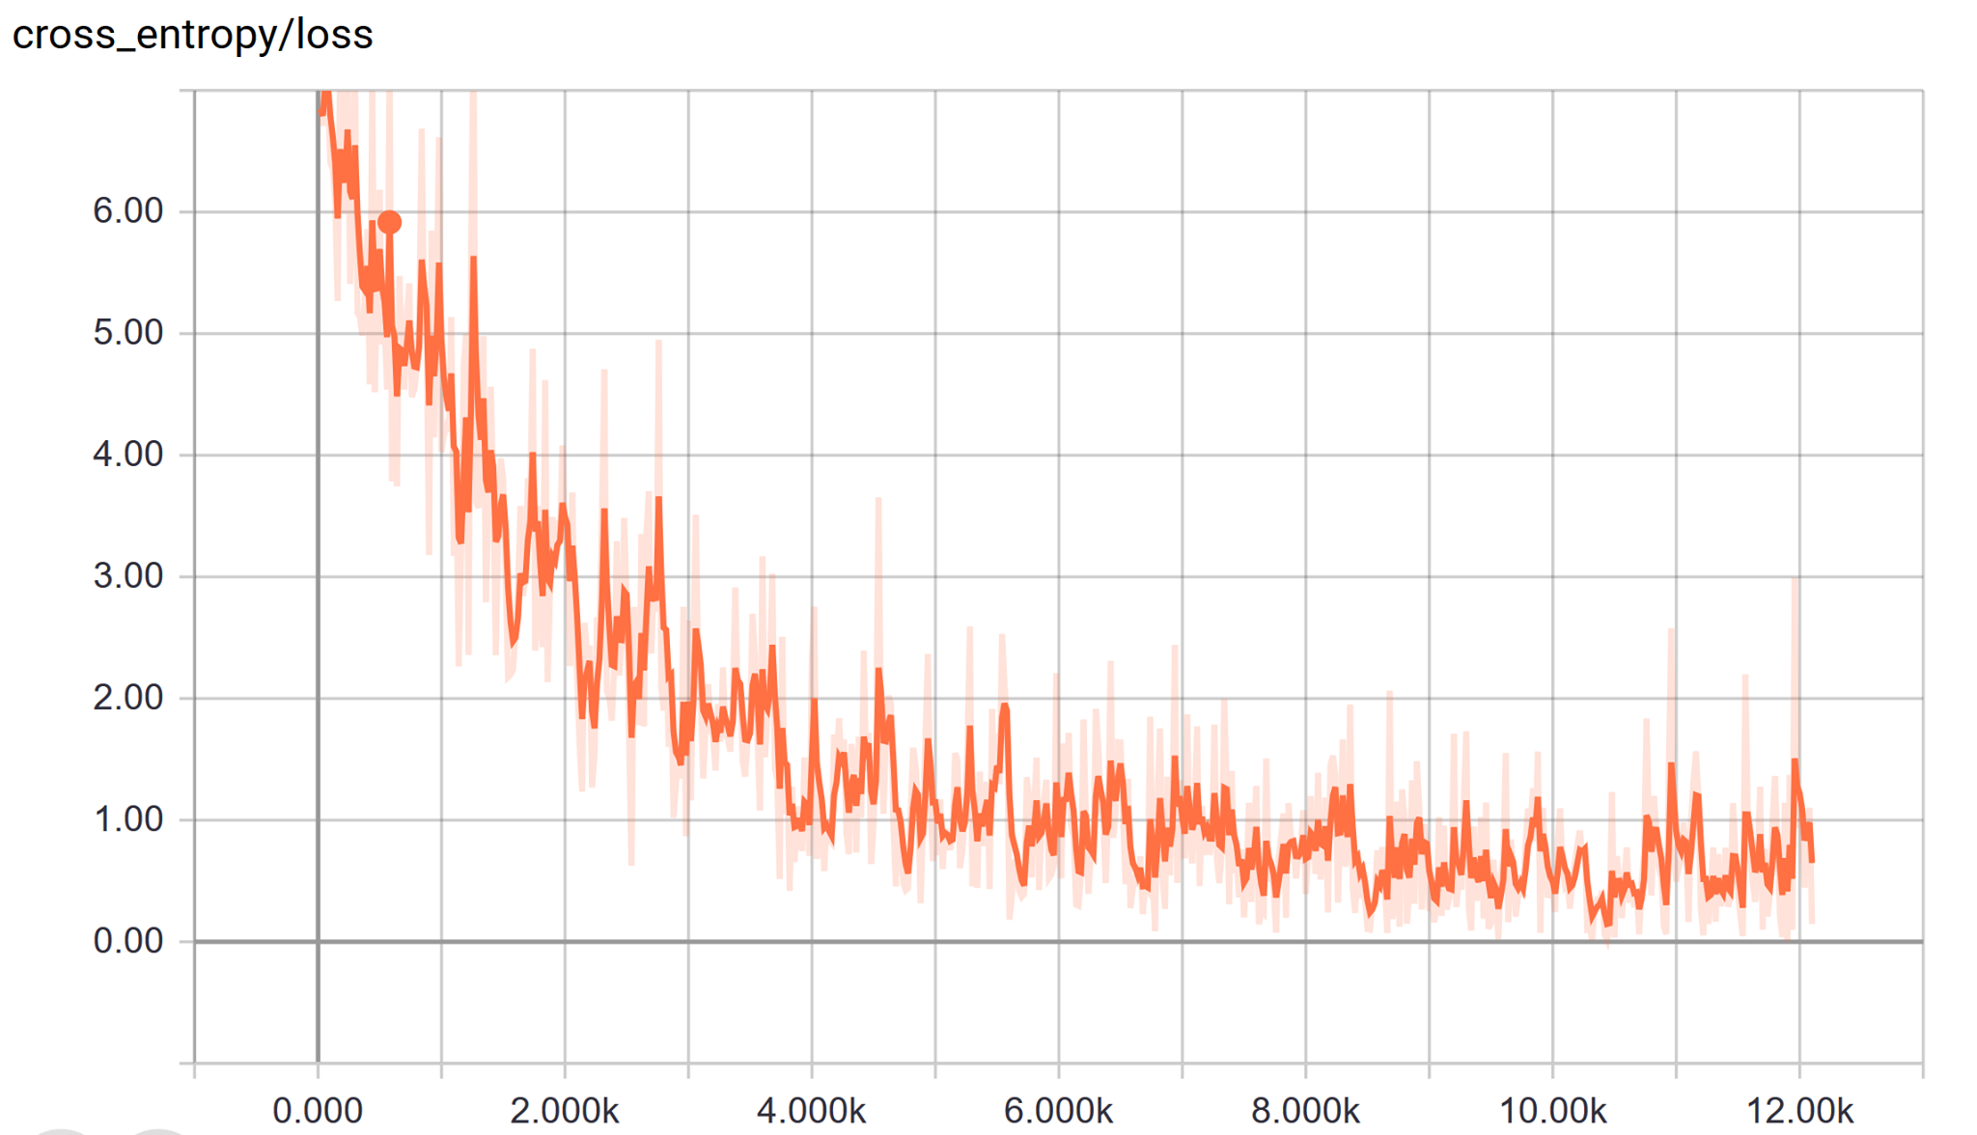
Graphs in Tenfold

Slide 19
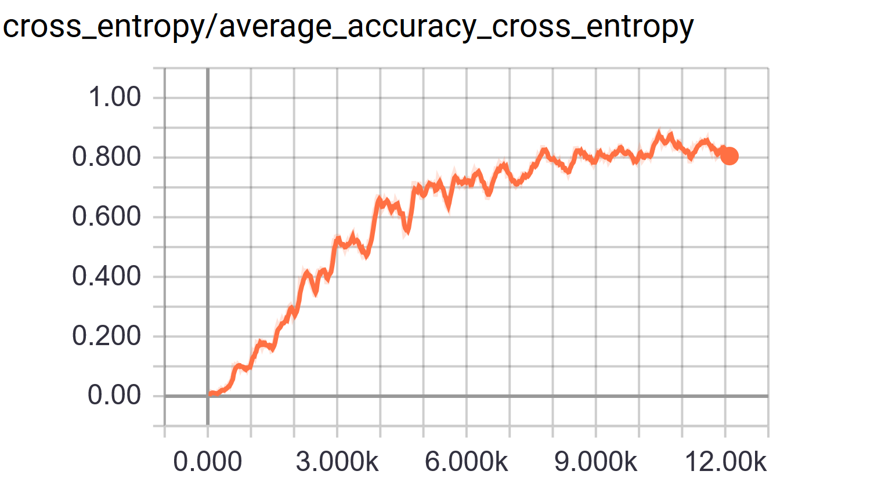
Graphs in Tenfold

Slide 20
Making of the RNN
To build RNN LSTM cells were used . A large amount of text from online was collected to train .

Slide 21
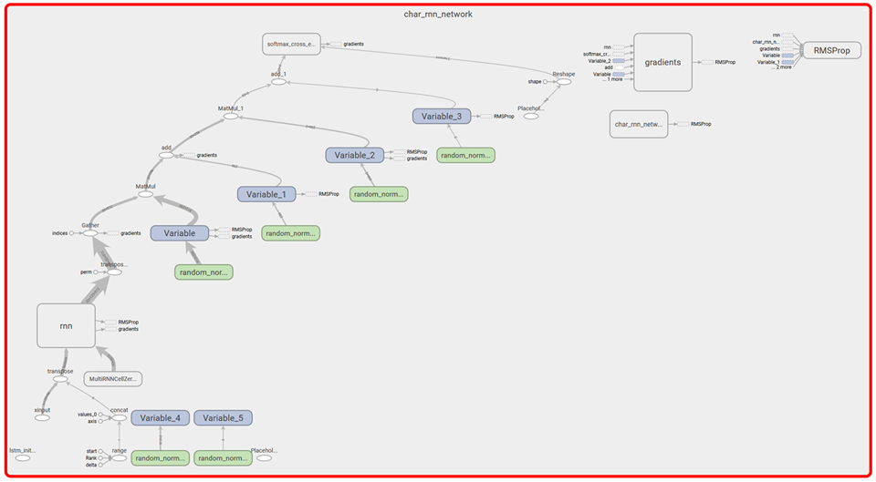
Workflow of RNN

Slide 22
Future plan
We will extract letters from individual words in future . In Bengali all the letters in words are connected which makes the task hard .
In out dataset there are image whose photos were correctly generated but classification was wrong we will used them for improving CNN even more .
We will improve RNN even more to validate sentences

