Slide 1
GEELY AUTO
CAR PRICE PREDICTION FOR THE ESTABLISHMENT OF AN AUTOMOBILE PLAN IN NIGERIA

Slide 2
Background
Automotive industry in Nigeria dates back to the 1950s and consists of the production of passenger cars and commercial trucks. Early production was led by the assembly line of Bedford TJ trucks made by United Africa Company's subsidiary, Federated Motors Industries and SCOA's production of Peugeot 404 pickup trucks. Significant development began in the 1970s, during a period of oil boom, the Federal Government of Nigeria signed joint venture partnerships with foreign car manufacturers to assemble vehicles and provide technical assistance towards vertical integration within the local industry. These foreign brands went on to dominate the industry from the middle of the 1970s to the end of the 1980s. The passenger vehicles brands were Peugeot Nigeria Ltd and Volkswagen. The commercial vehicles manufacturers, Leyland, Anambra Motor Manufacturing, and Styr competed with Bedford truck for dominance. The companies simply assembled kits and completely knocked down parts imported from abroad. In the marketplace, demand was largely dictated by the government's budgetary concerns. Towards the end of the 1980s the industry was negatively affected by a downturn in the economy, government's inconsistency and the higher cost of locally manufactured cars compared to imported counterparts. By 2000, used foreign cars dominated car sales in the country, and the rise of these affordable used cars negatively impacted the development of backward integration in the industry. Recently, a local brand, Innoson has opened an assembly plant in the country.

Slide 3
Car Population and Prices in Nigeria
As at Dec-2020 the Nigerian Bureau of statistics (NBS) recorded that there were 11.8 million registered vehicles in the country.
How much does a new car cost in 2022? Vehicles are also getting more expensive.
The average price paid for a new vehicle was the highest on record in July at $48,182, up 12% from the prior-year period. Buyers last month paid on average $875 above sticker price in the non-luxury segment.18 Aug 2022

Slide 4
Objectives
The company’s main aim is to know:
Which variables are significant in predicting the price of a car.
How well do those variables describe the price of a car.

Slide 5
The Data
The data for this analysis obtained through market surveys of different types of cars across the Nigerian automobile market.
It is characterized by the following features:
Car_ID:Unique id of each observation (Interger).
Symboling: Its assigned insurance risk rating, A value of +3 indicates that the auto is risky, -3 that it is probably pretty safe.(Categorical).
carCompany: Name of car company (Categorical)
Fueltype: Car fuel type i.e gas or diesel (Categorical)
Aspiration: Aspiration used in a car (Categorical)
doornumber : Number of doors in a car (Categorical)
Carbody: body of car (Categorical)
Drivewheel: type of drive wheel (Categorical)
Enginelocation: Location of car engine (Categorical)
Wheelbase: Weelbase of car (Numeric)
Carlength: Length of car (Numeric)
Carwidth:Width of car (Numeric)
Carheight:height of car (Numeric)

Slide 6
The Data cont’d
Curbweight:The weight of a car without occupants or baggage. (Numeric).
Enginetype:Type of engine. (Categorical).
Cylindernumber:cylinder placed in the car (Categorical) .
Enginesize:Size of car (Numeric).
Fuelsystem:Fuel system of car (Categorical).
Boreratio:Boreratio of car (Numeric).
Stroke:Stroke or volume inside the engine (Numeric).
Compressionratio:compression ratio of car (Numeric).
Horsepower:Horsepower (Numeric).
Peakrpm:car peak rpm (Numeric).
Citympg:Mileage in city (Numeric).
Highwaympg:Mileage on highway (Numeric).
price(Dependent variable):Price of car (Numeric).

Slide 7
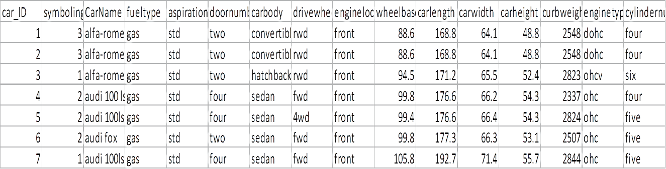
The Data
Below are the few rows of the data set with the columns continued.

Slide 8
Data Analysis
To achieve the objectives of the research, a multistage kind of analysis was carried from univariate, bivariate through multivariate types of data analysis, known as exploratory data analysis.
A predictive analysis was carried to enable the conclusion on the best variables that contribute to car pricing in the Nigerian market.

Slide 9
Univariate
This kind of analysis explores each variable or feature in the dataset separately.
The data was analyze using these methods as follows:

Slide 10
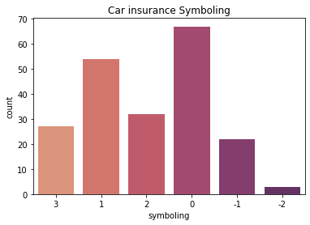
Univariate cont’d symboling
count 205
unique 6
top 0
freq 67
The car insurance symboling was treated as a categorical feature. It consist of 6 unique obser -vation (-2,-1,0,1,2,3), a total of 205 registered cars . A value of +3 indicates that the auto is risky, -3 that it is probably pretty safe. It show that most people register there cars for insurance.

Slide 11
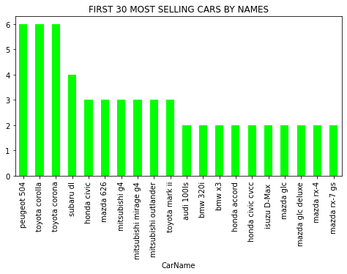
Univariate cont’d Car Name
count 205
unique 147
top Peugeot 504
Freq 6
Different types cars were surveyed(147 unique types of cars). Peugeot504,Toyota corolla and Toyota corona, have highest frequency of 6 each.
This means peugeot and Toyota are major occupiers of the market

Slide 12
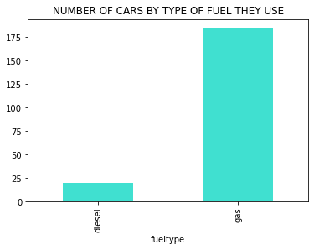
Univariate cont’d fueltype
diesel 20
gas 185
Out of 205 surveyed cars 20 uses diesel and 185 uses gas. It is clear that nigerians prefer cars that uses gas.

Slide 13
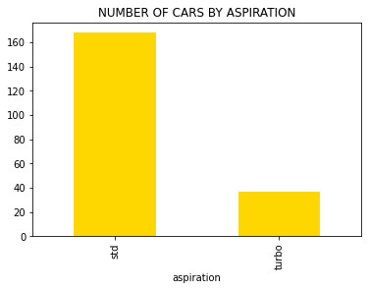
Univariate cont’d aspiration
std 168
turbo 37
Only 37 of the surveyed cars uses turbo chargers and 168 uses std system.
This clearly indicates tha most nigerians prefer cars aspirated by std

Slide 14
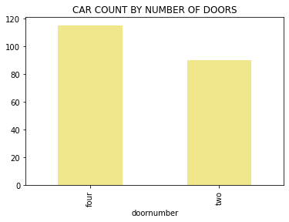
Univariate cont’d doornumber
four 115
two 90
It was discovered that, the majority of cars in Nigerian market are four door cars.

Slide 15
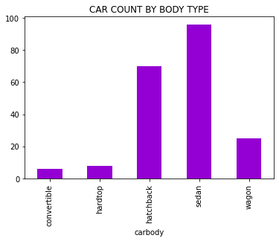
Univariate cont’d carbody
convertible 6
hardtop 8
hatchback 70
sedan 96
wagon 25
Sedan is the most preferred type car body in the market, followed by hatchback, wagon, hardtop and convertible in that order.

Slide 16
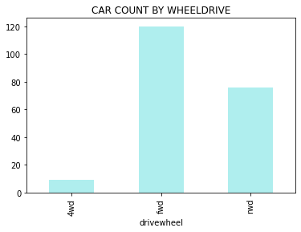
Univariate cont’d drivewheel
4wd 9
fwd. 120
rwd 76
Front wheel drive cars dominates the market with 120 sampled cars, followed by Rear wheel drive and four wheel drives.

Slide 17
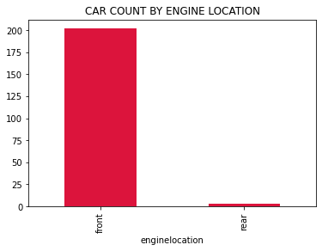
Univariate cont’d enginelocation
front 202
rear 3
Almost the whole of the market is fill with cars which has there engine at the front.

Slide 18
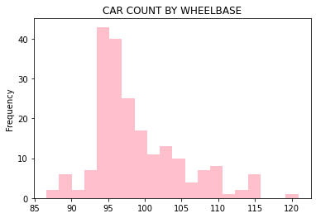
Univariate cont’d wheelbase
count 205.000000
mean 98.756585
std 6.021776
min 86.600000
25% 94.500000
50% 97.000000
75% 102.400000
max 120.900000
The mean wheel base is 98.8.
With the minimum wheelbase of 86.6 and the maximum of 120.9. 75% of the cars have there wheelbase around 102.4.

Slide 19
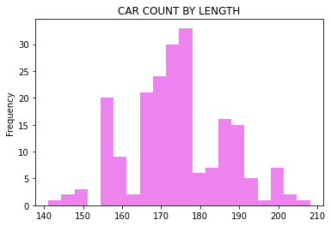
Univariate cont’d car length
count 205.000000
mean 174.049268
std 12.337289
min 141.100000
25% 166.300000
50% 173.200000
75% 183.100000
max 208.100000
With the mean car length of 174.04, the minimum car length is 141.1, the maximum is 208.1. 75% of the car lengths is around185.1

Slide 20
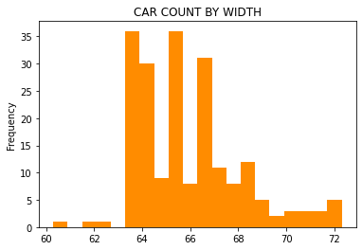
Univariate cont’d carwidth
count 205.000000
mean 65.907805
std 2.145204
min 60.300000
25% 64.100000
50% 65.500000
75% 66.900000
max 72.300000
The maximum car width in the market is 72.3, the minimum is 60.3 and the average car width is 65.9.
75% of the cars in the market have a width around 66.9.

Slide 21
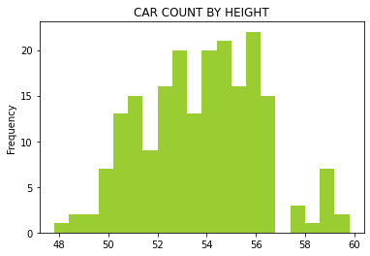
Univariate cont’d carheight
count 205.000000
mean 53.724878
std 2.443522
min 47.800000
25% 52.000000
50% 54.100000
75% 55.500000
max 59.800000
Average car height in the market is 53.7, highest car height is 59.8, and the least car height is 47.8.
Majority of the cars height is around 55.5.

Slide 22
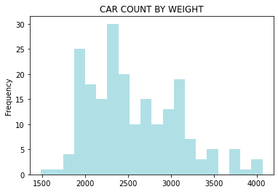
Univariate cont’d curb weight
count 205.000000
mean 2555.565854
std 520.680204
min 1488.000000
25% 2145.000000
50% 2414.000000
75% 2935.000000
max 4066.000000
With the average of 2555.6, a maximum car curbweight of 4066.0 and a minimum of 1488.0 most curbweight lies around 2936.0

Slide 23
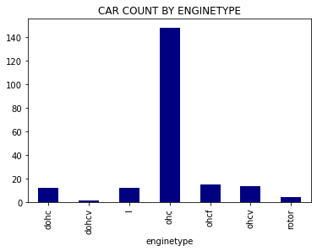
Univariate cont’d enginetype
dohc 12
dohcv 1
l 12
ohc 148
ohcf 15
ohcv 13
rotor 4
The most used engine type in the Nigerian market is OHC, followed by OHCF and OHCV. The least are ROTOR and DOHCV.

Slide 24
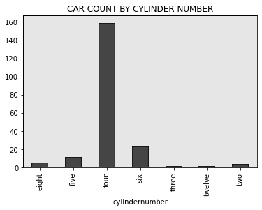
Univariate cont’d cylinder number
eight 5
five 11
four 159
six 24
three 1
twelve 1
two 4
Four cylinder engine cars have the largest of the automobile market , run up by six cylinder .

Slide 25
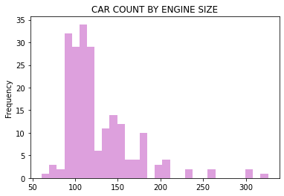
Univariate cont’d enginesize
count 205.000000
mean 126.907317
std 41.642693
min 61.000000
25% 97.000000
50% 120.000000
75% 141.000000
max 326.000000
The maximum engine size is 326.0, the minmum is 61.0 . The average is 126.9.
75% have an engine size around 141.0

Slide 26
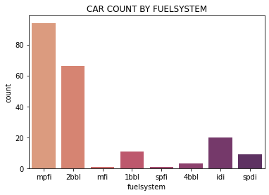
Univariate cont’d fuelsystem
1bbl 11
2bbl 66
4bbl 3
idi 20
mfi 1
mpfi 94
spdi 9
spfi 1
MPFI is the dominant fuel system in the market followed by 2BBL and other.

Slide 27
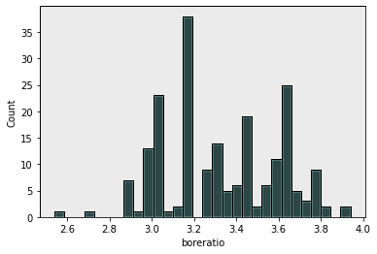
Univariate cont’d bore ratio
count 205.000000
mean 3.329756
std 0.270844
min 2.540000
25% 3.150000
50% 3.310000
75% 3.580000
max 3.940000
Maximum bore ratio is 3.9.
Minimum is 3.3.
Average bore ratio is 3.3.
75% of bore ratio is around 3.6

Slide 28
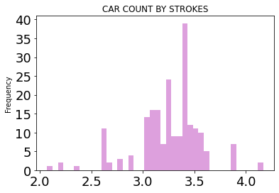
Univariate cont’d stroke
count 205.000000
mean 3.255415
std 0.313597
min 2.070000
25% 3.110000
50% 3.290000
75% 3.410000
max 4.170000
Average stroke is 3.3.
Maximum stroke is 4.2.
Minimum stroke is 2.1
Majority of stroke are around 3.4

Slide 29
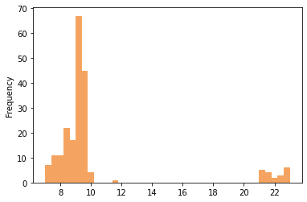
Univariate cont’d compressionratio
count 205.000000
mean 10.142537
std 3.972040
min 7.000000
25% 8.600000
50% 9.000000
75% 9.400000
max 23.000000
Average compression ratio is 10.1
Minimum compression ratio is 7.0
Maximum compression ratio is 23.0
75% lies around 9.4

Slide 30
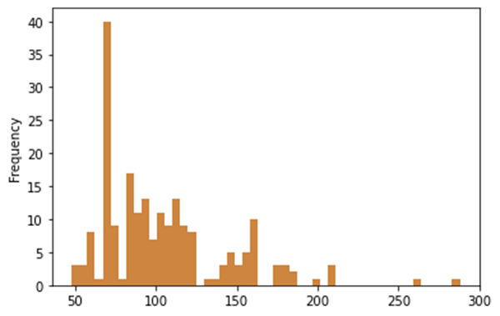
Univariate cont’d horsepower
count 205.000000
mean 104.117073
std 39.544167
min 48.000000
25% 70.000000
50% 95.000000
75% 116.000000
max 288.000000
Average horse power of cars in the market is 104.1
Minimum horsepower is 48.0.
Maximum horse power is 288.0
75% horse power is around 116.0

Slide 31
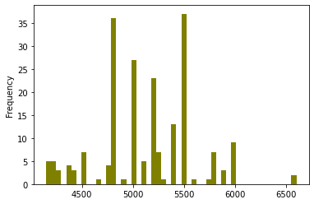
Univariate cont’d peakrpm
count 205.000000
mean 5125.121951
std 476.985643
min 4150.000000
25% 4800.000000
50% 5200.000000
75% 5500.000000
max 6600.000000
Average peakrpm is 5125.1.
Maximum peakrpm is 6600.0.
Minimum peakrpm is 4150.0.
Majority of the peakrpm lies around 5500.0.

Slide 32
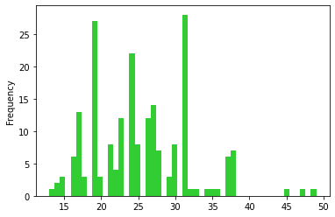
Univariate cont’d citympg
count 205.000000
mean 25.219512
std 6.542142
min 13.000000
25% 19.000000
50% 24.000000
75% 30.000000
Max 49.000000
Average citympg is 25.2.
Minimum citympg is 13.0
Maximum citympg is 49.0
Most citympg are around 30.0

Slide 33
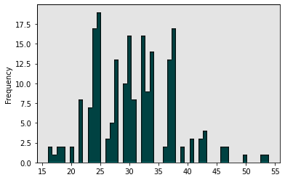
Univariate cont’d highwaympg
count 205.000000
mean 30.751220
std 6.886443
min 16.000000
25% 25.000000
50% 30.000000
75% 34.000000
max 54.000000
Average highwaympg is 30.8
Minimum highwaympg is 16.0
Maximum is 54.0
75% car highwaympg is around 34.0

Slide 34
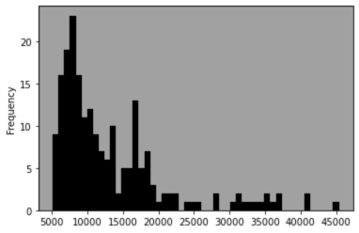
Univariate cont’d price
count 205.000000
mean 13276.710571
std 7988.852332
min 5118.000000
25% 7788.000000
50% 10295.000000
75% 16503.000000
max 45400.000000
The average price for a car in the market is 13,276.7,.
The maximum price of a car is 45400.0.
The minimum price is 5118.0
75% of the cars are sold for 16503.0

Slide 35
Bivariate Analysis
Bivariate data analysis is also one of the simplest forms of quantitative analysis. basically, it involves the analysis of two or more variables, for the purpose of determining the empirical relationship between them. The relationship can also be visualize using dotplots, line plots, joint plots and so on. It can also be presented by the use of tables.
The focus of this research work is to discover those factors that affect the pricing of cars in Nigeria. In the bivariate analysis, we try as much as possible to relate most of the variables to the price variable. The section starts with analyzing categorical data before the numeric.

Slide 36
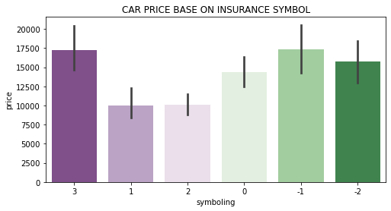
Car Price base on Insurance Symboling
Of the safest and insured cars -1 is the most expensive. On the other side the riskiest is 3, and it is the most expensive of all the cars in the market. The company can leverage on this opportunity by manufacturing directly insured cars to the market.

Slide 37
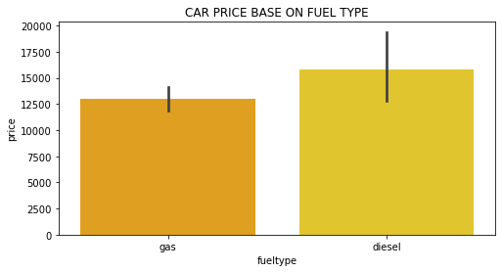
Car price base on fueltype
It is clear here that, cars that use diesel are more expensive than those who use gas

Slide 38
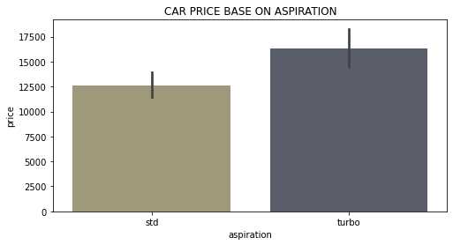
Car price base on aspiration
The turbo charged cars have the higher prices than the std aspirated cars.

Slide 39
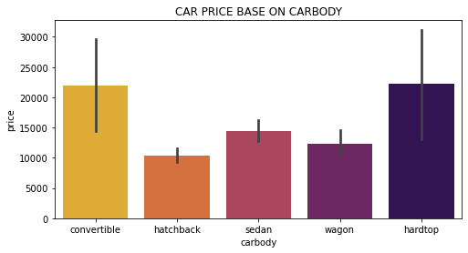
Car price base on car body
Hard top and convertible dominate the market in terms of prices, followed by sedan and others

Slide 40
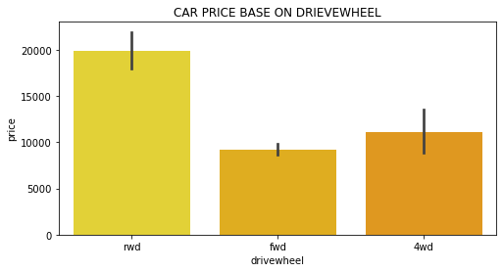
Car Price Base On Drive wheel
Rear wheel drive cars are more expensive than front wheel four wheel drive cars in the Nigerian market.

Slide 41
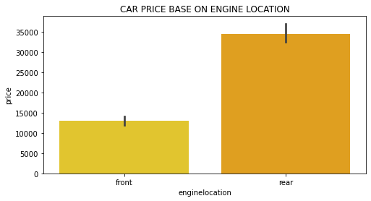
Car Price Base On enginelocation
Cars with rear engine location have higher price in the market

Slide 42
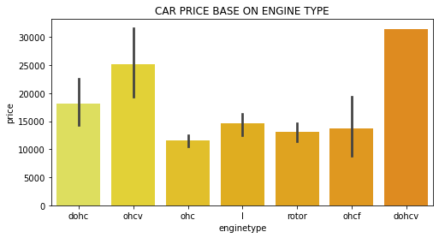
Car Price Base On Engine type
The dochv engine is very expensive in the market.
It is sold for about 30000. while other far less than 25000

Slide 43
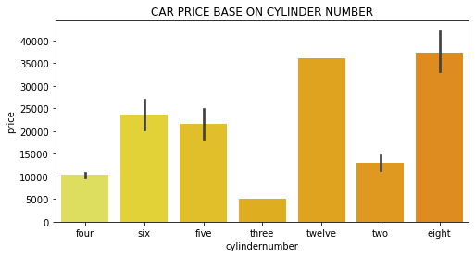
Car Price by cylindernumber
Eight and twelve cylinder cars are more expensive in the market than other.

Slide 44
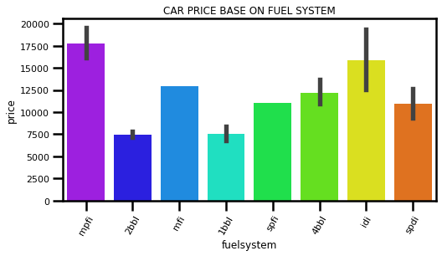
Car Price By fuelsystem
The MPFI fuel system cars in the aspect of price dominates the market.

Slide 45
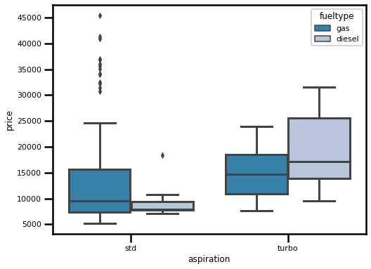
Turbo vs std by price
This figure shows the turbo charged cars leading the market by price. Turbo charged cars that uses diesel are higher than thos who gas.
On the category of std aspirated cars those who uses gas are higher than those who use diesel

Slide 46
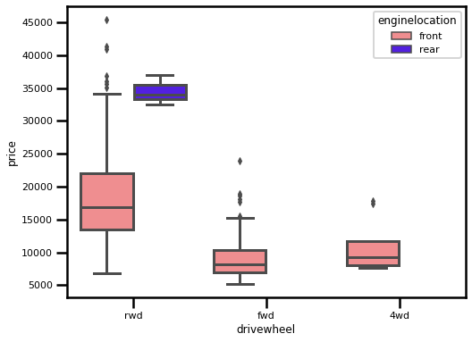
Drive wheel vs engine location vs price
From the category of rear wheel drive cars with rear engine are few in the market but higher in price than all cars.
On the category of front wheel drive no car is recorded with rear engine location, same thing with 4wd.

Slide 47
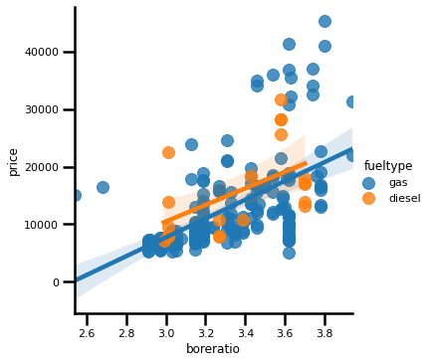
Price by bore ratio and fueltype
Price can still depend on car bore ratio and the fuel type car uses

Slide 48
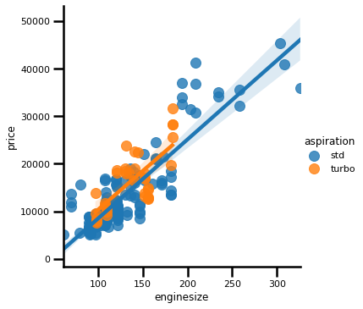
Price by car aspiration and engine size
Car price can also depend on the type of aspiration and engine size on the Nigerian market.

Slide 49
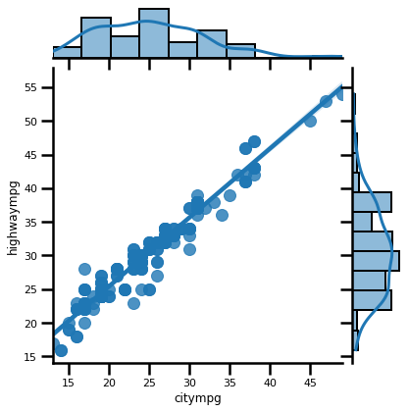
Citympg vs highwaympg
There is a strong relationship between citympg and highwaympg of cars sold in the Nigerian market.

Slide 50
Multivariate Analysis
The multivariate analysis is the simultaneous observation and analysis of more than one outcome variable. Multivariate
statistics concerns the understanding of the different aims and background of each of the different features of data, and how they relate to each other. We try to relate the numeric variables by correlating them in order to determine the levels of relationships between each one and others. The level of relationships between variable is more clear on the heatmap below.

Slide 51
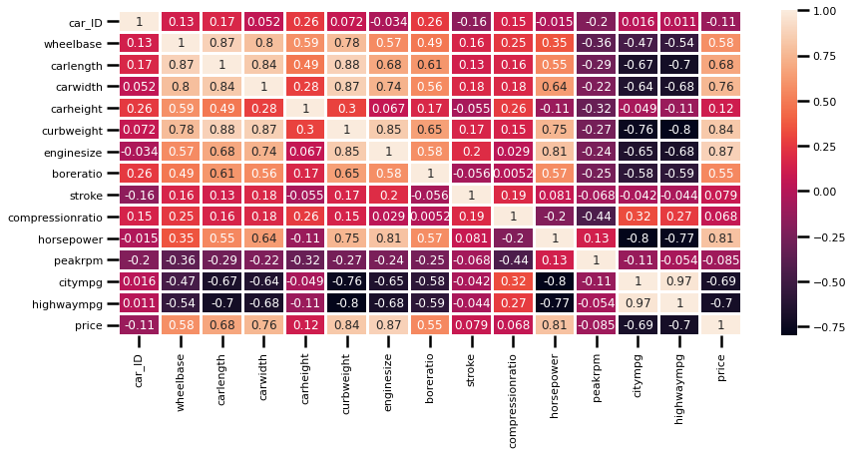
Heatmap

Slide 52
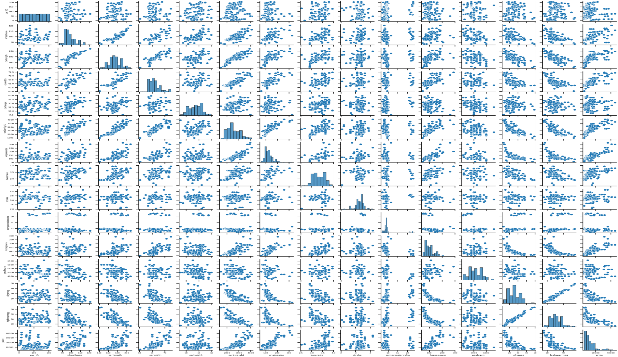
Pairplot

Slide 53
Selected features for building the model
All the categorical variables were used, except the car_ID and car name.
The following numeric variables were selected:
wheelbase 0.577816
carlength 0.682920
carwidth 0.759325
curbweight 0.835305
enginesize 0.874145
boreratio 0.553173
horsepower 0.808139
citympg 0.685751
highwaympg 0.697599

Slide 54
The prediction
The data was tested using different but with same purpose machine learning Tools(Ridge regression, Linear regression).
Ridge regression settles a problem where the model performs well on the traing data and poorly on the testing data. While linear regression is a straight forward tool which focus on finding the linear relationship between the target and predictors.

Slide 55
The prediction cont’d Results
Since these two models(linear and ridge regression) have a very close result. We will use the results obtained from linear regression , because the RMSE here is minimal.
Intercept : 12898.913755244754 (constant coefficient ) It means that if both the coefficients are zero, then the expected output (i.e., the Y) would be equal to the constant coefficient.

Slide 56
The prediction cont’d Results
Coefficient(x): Represents the change in the output Y due to a change of one unit in the X (Predictor variables ).
coefficient of determination: 0.8993194962322323, otherwise known r_squared, reflects the fit of the model. Values range from 0 to 1, where a higher value generally indicates a better fit, assuming certain conditions are met. In our case the we a very good fit

Slide 57
The prediction cont’d Results
RMSE: 2035.3316903994732 this is a very good property which examines the response variable.
Lower value of RMSE indicate a better fit. RMSE is a measure of how accurate the model predicts the response.
The RMSE value above is indicate a good prediction.
Below is the visualization of the predicted response.

Slide 58
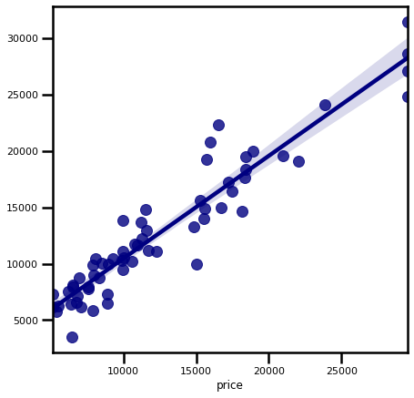

Slide 59
Summary
This section of the study summarizes the observations derive from the data.
It was seen that most cars in the market are not under insurance.
The top two companies in the market are Toyota and Peugeot.
Most cars in the market uses gas
The most preferred car aspiration is std and it’s the selling.
Sedan and hatchback are the most selling cars by body.
People prefer front wheel drive cars and front engine location mostly.
Most cars are sold around 16503 and below.
Most costly cars are not much in the market.

Slide 60
Recommendations
From all observations, the market is filled with not too expensive cars but also efficient.
Geely should consider investing here.

Slide 61
THAN KYOU

