Slide 1
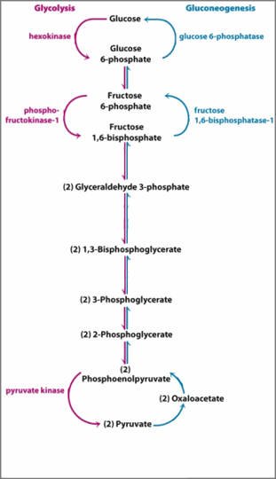
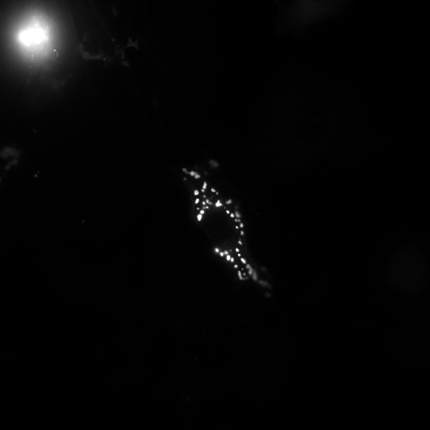

Slide 2
ROUNDED_RECTANGLE

Slide 3




Slide 4

ROUNDED_RECTANGLE

Slide 6
ROUNDED_RECTANGLE

