Slide 1
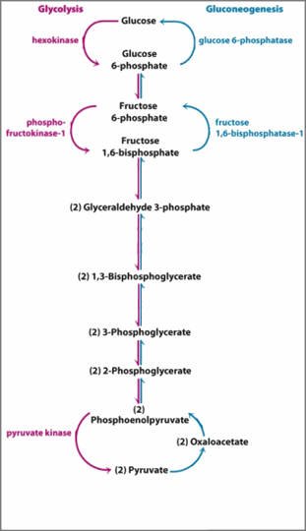
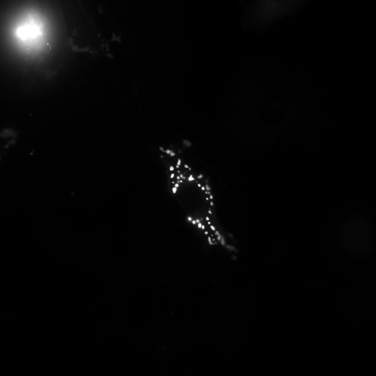

Slide 2
ROUNDED_RECTANGLE

Slide 4

ROUNDED_RECTANGLE

Slide 5





ROUNDED_RECTANGLE

