Slide 1
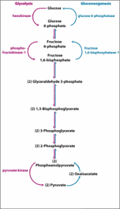
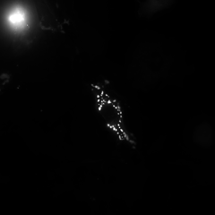

Slide 6






Slide 7

ROUNDED_RECTANGLE

