Slide 1

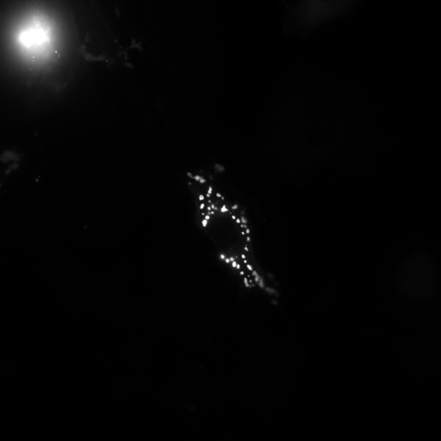
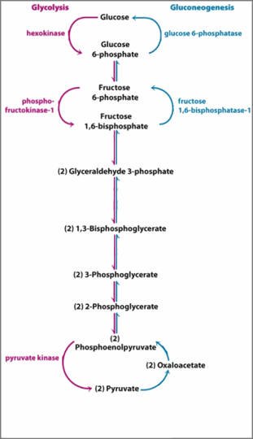




Cell 1

Slide 2

Cell 1
ROUNDED_RECTANGLE

