Slide 1







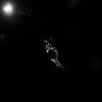
Cell 2
ROUNDED_RECTANGLE

