Slide 1
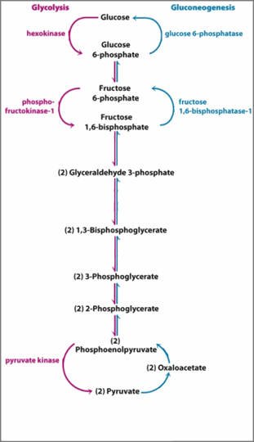


Slide 2






ROUNDED_RECTANGLE

