Slide 1
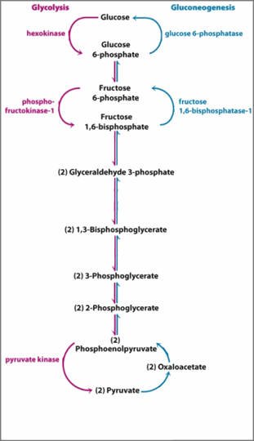
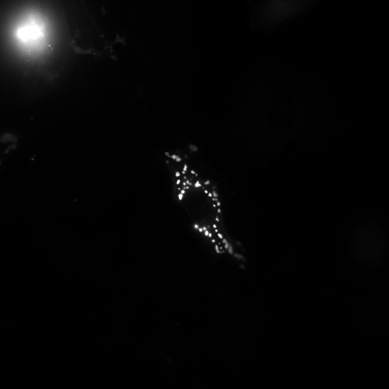
Cell 1

Slide 2






Cell 1
ROUNDED_RECTANGLE

