Slide 1


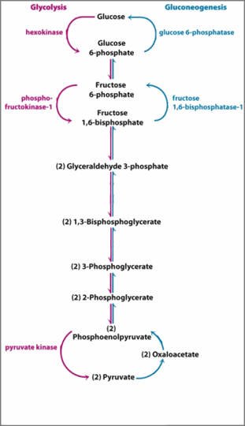





Slide 2

ROUNDED_RECTANGLE

