Slide 1
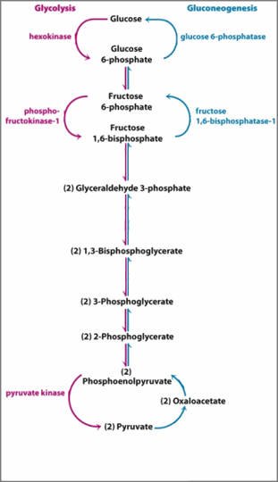
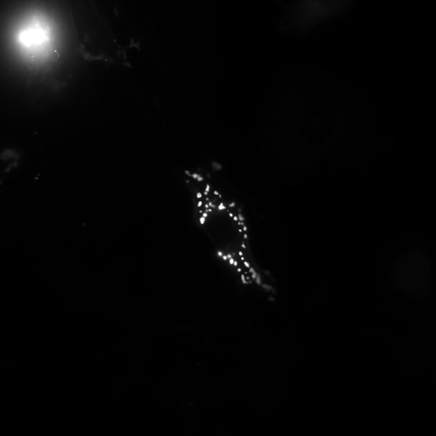
ROUNDED_RECTANGLE

Slide 2




ROUNDED_RECTANGLE

