Slide 1
CS 347 Final Project Review
Shuu Hossain
Nicholas Dant

Slide 2
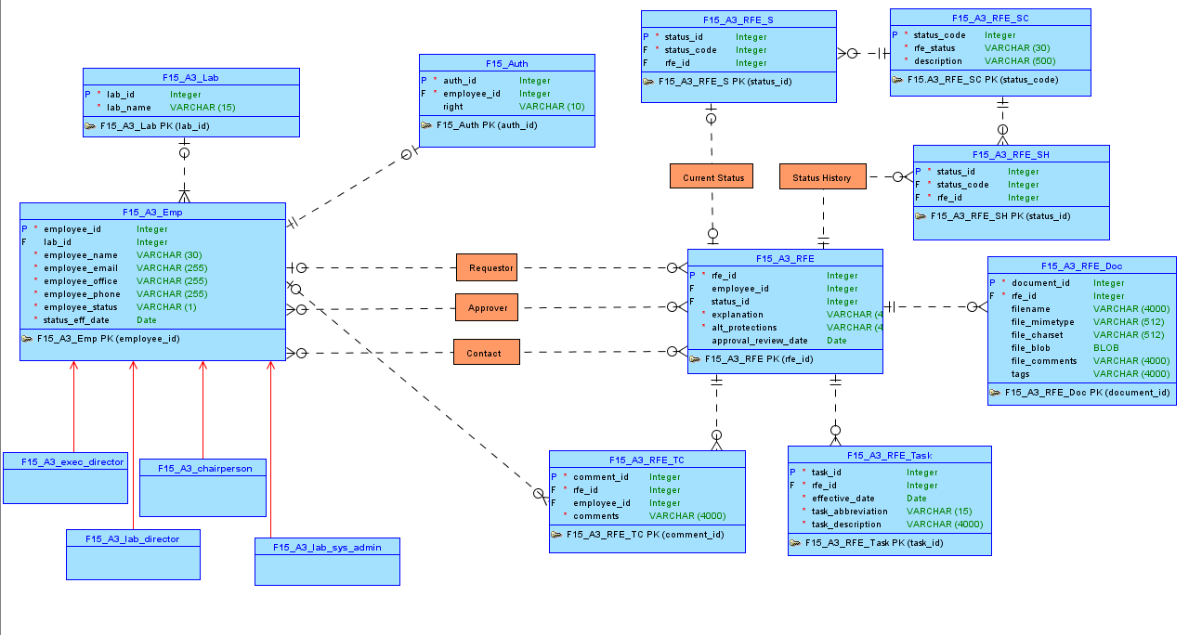

Slide 3
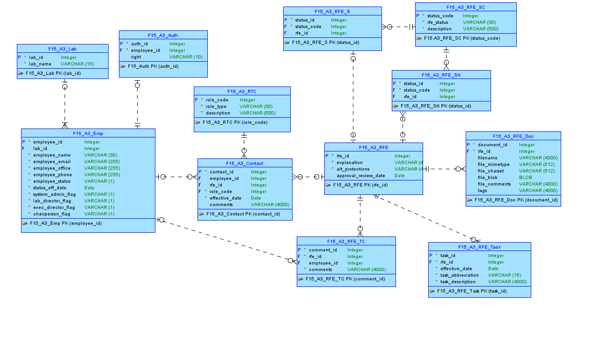

Slide 4
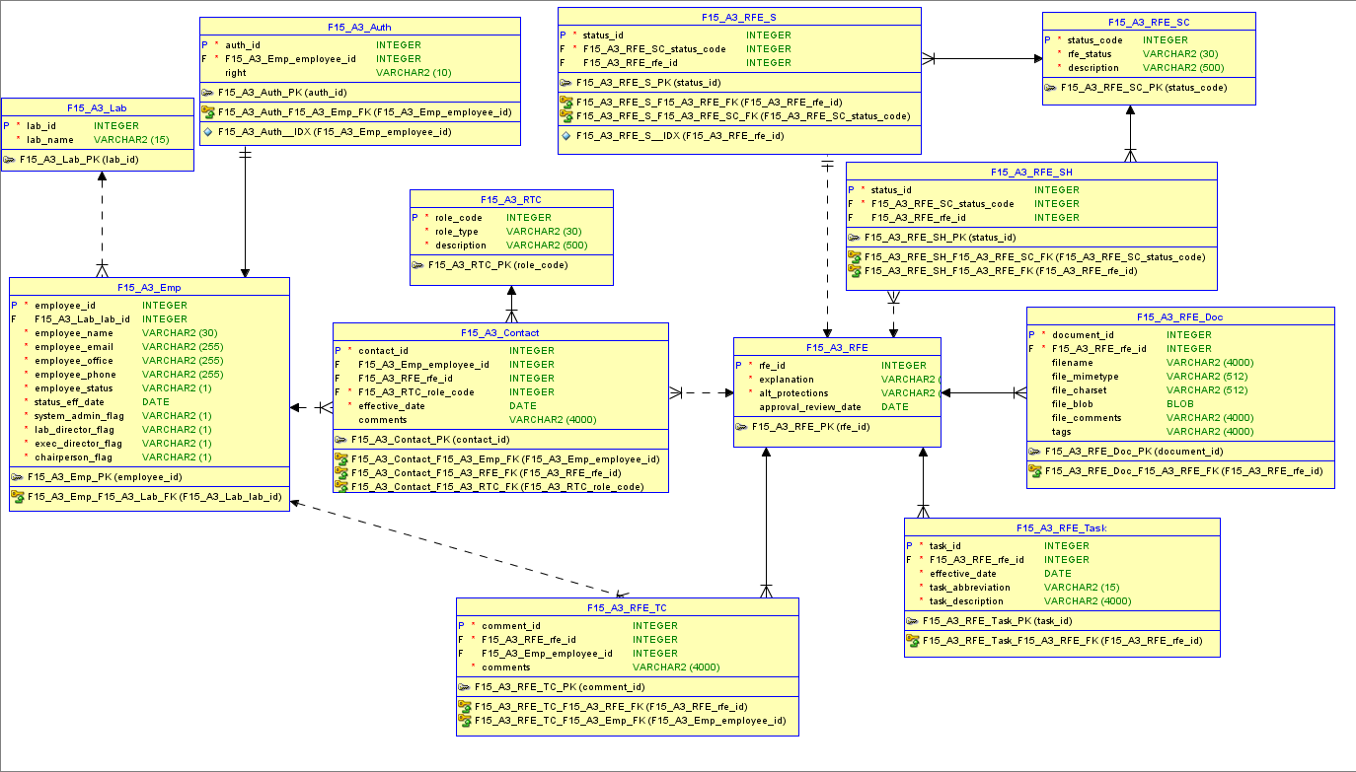

Slide 5
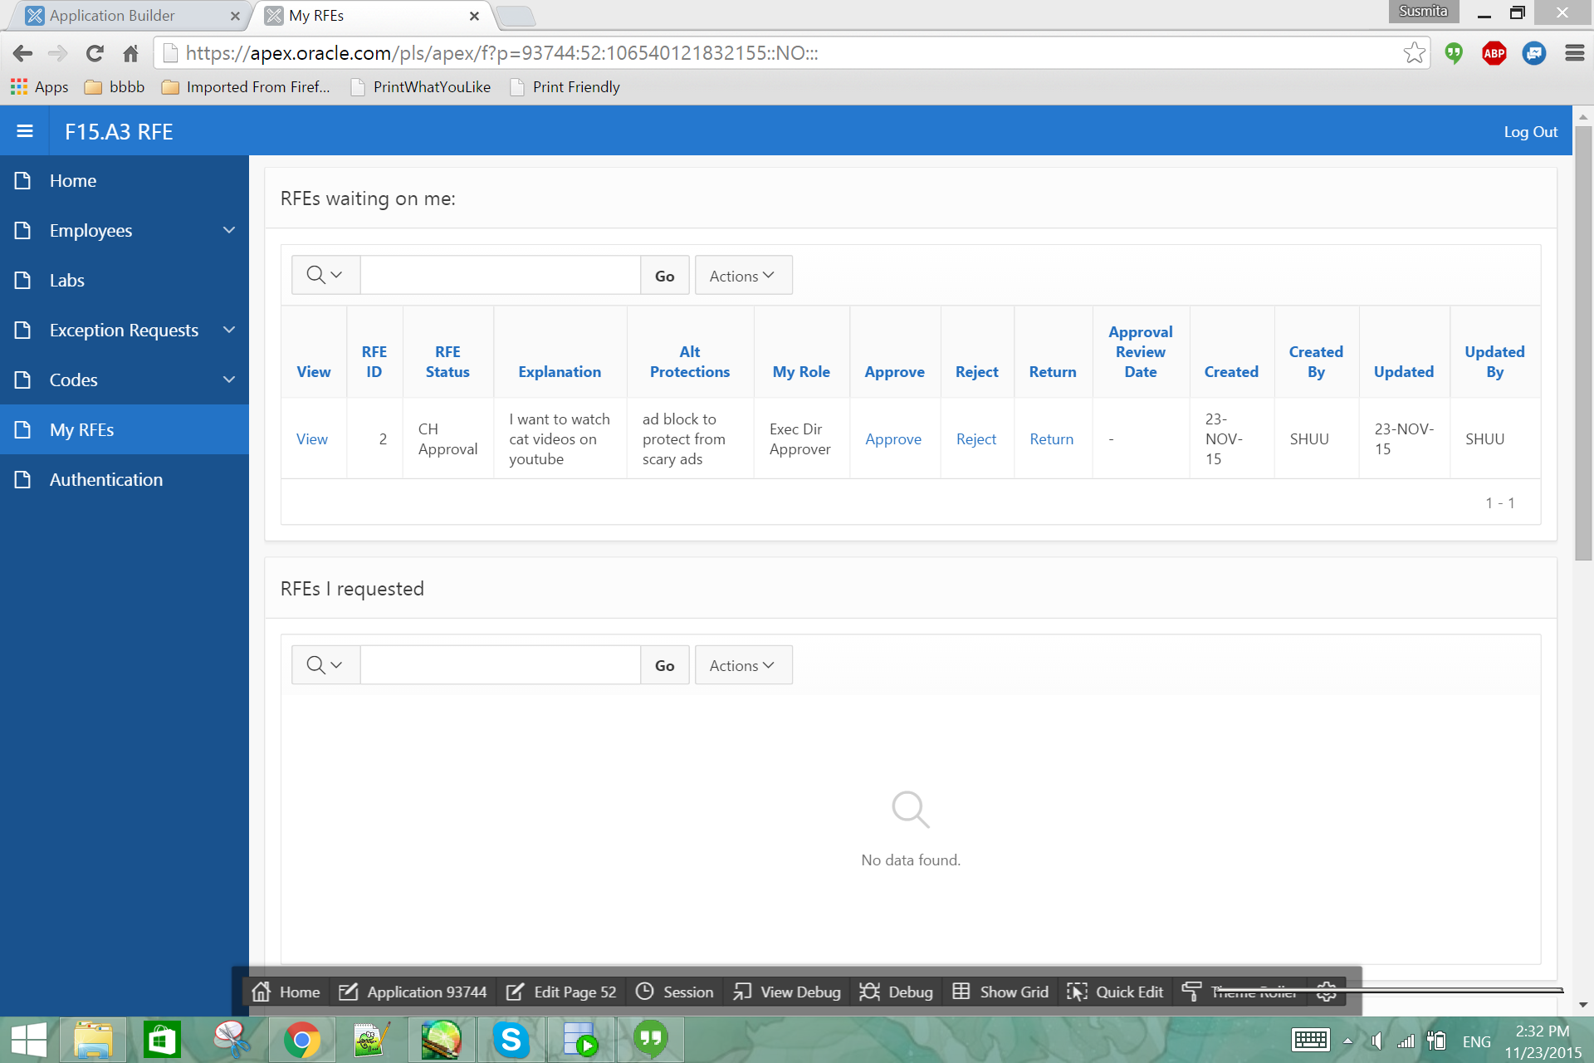

Slide 6
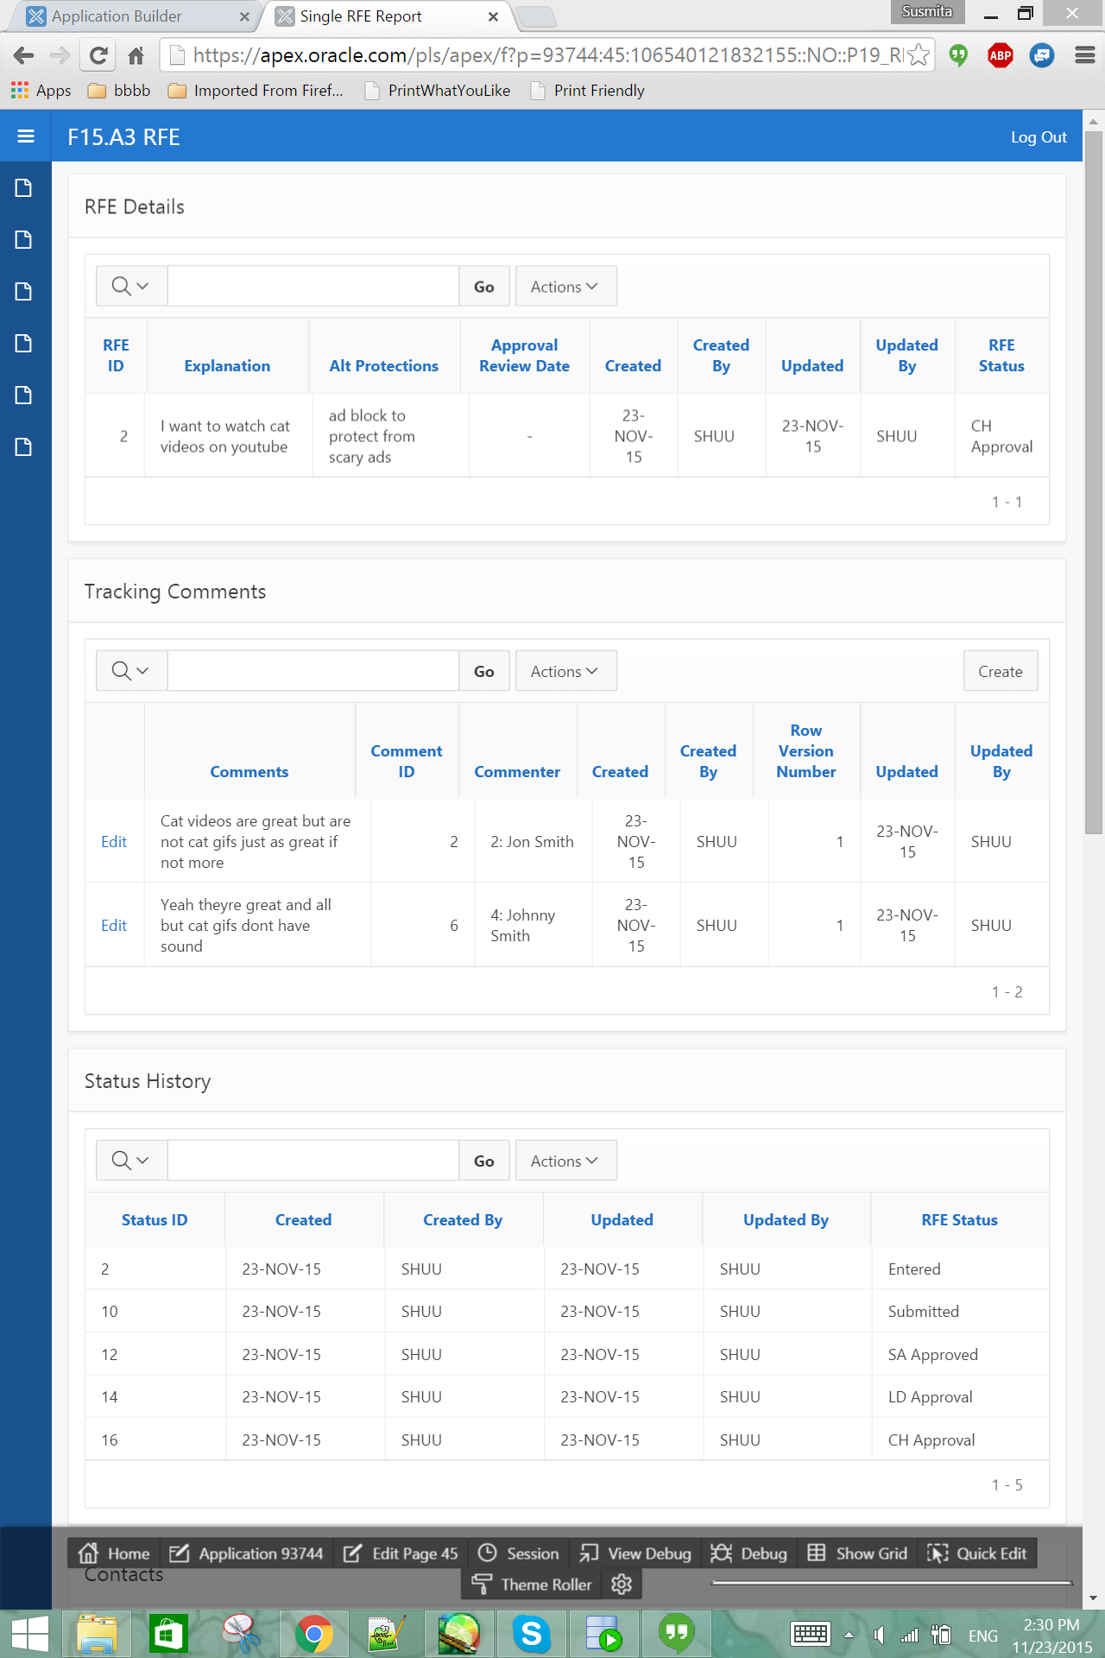
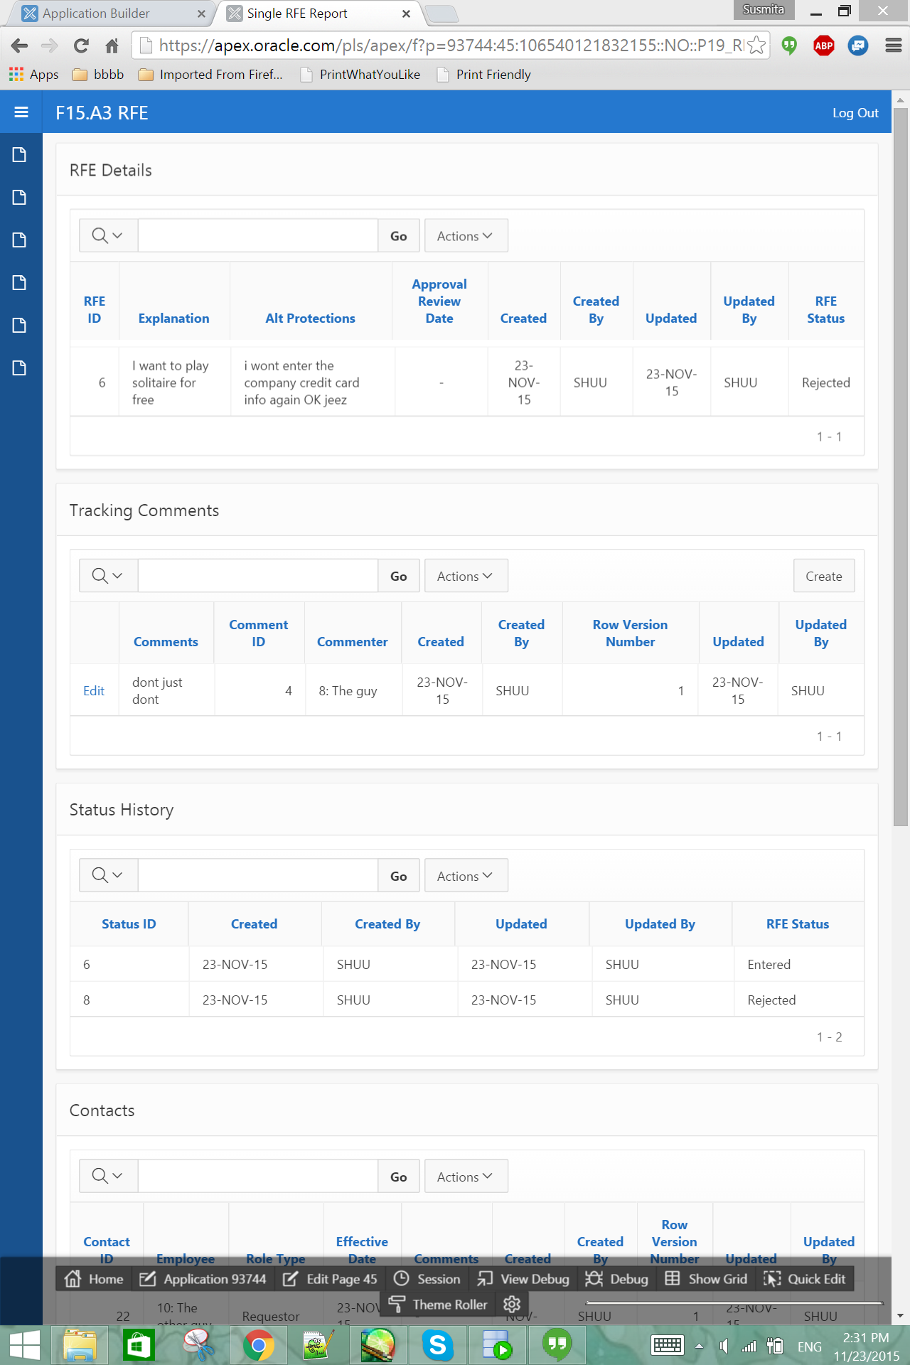

Slide 7
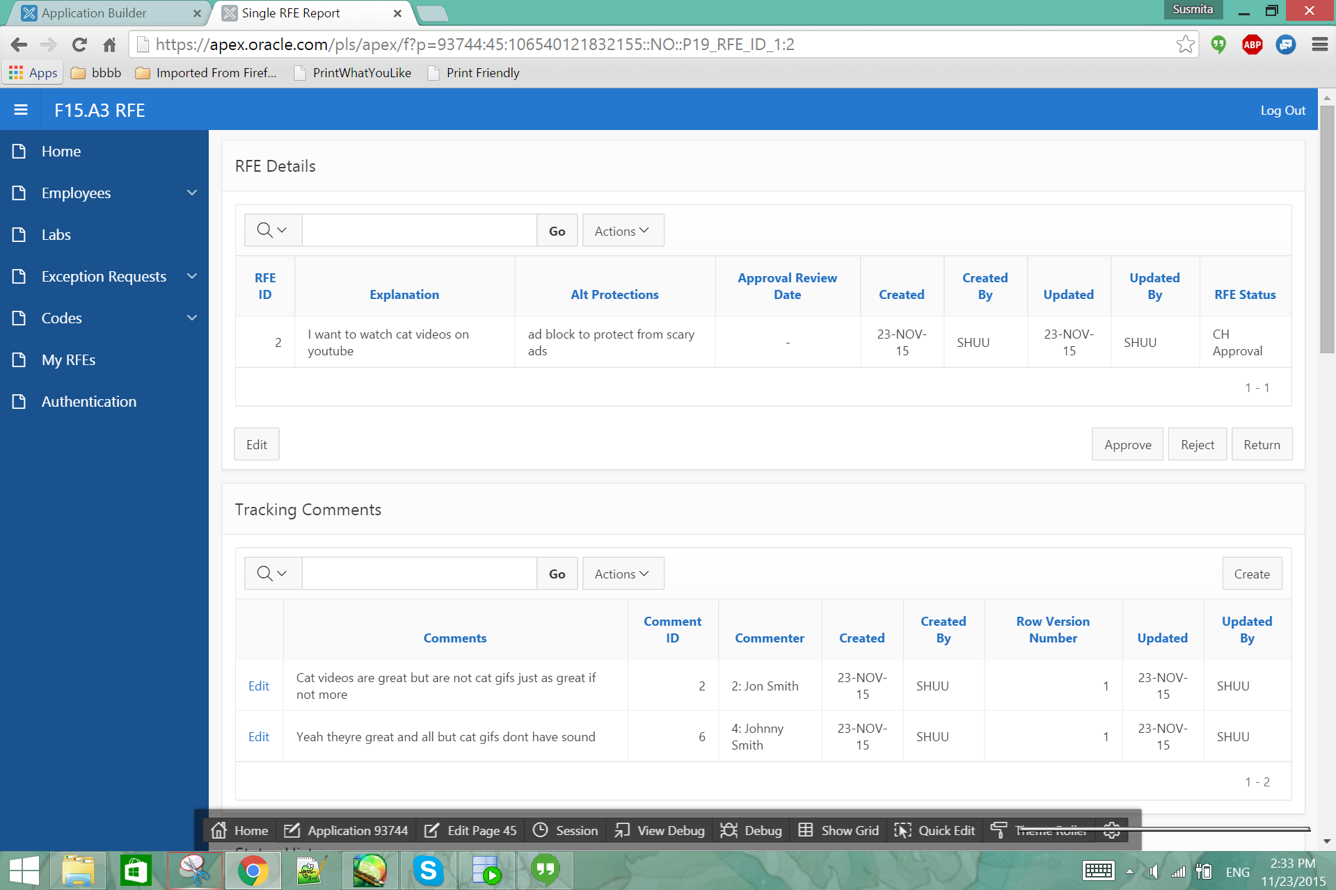

Slide 8
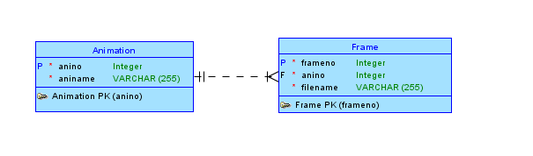

Slide 9
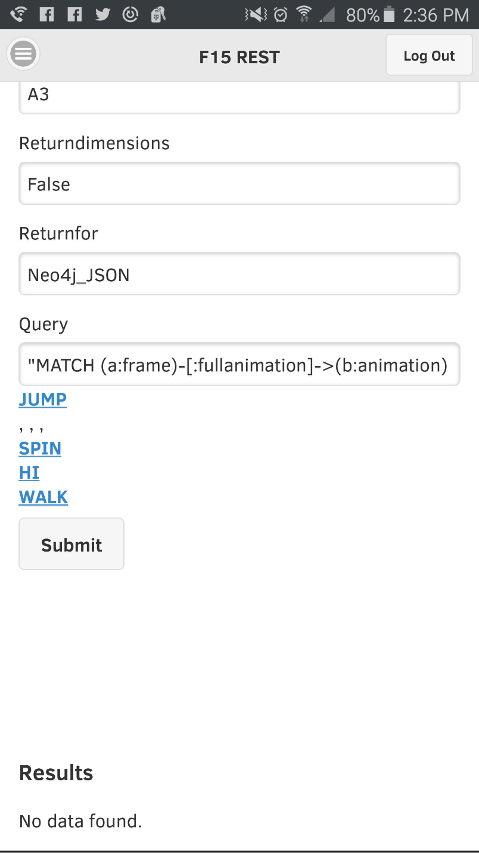
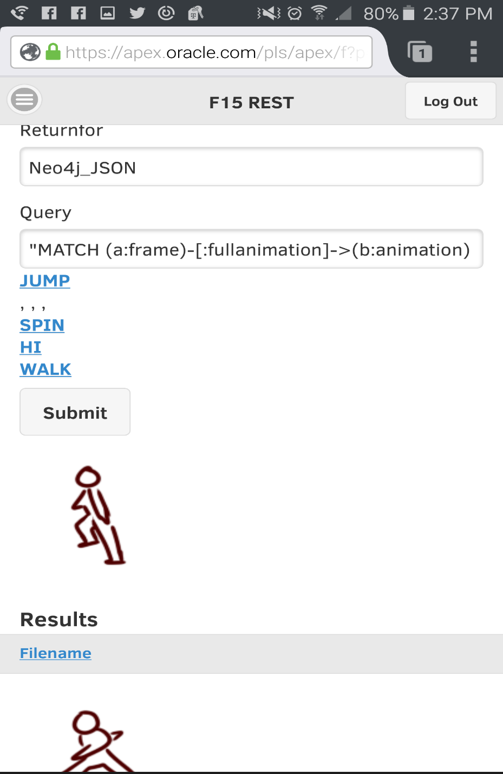
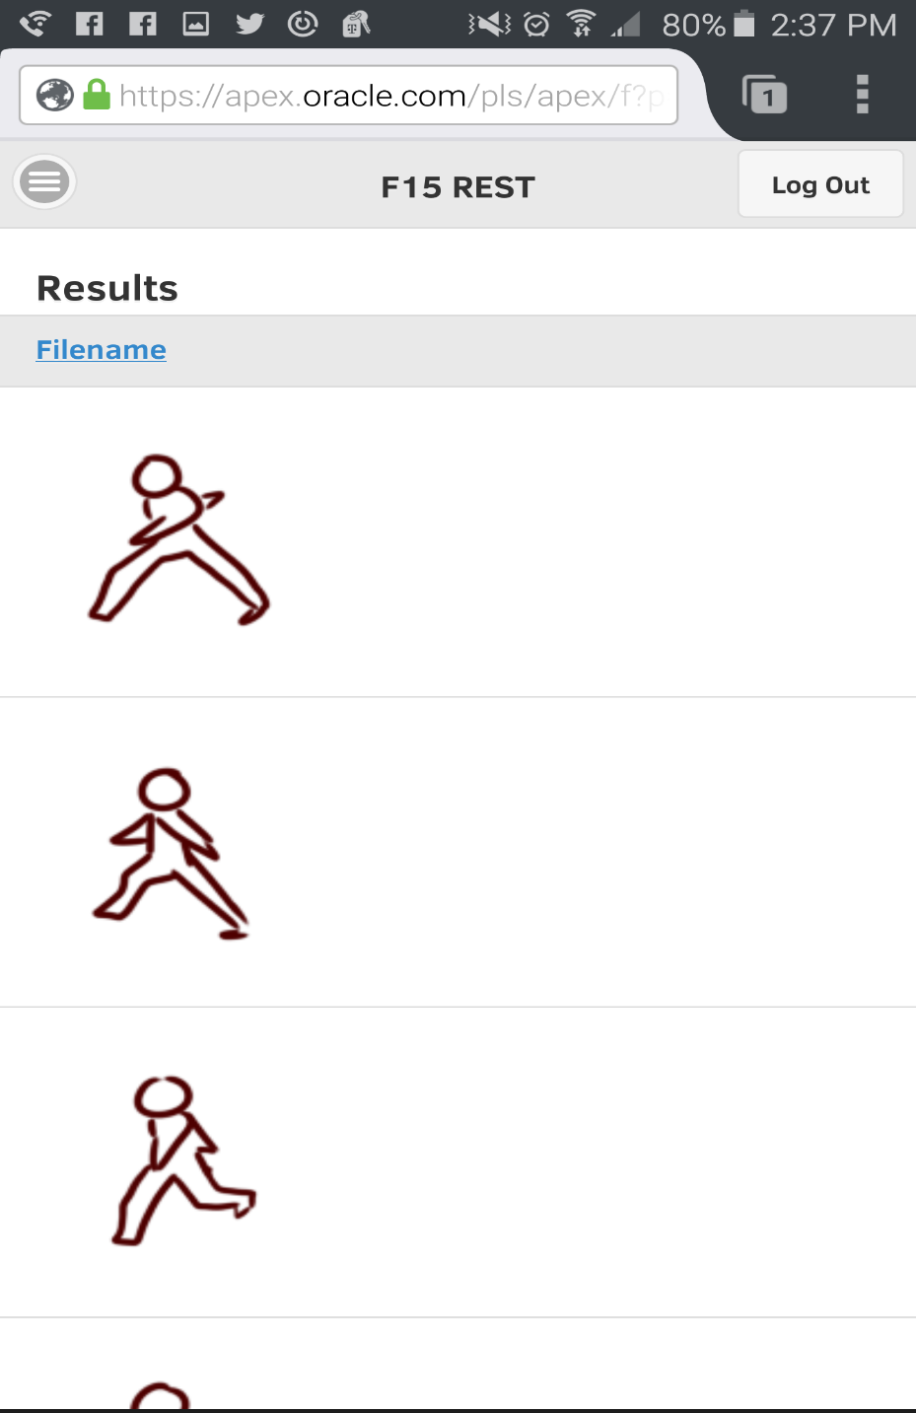
Mobile application for viewing different animations

Slide 10
https://github.com/Shuubuubear/F15-A3-ARL-Project
Part 1: https://apex.oracle.com/pls/apex/f?p=93744:1:13684656428106:::::
Part 2: https://apex.oracle.com/pls/apex/f?p=93068:2:2183787535705::NO:::

