Slide 1
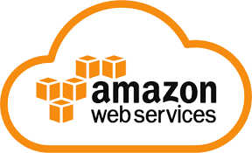
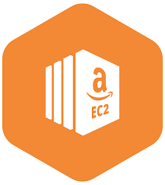
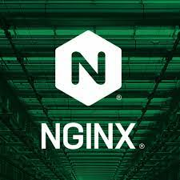



STEP-BY-STEP SET-UP & DEPLOYMENT OF A 2-TIER ARCHITECTURE
IAM role –AWS keys
In the EC2 instance, by default ssh port is 22 , 3000
Install nginx
file.pem
Install node.js
Set up reverse proxy
Transfer data required
APP instance
Create env DB_HOST
On prem / localhost/local data centre
Allows to ssh into EC2
The file has to have read only permission so we do - chmod 400 file.pem
In the EC2 instance, by default ssh port is 22 , 27017
Download and install mongodb
DATABASE instance

Slide 2
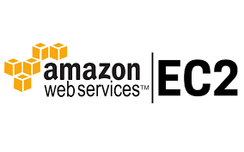

DISASTER RECOVERY PLAN – DR – S3 storage as DR for our data
S3 – simple storage service
S3 – storage classes
S3 – standard – glacier glass -
file.pem
AWS secret and secret keys using awscii
Setting up awscii on ec2/ubuntu 18.04
AWS keys
Python installed –Python3 or above
Awscii installed
AWS config setup with required keys
Pip3
Default python version is python3 or above –python –version
Alias python=python3

