Slide 1
CH4203: Organic Synthesis Laboratory
-------------------------------------------------------------------------
Expt. No. 1: Nitro-Aldol Reaction of p-Tolualdehyde with Nitromethane: Synthesis of β-Nitrostyrene
Date: 6th January, 2025
Instructor: Dr. Alakesh Bisai
Professor of Chemistry
Dept. of Chemical Sciences
Tutor 1: Mr. Satadru Dutta
Tutor 2: Ms. Antara De
Tutor 3: Mr. Saikat Bag

Slide 2
Experimental Procedure

Slide 3
Experimental Procedure

Slide 4
Experimental Procedure

Slide 5
Experimental Procedure

Slide 6
Experimental Procedure

Slide 7
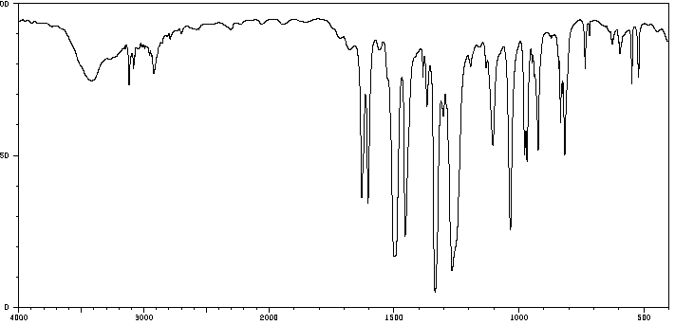
IR Spectra of β-Nitrostyrene
For Csp2-H bond
For C=C bond
For C=C bond
of phenyl ring
C-N stretching of C-NO₂
cm⁻¹
Fingerprint region

Slide 8
¹H NMR Spectra of p-Tolualdehyde

Slide 9
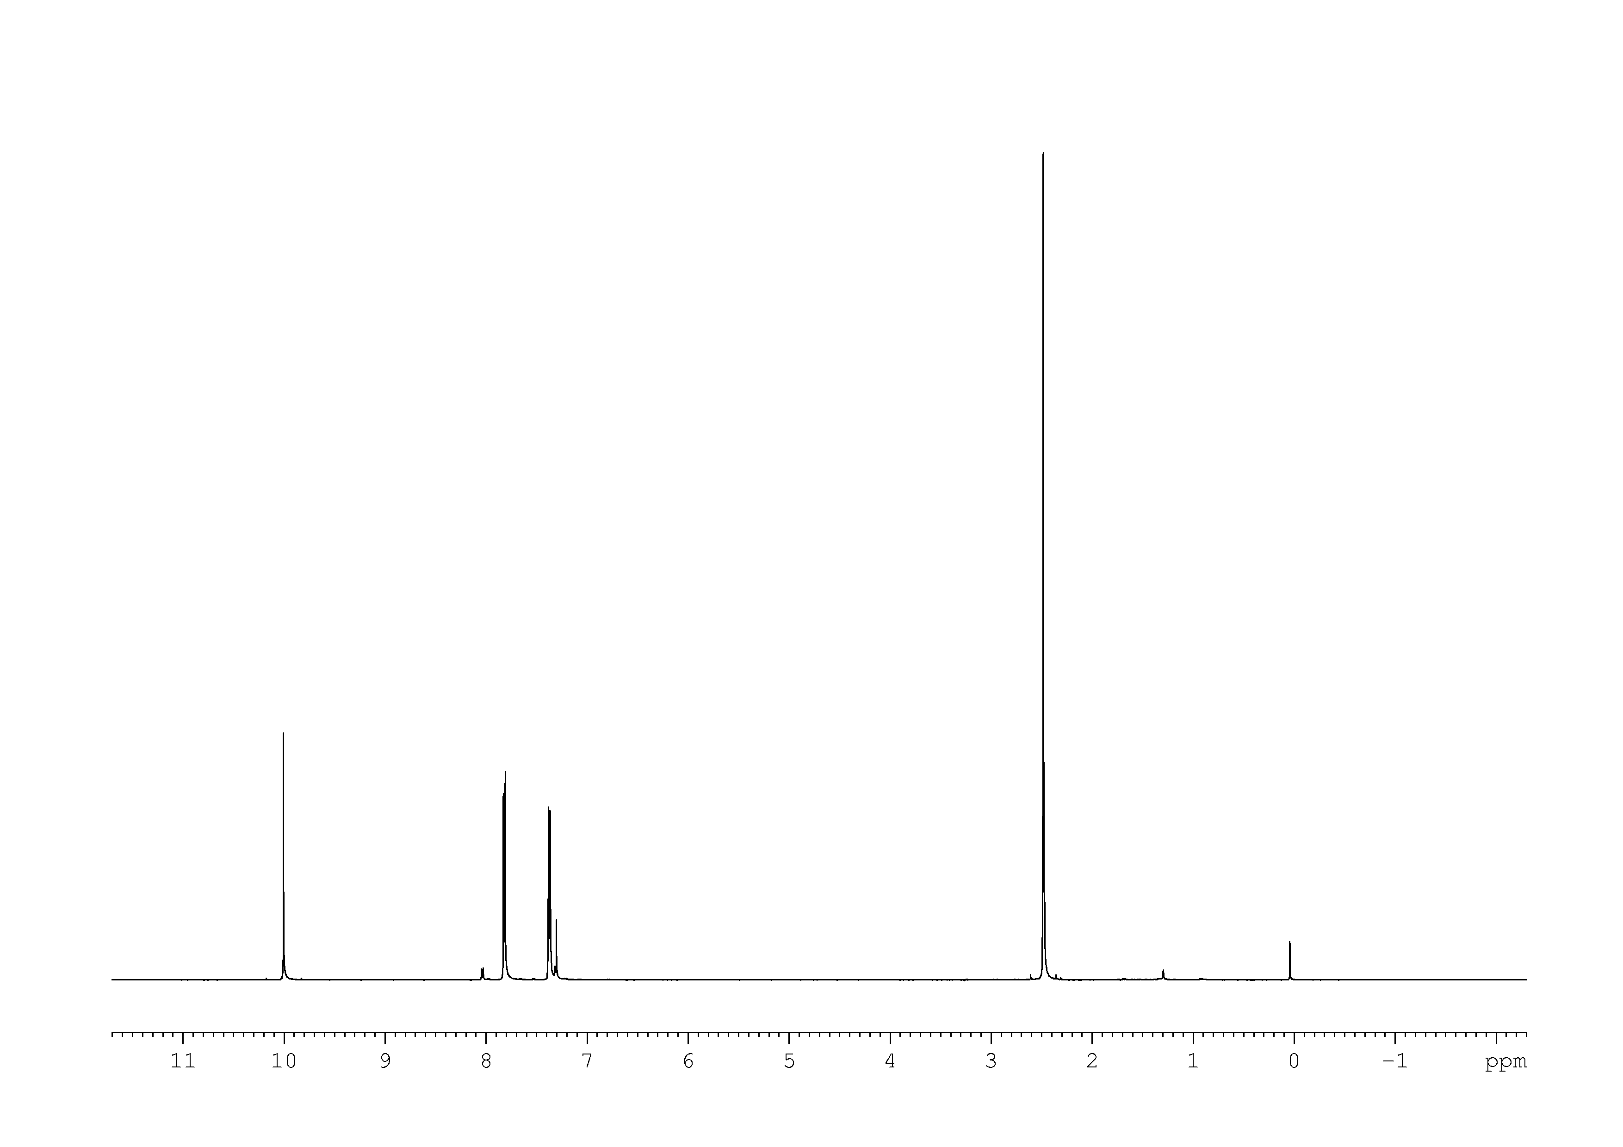
¹H NMR Spectra(400 MHz) of in CDCl₃

Slide 10
¹³C NMR Spectra

Slide 11
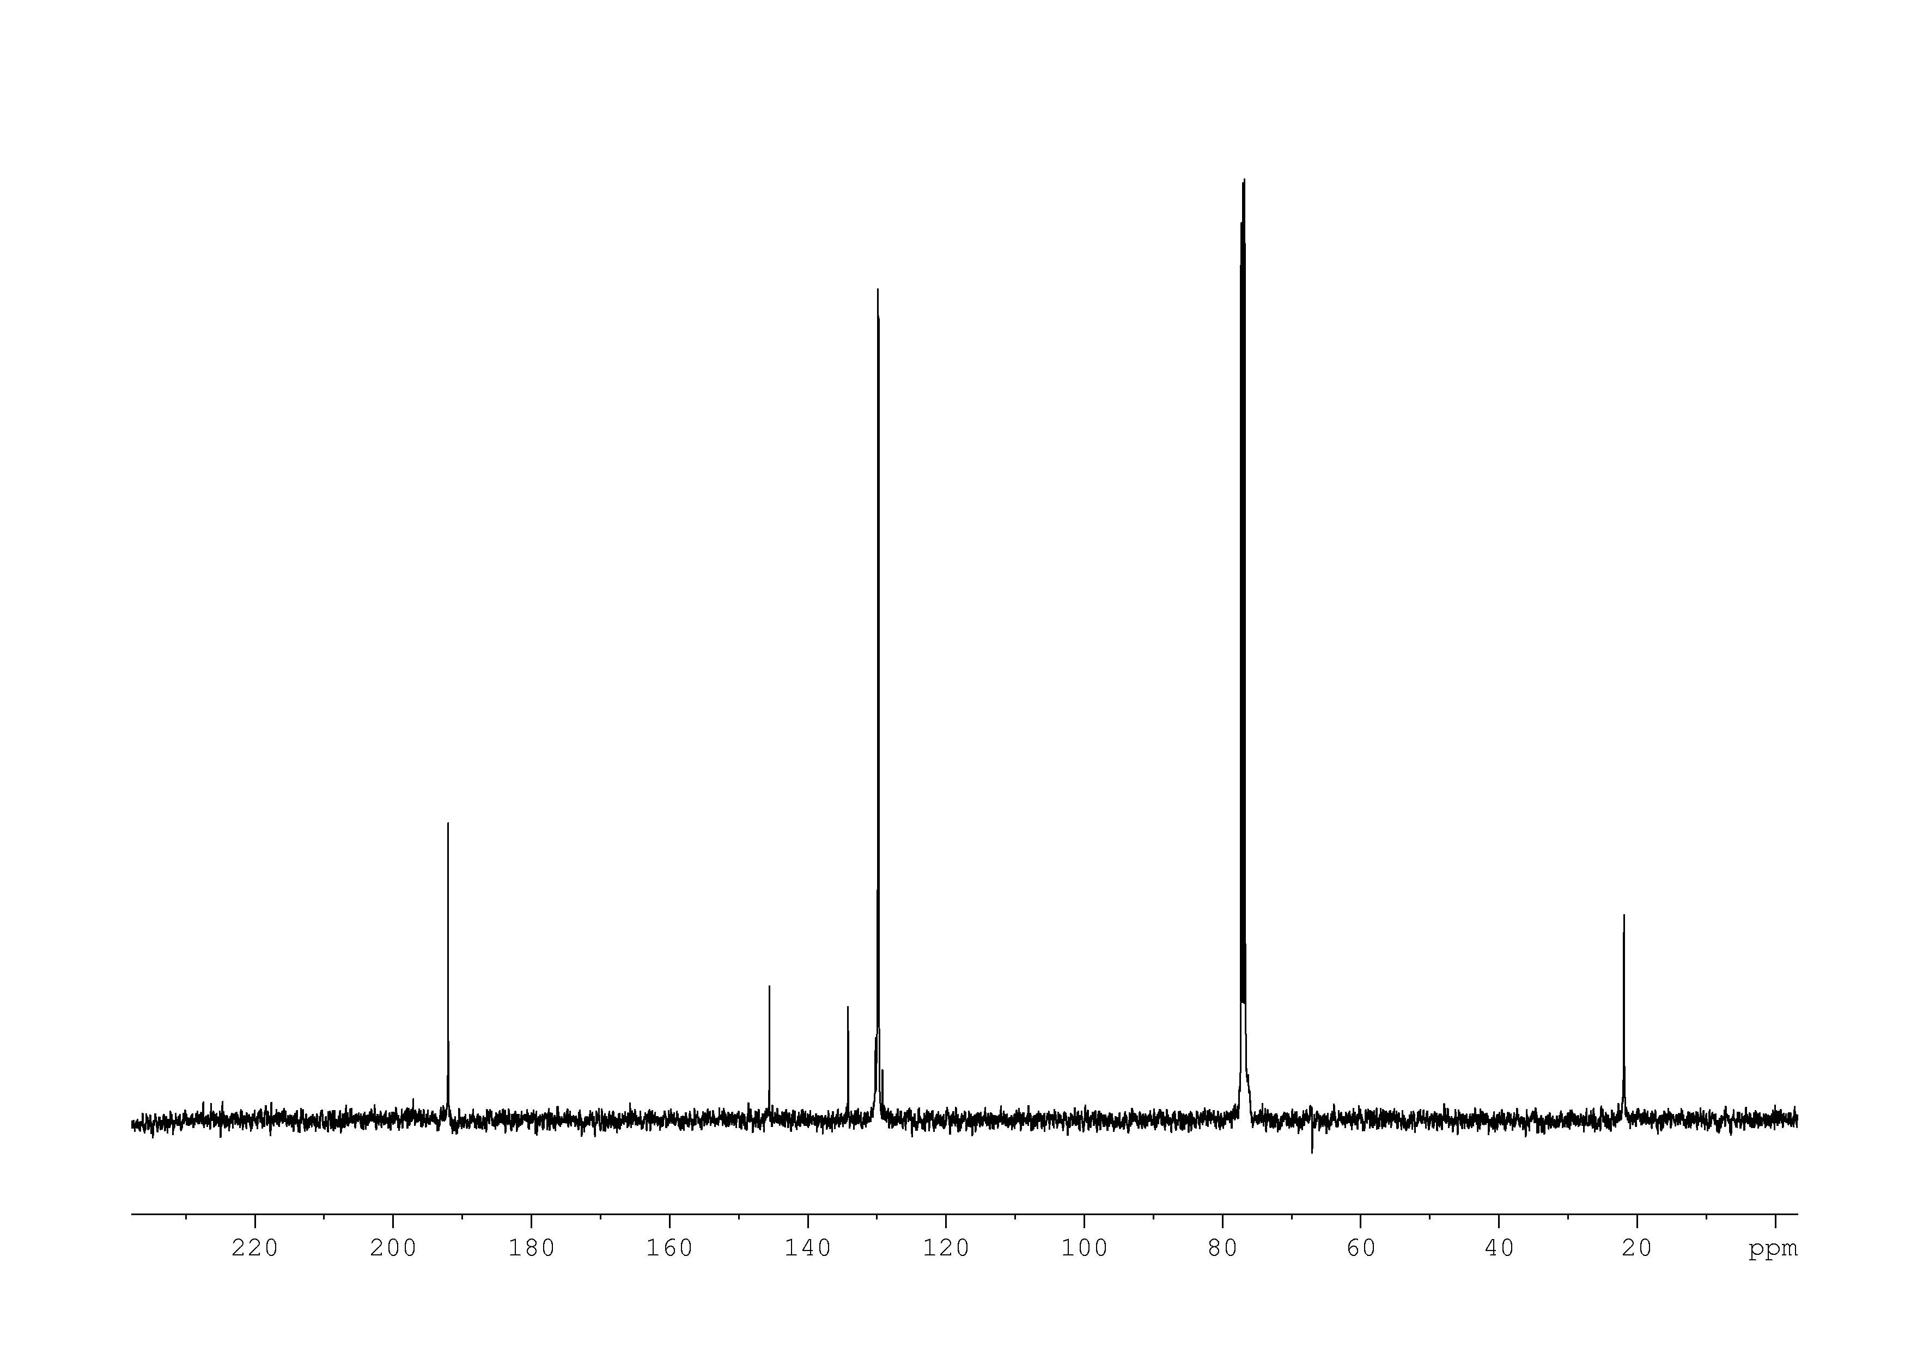
¹³C NMR Spectra(125 MHz) in CDCl₃

Slide 12
¹H NMR Spectra

Slide 13
¹H NMR Spectra(400 MHz) in CDCl₃

Slide 14
¹³C NMR Spectra

Slide 15
¹³C NMR Spectra(125 MHz) in CDCl₃

Slide 16
¹H NMR Spectra(400 MHz) in CDCl₃

Slide 17
¹³C NMR Spectra(125 MHz) in CDCl₃

