Slide 1
CH4203: Organic Synthesis Laboratory
----------------------------------------------------------------------------------------------
Expt. No. 7:
Synthesis of Organocatalyst Based on Triazole Scaffolds
&
Organocatalytic Asymmetric Michael Addition of Cyclohexanone with β−Nitrostyrene
Instructor: Dr. Alakesh Bisai
Professor of Chemistry
Dept. of Chemical Sciences

Slide 2
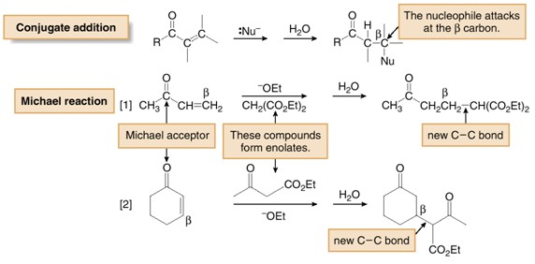
Conjugate Addition: Michael Addition

Slide 3
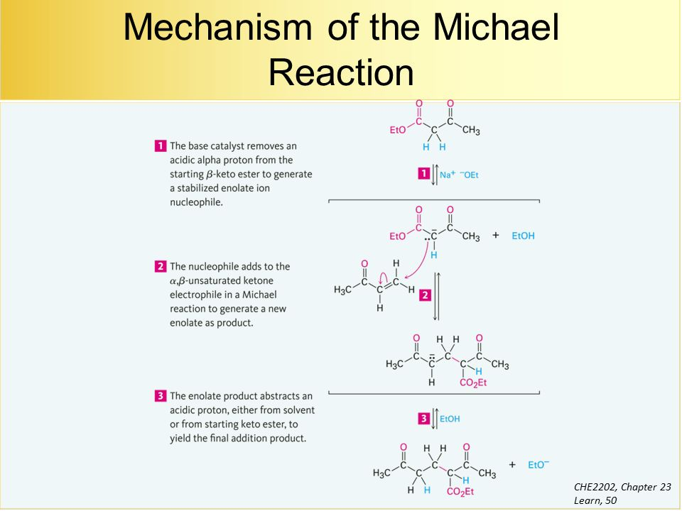
Mechanism: Michael Reaction

Slide 4
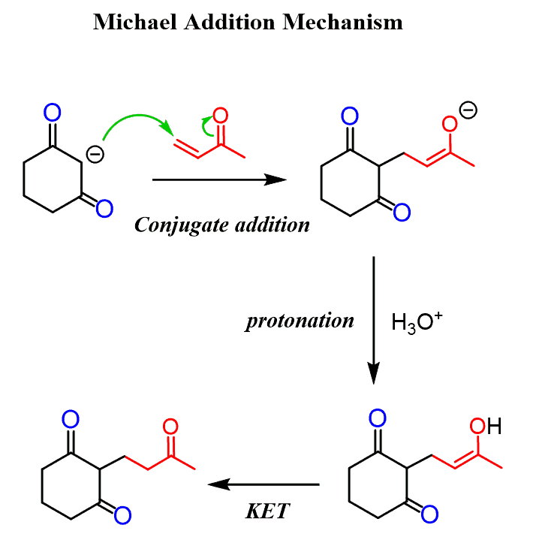
Michael Addition

Slide 5
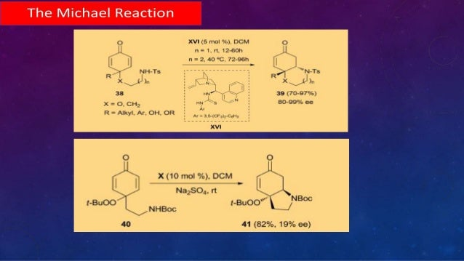
Organocatalytic Michael Addition

Slide 6
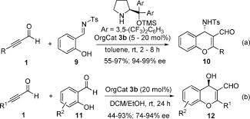
Organocatalytic Michael & Cascade

Slide 7
Synthesis of Organocatalyst for Michael Addition

Slide 8
Organocatalytic Enantioselective Michael Addition

Slide 9
Organocatalytic Enantioselective Michael Addition: Proposed TS

Slide 10
Application: Montanine Type Amaryllidaceae Alkaloids

Slide 11
Application: Montanine Type Amaryllidaceae Alkaloids

Slide 12
Application: Montanine Type Amaryllidaceae Alkaloids

