Slide 1
CH4203: Organic Synthesis Laboratory
-------------------------------------------------------------------------
Expt. No. 1: Nitro-Aldol Reaction of p-Tolualdehyde with Nitromethane: Synthesis of β-Nitrostyrene
Date: 6th January, 202
Instructor: Dr. Alakesh Bisai
Professor of Chemistry
Dept. of Chemical Sciences

Slide 2
Active Pharmaceutical Ingredients (API’s): Enantiomers

Slide 3
API’s with different Biological Properties:
Importance of Enantioenriched Organic Molecules as Drugs

Slide 4
Active Pharmaceutical Ingredients (API’s):
Importance of Single Enantiomer

Slide 5
Active Pharmaceutical Ingredients (API’s):
Importance of Single Enantiomer

Slide 6
API’s with different Biological Properties:
Importance of Enantioenriched Organic Molecules as Drugs

Slide 7
Active Pharmaceutical Ingredients (API’s):
Importance of Single Enantiomer

Slide 8
Active Pharmaceutical Ingredients (API’s): Enantiomers

Slide 9
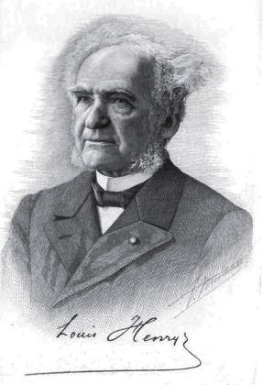
Expt.: Nitro-Aldol Reaction of p-Tolualdehyde with Nitromethane: Synthesis of β-Nitrostyrene
Louis Henry
The Henry reaction is a classic carbon–carbon bond formation reaction and it was discovered in 1895 by the Belgian chemist Louis Henry and the reaction was named after him.
It is the combination of a nitroalkane and an aldehyde or ketone in the presence of a base to form β-nitro alcohols.This type of reaction is referred to as a nitroaldol reaction.
The Henry reaction is a useful technique in the area of organic chemistry due to the synthetic utility of its corresponding products, as they can be easily converted to other useful synthetic intermediates many of these uses have been exemplified in the syntheses of various pharmaceuticals including the β-blocker (S)-propranolol , the HIV protease inhibitor Amprenavir (Vertex 478).

Slide 10
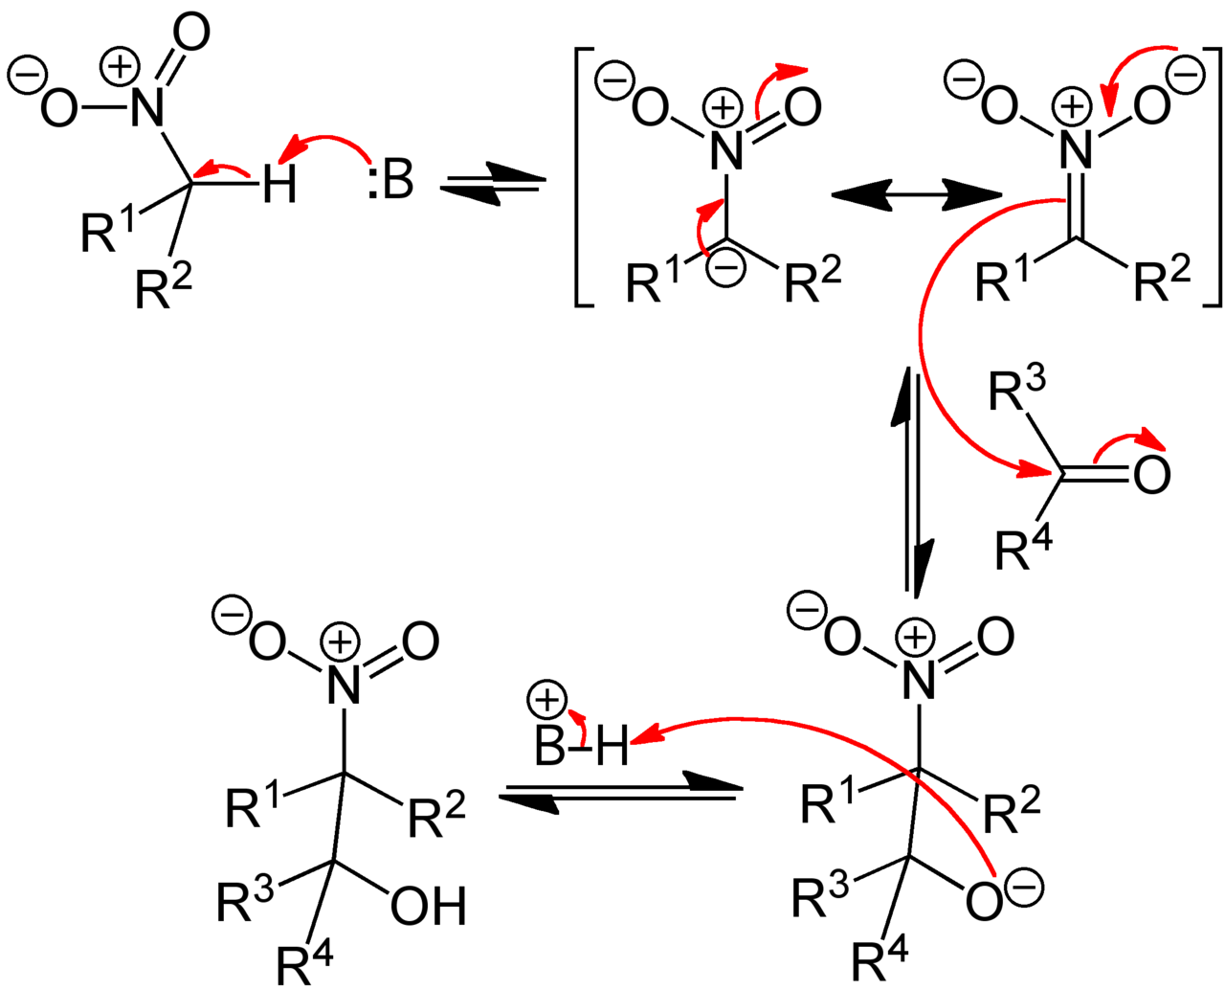
Henry Reaction: Mechanism
In the Henry reaction of nitromethane and benzaldehyde for the synthesis of β-hydroxy nitro compound, nitromethane contributes to HOMO while benzaldehyde contributes to LUMO

Slide 11
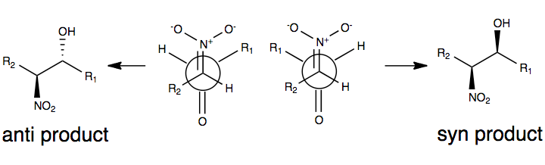
Henry Reaction: Stereochemical Course
Due to the reversibility of the reaction and the tendency for easy epimerization of the nitro-substituted carbon atom (among a number of factors), the Henry reaction will typically produce a mixture of enantiomers or diastereomers

Slide 12
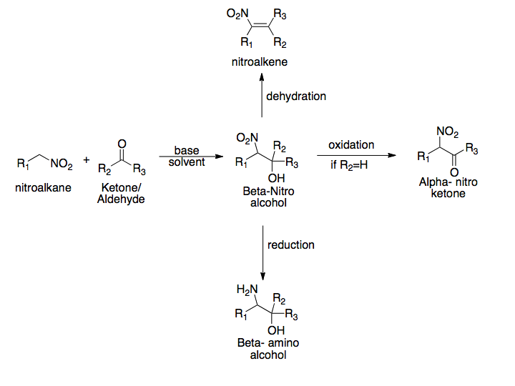
Henry Reaction: followed by different conditions

Slide 13
1,4 addition to β-Nitrostyrene: preparation of δ-keto nitro compound

Slide 14
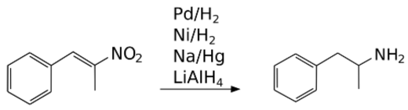
Reduction of β-Nitrostyrene

Slide 15
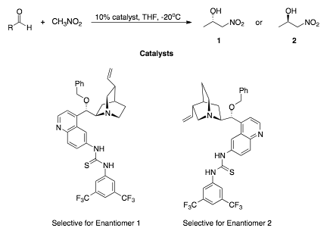
Asymmetric Henry Reaction: Using Organocatalysis
Organocatalysis- In 2006, Hiemstra and coworkers explored the use of quinine derivatives as asymmetric catalysts for the reaction between aromatic aldehydes and nitromethane. Through the use of particular derivatives, they were able to induce direct enantioselection through the use of the proper catalyst.

Slide 16
Nitro-Aldol Reaction of p-Tolualdehyde with Nitromethane: Synthesis of β-Nitrostyrene

Slide 17
Asymmetric Synthesis of Antidepressant Drug, (R)-Rolipram

Slide 18
Asymmetric Synthesis of Paroxetine,
a Selective Serotonin
Reuptake Inhibitor (SSRI)

