Slide 1
X-ray Diffraction and Structure of Solids

Slide 2

Plane Groups
The plane group arising from the square lattice are, P4, P4mm and P4gm.
+
+
+
+
+
+
+
+
P4
+
+
+
+
Symmetry elements
+
+
P4
+
+

Slide 3

Plane Groups
The plane group arising from the square lattice are, P4, P4mm and P4gm.
+
+
+
+
+
+
+
+
+
+
+
+
+
+
+
+
Symmetry elements
+
+
+
+
+
+
+
+
+
P4mm
+
+
+
+
+
+
+

Slide 4
Plane Groups
The plane group arising from the square lattice are, P4, P4mm and P4gm.
+
+
+
+
+
+
+
+
+
+
+
Symmetry elements
+
+
+
+
+
+
+
+
P4gm
+

Slide 5
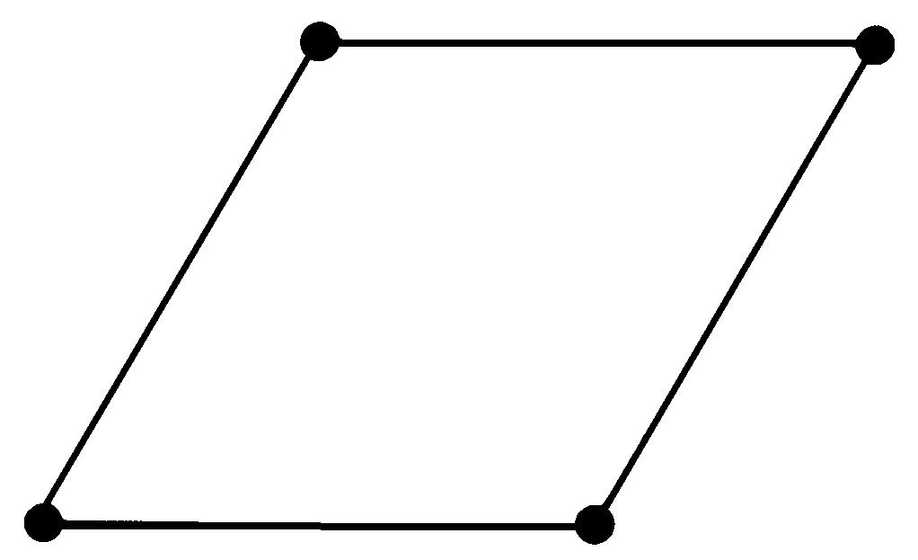
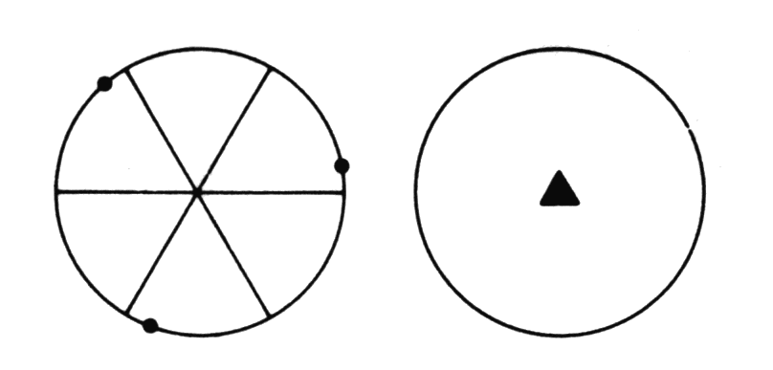
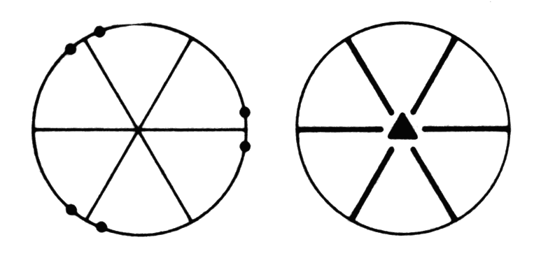
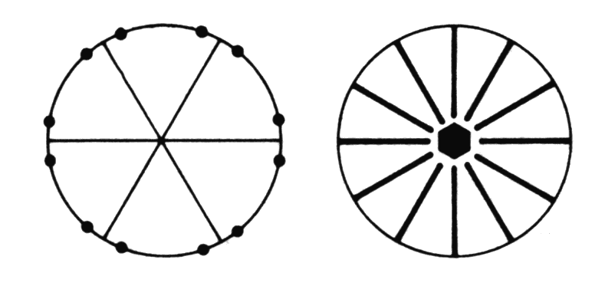
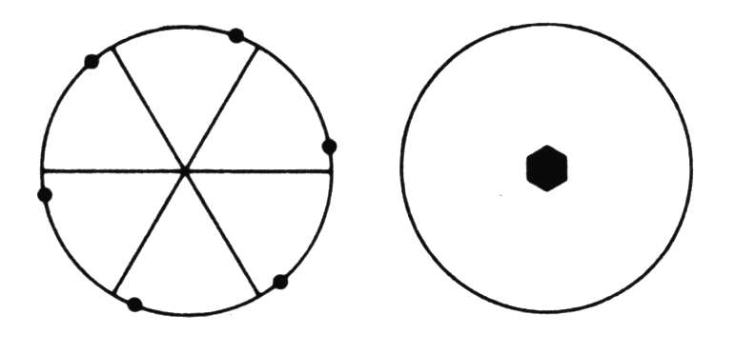
Hexagonal lattice p
Unit cell
2D Point Groups
3, 3m, 6 , 6mm
120°
Unit Cell
a = b , γ = 120°
a = b, α = 120°
3 + m = 3m
6mm
3
6

Slide 6
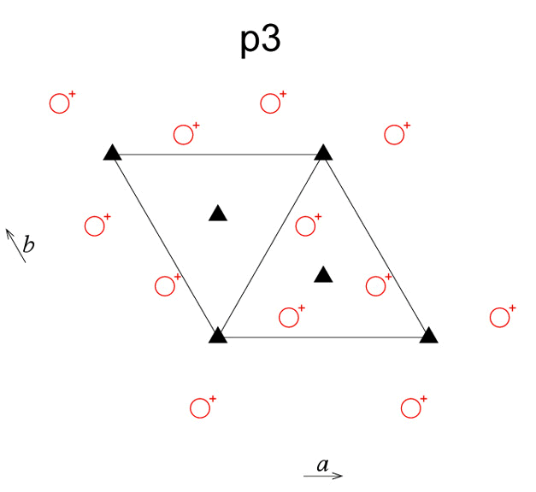
Plane Groups
+
+
+
+
+
+
+
+
+
+
+
+

Slide 7
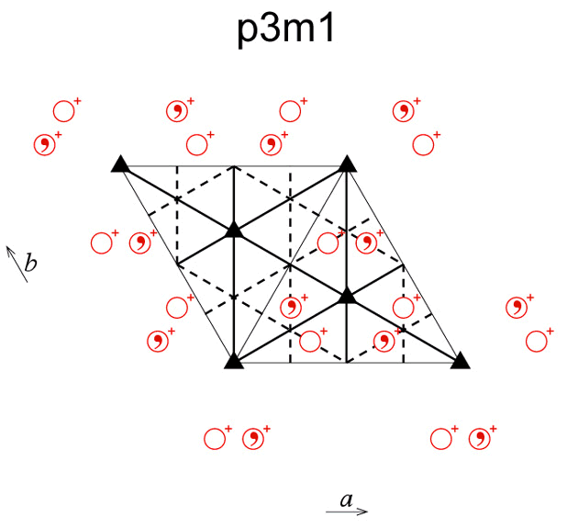
Plane Groups

Slide 8
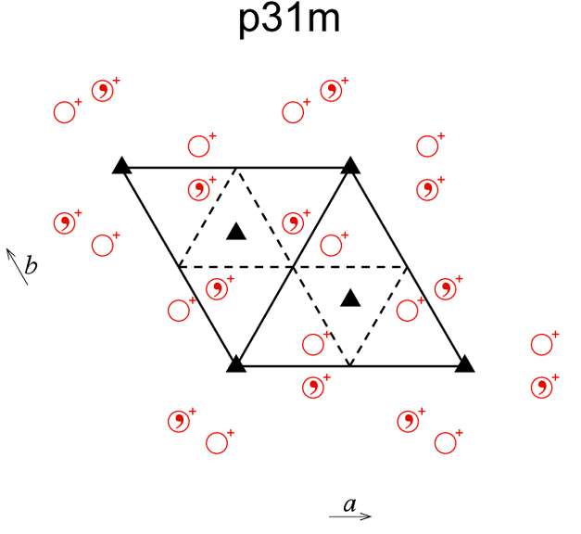

Slide 9
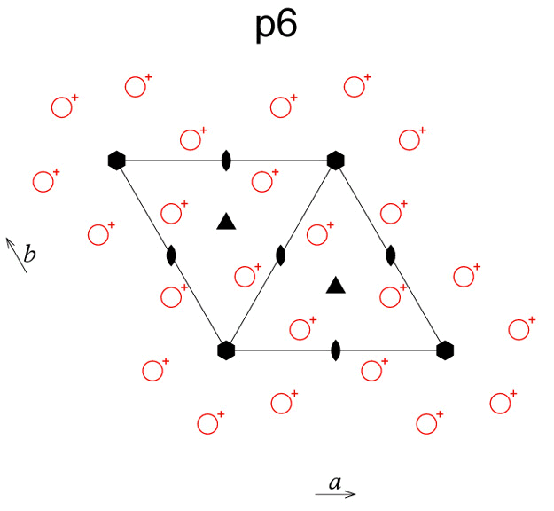

Slide 10
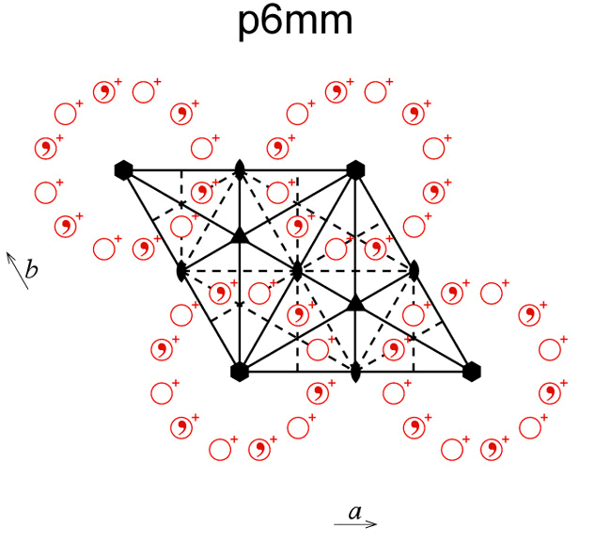

Slide 11
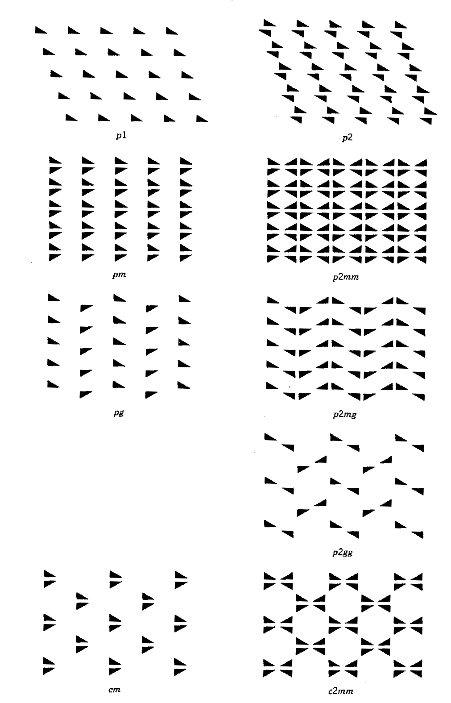
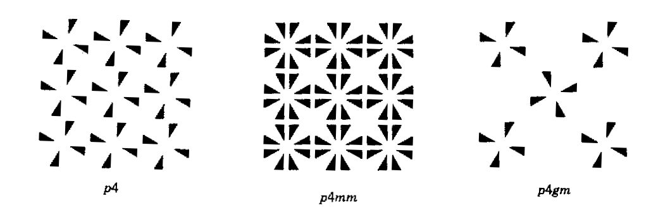
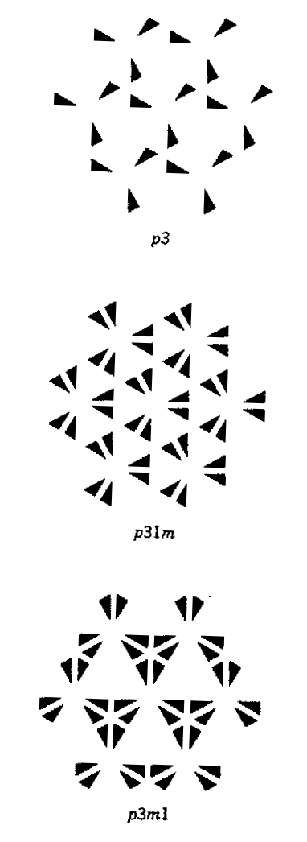
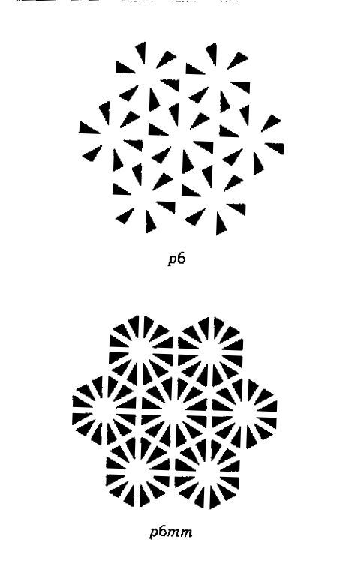

Slide 12
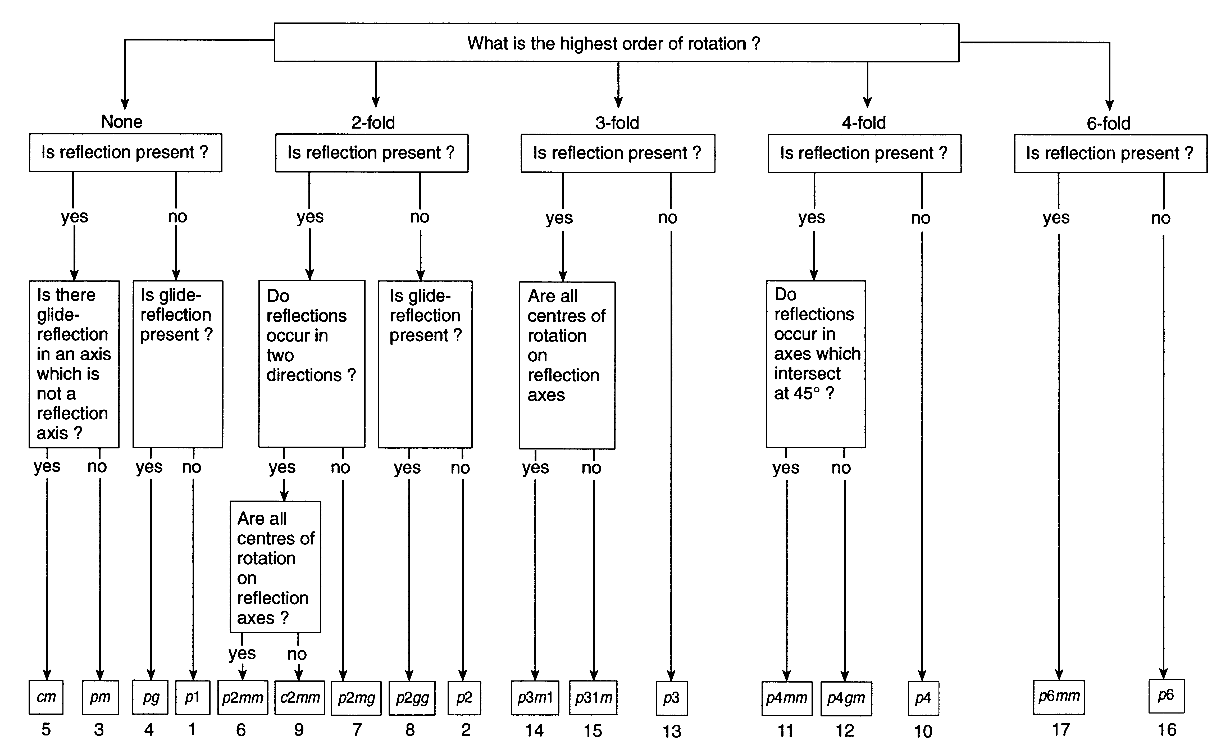
Plane Group Identification

Slide 13
Screw axis
A screw axis (helical axis or twist axis) is a line that is simultaneously the axis of rotation and the line along which translation of a body occurs.
The translation component of the screw axis cannot be arbitrary. They can take only definite values related to lattice periodicity.
For an n-fold rotation axis, n rotations of 2π/n are required to bring the object back to its original position.
In case of n-fold screw axis each rotation of 2π/n is accompanied by translation.
If after each rotation an object is translated along the axis by T, at the end of n-screw operations the object will have been translated by nT.
After every n-screw operation an object should reach the position corresponding to some other lattice point in direction.

Slide 14
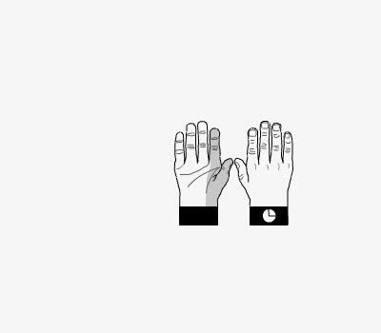
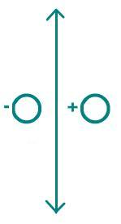
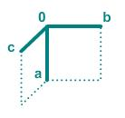
2-fold rotation with axis in the plane of the screen
Here the rotation axis lies in the page.
Rotation about the axis by 180 degrees gives the same hand pattern.

Slide 15
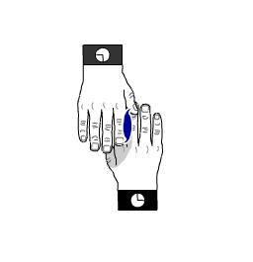
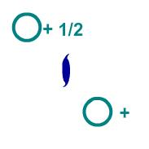
2-fold screw perpendicular to plane of screen.
Here the screw axis is perpendicular to the page.
The bottom hand rotates while translating out of the page to become the top hand.

Slide 16
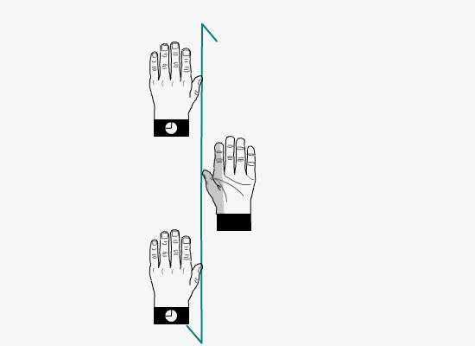
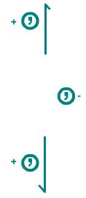
2-fold screw with axis in the plane of the screen.
Here the screw axis lies in the page.
The bottom left hand rotates and translates to become the hand on the right.
The diad screw is symbolically represented by 2₁ and is a combined operation of 180º rotation accompanied by a translation along the axis by half the repeat distance.

Slide 17



Two fold screw axis
2₁ fold Screw
2 fold Axis

Slide 18
Three fold Screw axis
There are two possible translation, 1/3 and 2/3 times the repeat period along the axis for three fold screw axis.
These are symbolically denoted by 3₁ and 3₂.
The rotation in anticlockwise direction, an axis 3₁ will repeat the object at heights 1/3, 2/3 and 3/3 in orientations at 120º, 240º and 360º.
3/3a
a
2/3a
1/3a
3
3₁

Slide 19
Three fold Screw axis
Similarly, a 3₂ operation means an anticlockwise rotation of 120º followed by a translation of 2/3 times the repeat period in the direction of the axis.
One further operation of 3₂ means a total anticlockwise rotation of 240º and net translation of 4/3 times the repeat period. The translation of 4/3 is equivalent to 1/3 as they differ by one repeat period in the same direction and therefore is equivalent owing to lattice periodicity.
The clockwise rotation of 120º and the translation of 1/3 gives the same arrangement as that obtained by anticlockwise rotation of 120º and translation of 2/3.
3/3a
a
2/3a
1/3a
3
3₂

Slide 20
Four fold Screw axis
There are three types of four fold screw axes, viz. 4₁ , 4₂ and 4₃.
The screw axes 4₁ and 4₃ are also the pair of enantiomorphous as 3₁ and 3₂.
Whereas 4₂ has no sense of rotation as same pattern is obtained by rotating clockwise or anticlockwise directions.
½
0,1
½
¾
½
¼
¼
½
¾
0,1
0,1
0,1
4₁
4₂
4₃

Slide 21
Two fold screw axis
2₁ fold Screw
2 fold Screw

Slide 22
Three fold Screw axis
There are two possible translation, 1/3 and 2/3 times the repeat period along the axis for three fold screw axis.
These are symbolically denoted by 3₁ and 3₂.
The rotation in anticlockwise direction, an axis 3₁ will repeat the object at heights 1/3, 2/3 and 3/3 in orientations at 120º, 240º and 360º.
3/3a
a
2/3a
1/3a
3
3₁

Slide 23
Three fold Screw axis
Similarly, a 3₂ operation means an anticlockwise rotation of 120º followed by a translation of 2/3 times the repeat period in the direction of the axis.
One further operation of 3₂ means a total anticlockwise rotation of 240º and net translation of 4/3 times the repeat period. The translation of 4/3 is equivalent to 1/3 as they differ by one repeat period in the same direction and therefore is equivalent owing to lattice periodicity.
The clockwise rotation of 120º and the translation of 1/3 gives the same arrangement as that obtained by anticlockwise rotation of 120º and translation of 2/3.
3/3a
a
2/3a
1/3a
3
3₂

Slide 24
Three fold Screw axis
The conventional direction of rotation is anticlockwise. It is for this reason that 3₁ is shown as and 3₂ is shown as
4/3 (⅓)
⅔
⅓
⅔
0,1
0,1
3₁
3₂
The pair of screw axes 3₁ and 3₂ are termed as enantiomorphous as they differ only in the handedness of rotation.

Slide 25
Four fold Screw axis
There are three types of four fold screw axes, viz. 4₁ , 4₂ and 4₃.
The screw axes 4₁ and 4₃ are also the pair of enantiomorphous as 3₁ and 3₂.
Whereas 4₂ has no sense of rotation as same pattern is obtained by rotating clockwise or anticlockwise directions.
½
0,1
½
¾
½
¼
¼
½
¾
0,1
0,1
0,1
4₁
4₂
4₃

Slide 26
Four fold Screw axis
Let's see how these enantiomorphous operations work! First we'll consider a 4₁ screw axis.
The operation is a rotation by +90°, followed by a translation of ¼ along the c direction.
As you will see, the operation cycles on the fourth repetition, giving the original point translated one full unit cell along c, i.e., to the point (x, y, 1 + z).

Slide 27
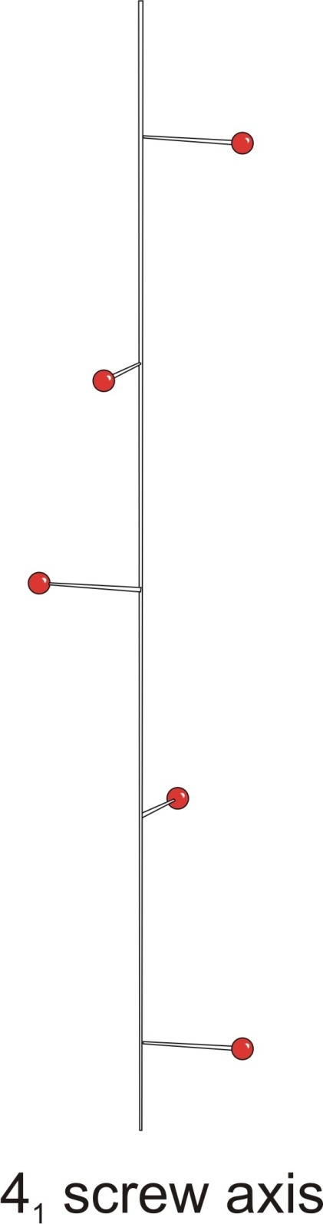
c
a
b

Slide 28
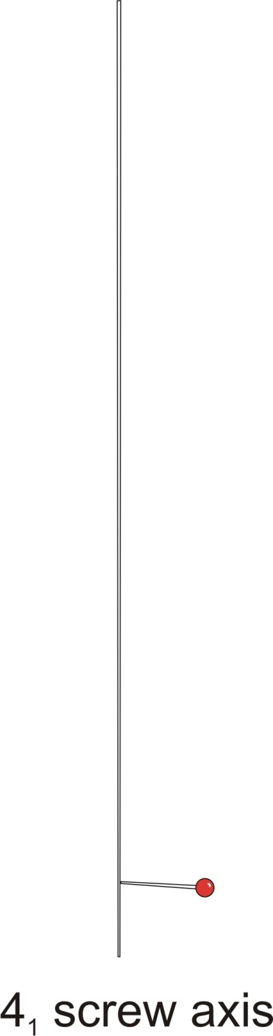
c
a
b
Rotation is right-handed

Slide 29
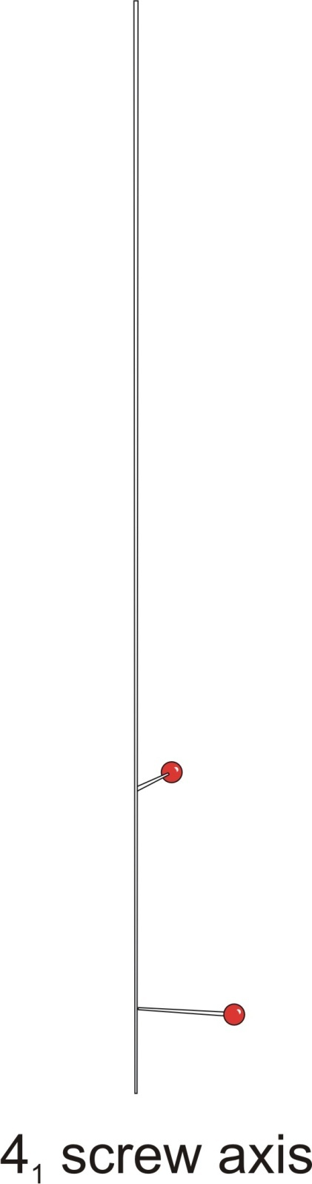
c
a
b

Slide 30
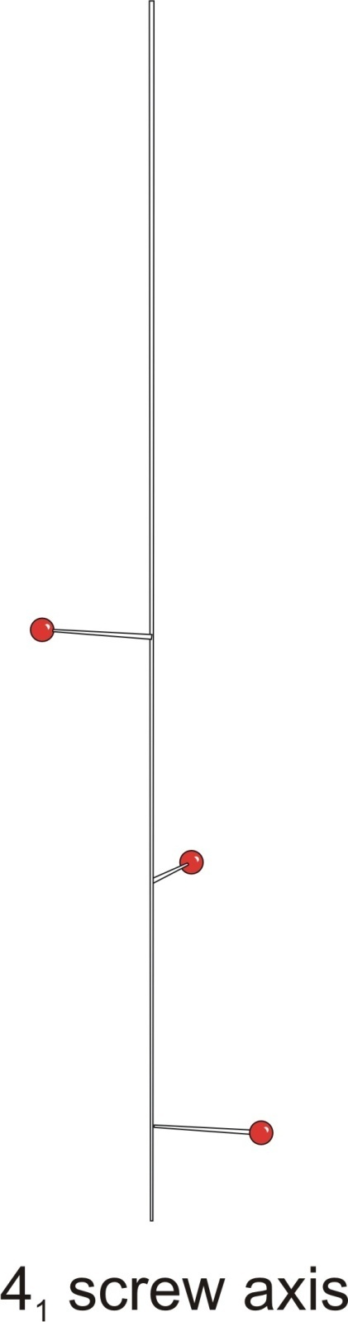
c
a
b

Slide 31
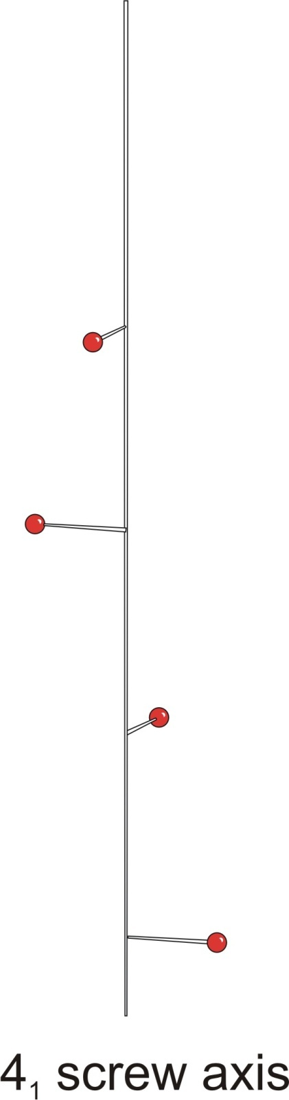
c
a
b

Slide 32
Let us study the operation of 4₁ screw along with its enantiomorphous counterpart, a 4₃ screw axis.
A 4₃ screw operation is a rotation by +90°, followed by a translation of ¾ along the c direction. However, it is completely correct - and useful - to consider the operation as a rotation of -90°, followed by a translation of ¼ along the c direction. Note the different, opposite sense of the rotations & look at the arrows as a reminder.

Slide 33
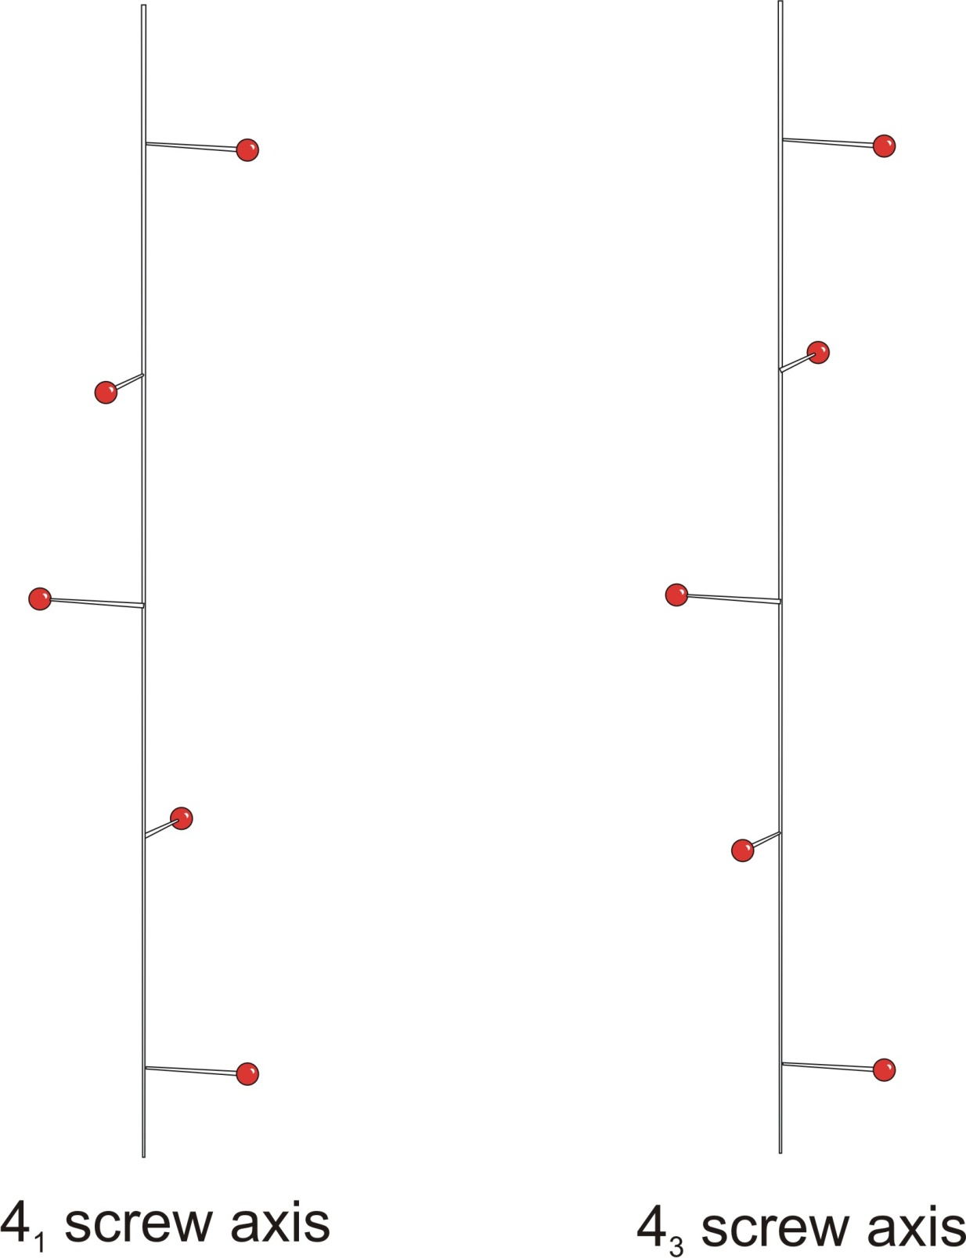
c
Rotation is right-handed
Rotation is left-handed
a
b

Slide 34
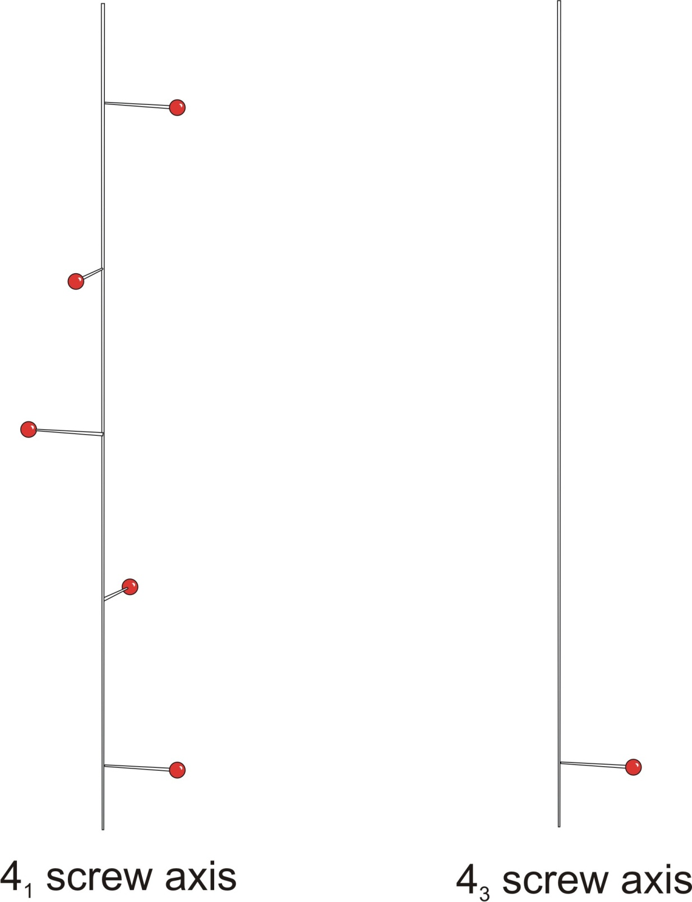

Slide 35
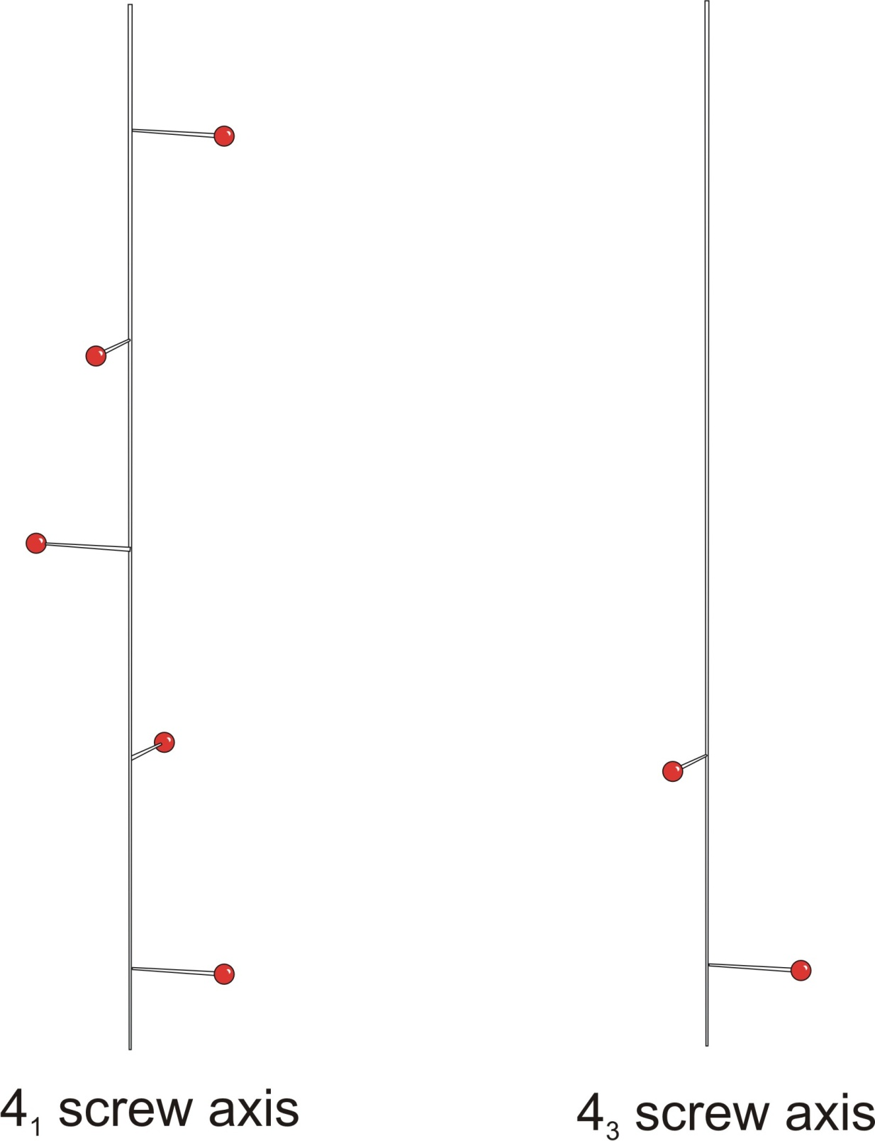

Slide 36
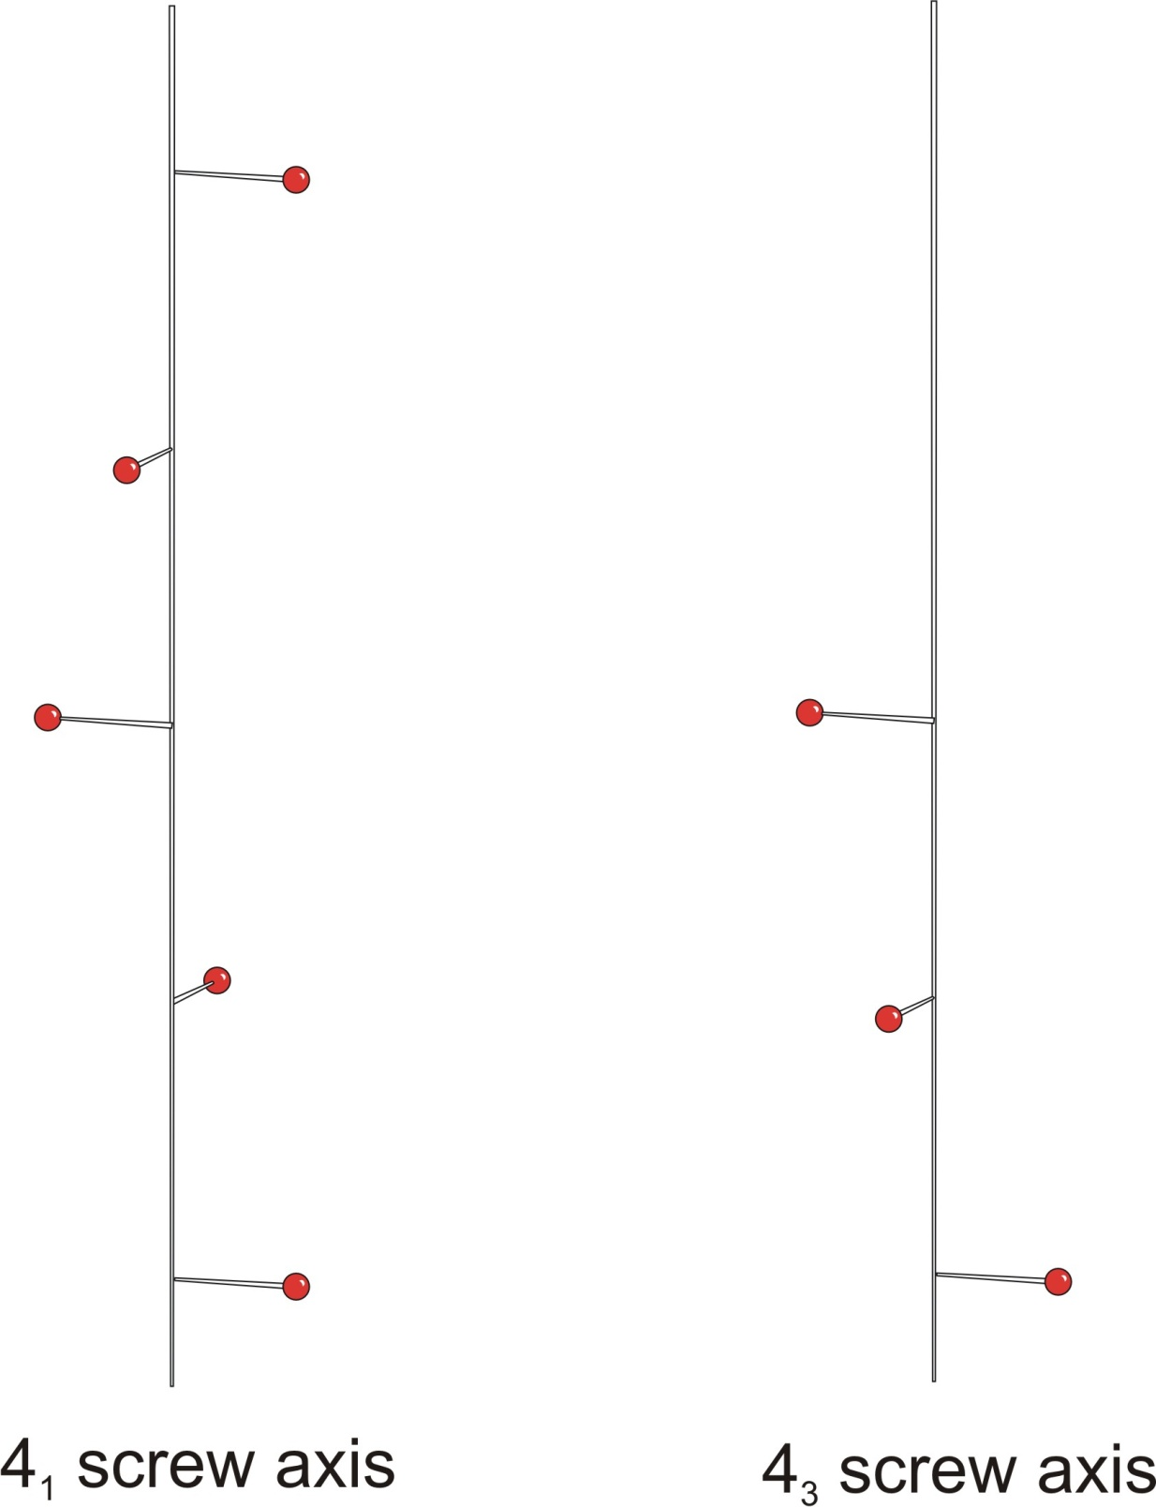

Slide 37
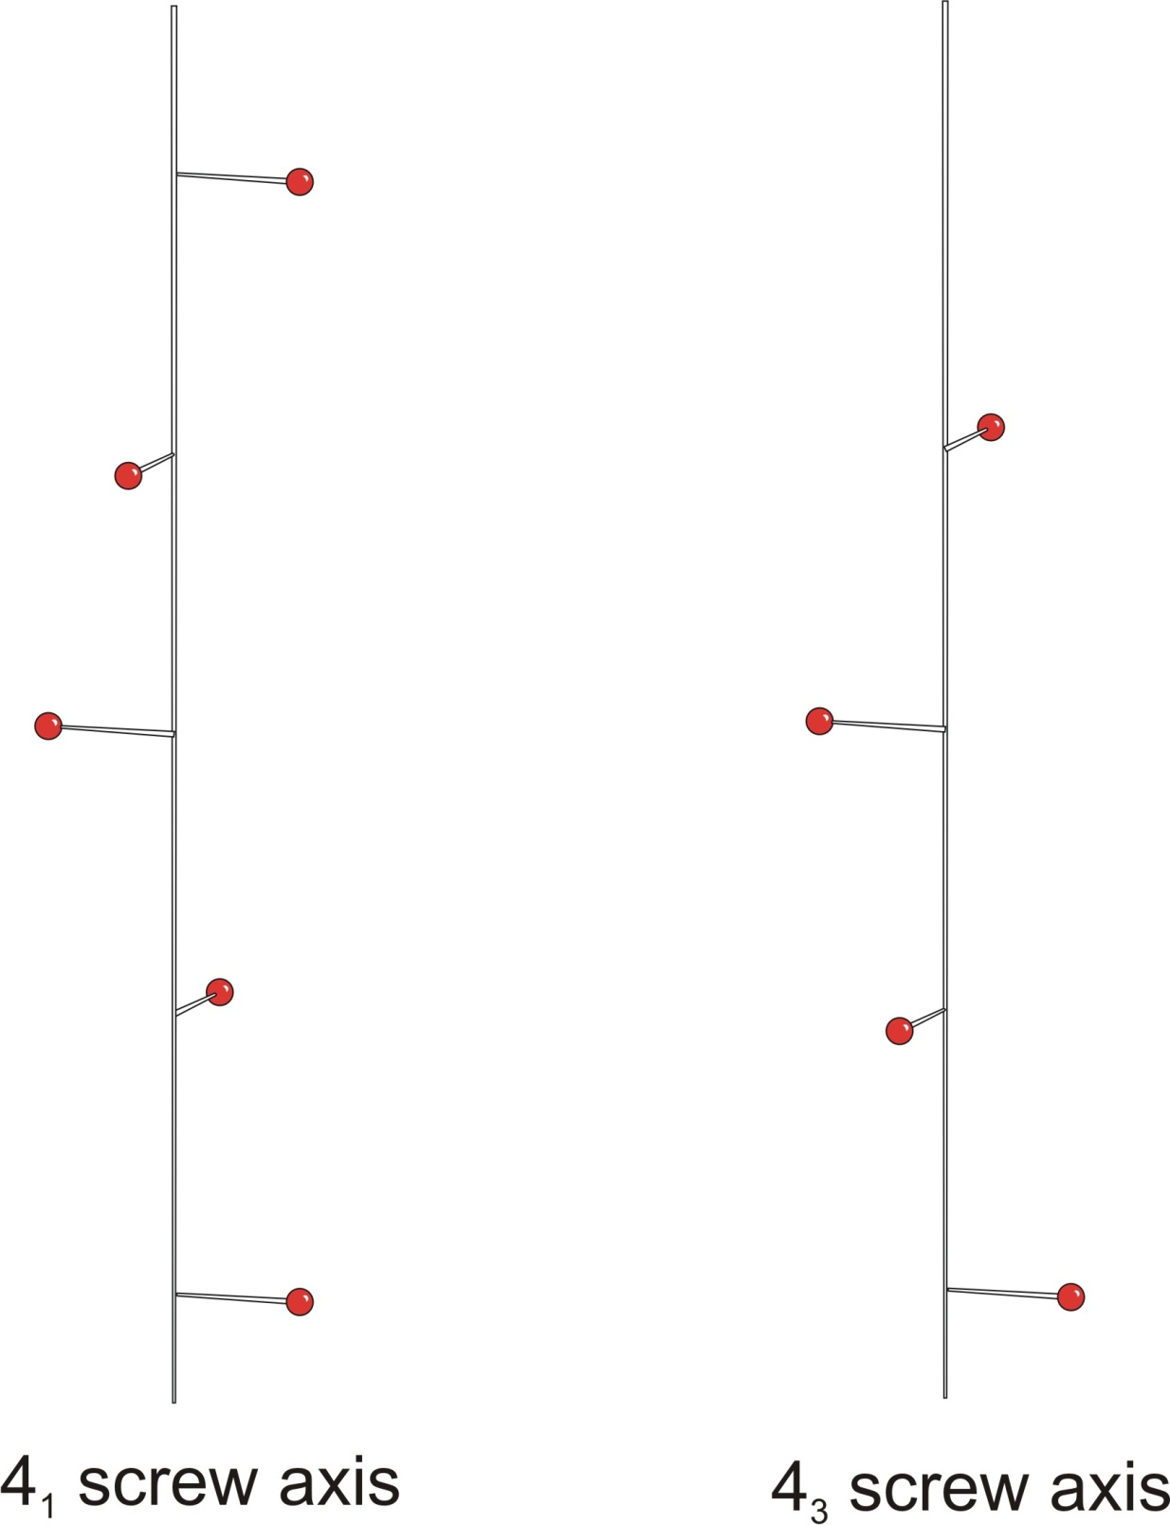

Slide 39
So….we've just seen how the 4₃ screw axis may be considered as a "left-handed version", an enantiomorphous version, of the 4₁ screw axis. In this case, both have a c/4 translational component.
Now….let's continue the tour! We'll look at what happens if we consider the 4₃ axis as a right-handed rotation, with a 3c/4 translational component.

Slide 40
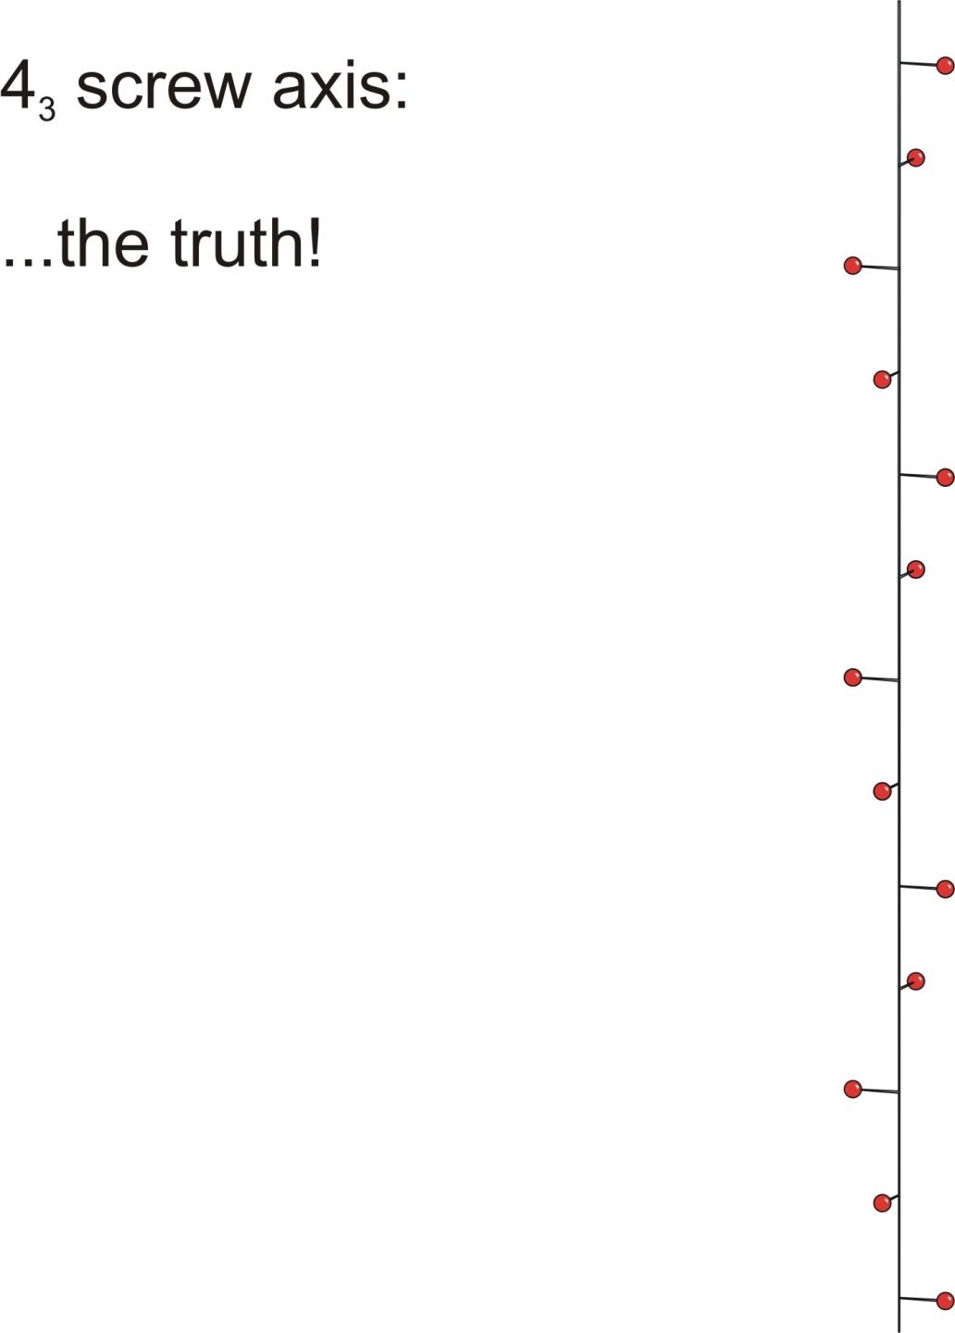
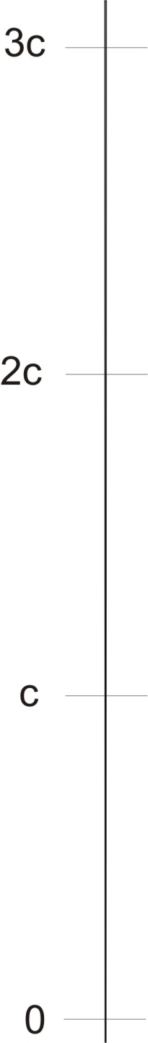
To see the full effect here, we need to observe three full unit cells along the c direction.

Slide 41
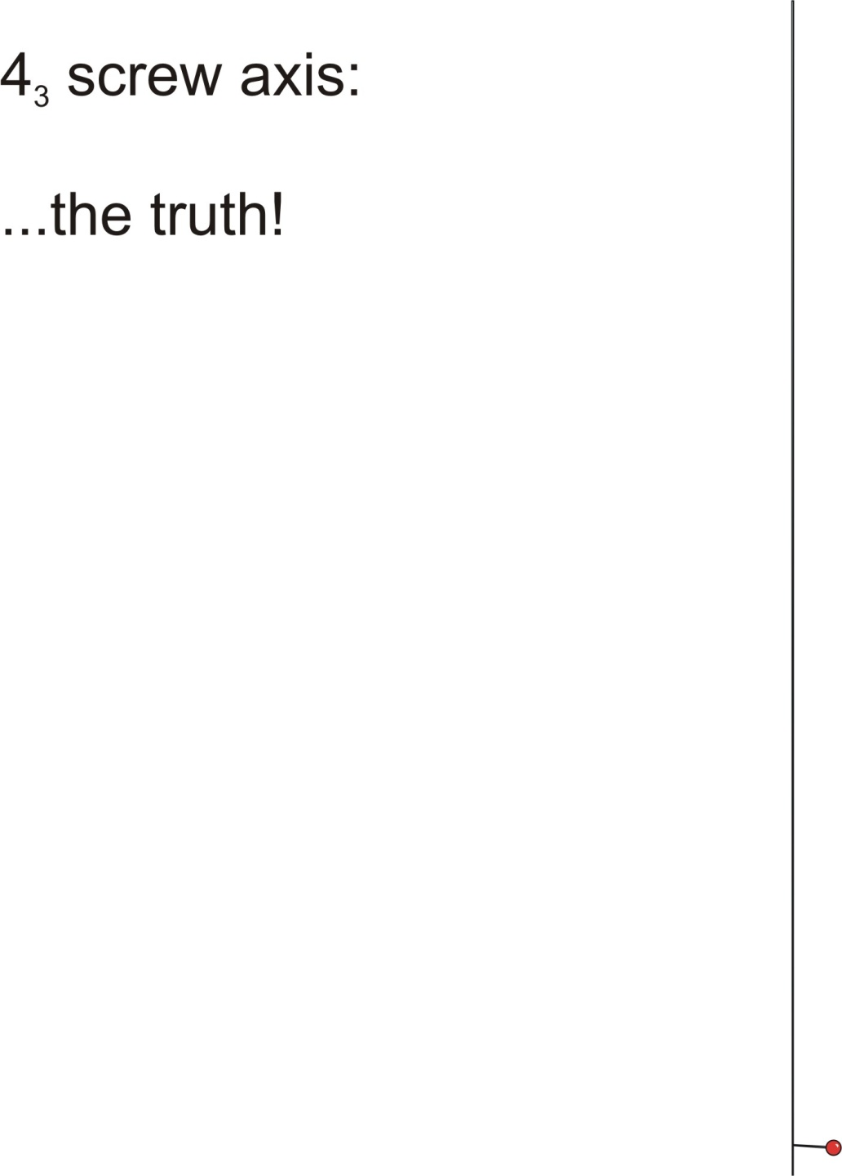
Rotation is right-handed

Slide 42
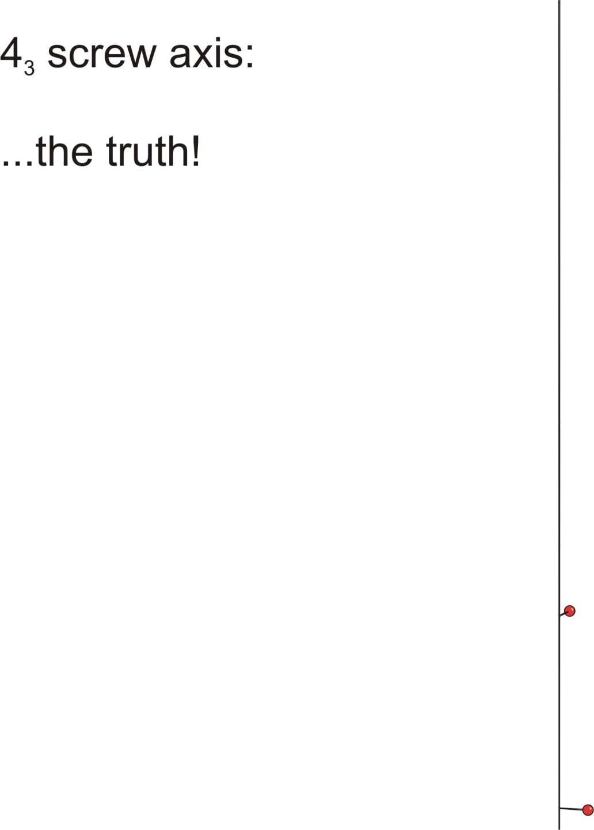
Rotation is right-handed
First translation is 3c/4

Slide 43
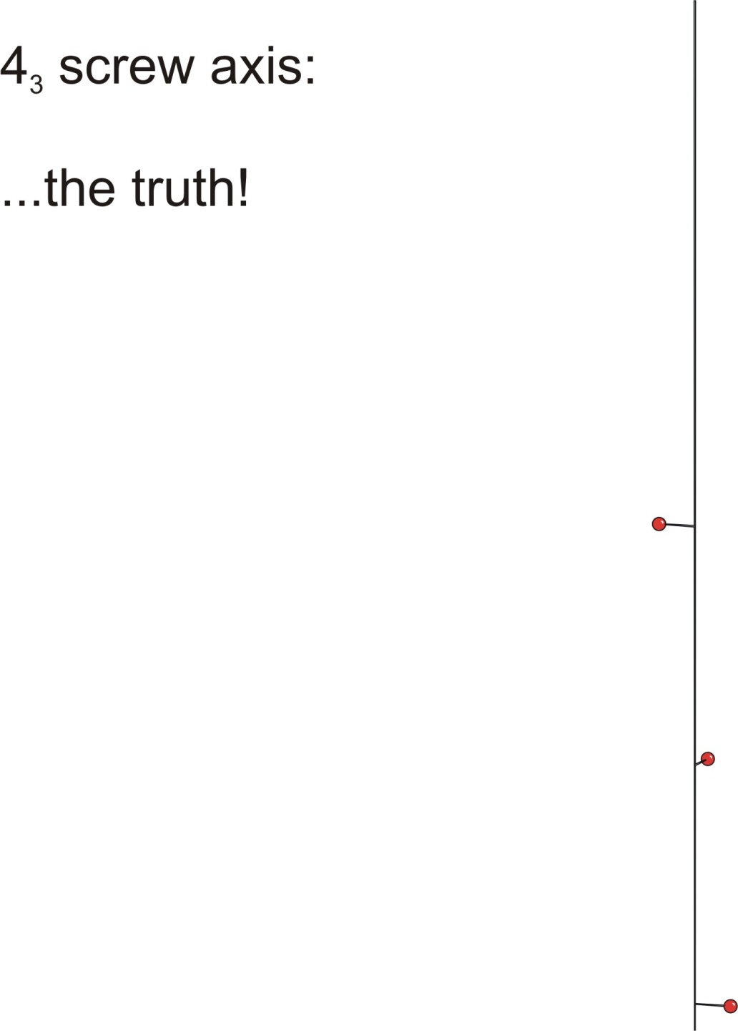
Rotation is right-handed
Next translation advances the point by 6c/4

Slide 44
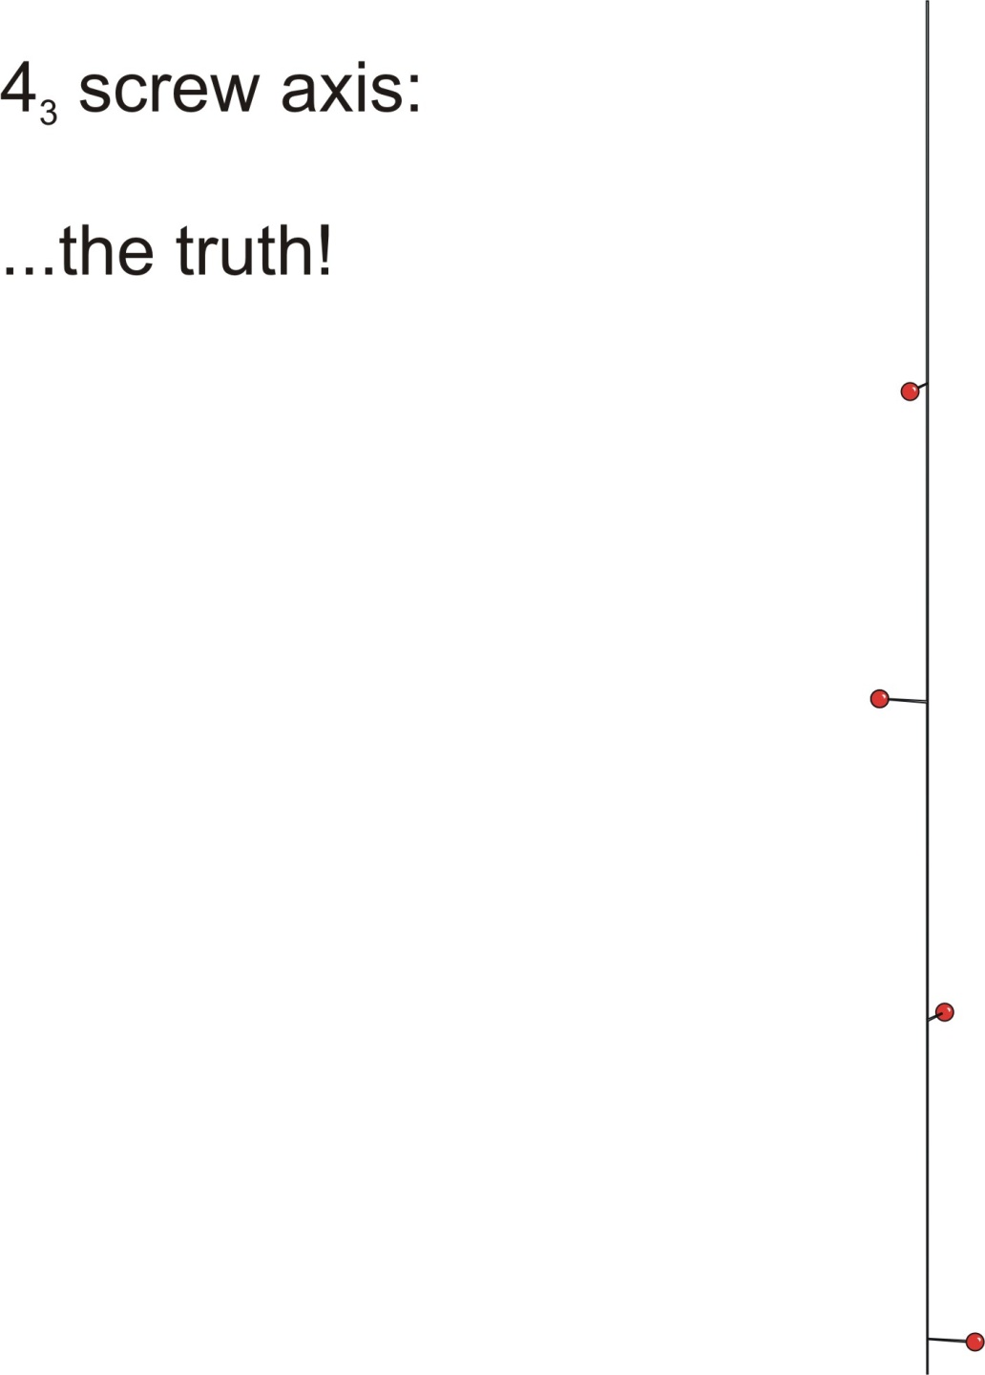
Next translation advances the point by 9c/4

Slide 45
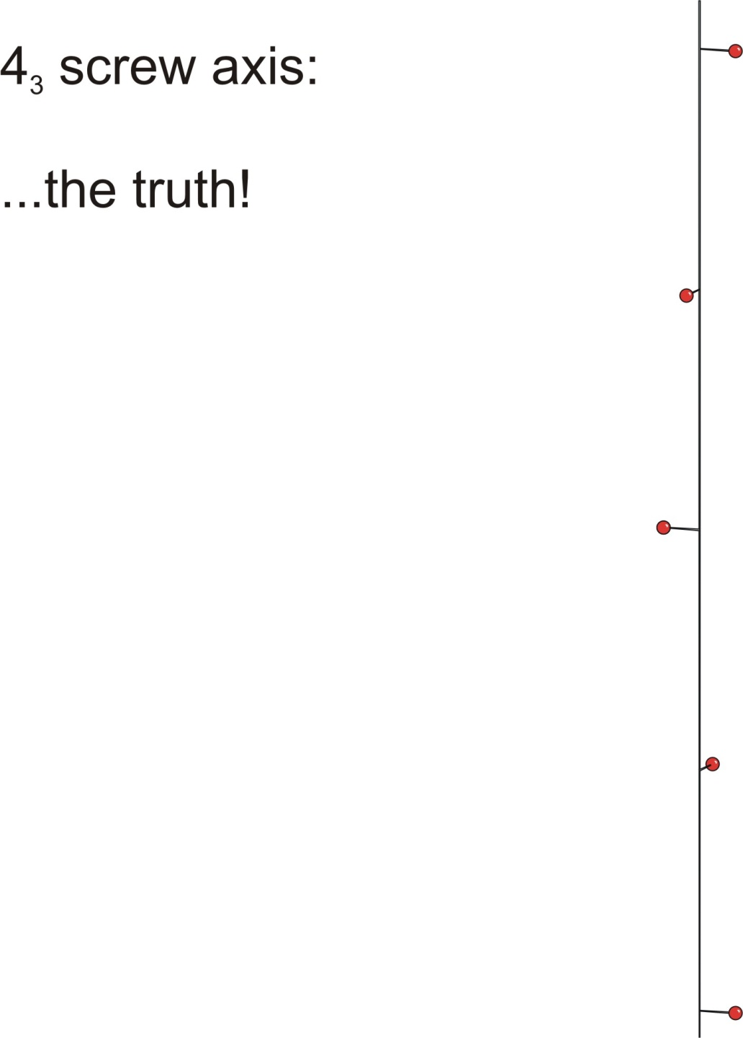
Finally, 3+z
The definition of a 4₃ axis includes a +90º rotation, followed by a translation of ¾ along c.
After the first application of the operation, we are in a second unit cell (+6c/4), and so forth.
In order to fill the first cell, we'll have to translate the new points "back" into the first cell.

Slide 46
Translate point at (x, y, 3 + z) -1 and -2 unit cells

Slide 47
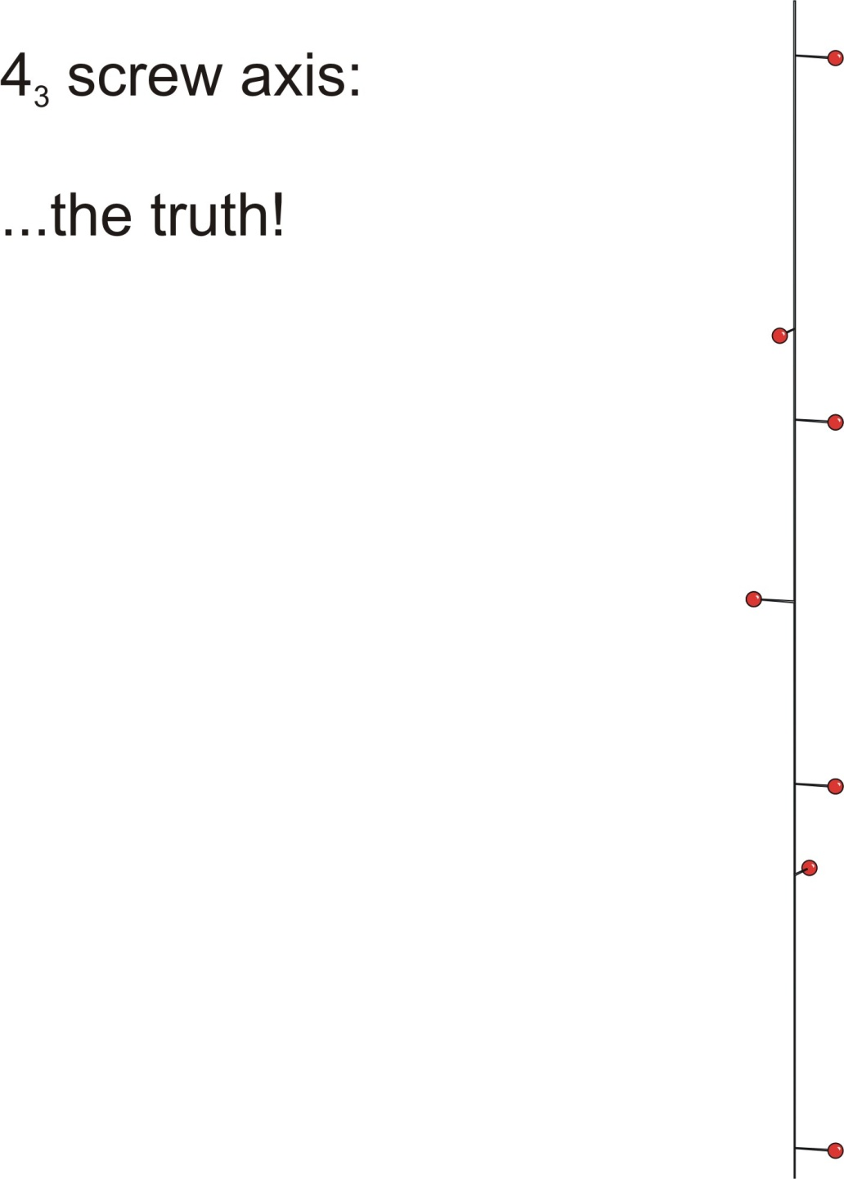
Translate point at (x, y, 3 + z) -1 and -2 unit cells

Slide 48
Translate point at (y, -x, 9/4 + z) -1 and -2 unit cells

Slide 49
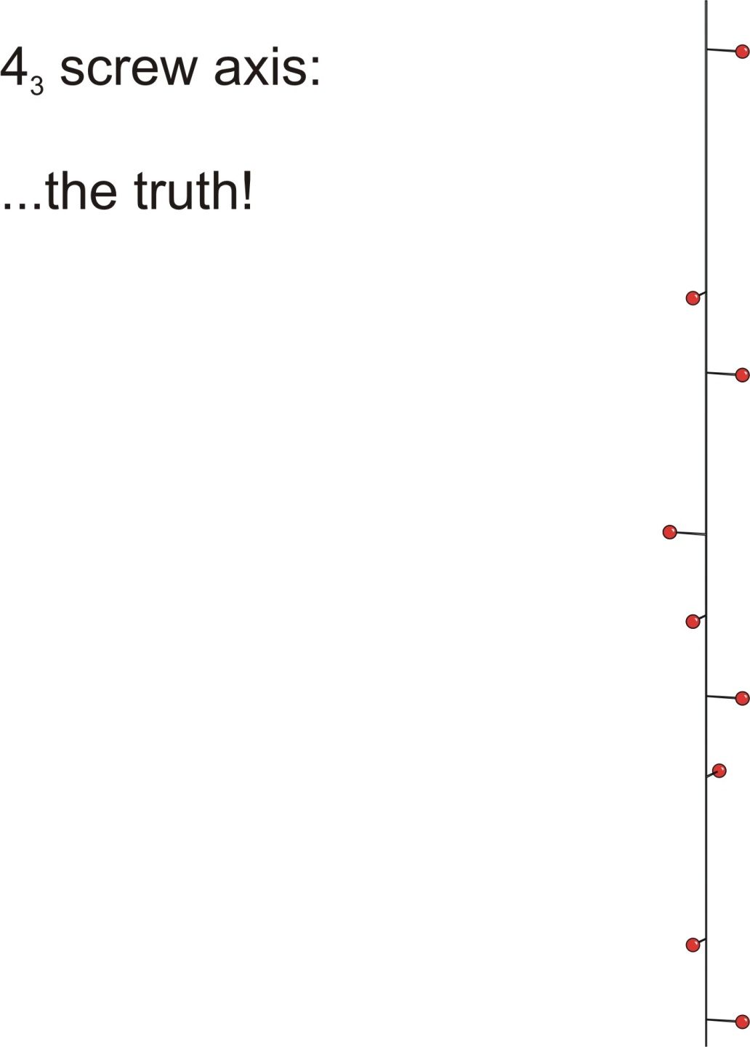
Translate point at (y, -x, 9/4 + z) -1 and -2 unit cells

Slide 51
Translate point at (-x, -y, 6/4 + z) +1 and -1 unit cells

Slide 52
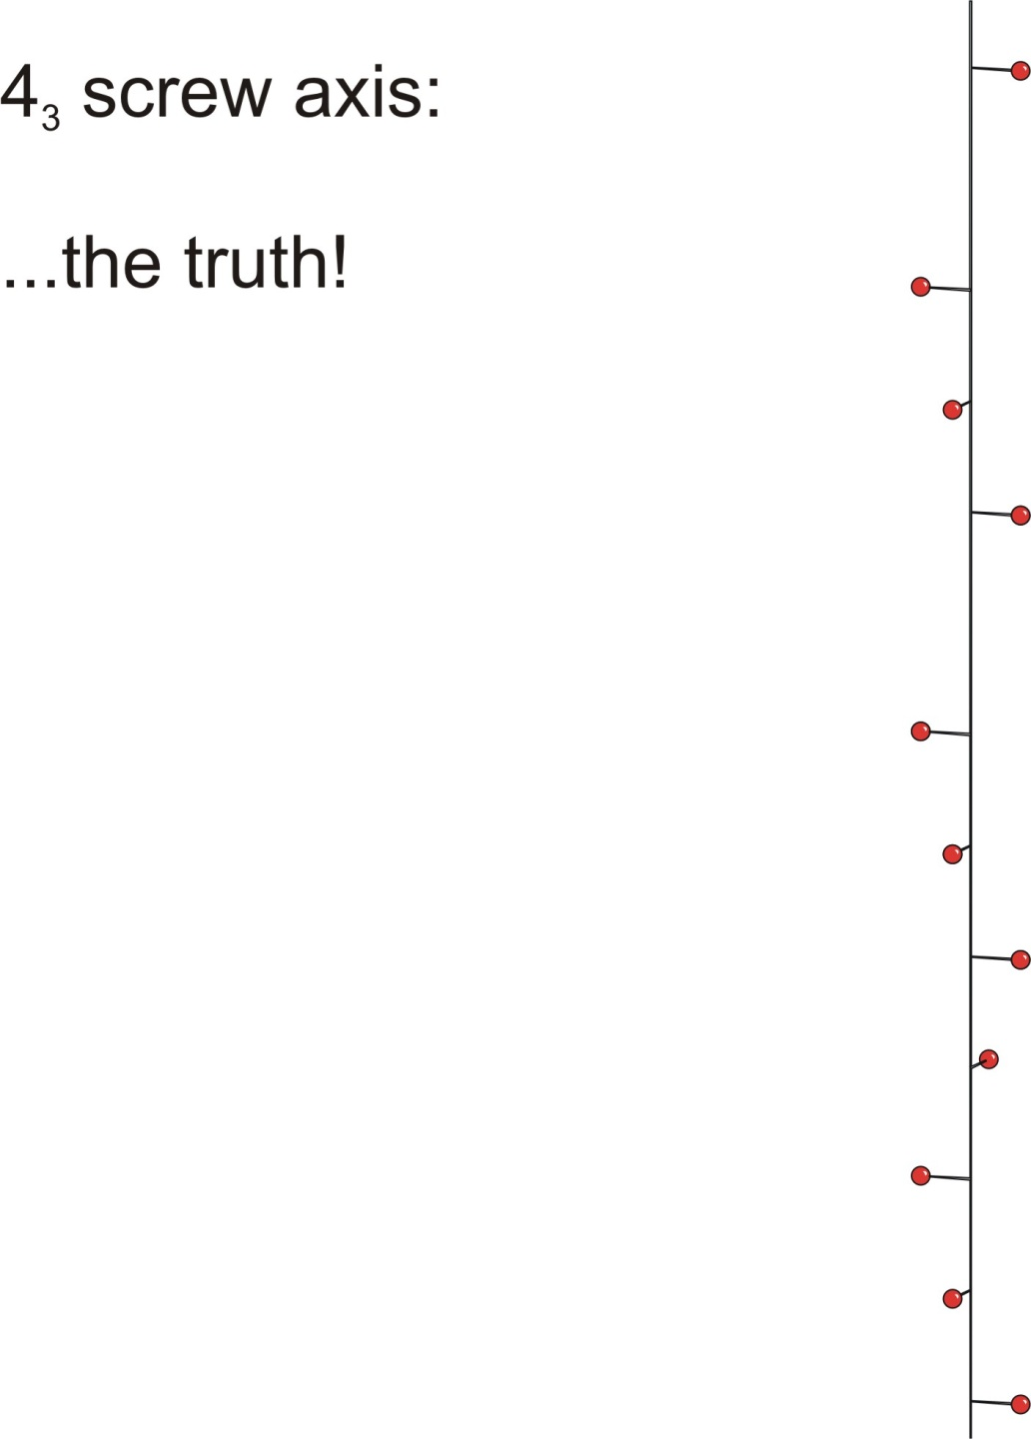
Translate point at (-x, -y, 6/4 + z) +1 and -1 unit cells

Slide 53
Translate point at (-y, x, 3/4 + z) +1 and +2 unit cells

Slide 54
Translate point at (-y, x, 3/4 + z) +1 and +2 unit cells

Slide 56
Six fold Screw axis
There are five possible six fold screw axes, viz. 6₁ , 6₂ , 6₃ , 6₄ and 6₅.
The pair of screw axes 6₁ & 6₅ and 6₂ & 6₄ form the pair of enantiomorphous as 3₁ & 3₂ and 4₁ & 4₃
However, 6₃ like 2₁ and 4₂ does not have definite sense of rotation as same pattern is obtained by rotating clockwise or anticlockwise directions.
½
2/6
½
4/6
2/6
4/6
5/6
1/6
1/6
5/6
½
0,1
0,1
0,1
6₁
6₅
0,1
1/2
1/2
0,1
0,1
0,1
2/3
1/3
6₃
1/3
2/2
1/3
2/3
2/3
1/3
0,1
0,1
6₄
6₂

Slide 57
Four fold Screw axis
Let's see how these enantiomorphous operations work! First we'll consider a 4₁ screw axis.
The operation is a rotation by +90°, followed by a translation of ¼ along the c direction.
As you will see, the operation cycles on the fourth repetition, giving the original point translated one full unit cell along c, i.e., to the point (x, y, 1 + z).

Slide 58
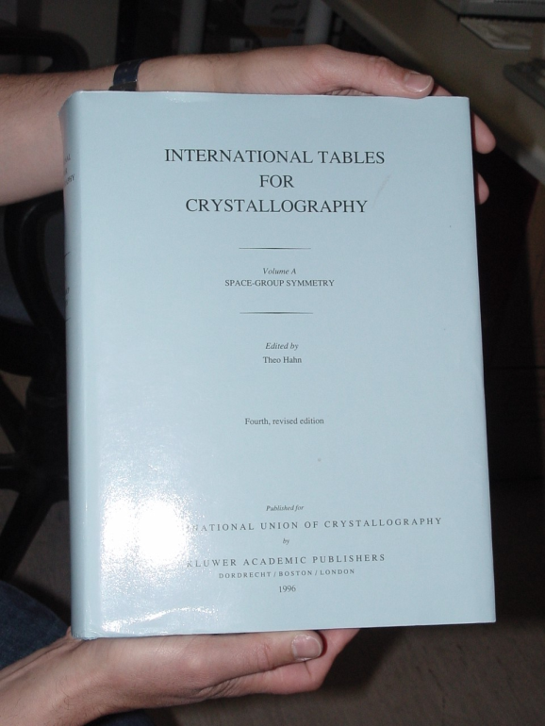
Space Group
What is space group?
space group symmetry = the symmetry of lattice ∧
the symmetry of the object around each lattice point
Combination of point group, lattice and rotation/translational symmetries
result in 230 possible space groups for 3d crystals.
Only 65 of these can be used for
protein crystals (handedness)
All the space groups are tabulated in the
International Tables for Crystallography

Slide 59
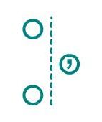
Glide Plane and Screw Axis
glide plane
Two fold screw axis

Slide 60
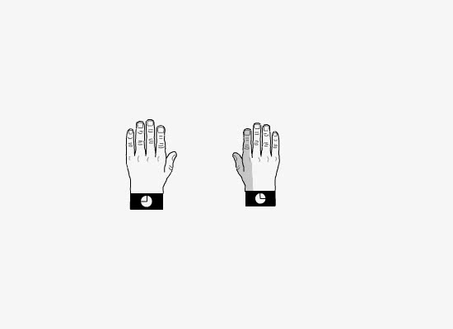
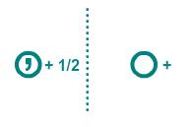
c-glides
The glide plane here (the ac plane) is perpendicular to the page.
Translation is "out-of the page" along the c axis.
The left hand is reflected across the mirror plane, and translated 1/2 unit along c.

Slide 61
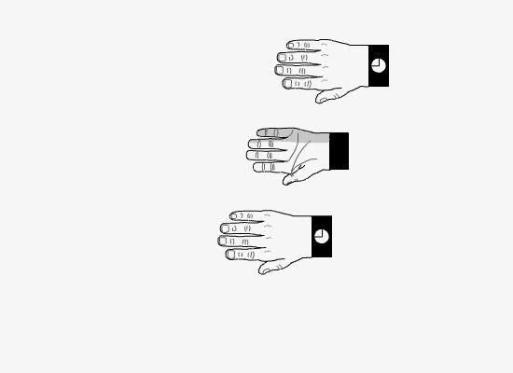
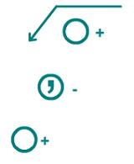
The glide plane lies in the ab plane. Translation is along a.
The right hand is reflected across the page. Then the reflection is translated along a.
a-glides
The glide plane lies in the ac plane. Translation is along a.
The right hand is reflected across the page. Then the reflection is translated along a.

Slide 62
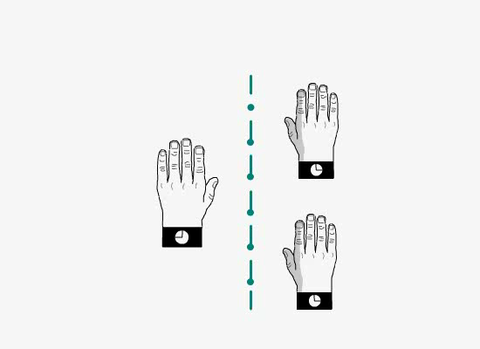
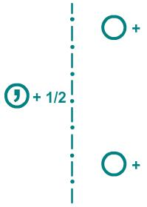
n-glides
The reflection plane is perpendicular to the page.
Translation is half along a, half along c.
The left hand is reflected across the glide plane.
The reflection translates along a by 1/2 unit, then along c by 1/2 unit.

Slide 63


Inversion Center
The center of inversion is a point.
The right and left hands in this position have an inversion center. Each finger is in opposition

Slide 64
Diagrams of Equivalent General Positions
Suppose the unit cell (ab projection) is lying horizontally on table
The height of the position indicated on a projection are the
coordinate along the z-axis.
The symbol + means a distance z in an upward direction
The symbol – means the same distance in a downward direction
Symbol indicating position occupied by right handed molecule
,
Symbol indicating position occupied by left handed molecule
Mirror plane of symmetry parallel to the plane of projection; where the position superposed.
─
+

Slide 65
Space Group
Internal and external symmetry elements
a2
a1
a
a
Two operation of mirror symmetry bring back object to the original position.
Two successive glide operation moves the object to next unit cell.
Similar is the case of screw operations.
Successive operation of internal symmetry elements on any object gives rise to an extended pattern.
Whereas successive operation of external symmetry elements on any object gives rise to limited number of objects and therefore do not lead to an extended pattern: an object is repeated inside the same unit cell as a result of repeated operations of external symmetry elements.

Slide 66


Packing Polymorph
Paracetamol
Orthorhombic (Pbca)
Monoclinic(P2₁/c)
J. Pharm. Sci., 1983, 72, 232

Slide 67
Space Group
We know that the external symmetry elements such as rotation, refection and mirror gives rise to 32 point groups.
The combination of these symmetries with lattice translation including glide line gives rise to extended pattern in 2D led to 17 plane groups.
All possible symmetry combination which an extended pattern such as crystal can have, may be obtained by self consistent combination of all the symmetry elements including screw axis and glide planes and their repetitions by the space lattice translation in 3D. Total 230 combinations called space groups.

Slide 68
32 point groups
System | Class |  | Symmetry Clements
 | H-B | Schon-flies
Triclinic | 1 1(bar) | C₁ C_{i} | E E i
Monoclinic | m 2 2/m | C_{s} C₂ C_{2h} | E σ_{h} E C₂ E C₂ σ_{h}
Orthorhombic | 2mm 222 mmm | C_{2v} D₂ D_{2h} | E C₂ σ’_{V} σ”_{V} E C₂ C’₂ C”₂ E C₂ C’₂ C”₂ i σ_{h} σ’_{V} σ”_{V}
Tetragonal | 4 4(bar) 4/m 4mm 4(bar)2m 422 4/mmm | C₄ S₄ C_{4h} C_{4v} D_{2d} D₄ D_{4h} | E C₄ C₂ E S₄ C₂ E C₄ C₂ i 2S₄ σ_{h} E C₄ C₂ 2σ’_{V} 2σ_{d} E C₂ C’₂ C”₂ 2σ_{d} 2S₄ E C₄ C₂ 2C’₂ 2C”₂ E C₄ C₂ 2C’₂ 2C”₂ i 2S₄ σ_{h} 2σ’_{V} 2σ_{h}

Slide 69
32 point groups
System | Class |  | Symmetry Clements
 | H-B | Schon-flies
Trigonal (rhombohedral) | 3 3(bar) 3m 32 3(bar)m | C₃ S₆ C_{3v} D₃ D_{3d} | E C₃ E C₃ i 2S₄ E C₃ 3σ_{V} E C₃ 3C₂ E C₃ 3C₂ i 2S₆ 3σ_{d}
Hexagonal | 6 6(bar) 6/m 6(bar)m2 6mm 622 6/mmm | C₆ C_{3h} C_{6h} D_{3h} C_{6v} D₆ D_{6h} | E C₆ 2C₃ C₂ E C₃ σ_{h} 2S₃ E C₆ 2C₃ C₂ i 2S₃ 2S₆ σ_{h} E C₃ 3C₂ σ_{h} 2S₃ 3σ_{V} E C₆ 2C₃ C₂ 3σ_{V} 3σ_{d} E C₆ 2C₃ C₂ 3C’₂ 3C”₂ E C₆ 2C₃ C₂ 3C’₂ 3C”₂ i 2S₃ 2S₆ σ_{h} 3σ_{d} 3σ_{v}
Cubic | 23 m3 4(bar)3m 432 m3m | T T_{h} T_{d} O O_{h} | E C₃ 4C²₃ 3C₂ E C₃ 4C²₃ 3C₂ i 8S₆ 3σ_{h} E C₃ 3C₂ 6σ_{d} 6S₄ E C₃ 3C₂ 6C’₂ 6C₄ E C₃ 3C₂ 6C₂ 6C₄ i 8S₆ 3σ_{h} 6σ_{d} 6S₄

Slide 70

Bravais Lattices
7 Crystal System
14 Bravais Lattices

Slide 71
Derivation of Space Group
Total seven crystal system; one crystal system at a time.
A particular system has definite number of point groups, e.g. monoclinic system has 2, m and 2/m.
Combination of screw axis and glide planes with the point group symmetries in monoclinic system gives rise to 2, 2₁, m, c, 2/m, 2₁/m, 2/c, 2₁/c symmetry group (y-axis as unique axis).
Each of the symmetry groups thus obtained has to be repeated by lattice translations of the Bravais lattices of that crystal systems. In case of monoclinic system P and C lattices. All the above symmetries will be associated with both P and C lattice translations.
There are total 13 space groups in monoclinic systems; Pm, Pc, Cm, Cc, P2, P2_{1,} C2, P2/m, P2₁/m, C2/m, P2/c, P2₁/c, C2/c…
Similarly space groups for other systems can be worked out.

Slide 72

Space group
Triclinic
Primitive Triclinic
In the triclinic system, a ≠ b ≠ c; α ≠ β ≠ γ ≠ 90º. Triclinic crystals either have only 1 symmetry (a 360° rotation, crystal class 1) or possess a center of inversion (crystal class ).

Slide 73
We’ll start by adding the translations component, and recording the unique set of symmetry position(s) generated for a single atom.
Then we can deduce the number of such atoms within unit cell and we will denote this number as Z. Beside the number of symmetry related atoms, we’ll list their positions.
At a time after all the unique atoms within the cell have been generated we’ll draw a box around the “General Position”, the set within the unit cell equivalent by symmetry.
The General Position thus contains a certain number of equivalent points per cell; the number is referred to as Z. We will also say that the multiplicity (the number) of the General Position is Z.

Slide 74
In the International tables for X-ray Crystallography, Volume A. section 2.11, the term "General Position" is defined as follows:
A set of symmetrically equivalent points...is said to be in 'general position' if each of its points is left invariant only by the identity operation but by no other symmetry operation of the space group. Each space group has only one general position.

Slide 75
Our first example is space group No. 1, P1 – the symbol informs us that we have a primitive lattice, and only “1” symmetry.
A number, n, as a symmetry element in Hermann-Mauguin notation (used throughout the tutorial) refers to a rotation by 360/n degrees. Thus 1 refers to a 360° rotation.
We will consider the effect of symmetry on a molecule or group located at a “general position” in the unit cell, with coordinates (+x, +y, +z).

Slide 76
a
c
+
+
+
+
Z=1;

Slide 77
So, we’ve got one molecule per unit cell (Z = 1).
Let’s consider some properties of space groups
A space group that may contain molecules of one hand only is referred to as “Enantiomorphous”.
A space group that MUST contain pairs of enantiomers is referred to as “Non-enantiomorphous”.
A space group that contains a center of symmetry is referred to as “Centrosymmetric”; if there is no center of symmetry, it is called “Non-centrosymmetric”.
Which two phrases describe the properties of handedness and centrosymmetry for P1?

Slide 78
a
c
+
+
+
+
Z=1;
Enantiomorphous
Non-centrosymmetric

Slide 79
Note that there are "halfway marks" on each unit cell , a visual guide:
Now, let's review some of the jargon introduced earlier:
a
c
Reference atom
+
+
An equivalent position
Gridline for c/2
Prefix
+
+
Gridline for a/2
Number of equivalent positions contained within one unit cell
In this area we'll list the set of equivalent points belonging to the general position
Z=1;

Slide 80
a
,
,
c
-
-
Symbol: = -1= inversion center
+
+
,
,
-
-
+
+
Z=2;
Is this space group enantiomorphous or non-enantiomorphous?
Non-enantiomorphous

Slide 81
a
,
,
c
-
-
+
+
,
,
-
-
+
+
Z=2;
Is this space group centrosymmetric or non-centrosymmetric?
Centrosymmetric

Slide 82
a
,
,
c
-
-
Z=2;
+
+
,
,
-
-
+
+
Note that there are two molecules per unit cell, and that other centers of symmetry (at a/2, b/2, c/2 and combinations thereof) were generated as we added atoms or groups.
It turns out that there are eight centers of symmetry: where are they?
(0, 0, 0) ; (½, 0, 0); (0, 0, ½); (½, 0, ½);
(0, ½, 0); (½, ½, 0); (0, ½, ½); (½, ½, ½)

Slide 83
We are now ready to move to the monoclinic system. There are 13 monoclinic space groups.
Monoclinic crystals belong to crystal classes 2, m or 2/m. In this section we’ll consider space groups P2, C2, and P2₁.
We’ll start with space group P2, No. 3. In this case we have a primitive monoclinic unit, with a twofold axis.

Slide 84


In the monoclinic system, a ≠ b ≠ c; α = γ = 90º, and β ≠ 90º. The b axis is perpendicular to a and c, and we thus call it the unique axis.
It is only possible to place a 2 along the b axis, and only possible to place a mirror plane (m) perpendicular to the b axis.

Slide 85
a
c
+
+
+
+
+
+
+
+
Z=2;

Slide 86
a
c
+
+
+
+
+
+
+
+
Z=2;

Slide 87
a
c
+
+
+
+
+
+
+
+
Z=2;
Is this group enantiomorphous or non-enantiomorphous?
Enantiomorphous

Slide 88
a
c
+
+
+
+
+
+
+
+
Z=2;
Is this group centrosymmetric or non-centrosymmetric?
Non-centrosymmetric

Slide 89
a
c
+
+
Z=2;
+
+
+
+
+
+
Note that there are two molecules per unit cell, and that other 2-fold rotation axes were generated at a/2 and b/2 as we added atoms or groups.
It turns out that there are four independent rotation axes: where are they?
(0, y, 0); (0, y, ½); (½, y, 0); (½, y, ½)
Note that (0, y, 0);… represents a line rather than a point!

Slide 90
a
c
+
+
+
+
+
+
+
+
These four independent twofold rotation axes correspond to the four separate special positions for P2, each with a multiplicity (M_{sp}) of 1
M_{sp} Coordinates
1 | (0, y, 0) | (0, y, ½) | (½, y, 0) | (½, y, ½)

Slide 91
The term "Special Position“ is defined as follows:
A set of symmetrically equivalent points...is said to be in 'special position' if each of its points is mapped onto itself by at least one further symmetry operation of the space group.
Each of the four twofold axes corresponds to a special position in P2.
Recall that special positions always correspond to a point group symmetry element, i. e. a rotation axis, reflection, inversion or rotary inversion axis. A special position always has reduced multiplicity compared to the general position.

Slide 92

a
½
+
c
+
½
+
+
+
+
½
½
+
+
Z=2;
Is this group enantiomorphous or non-enantiomorphous?
Enantiomorphous

Slide 93
a
½
+
c
+
½
+
+
+
+
½
½
+
+
Z=2;
Is this group centrosymmetric or non-centrosymmetric?
Non-centrosymmetric

Slide 94
The next space group is C2, number 5. The rotational symmetry is just as you saw in the previous rendering of P2. But here the difference is in the lattice type. The “C” refers to C-centering, i.e., centering on the crystal ab face; recall that the C-centering operation involves a (½, ½, 0)+ translation applied to all primitive lattice points.
For each general position at x, y, z there will be an equivalent atom at ½+x, ½+y, z as a result of C-centering. Let us choose origin on 2-fold axis and will operate 2[0y0] on the above positions one gets

Slide 95
a
c
+
½
+
+
+
½
+
+
+
½
+
+
+
½
+
+
Z=4;
Is this group enantiomorphous or non-enantiomorphous?
Enantiomorphous

Slide 96
a
c
+
½
+
+
+
½
+
+
+
½
+
+
+
½
+
+
Z=4;
Is this group centrosymmetric or non-centrosymmetric?
Non-centrosymmetric

Slide 97


Slide 98


