Slide 1
Space filling repeat patterns
Only 2, 3, 4 and 6-fold rotations can produce space filling patterns

Slide 2
The four types of rotation axes shown along with the 1 fold axis, are the only rotation axes possible for a 2D and 3D lattice.
The periodicity (i.e. operation of translation) will impose
rotational symmetry to a lattice.
mt
s
s
P’
Q’
α
α
t
t
α
α
t
P
t
Q
t
If P and Q are lattice points. If the lattice possesses a rotation
of α angle, the resulting P’ and Q’ are also lattice points.
D_{P’Q’} = mt = t + 2s = t + 2tcos α
(m must be an integer).

Slide 3
D_{P’Q’} = mt = t + 2t cosα (m must be an integer).
(m-1)t = 2t cosα ➔
cos α = (m-1)/2
m must fall in the range of 3 to -1, since -1 ≤ cosα ≤ 1 :
m α n-fold rotation
3 360 º 1 (one-fold)
2 60 º 6 (six-fold)
1 90 º 4 (four-fold)
0 120 º 3 (three-fold)
-1 180 º 2 (two-fold)
In all 2D and 3D lattices, only five kinds of rotation angles are allowed.
No five-fold and higher than 6-fold rotation axes allowed in 2D and 3D lattice.
All 2D lattice contain at least 2-fold axis (not true for 3D lattice)

Slide 4
Combining symmetry operations
An object can possess several symmetry elements.
Not all symmetry elements can be combined arbitrarily
- for example, two perpendicular two-fold axes imply the existence of a third perpendicular two-fold.
Translational symmetry in 3D imposes limitations
- only 2, 3, 4 and 6-fold rotation axes allow for space filling
translational symmetry
The allowed combinations of symmetry elements are called point groups
- there are 32 point groups that give rise to periodicity in 3D
Show 3D repeat pattern
Contain symmetry elements
32 point groups exist

Slide 5
32 point groups
System | Class |  | Symmetry Clements
 | H-B | Schon-flies
Triclinic | 1 1(bar) | C₁ C_{i} | E E i
Monoclinic | m 2 2/m | C_{s} C₂ C_{2h} | E σ_{h} E C₂ E C₂ σ_{h}
Orthorhombic | 2mm 222 mmm | C_{2v} D₂ D_{2h} | E C₂ σ’_{V} σ”_{V} E C₂ C’₂ C”₂ E C₂ C’₂ C”₂ i σ_{h} σ’_{V} σ”_{V}
Tetragonal | 4 4(bar) 4/m 4mm 4(bar)2m 422 4/mmm | C₄ S₄ C_{4h} C_{4v} D_{2d} D₄ D_{4h} | E C₄ C₂ E S₄ C₂ E C₄ C₂ i 2S₄ σ_{h} E C₄ C₂ 2σ’_{V} 2σ_{d} E C₂ C’₂ C”₂ 2σ_{d} 2S₄ E C₄ C₂ 2C’₂ 2C”₂ E C₄ C₂ 2C’₂ 2C”₂ i 2S₄ σ_{h} 2σ’_{V} 2σ_{h}

Slide 6
32 point groups
System | Class |  | Symmetry Clements
 | H-B | Schon-flies
Trigonal (rhombohedral) | 3 3(bar) 3m 32 3(bar)m | C₃ S₆ C_{3v} D₃ D_{3d} | E C₃ E C₃ i 2S₄ E C₃ 3σ_{V} E C₃ 3C₂ E C₃ 3C₂ i 2S₆ 3σ_{d}
Hexagonal | 6 6(bar) 6/m 6(bar)m2 6mm 622 6/mmm | C₆ C_{3h} C_{6h} D_{3h} C_{6v} D₆ D_{6h} | E C₆ 2C₃ C₂ E C₃ σ_{h} 2S₃ E C₆ 2C₃ C₂ i 2S₃ 2S₆ σ_{h} E C₃ 3C₂ σ_{h} 2S₃ 3σ_{V} E C₆ 2C₃ C₂ 3σ_{V} 3σ_{d} E C₆ 2C₃ C₂ 3C’₂ 3C”₂ E C₆ 2C₃ C₂ 3C’₂ 3C”₂ i 2S₃ 2S₆ σ_{h} 3σ_{d} 3σ_{v}
Cubic | 23 m3 4(bar)3m 432 m3m | T T_{h} T_{d} O O_{h} | E C₃ 4C²₃ 3C₂ E C₃ 4C²₃ 3C₂ i 8S₆ 3σ_{h} E C₃ 3C₂ 6σ_{d} 6S₄ E C₃ 3C₂ 6C’₂ 6C₄ E C₃ 3C₂ 6C₂ 6C₄ i 8S₆ 3σ_{h} 6σ_{d} 6S₄

Slide 7
The Hermann-Mauguin (H-M) Notation
The addition of translation components into the point groups symmetry created space groups.
Schonflies notation for the space group symmetry are complex.
He added superscripts to the point group to denote space groups.
Because of this Hermann and Mauguin developed an alternating system to symbolize space group symmetry.
Schonflies Notations | Hermann-Mauguin Notations | Schonflies Notations | Hermann-Mauguin Notations
C₁ | 1 | σ_{h} | n/m
C₂ | 2 | σ_{v} | nm
C₃ | 3 | i | 1 (bar) or (bar) 1
C₄ | 4
C₆ | 6

Slide 8

The Hermann-Mauguin Notation
The most significant difference between the two scheme is the lack of roto-reflection axes in H-M system.
Instead, roto-inversion axis are used.
A roto-inversion axis consists of a rotation axis containing a center of inversion.
A roto-inversion operation about an n-fold roto-inversion axis involve a k. 2π/n rotation (k = 1, 2, 3…..n) followed by an inversion.
The symbol for roto-inversion axis is the integer corresponding to the rotation axis with a bar over the number

Slide 9
Rotoinversion-axis
Rotoinversion (1, 2, 3, 4, 6) – combination of rotation and inversion. Called bar-1, bar-2, etc.
1,2,6 equivalent to other functions

Slide 10
4-fold rotoinversion axis (4)

Slide 11
4-fold rotoinversion axis (4)
1. Rotate by 360/4

Slide 12
4-fold rotoinversion axis (4)
2. Invert

Slide 13
4-fold rotoinversion axis (4)
2. Invert

Slide 14
4-fold rotoinversion axis (4)
3. Rotate by 360/4

Slide 15
4-fold rotoinversion axis (4)
4. Invert

Slide 16
4-fold rotoinversion axis (4)
3. rotation by360/4 4. Invert

Slide 17
4-fold rotoinversion axis (4)
5. Rotate by 360/4

Slide 18
4-fold rotoinversion axis (4)
5. rotation by360/4 6. Invert

Slide 19
4-fold rotoinversion axis (4)
This is also a unique operation

Slide 20
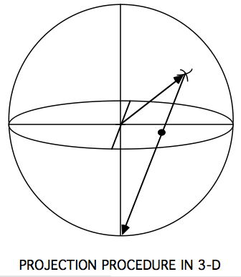
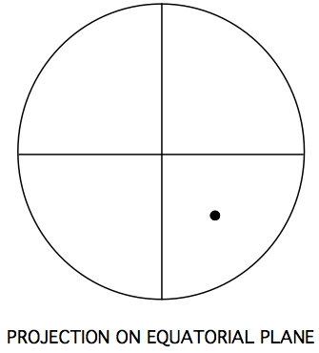
Stereographic projections
Show or represent 3-D object in 2-D
Procedure:
Place object at center of sphere
From sphere center, draw line representing some feature of object out to intersect sphere
S
Connect point to N or S pole of
sphere. Where sphere passes
through equatorial circle, mark
projected point
Show equatorial circle in 2-D –
this is stereographic projection

Slide 21
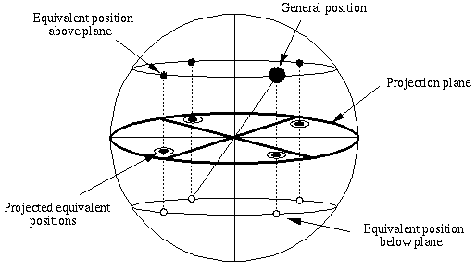
Stereographic Projection & Point Group

Slide 22
Representation of crystallographic point groups
The stereographic projection is plotted on the equatorial great circle in the xy plane.
The plot is referred to as stereogram
The point of intersection of above the plane are drawn with a filled circle and those below the plane are drawn with open circle.
The equatorial circle is drawn with dash line unless it is coplanar with the mirror plane.
In that case circle is drawn with a solid line to indicate the presence of the mirror
The axis of highest symmetry is selected as z-axis

Slide 23
Representation of crystallographic point groups
The order of the axis is indicated by a symbol (e.g. a 3-fold axis is represented by a triangle).
The x and y axes are indicated with light dash horizontal and vertical lines respectively.
Vertical mirror planes are shown as a bold solid lines corresponding to the diameter of the circle.
The x-axis is the reference axis of rotation
Thus whenever there are mirror planes containing the z-axis, at least one of these symmetry element will be coincident with the x axis.

Slide 24
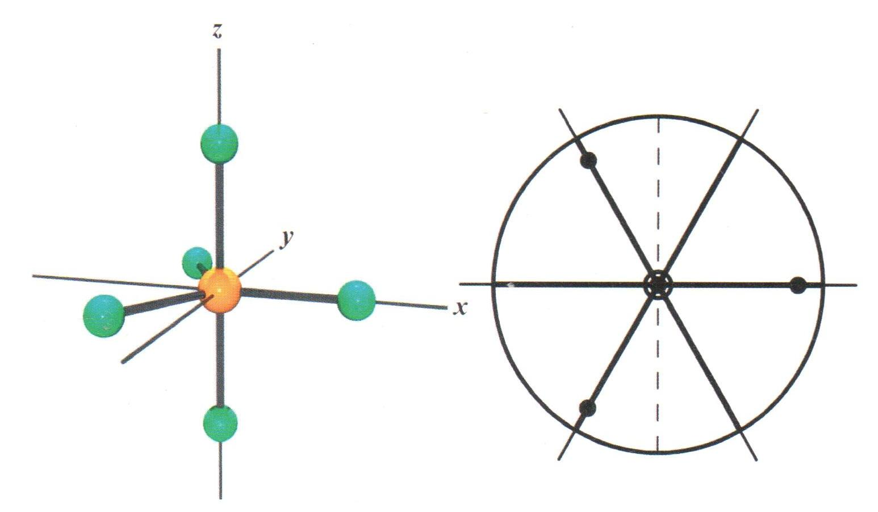
PF₅ molecule in orthonormal coordinate system and
its stereographic projection
The three dots in the plane illustrate 3-fold axis.
The axial point above the plane is shown as projected dot, and the point below the plane as a projected ring.
The heavier lines indicate vertical mirror planes, the lighter lines extending beyond the perimeter are the two-fold axes, and the solid circle indicates the horizontal mirror plane.
The dash (----) line is reference line for the y-axis.

Slide 25
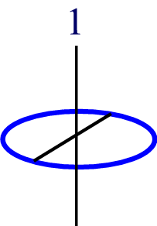
Representation of rotation axis on stereogram
Types of pure rotation symmetry
    Rotation 1, 2, 3, 4, 6
    Rotoinversion 1 (= i), 2 (= m), 3, 4, 6
Monad axis, 1 ≡ C₁

Slide 26
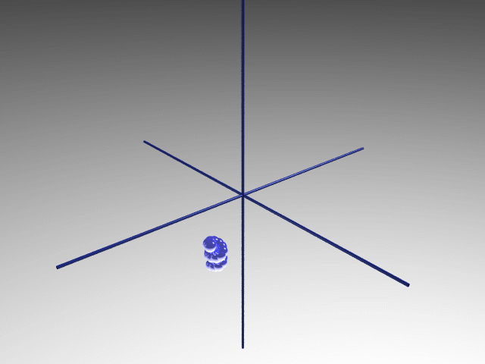
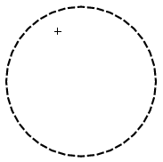
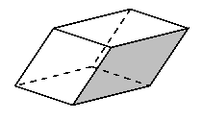
One-fold rotation (rotation by 360°)
1

Slide 27
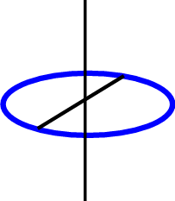
2
    Rotation 1, 2, 3, 4, 6
    Rotoinversion 1 (= i), 2 (= m), 3, 4, 6
diad axis, 2 ≡ C₂
Draw point group diagrams (stereographic projections)
symmetry elements equivalent points

Slide 28

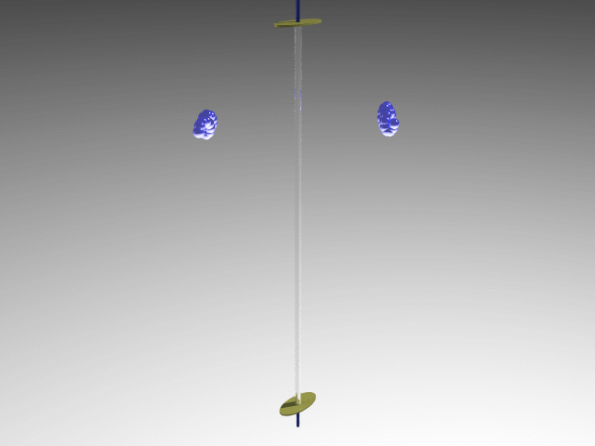
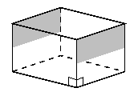

2

Slide 29
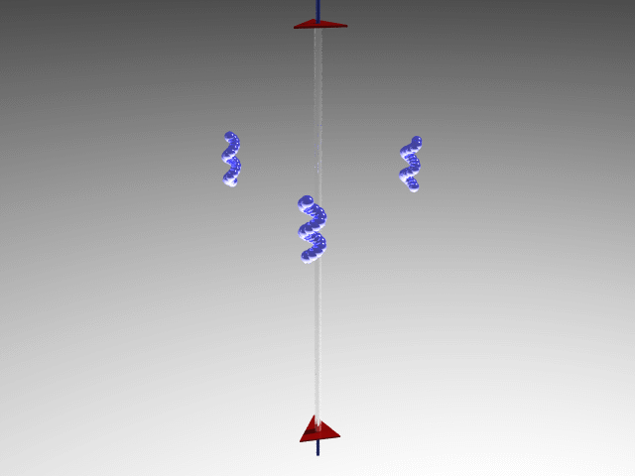
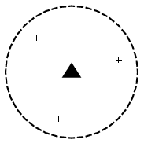
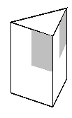
3
triad axis, 3 ≡ C₃
3

Slide 30
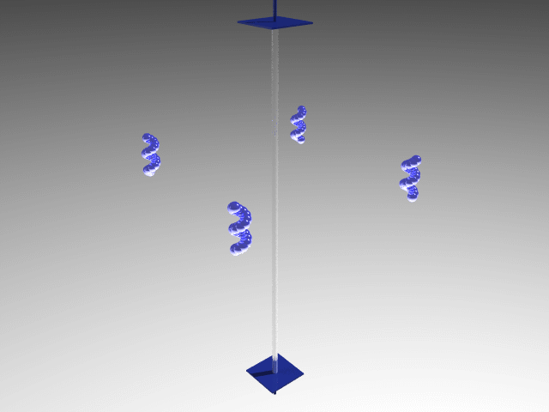
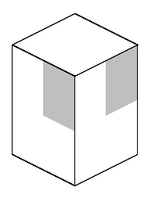
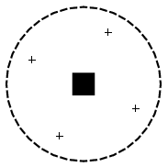
4
tetrad axis, 4 ≡ C₄
4

Slide 31
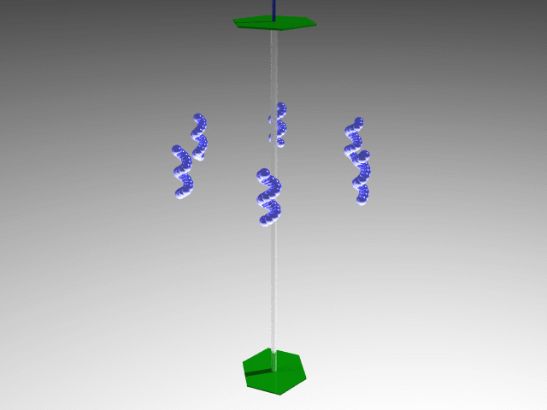
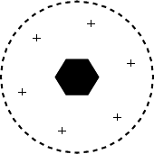
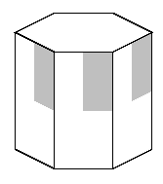
6
hexad axis, 6 ≡ C₆
6

Slide 32
1
    Rotation 1, 2, 3, 4, 6
    Rotoinversion 1 (= i), 2 (= m), 3, 4, 6
1 ≡ S₂ ≡ i
Draw point group diagrams (stereographic projections)
symmetry elements equivalent points

Slide 33
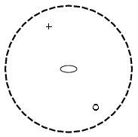
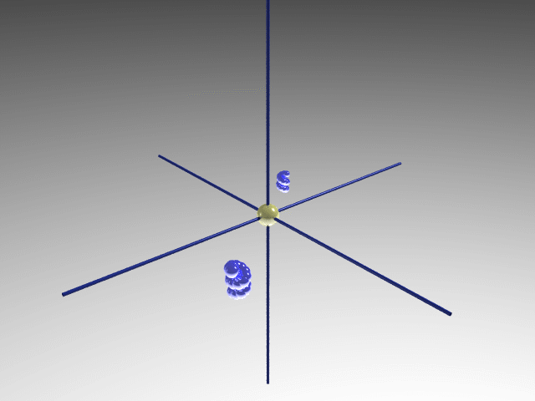
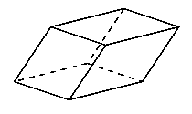
_
1

Slide 34
2
    Rotation 1, 2, 3, 4, 6
    Rotoinversion 1 (= i), 2 (= m), 3, 4, 6
2 ≡ S₁ ≡ m
Draw point group diagrams (stereographic projections)
symmetry elements equivalent points

Slide 35
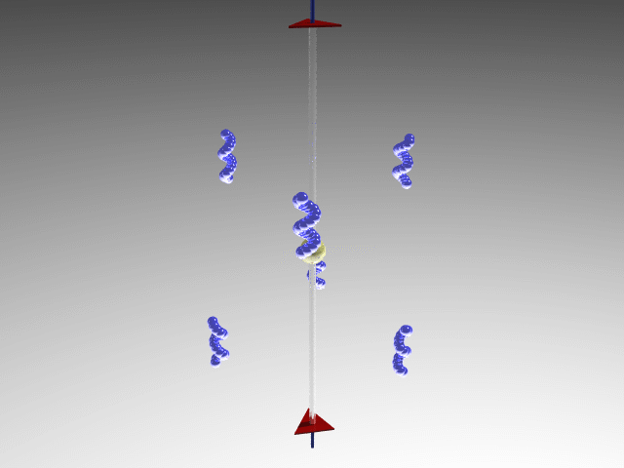

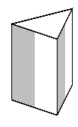
3
+
+
3 ≡ S₆
+
_
3

Slide 36
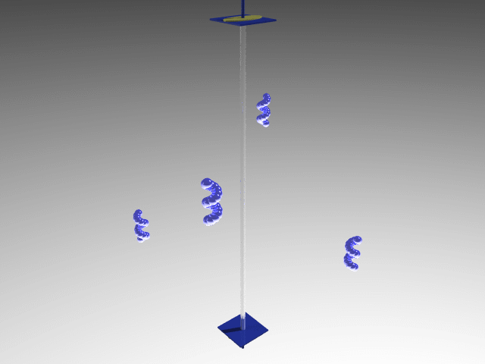
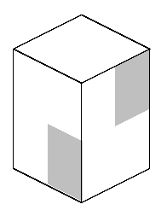
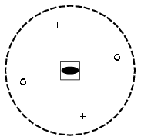
4
The diad axis also exists as a consequence of the 4-fold rotoinversion; the 4(bar) axis is therefore represented by a combination of symbol for the tetrad and diad rotation axes.
This is general property of n(bar) axes when n is even number
4 ≡ S₄
_
4

Slide 37
6
6 ≡ S₃ ≡ 3/m
The 6(bar) axis is represented by a combination of triad and hexad axial symbols.
The 6-fold rotoinversion axis generate a horizontal mirror plane in addition to the triad axis so that
6(bar) = 3/m.

Slide 38
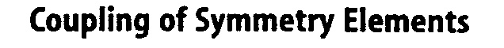
Combination of inversion and rotation
1 2 3 4 6
n + i
1 2 3 4 6
i
m
Ten basic symmetry elements in crystals

Slide 39
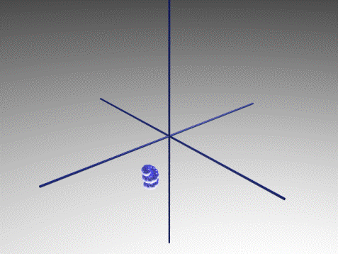
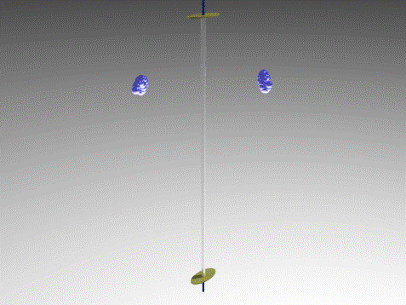
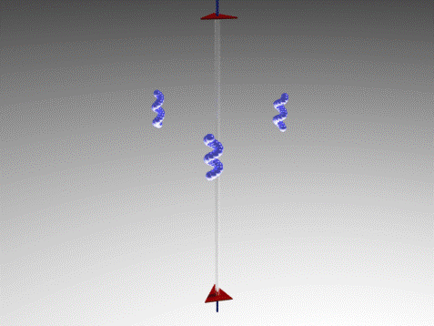
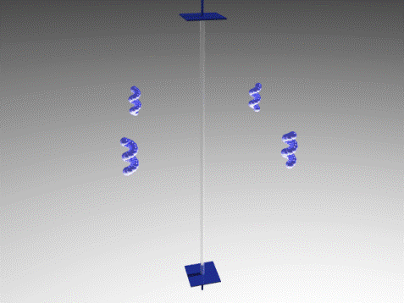
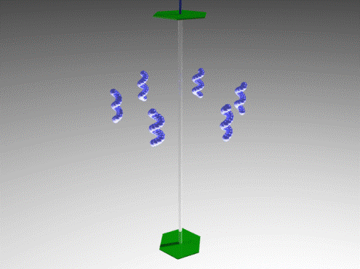
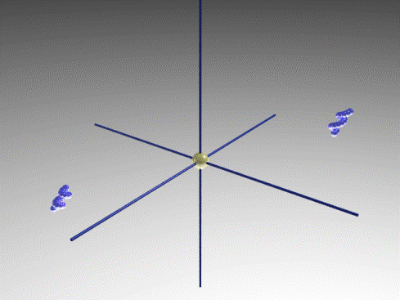
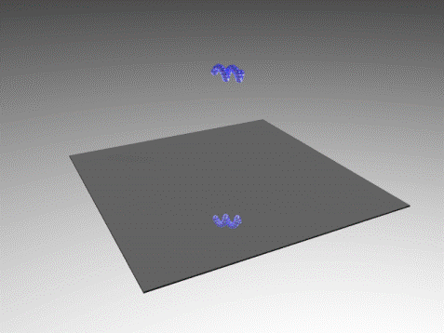
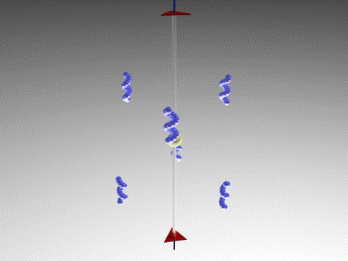
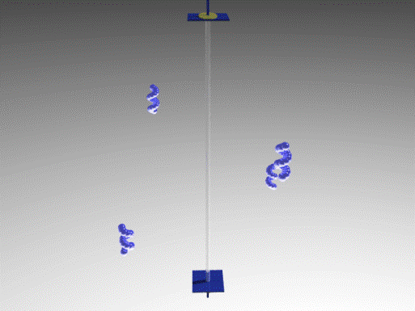
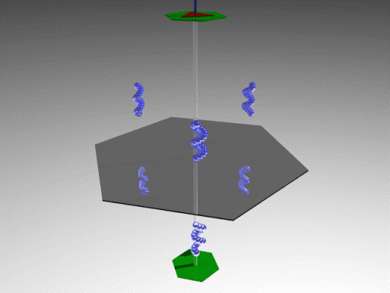

Slide 40
Combination of symmetry elements
There are total 10 symmetry elements available to the crystal lattice.
Their random combination will produce very large number of crystal symmetries.
However only certain combination of these symmetry elements are possible as their corresponding symmetry operation do not constitute a point group.
Because of this the combination of certain symmetry elements will generate other symmetry elements.
The relationships are………

Slide 41
Representation of crystallographic point groups
The intersection of two mirror planes is a rotation axis.
If the dihedral angle between the two mirror plane is 2π/n, then the axis is an n-fold axis. Let us examine the case of n=3.

Slide 42
Representation of crystallographic point groups
If a mirror plane contains an n-fold axis, then there are n-1 additional mirror planes which also contains the axis.
This is converse of previous relationship
The original mirror plane combined with 3-fold rotation axis generates the stereogram as shown. The triad axis has created additional two mirror planes.

Slide 43
Representation of crystallographic point groups
If a there are two intersecting diad axes with an angle 2π/n between them, then there must be an n-fold axis perpendicular to both of the diad axes.
This creates triad axis perpendicular to the two diad axes with an inter axial angle between the diads of 2π/3.

Slide 44
Representation of crystallographic point groups
If there is an n-fold axis intersecting a perpendicular diad axis, then there are n-1 additional diad axes, separated from one another by angle of 2π/n.
This is converse of the third relationship
If the diad axis is perpendicular to the triad axis, then two more diad axes will be generated by the triad axis.

