Slide 1
X-ray Diffraction and Structure of Solids

Slide 2
Course Goals
To develop an understanding of basic crystallographic concepts
-Helpful for determining a crystal structure on our own
To be able to interpret the crystallographic data in publications
-What do the data mean?
To gain an appreciation of the steps involved in a crystal structure determination
-Enables you to interact with the “black box” if default settings don’t lead to a solution

Slide 3
So our objectives are……
To understand the principles governing the build up of crystal, types of unit cells and modes of packing.
Understand the relation between unit cell, crystal dimensions and symmetry.
Visualize the link between crystal structure and symmetry. Exploiting the diffraction of the X-ray as a tool for determination of crystal structure and studying the structures of solids.

Slide 4
Course contents………
Introduction: Some Historical Background
Crystal Lattices
(a) solid state
(b) crystalline state
(c) vectors in crystallography
(d) matrices in crystallography
(e) coordinate systems in crystallography
Crystal Symmetry
(a) symmetry concept
(b) symmetry group theory
(c) 2D and 3D point groups, Laue groups
(d) space groups

Slide 5
Course contents………
4. Close Packed Structures, Miller Indices and Reciprocal Lattice
Physical Properties of Crystals
X-rays: Origin, Properties
X-ray Diffraction & Bragg’s Law
Ewald Sphere
X-ray Diffraction Techniques
Single Crystal Techniques
Fourier Transforms (real vs reciprocal space)
Scattering of X-rays by Crystals

Slide 6
Course contents……..
The atomic structure factor
The structure factor (X-ray diffraction, elecyron diffraction, neutraction)
The Friedel’s Law
Systematic Absences
Practical determination of space groups
Data reduction
Lorentz-Polarizaion corrections
Interpretation of intensity data
Theory of structure factors and Fourier synthesis
The phase problem

Slide 7
Course contents……..
Crystal Structure Solution: Experimental
(a) Patterson method with and without heavy atom
(b) Search Method
(c) The isomorphous replacement method
(d) The anomolous dispersion method
Crystal Structure Solution: Statistical Methods
(a) Direct Method
(b) Maximum Entropy
Crystal Structure Refinement
Estimated standard deviation and R value

Slide 8
Course contents……..
Introduction to PXRD
Conformation
Atomic and Molecular Displacements
Charility and Absolute Structure
Packing in Crystals
Exploring Structure with CSD
Crystal Growing Methods
Crystal selection to structure refinement (Training)
CIF preparation and cifcheck and CIF deposition

Slide 9
Reference Books
1) Crystal Structure Analysis for Chemist and Biologists
J. P. Glusker, M. Lewis and M. Rossi
2) X-ray Structure Determination- A Practical Guide
George H. Stout and Lyle H. Jensen
3) Fundamentals of Crystallography
Editor: Carmelo Giacovazzo
4) Crystallography for Solid-State Physics
A. R. Verma and O. N. Srivastava
5) Crystal Structure Analysis: Principle and Practice
W. Clegg, A. J. Blake, J. M. Cole, J. S. O. Evans and P. Main
6) Crystallography Made Crystal Clear
Gale Rhodes

Slide 10
Crystallography – what & why?
What?
- Extraction of structural information from X-ray diffraction data
- Determination of the molecular structure of crystalline solids
- Location and type of atoms, bond distances/local environment
Absolute structure
Understanding Molecular Psychology
is the science of the structure of crystals; it includes
the ways of describing the structure of a crystal
the atomic and molecular arrangement in 3D
the methods by which structures are determined

Slide 11
Crystallography – what & why?
Why?
Materials’ properties are intimately related to their structures
Understanding certain properties requires knowledge of atomic arrangement, e.g. piezoelectrics, polarization, optical activity
Can be applied to both single crystals (small and big molecules) and in some cases powders
This technique is essential for chemists today for knowledge of accurate molecular structure, which is essential for structure based functional studies to aid in the development of effective materials.
Impact of crystallography can be seen in the large number of Nobel Prizes for work related to crystallography or diffraction

Slide 12
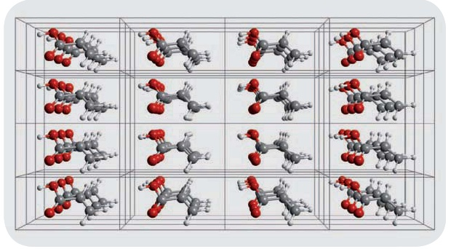
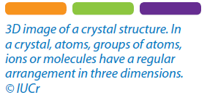
Crystallography Matters

Slide 13
Polymorphism
The ability of a compound to exist in more than one crystal form i.e. different molecular arrangements in the crystal lattice.
Packing Polymorph
Conformational Polymorph

Slide 14
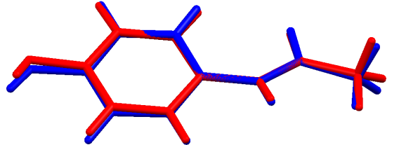
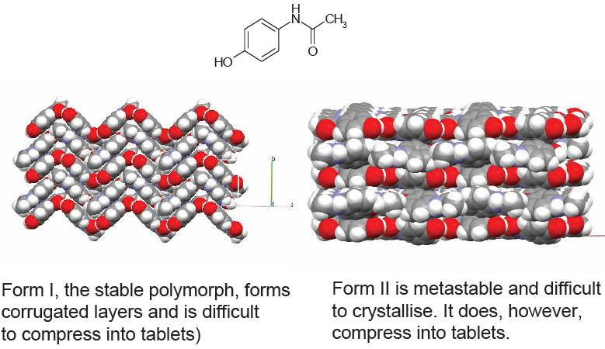
Packing Polymorph
Paracetamol
Orthorhombic (Pbca)
Monoclinic(P2₁/c)
J. Pharm. Sci., 1983, 72, 232

Slide 15
Conformational Polymorph
Ritonavir
Form I
Form II
Morris, J. et al. Pharmaceutical Research,
Vol. 18, No. 6, 2001

Slide 16
Difference in Molecular Arrangements
Form I
Form II

Slide 17



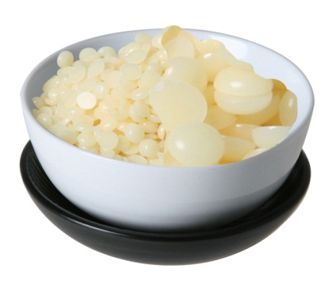

In Chocolates:
Cocoa butter - The main ingredient of chocolate.
Six Polymorphs of Cocoa Butter
The fats in cocoa butter can crystallize in six different forms. The six different crystal forms have different properties.

Slide 18
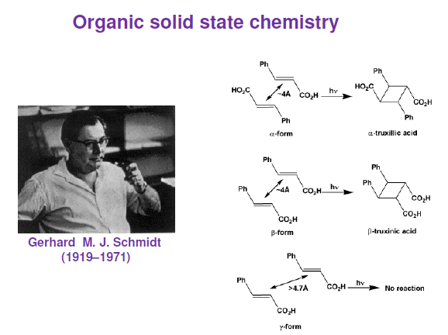

Slide 19
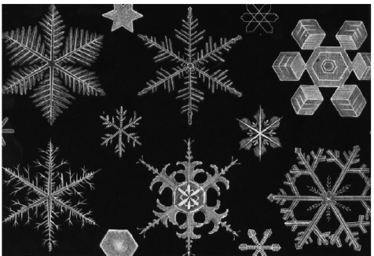
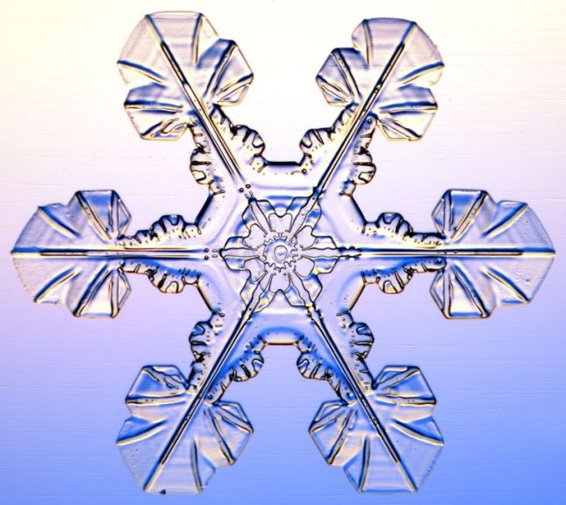
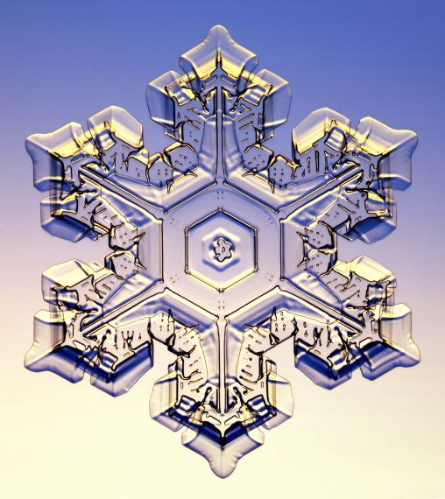
Early thoughts about crystals
Symmetry
Crystals are solid - but solids are not necessarily crystalline.
Crystals have symmetry (Kepler,1611) and long range order.
- First speculation on the nature of six-fold symmetry of snowflakes based on the observation that small ice spheres can produce a regular polygon.

Slide 20
Group discussion
Kepler wondered why snowflakes have 6 corners, never 5 or 7. By considering the packing of polygons in 2 dimensions, demonstrate why pentagons and heptagons shouldn’t occur.
Empty space is not allowed

Slide 26
?
Empty space is not allowed

Slide 27
Empty space is not allowed

Slide 28
External Appearance of Crystals
Crystal faces: crystal usually bounded by a number of flat surfaces (faces).
Crystal edge: It is formed by intersection of two adjacent faces
Face
4 + 4 + 4 = 12 edge

Slide 29
External parts of crystal
Solid angle: It is formed by intersection of more than two adjacent faces
Interfacial Angle: It is angle between two adjacent faces.
More accurately it is angle locates between two verticals drawn to any two adjacent faces.
Interfacial
Angle
4 + 4 = 8 Solid angle
Interfacial Angle

Slide 30
Crystal Forms
Any grouping of crystal faces that are arranged in the same symmetry is referred to as a crystal's “Form”. There are approximately 48 unique crystal forms which are divided into either
Open Form
Closed Isometric Form or
Closed non-Isometric Form
Open Forms
The eighteen open-forms are those facet groupings that are related by symmetry, but do not completely enclose a volume of space. A crystal with open-form faces also requires some additional closed-form facets to complete a structure.

Slide 31
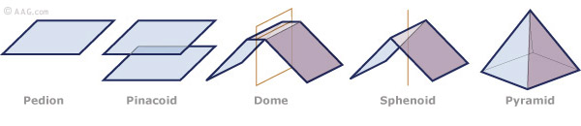
Crystal “Open” Forms
Flat face that is not parallel, or geometrically linked to any other faces
Two parallel faces, forming tabular crystals
Found in monoclinic and orthorhombic crystals
Have two-fold rotational axes
Multiple facets converge on a single crystallographic axis, and pyramid forms are not possible on minerals from the isometric, monoclinic or triclinic systems

Slide 32
A pedion is an open, one faced form. Pedions are the only forms that occur in the Pedial class (1). Since a pedion is not related to any other face by symmetry, each form symbol refers to a single face. For example the form {100} refers only to the face (100), and is different from the form { 100} which refers only to the face (100). Note that while forms in the Pedial class are pedions, pedions may occur in other crystal classes.
A Pinacoid is an open 2-faced form made up of two parallel faces. In the crystal drawing shown here the form {111} is a pinacoid and consists of two faces, (111) and (-1-1-1). The form {100} is also a pinacoid consisting of the two faces (100) and ( -100). Similarly the form {010} is a pinacoid consisting of the two faces (010) and (0-1 0), and the form {001} is a two faced form consisting of the faces (001) and (00-1). In this case, note that at least three of the above forms are necessary to completely enclose space. While all forms in the Pinacoid class are pinacoids, pinacoids may occur in other crystal classes as well.

Slide 33
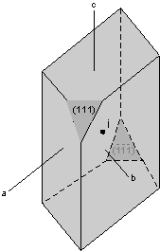
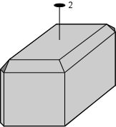
Sphenoids
Pinacoid

Slide 34
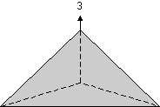

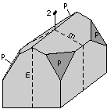
PyramidsA pyramid is a 3, 4, 6, 8 or 12 faced open form where all faces in the form meet, or could meet if extended, at a point.
Trigonal pyramid: 3-faced form where all faces are related by a 3-fold rotation axis.
Ditrigonal pyramid: 6-faced form where all faces are related by a 3-fold rotation axis. Note that if viewed from above, the ditrigonal pyramid would not have a hexagonal shape; its cross section would look more like that of the trigonal prism discussed above.
Rhombic pyramid: 4-faced form where the faces are related by mirror planes. In the drawing shown here the faces labeled "p" are the four faces of the rhombic pyramid. If extend, these 4 faces would meet at a point.

Slide 35
Tetragonal pyramid: 4-faced form where the faces are related by a 4 axis. In the drawing the small triangular faces that cut the corners represent the tetragonal pyramid. Note that if extended, these 4 faces would meet at a point.
Ditetragonal pyramid: 8-faced form where all faces are related by a 4 axis. In the drawing shown here, the upper 8 faces belong to the ditetragonal pyramid form. Note that the vertical faces belong to the ditetragonal prism.
Hexagonal pyramid: 6-faced form where all faces are related by a 6 axis. If viewed from above, the hexagonal pyramid would have a hexagonal shape.
Dihexagonal pyramid: 12-faced form where all faces are related by a 6-fold axis. This form results from mirror planes that are parallel to the 6-fold axis.

Slide 36
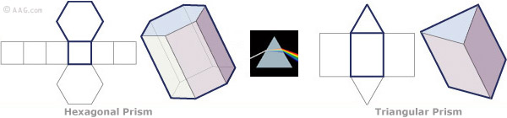
Open Hexagonal & Triangular Prisms
Prisms have a set of facets that run parallel to an axis of a crystal, yet never converge with it. Quartz forms two sets of three sided prisms. Prisms are not possible in isometric or triclinic minerals.
A Hexagonal prism is comprised of two hexagonal bases connected by a set of six rectangular faces that run parallel to, and never converge with an axes.
A triangular prism is comprised of two triangular bases connected by a set of three rectangular faces that run parallel to, and never converge with an axes in the crystal. This form is similar to a light-refracting 60º prism.

Slide 37
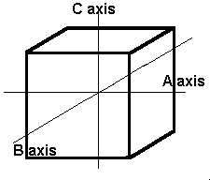
The Isometric System
The first and simplest crystal system is the isometric or cubic system. It has three axes, all of which are the same length. The three axes in the isometric system all intersect at 90º to each other. Because of the equality of the axes, minerals in the cubic system are singly refractive or isotropic.

Slide 38
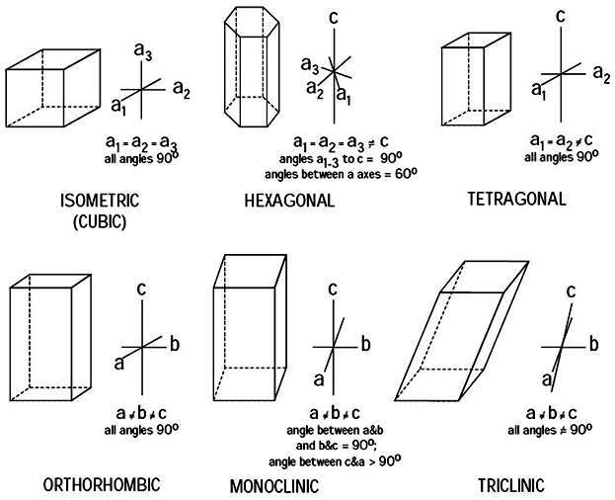

Slide 39
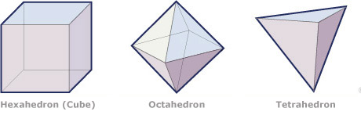
Close Isometric Forms
These forms include:
Hexahedron (Pyrite) Dodecahedron (Rhombic)
Octahedron (Diamond, Spinel) Hexoctahedron (Diamond)
Tetrahedron (Tetrahedrite)
A hexahedron (cube) has eight points, six faces, and twelve edges that are perpendicular to each other, forming 90 degree angles.
An octahedron has two four sided pyramids lying base to base, and is totally symmetrical with no top, or bottom and has eight faces.
A tetrahedron has four equilateral triangular faces.

Slide 40
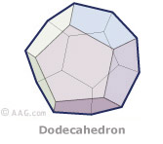
Close Isometric Forms
Continued
A dodecahedron has 12 faces and there are four types of dodecahedrons listed in order of descending symmetry:
Symmetrical pentagonal (five edged polygons) dodecahedrons,
Asymmetrical (tetartoid) pentagonal dodecahedrons,
Delta (four edged polygons) dodecahedrons, and
Rhombic dodecahedrons. A Hexoctahedron is a multi-faceted dodecahedron with 48 triangular faces.

Slide 41
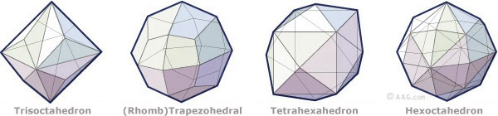
Closed non-Isometric Forms Continued…
Hexagonal (Trigonal) Closed Forms
  Hexagonal Pyramid
  Hexagonal Bipyramid (Apatite)
  Dihexagonal bipyramid (Beryl)
  Hexagonal Trapezohedron
  Hexagonal Scalenohedron
  Tetrahexahedron
Tetragonal Closed Forms
  Tetragonal Disphenoid
  Tetragonal Scalenohedron
  Tetragonal Trapezohedron
  Tetragonal Trapezohedral Trisoctahedron
  Tetragonal Ditetragonal Bipyramidal (Rutile)

Slide 42
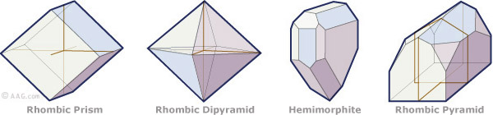
Closed non-Isometric Forms Continued…
3. Rhombohedral Closed Forms
  Rhombohedral Trapezohedral (Quartz)
  Rhombohedral Hemimorphic (Tourmaline)
  Rhombohedral Holohedra (Calcite)
  Rhombohedral Dodecahedron (Garnet, Fluorite)
  Rhombohedral Trisoctahedron
4. Orthorhombic Closed Forms
  Rhombic Prism
  Rhombic Pyramid
  Rhombic Dipyramid
  Rhombic Hemimorphic
  Rhombic Sphenoid
  Rhombic Pyramid
5. Monoclinic Closed Forms
  Prism
  Monoclinic Clinopinacoid
6. Triclinic Closed Forms
  Prism
  Triclinic Dipyramid

Slide 43
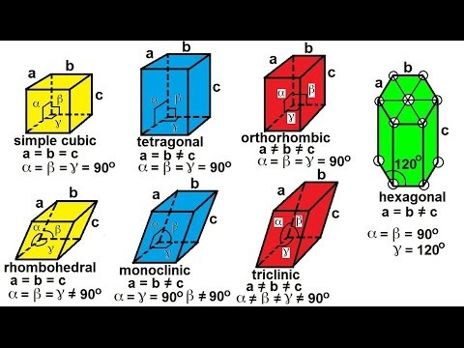
Seven (7) Crystal Systems
Cubic
Hexagonal
Rhombohedral
Tetragonal
Orthorhombic
Monoclinic
triclinic
Notes:
These fluorite crystals, from China, are basically cubes, but have their edges beveled by the dodecahedral form.

Slide 44
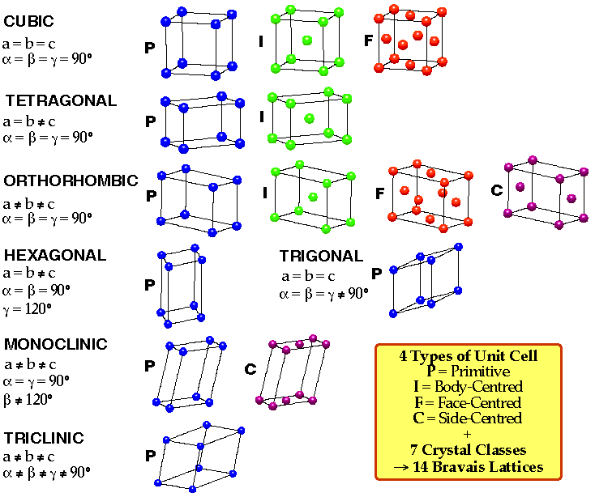
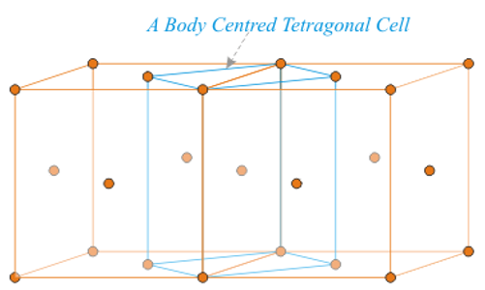
Bravais Lattices
7 Crystal System
14 Bravais Lattices
More than 40 Possible

Slide 45
Symmetry Elements and Operations
“Symmetry elements define the (conceptual) motion of an object in space,
the symmetry operation, leads to an arrangement that is indistinguishable from the initial arrangement.”

Slide 46
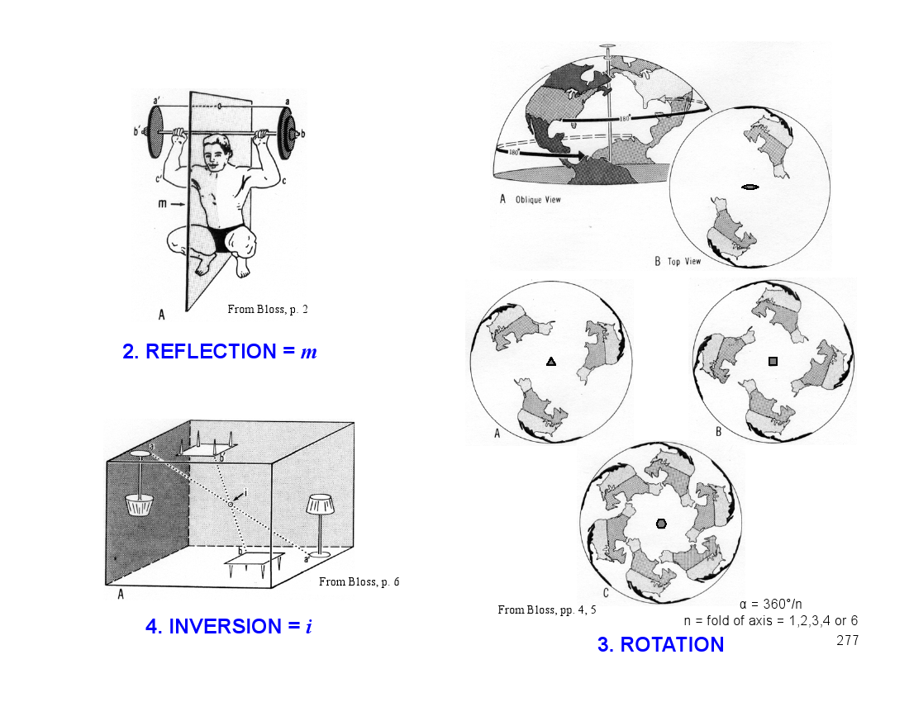
Symmetry Operations & 32 Point Groups
Rotation, reflection and inversion operations generate a variety of unique arrangements of lattice points (i.e., a shape structure) in three dimensions.

Slide 47
Symmetry Operations & 230 Space Groups
“Translations are used to generate a lattice from that shape structure. The translations include
a simple linear translation,
a linear translation combined with mirror operation (glide plane), or
a translation combined with a rotational operation (screw axis).
A large number of 3D structures
(the 230 Space Groups) are generated by these translations acting on the 32 point groups.”

Slide 48

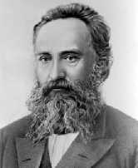
Space groups
The combination of all available symmetry operations (32 point groups), together with translation symmetry, within the all available lattices(14 Bravais lattices) lead to 230 Space Groups that describe the only ways in which identical objects can be arranged in an infinite lattice. The International Tables list those by symbol and number, together with symmetry operators, origins, reflection conditions, and space group projection diagrams.
Arthur Moritz Schönflies
(1853-1928)
Yevgraf Stepanovich Federov
(1853-1919)

Slide 49
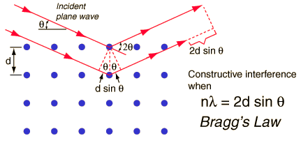

Bragg’s Law
When x-rays are scattered from a crystal lattice, peaks of scattered intensity are observed which correspond to the following conditions:
The angle of incidence = angle of scattering.
The path length difference is equal to an integer number of wavelengths.
The condition for maximum intensity contained in Bragg's law above allow us to calculate details about the crystal structure, or if the crystal structure is known, to determine the wavelength of the x-rays incident upon the crystal.
http//:hyperphysics.phy-astro.gsu.edu/hbase/quantum/bragg.html

Slide 50
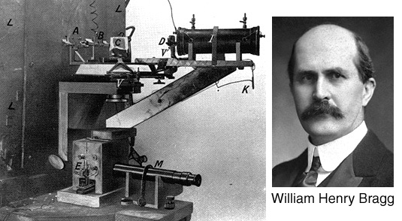
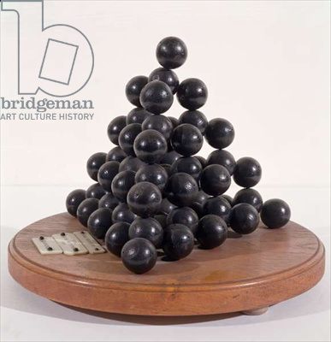
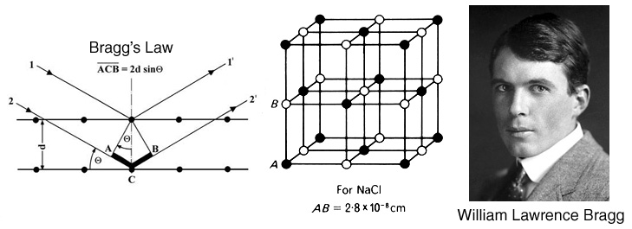

Slide 51
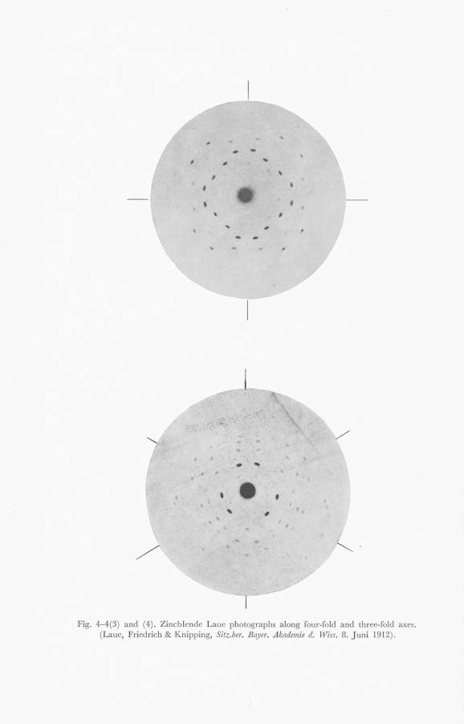
Von Laue’s Photograph of Zinc Blende (Sphalerite, ZnS), 1912

Slide 52
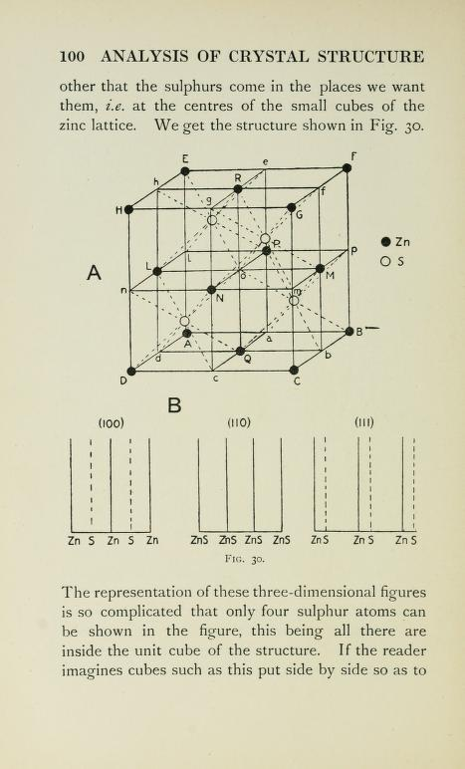
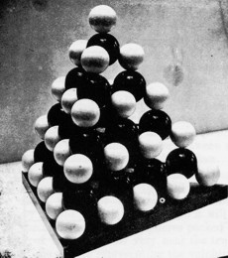
Zinc Blende: Von Laue & the Braggs
“The most satisfying result was on von Laue’s photograph of diffraction from zinc blende crystals.
Von Laue had assumed that atoms in zinc blende are arranged in a simple cubic lattice, but if this was true Bragg’s law wouldn’t explain the diffraction pattern.
But if the arrangement of atoms was…arranged in a face centred cubic lattice, the diffraction pattern was explained perfectly.”

Slide 53


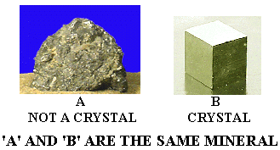
SOLID MATERIALS
CRYSTALLINE
Single Crystal
POLYCRYSTALLINE
AMORPHOUS
(Non-crystalline)

Slide 54
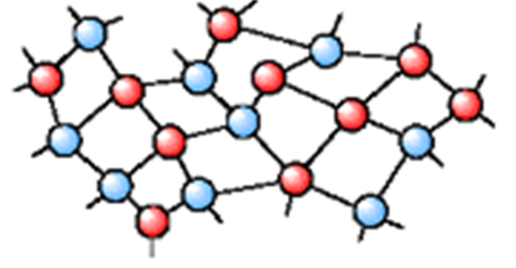
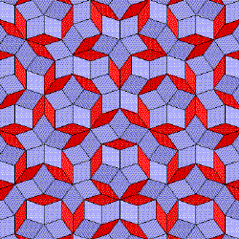
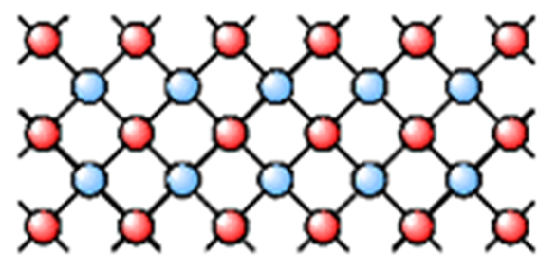
CLASSIFICATION OF SOLIDS BASED ON ATOMIC ARRANGEMENT
AMORPHOUS
QUASICRYSTALS
CRYSTALS
Short range order
+
No periodicity
order
+
No periodicity
long range order
+
periodicity

Slide 55


Amorphous solids
  Rigid and appear solid
  Short-Range order
  Don’t have a specific pattern
  Refered to as supercooled liquids
  When heated particles get softer and softer before they melt
  Ex: glass, rubber, plastics

Slide 56
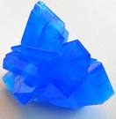
Crystalline solids
  Particles are highly ordered & in repeating patterns
  Long Range Order
  Sharp Melting Point
  Well developed symmetry
  Ex: snow, sodium chloride, sugar

Slide 57
Types of Solids
Single crsytal, polycrystalline, and amorphous, are the three general types of solids.
Each type is characterized by the size of ordered region within the material.
An ordered region is a spatial volume in which atoms or molecules have a regular geometric arrangement or periodicity.

Slide 58
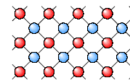
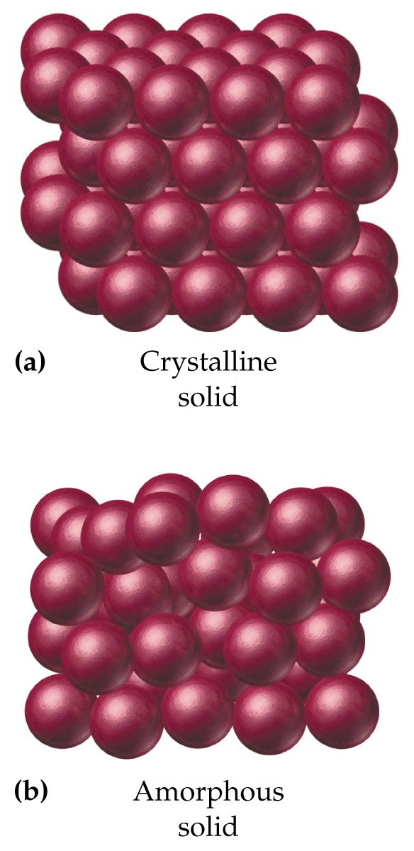
Crystalline Solid
Crystalline Solid is the solid form of a substance in which the atoms or molecules are arranged in a definite, repeating pattern in three dimension.
Single crystals, ideally have a high degree of order, or regular geometric periodicity, throughout the entire volume of the material.

Slide 59
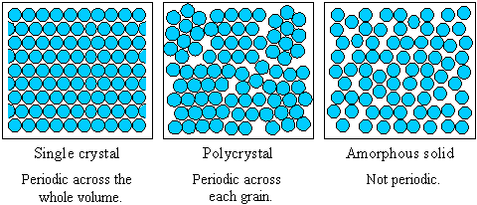
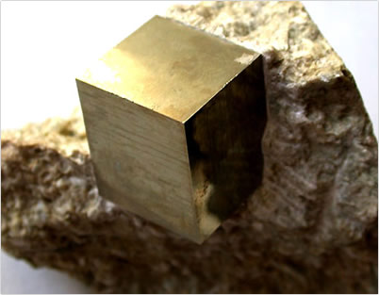
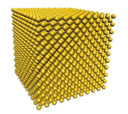
Crystalline Solid
Single crystal has an atomic structure that repeats periodically across its whole volume. Even at infinite length scales, each atom is related to every other equivalent atom in the structure by translational symmetry
Single Pyrite
Crystal
Amorphous
Solid
Single Crystal

Slide 60
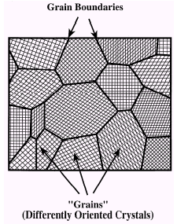
Polycrystalline Solid
Polycrystal is a material made up of an aggregate of many small single crystals (also called crystallites or grains).
Polycrystalline material have a high degree of order over many atomic or molecular dimensions.
These ordered regions, or single crytal regions, vary in size and orientation wrt one another.
These regions are called as grains (domain) and are separated from one another by grain boundaries. The atomic order can vary from one domain to the next.
The grains are usually 100 nm - 100 microns in diameter. Polycrystals with grains that are <10 nm in diameter are called nanocrystalline.
Polycrystalline
Pyrite form
(Grain)

Slide 61
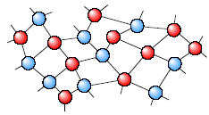
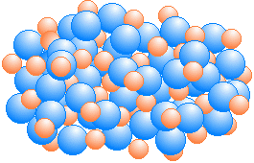
Amorphous Solid
Amorphous (Non-crystalline) Solid is composed of randomly orientated atoms, ions, or molecules that do not form defined patterns or lattice structures.
Amorphous materials have order only within a few atomic or molecular dimensions.
Amorphous materials do not have any long-range order, but they have varying degrees of short-range order.
Examples to amorphous materials include amorphous silicon, plastics, and glasses.
Amorphous silicon can be used in solar cells and thin film transistors.

Slide 62
Bonding in Solids
The physical properties of solids like hardness, electrical conductivity, and melting point, depend on kind of particles that make up the solid and the strength of attractive forces between them.
4 types:
  Metallic solids
  Molecular solids
  Ionic solids
  Covalent network

Slide 63

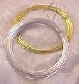
Metallic Solids
Particles: atoms
Forces: metallic bond
Examples: metallic elements

Slide 64
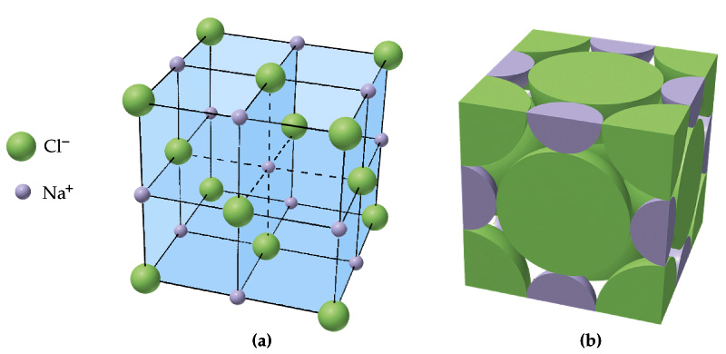
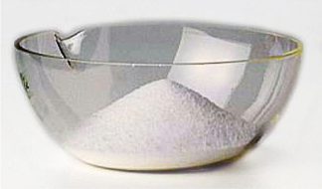
Ionic Solids
Particles:
cations & anions
Forces:
electrostatic attractions
Examples:
NaCl, KBr, MgSO₄

Slide 65
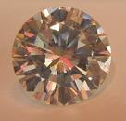

Covalent-network solids
Particles: atoms
Forces: covalent bonds
Examples: diamond, graphite, silicon, quartz (SiO₂)

Slide 66

Molecular Solids
Particles: atoms or molecules
Forces: Intermolecular forces
dipole-dipole,
Ion-dipole forces
dispersion forces,
hydrogen bonds
van der Waals forces
Examples: organic compounds like
CH₄, sugar (C₁₂H₂₂O₁₁), and
some inorganic compounds like
CO₂, H₂O, SO₃

Slide 67

Hydrogen Bonding
Hydrogen bonding typically occurs when a hydrogen atom bonded to O, N, or F, is electrostatically attracted to a lone pair of electrons on an O, N, or F atom in another molecule.

Slide 68
van der Waals Forces
van der Waals forces are also known as London forces.
They are weak interactions caused by momentary changes in electron density in a molecule.
They are the only attractive forces present in nonpolar compounds comprising neutral atoms and molecules.
The explanation of these weak forces of attraction is that there are natural fluctuation in the electron density of all molecules and these cause small temporary dipoles within the molecules. It is these temporary dipoles that attract one molecule to another. They are called van der Waals' forces.

Slide 69

Intermolecular Forces
As the polarity of an organic molecule increases, so does the strength of its intermolecular forces.
Summary of Intermolecular Forces

Slide 70
Types of Bonding
Ionic
Bonding
High Melting Point
Hard and Brittle
Non conducting
solid
NaCl, CsCl, ZnS
Van Der Waals
Bonding
Low Melting Points
Soft and Brittle
Non-Conducting
Ne, Ar, Kr and Xe
Metallic
Bonding
Variable Melting
Point
Variable
Hardness
Conducting
Fe, Cu, Ag
Covalent
Bonding
Very High Melting
Point
Very Hard
Usually not
Conducting
Diamond, Graphite
Hydrogen
Bonding
Low Melting Points
Soft and Brittle
Usually
Non-Conducting
İce,
organic solids

