Slide 1
CH4206
Recommended Books:
Spectrometric Identification of Organic Compounds. Robert M. Silverstein, Francis X. Webster, David J. Kiemel, David L. Bryce
Introduction to Spectroscopy. Donald L. Pavia, Gary M. Lampman, George S. Kriz, James R. Vyvyan
Fundamentals of Molecular Spectroscopy by Colin N. Banwell and Elaine M. Mccash
Organic Spectroscopy. William Kemp
Spectroscopy of Organic Compounds. P. S. Kalsi

Slide 2
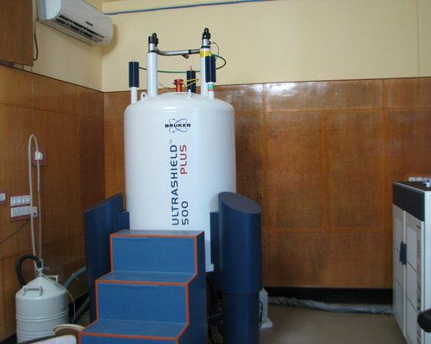
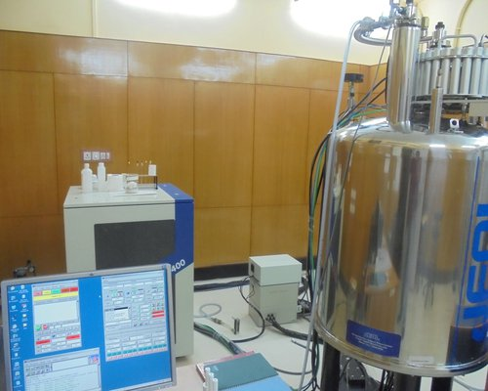
Challenge in Synthetic Chemistry
Molecules are invisible to the naked eye.
Chemical reactions often confirmation of the product's structure.
Enables synthesis of organic and inorganic molecules.
Requires precise tools to determine:
  Exact molecular structure
  Atomic connectivity
  Stereochemistry
NMR Spectroscopy: A Powerful Solution
Utilizes the nuclear spin of certain isotopes (e.g., ¹H, ¹³C).
Molecules are placed in an external magnetic field and irradiated with RF light.
Yields NMR spectra that: Reveal chemical environments of nuclei, Help deduce the molecule's exact structure.

Slide 3
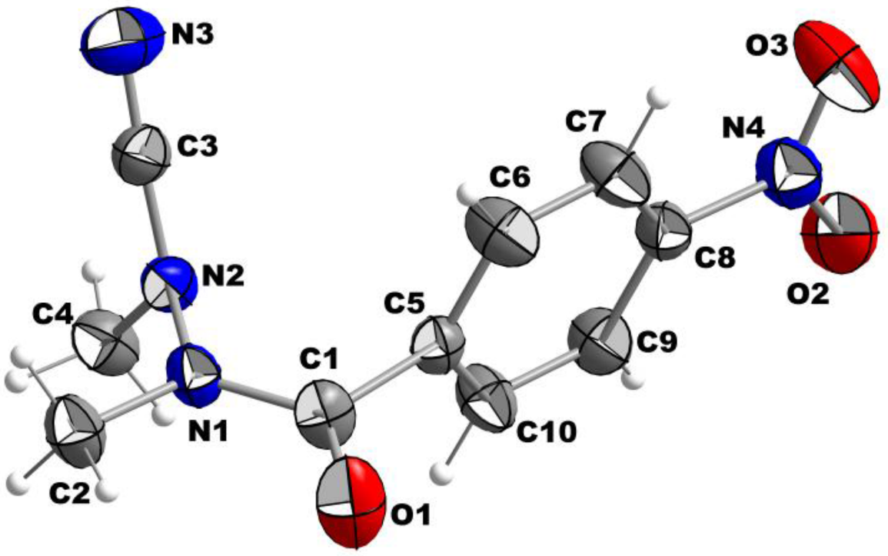
X-ray Crystallography
The best technique to elucidate the chemical structure of a compound including
stereochemistry
However, can be performed ONLY for solid state samples which are called single crystals

Slide 4
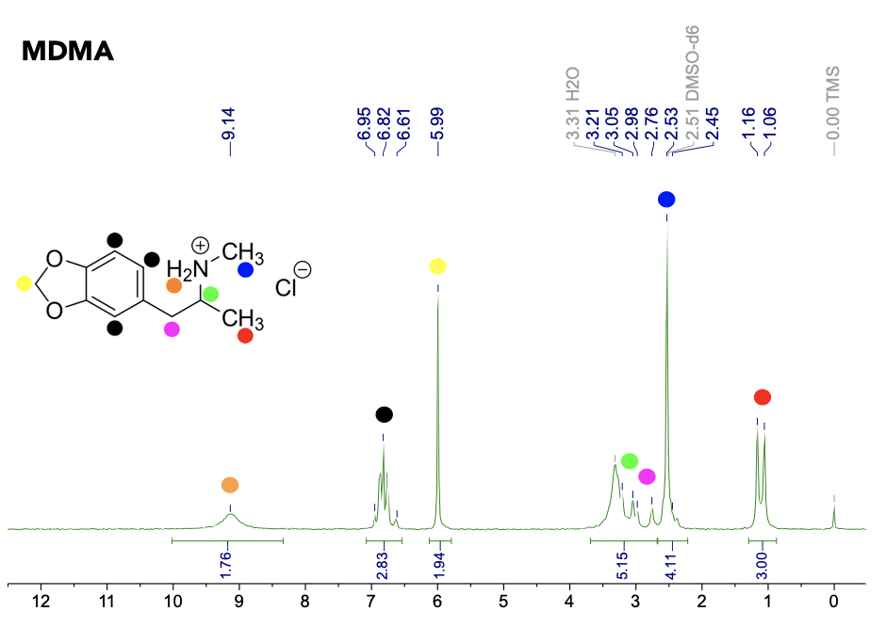
NMR Spectroscopy
We don’t get the structure directly
Rather we get a kind of code from which we can arrive at the structure
Can be performed in liquid, solid and gas phase

Slide 5
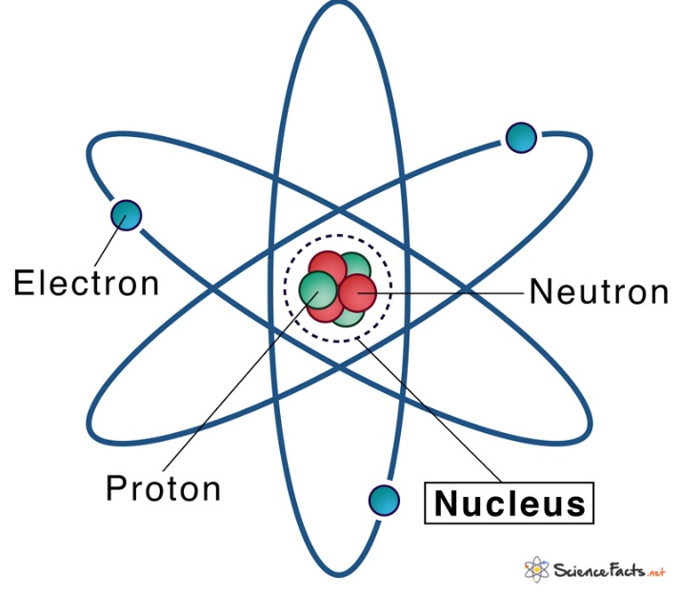
What is NMR Spectroscopy?
Nuclear Magnetic Resonance Spectroscopy
Something to do with the magnetic properties of the nuclei
We will see later what is meant by resonance
Each atomic nucleus has four important physical properties:
1. Mass
2.Electric charge
3. Magnetism
4. Spin

Slide 6
Nuclear Magnetism and Nuclear spin
Nuclear magnetism and nuclear spin, are much less evident
The bulk magnetism of some materials, such as iron, is due to the electrons, not to the nuclei
Magnetic properties of materials are dominated by electrons
Essentially the electrons are much more magnetic than nuclei
NMR spectroscopy is related to nuclear magnetism
Nuclear magnetism arises from the magnetic properties of protons and neutrons
The magnetic properties of proton and neutron are due to spin angular momentum (I)

Slide 7
For an electron……
Conventional angular momentum: Arises from its motion; orbital angular momentum due to its circulating motion around the nucleus
Intrinsic or spin angular momentum which arises from nothing, being simply a feature of the electron's nature and which is always same for an electron namely ½
There is no such concept as the rotation of electron around its own axis, its only spin
Spin is an abstract quantum-mechanical description
In a similar way certain nuclei have spin angular momentum (spin)

Slide 8
The magnetic properties of proton and neutron are due to spin angular momentum (I)
Proton Neutron
I 1/2 1/2
Effective magnetic moment of a nucleus is a resultant of proton and neutron spins
Nuclear magnetic moment µ = γI
NMR deals with nuclei having I ≠ 0

Slide 9
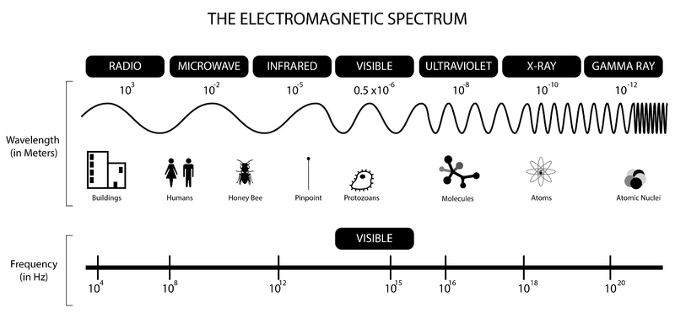
NMR spectroscopy is the study of interaction of radiofrequency (R_{f}) with the nuclei
of molecules placed in a strong magnetic field

Slide 10
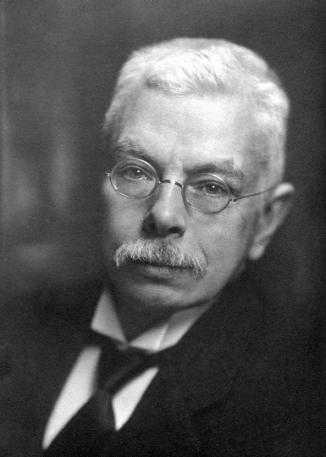

Historical Perspective
Nuclear Zeeman Splitting
Zeeman first observed the strange behaviour of certain nuclei when subjected to strong magnetic field at the end of 19th Century-Zeeman Effect
Splitting of a spectral line in the presence of a static magnetic field into several components
NMR spectrometers were commercially available only in 1950s
Pieter Zeeman
Netherlands
Nobel Prize (1902, Physics)
Aurora Borealis

Slide 11
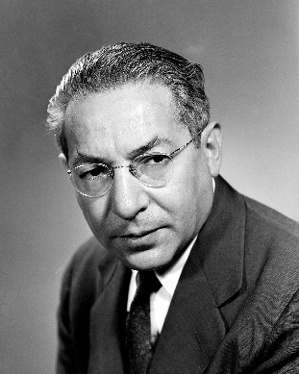
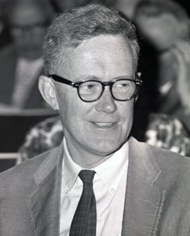

The discovery of NMR goes to Isidor Isaac Rabi, who received the Nobel Prize in Physics in 1944. Rabi described how nuclei (hydrogen, deuterium, and lithium) could be induced to flip their principal magnetic orientation by an oscillating magnetic field in vacuum.
I. I. Rabi
In December 1945, Edward Mills Purcell at Harvard University detected the first solid-state NMR signal in 1 kg of paraffin wax. Almost simultaneously Felix Bloch at Stanford University carried out the first liquid-state NMR experiment in water.
E. M. Purcell
Purcell and Bloch shared the Nobel Prize in Physics in 1952.
It is a remarkable fact that the discovery, development and applications of NMR have resulted in no less than 8 Nobel laureates in Physics, Chemistry and Medicine!
F. Bloch

Slide 12
NMR spectroscopy
Lots of time we do chemistry, we face big challenge that is we can not see the molecules, we do some chemical reactions to get a product, and we need some way to make sure that what we obtained, because we can not see the structure of a molecule by naked eyes. To address this challenge, we have a number of techniques that fall under the umbrella, term of spectroscopy…
By modern synthetic chemistry literally we can build or synthesize any molecule, that can be organic or inorganic molecules, that we can think of. And we need a way that precisely tells us what is molecule exactly, its total structure, all the connectivity, all the stereochemistry. This is done by NMR.
Only certain atomic nuclei like proton ¹H and ¹³C exhibit nuclear spin and we can take advantage of this spin… By placing a molecule to an external magnetic field, we irradiate the molecule with light of RF. We get interesting spectroscopic data, that generates NMR spectrum which tells us precise chemical environment of every single proton in the molecule and we can use this information to determine the exact structure of the molecule.

Slide 13
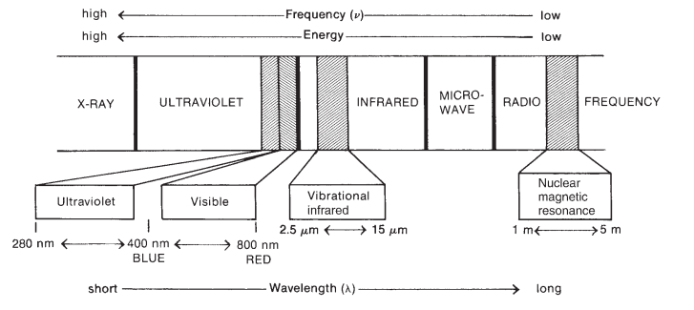
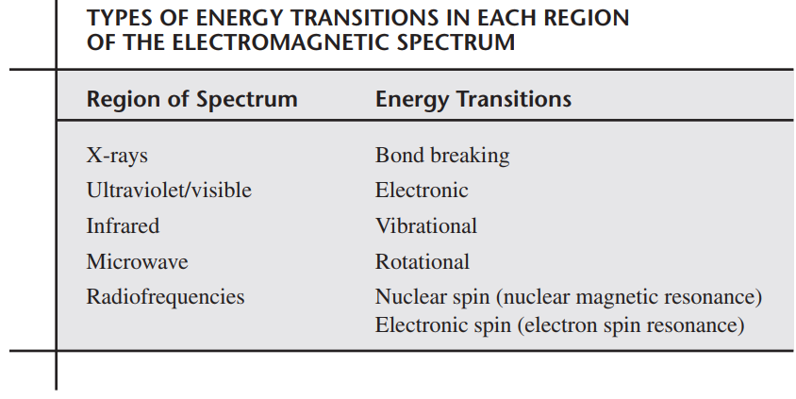
Electromagnetic Spectrum
Energy transitions: bond breaking, electronic, vibrational, rotational and nuclear or electronic spin transitions

Slide 14
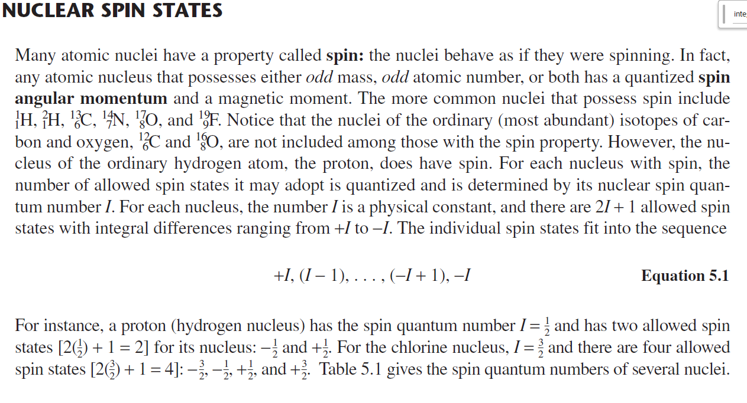

Slide 15
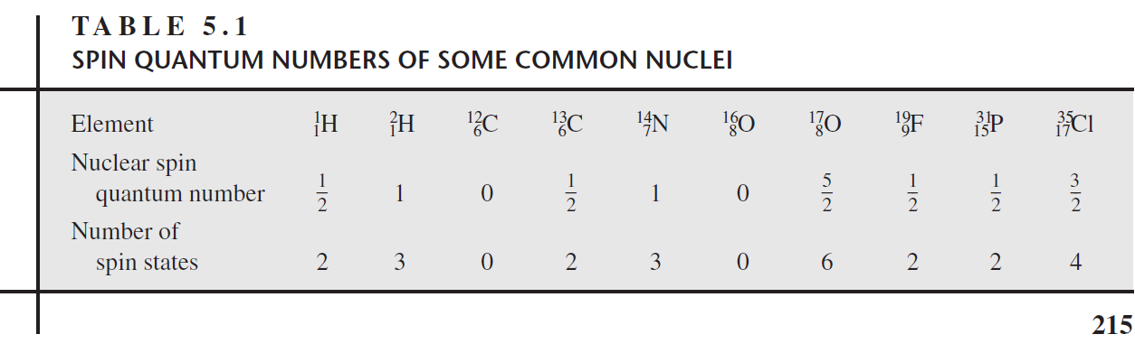

Slide 16
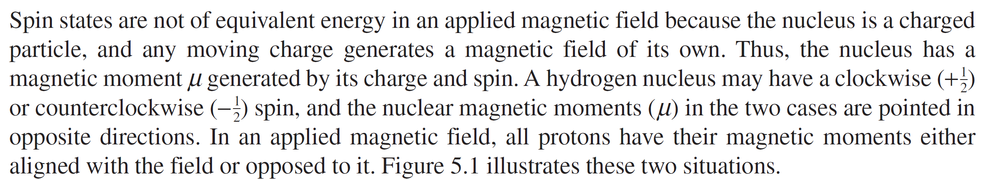
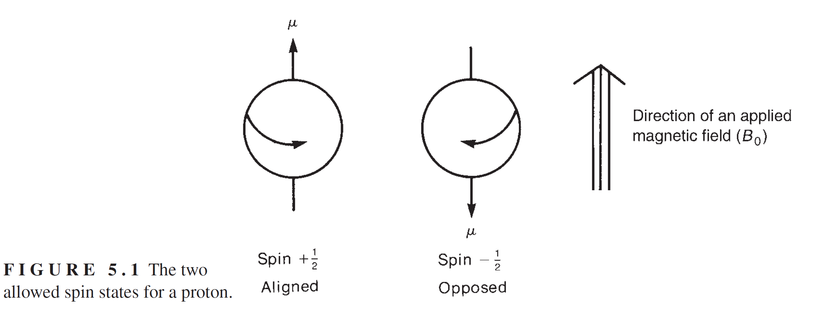

Slide 17
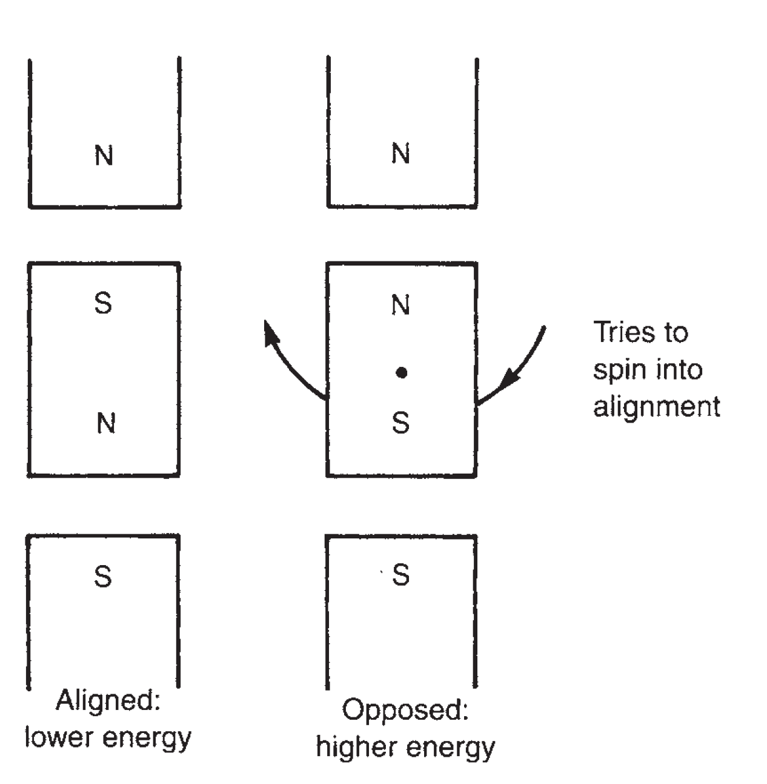

Slide 18
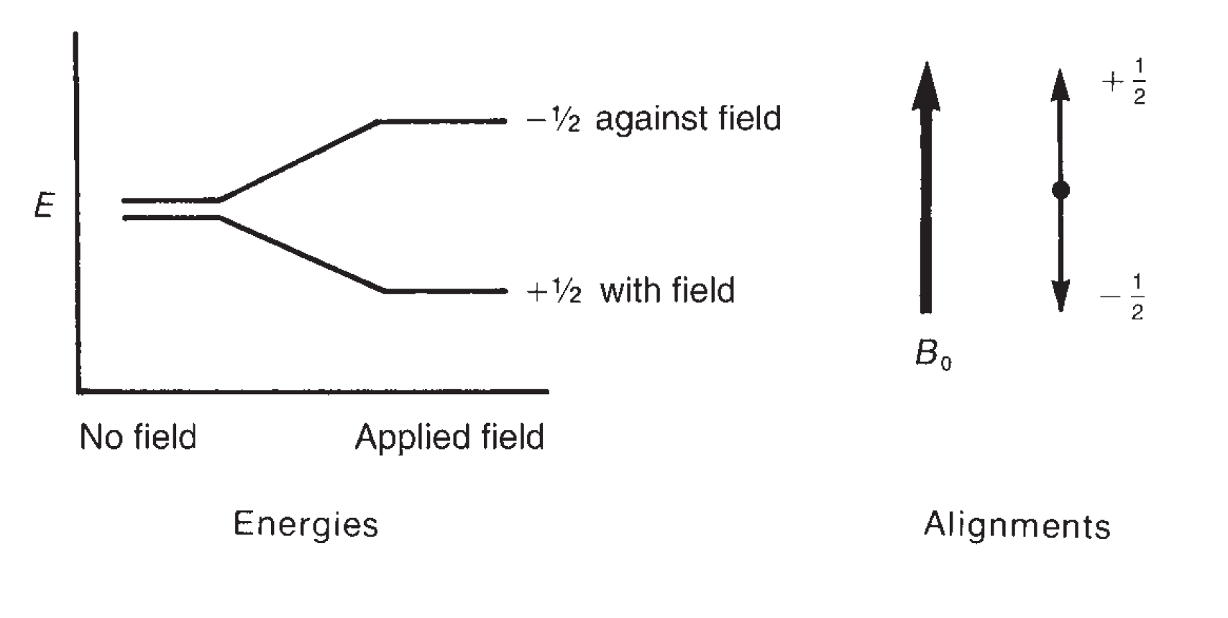

Slide 19
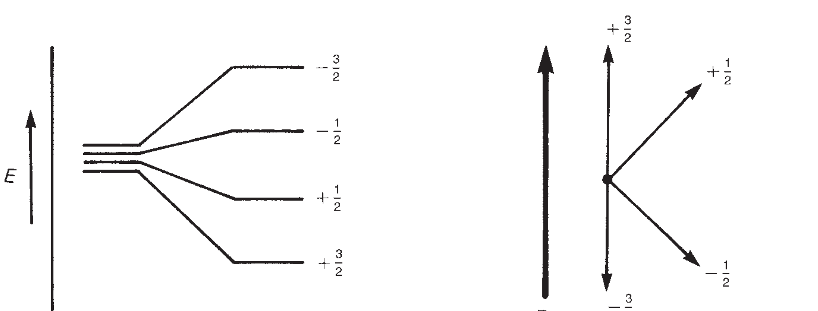

Slide 20
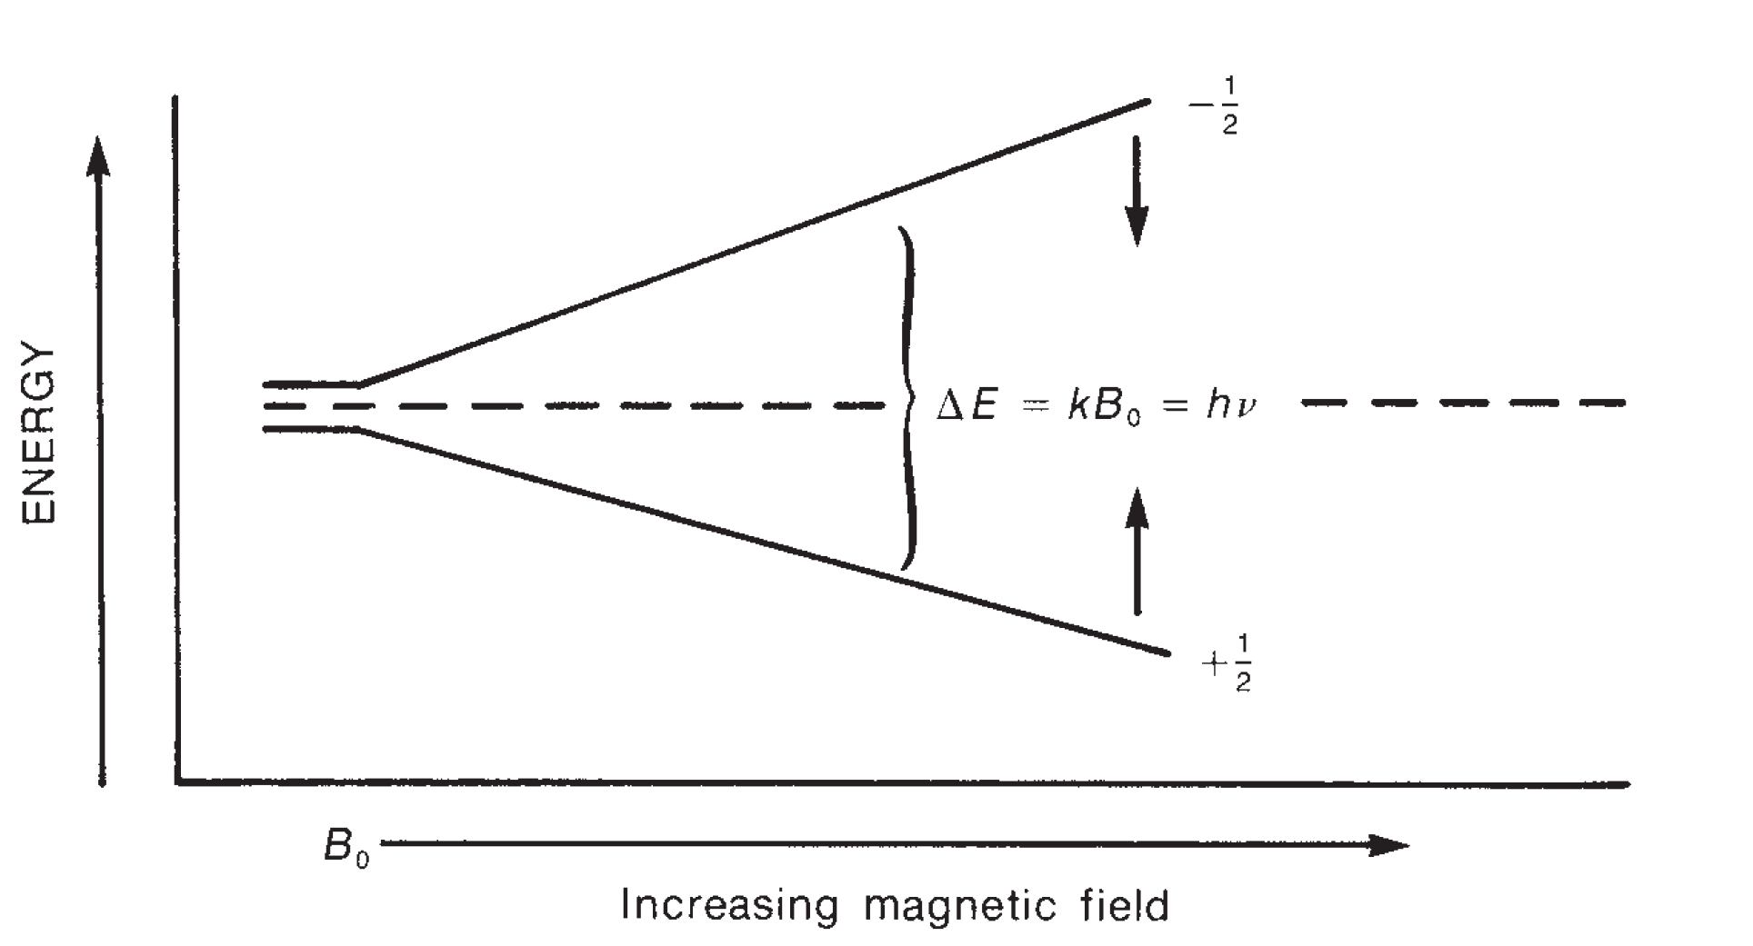

Slide 21
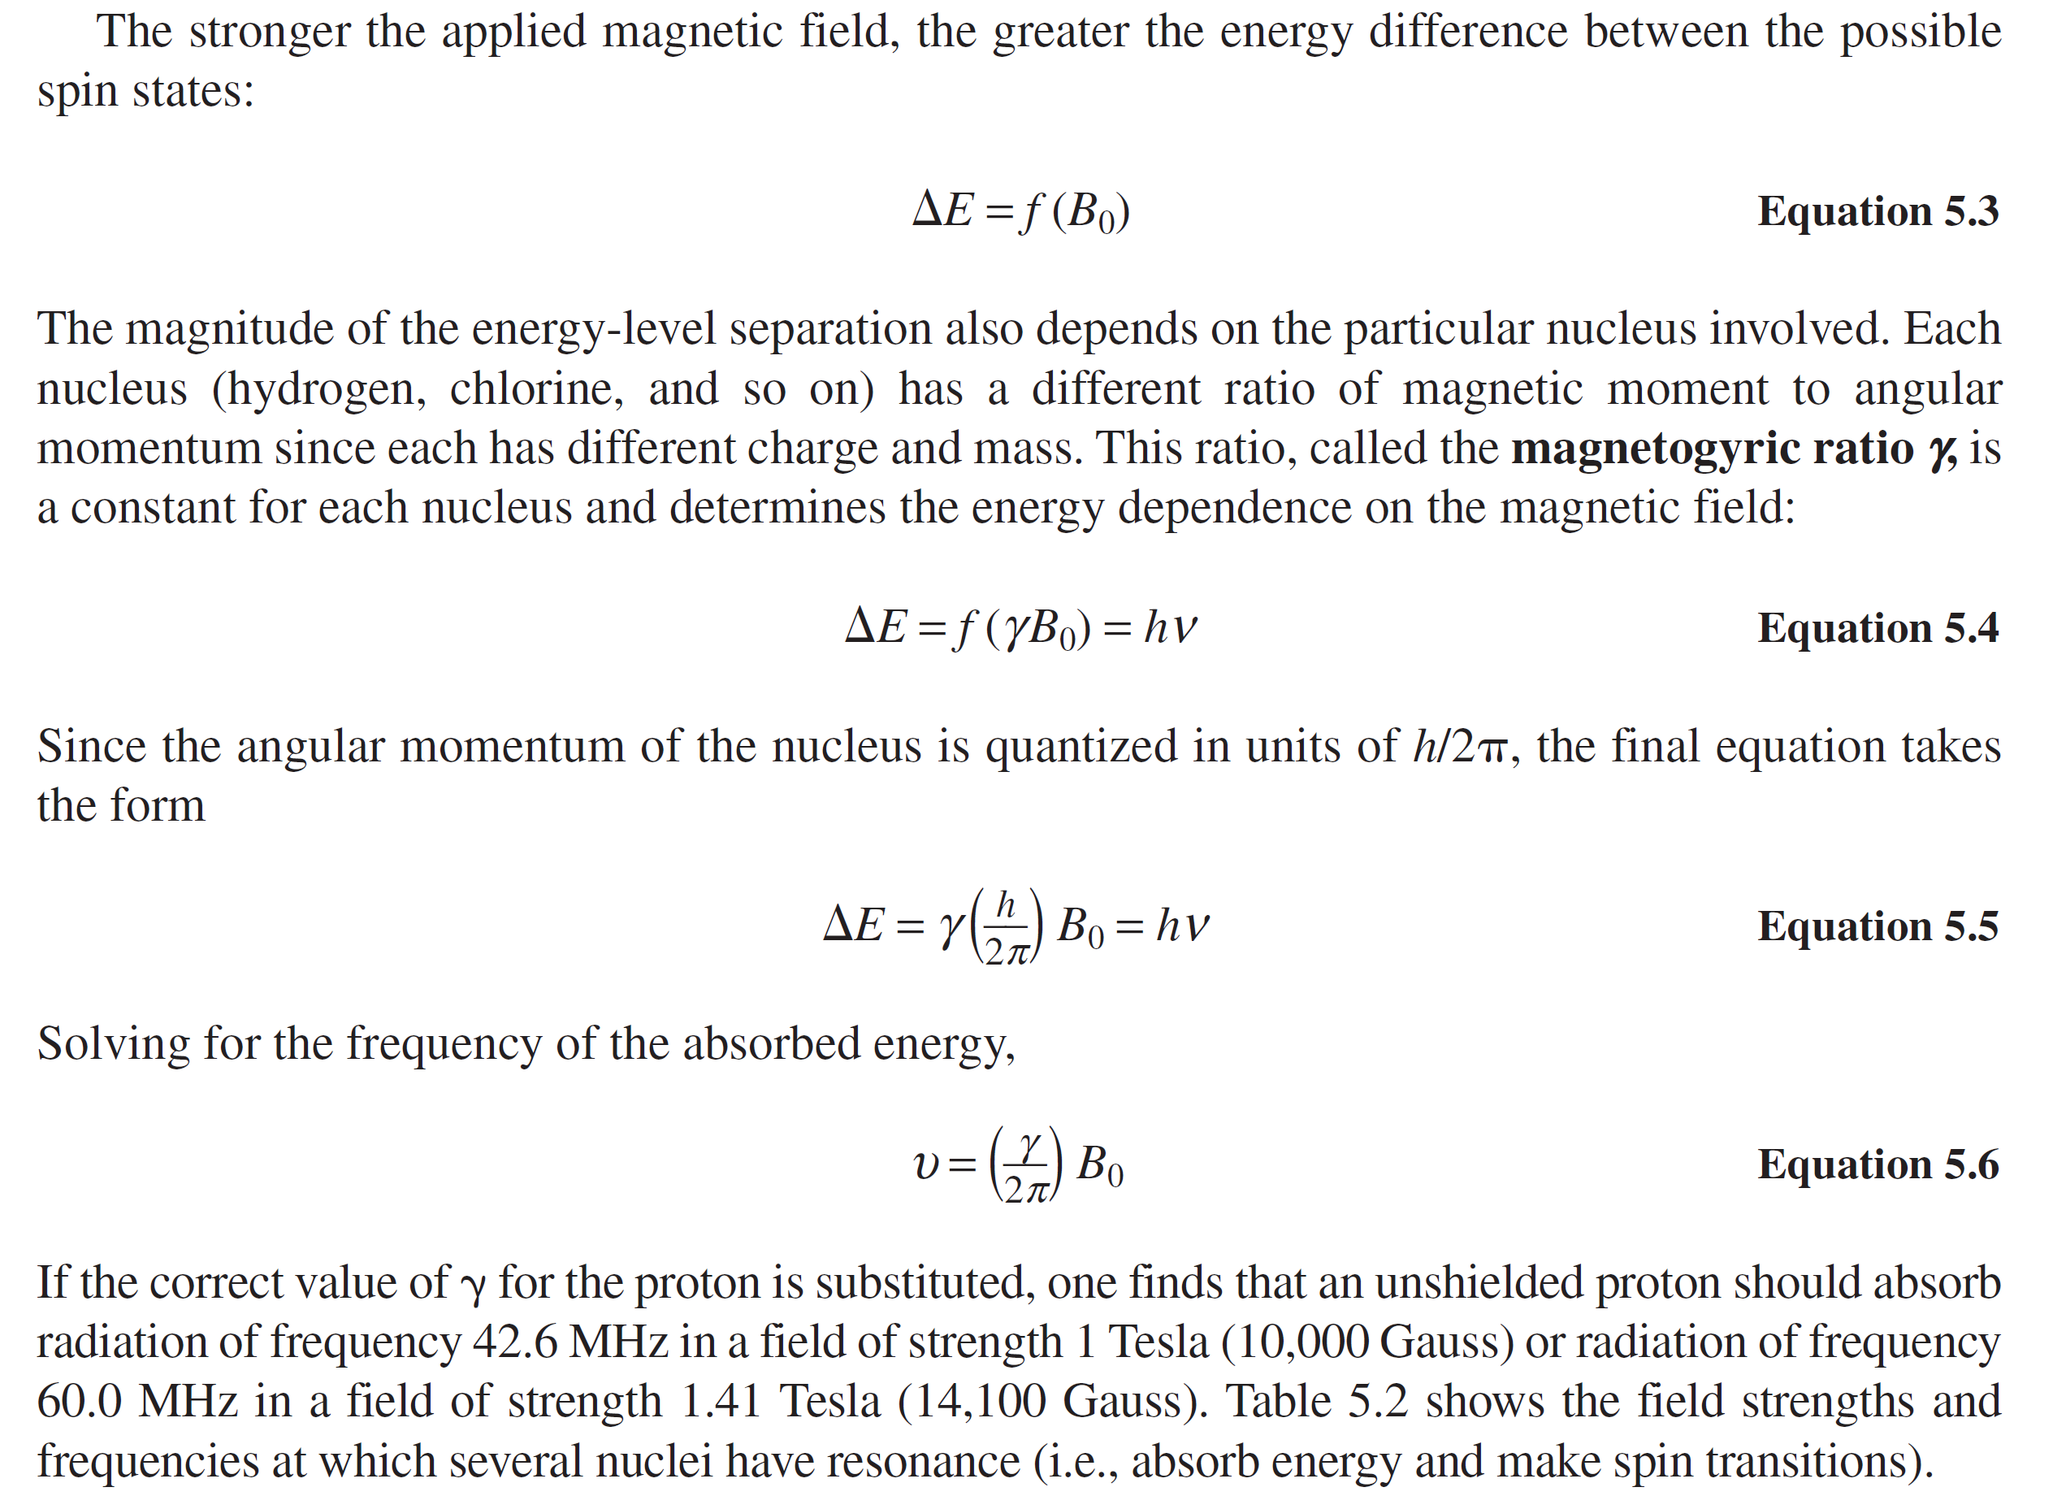

Slide 22
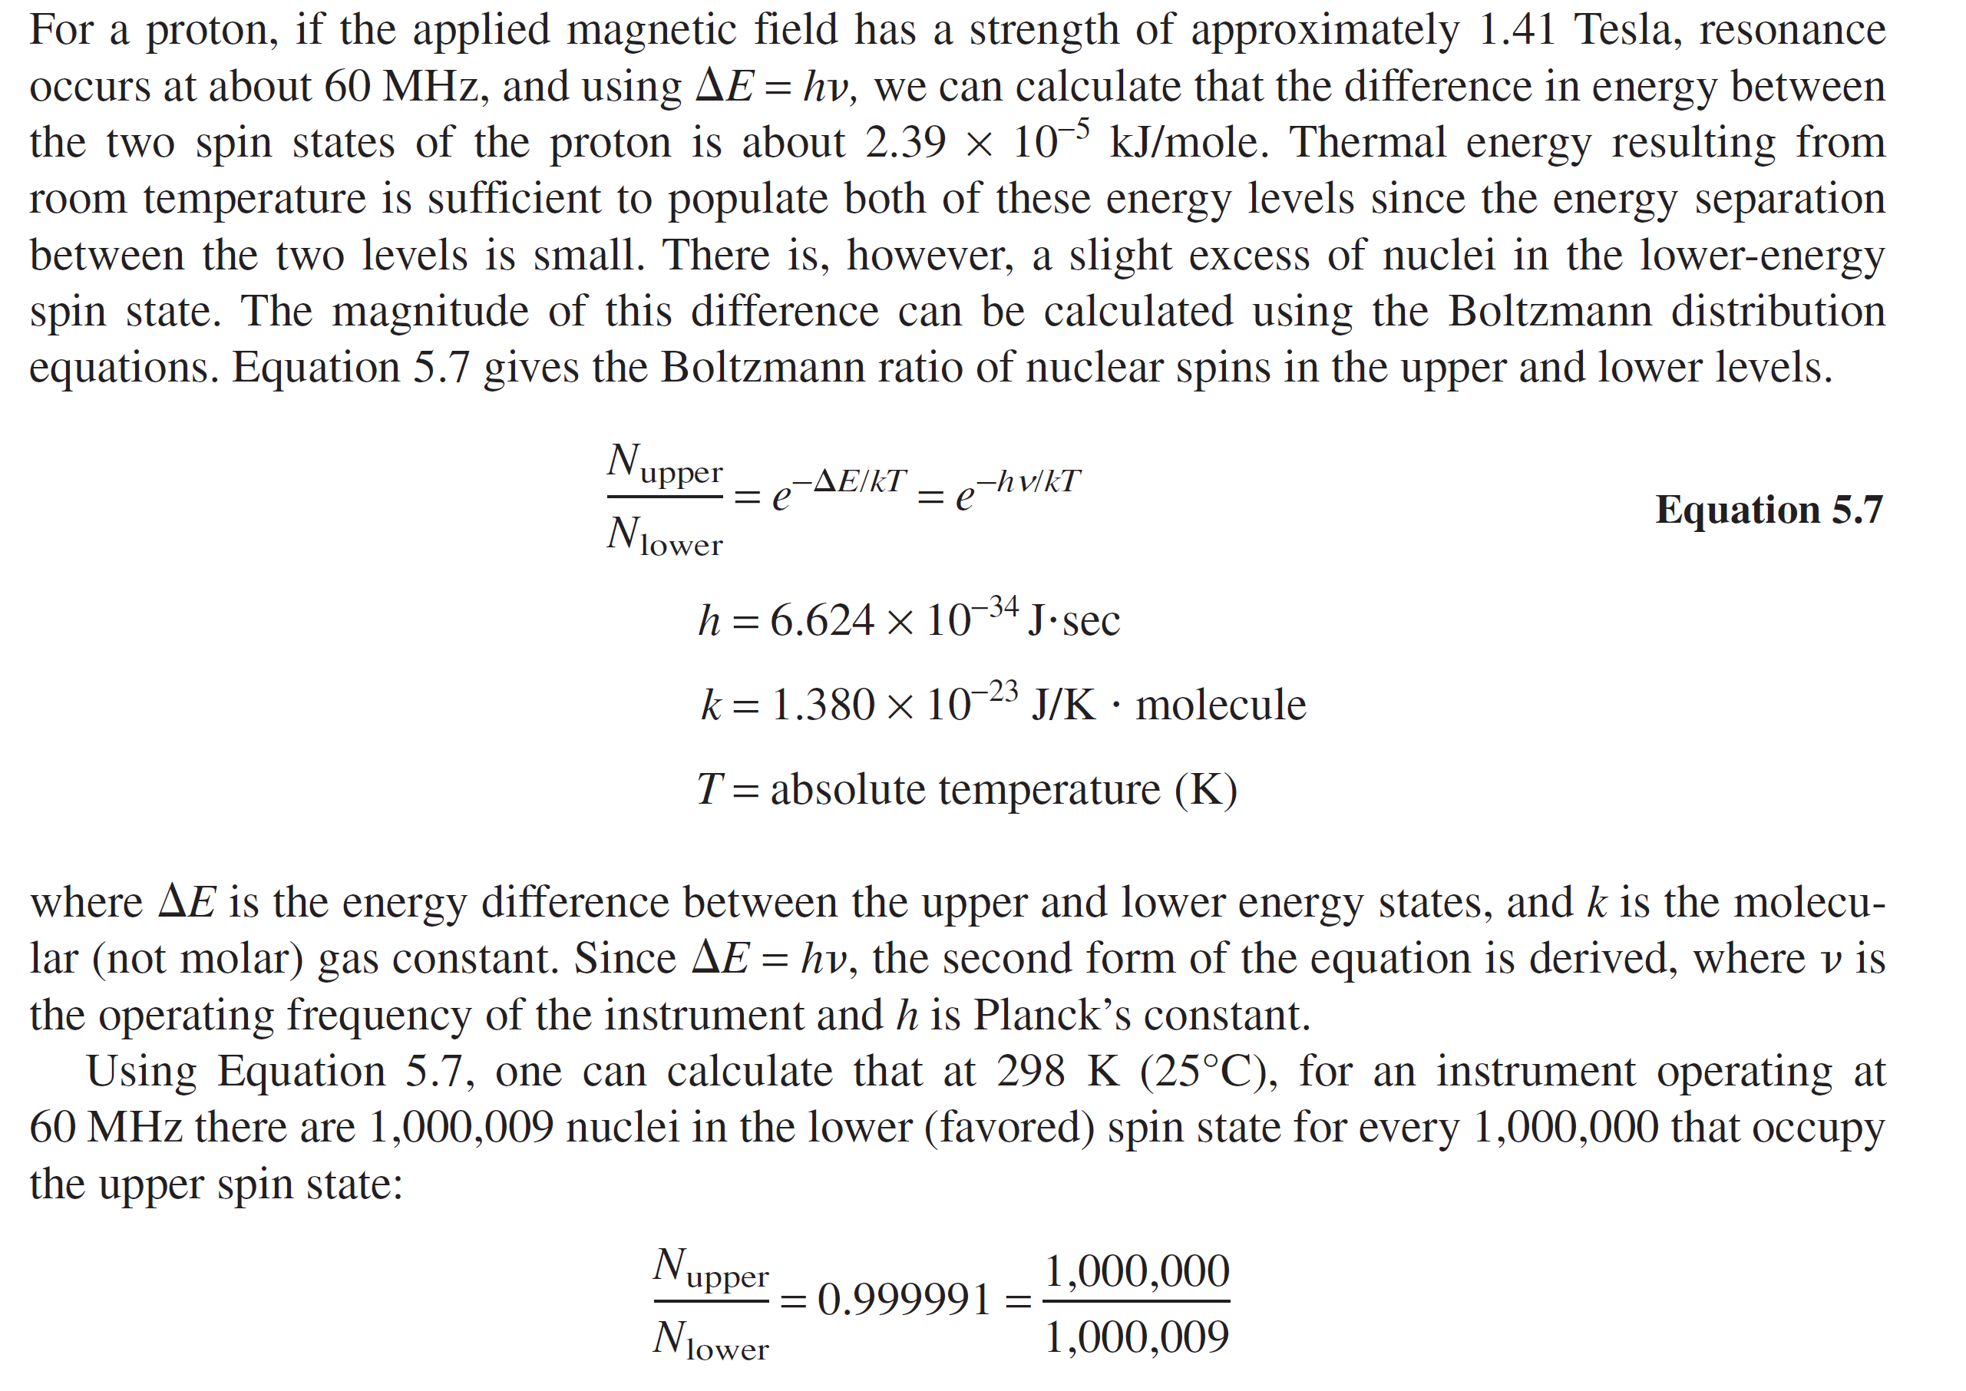

Slide 23
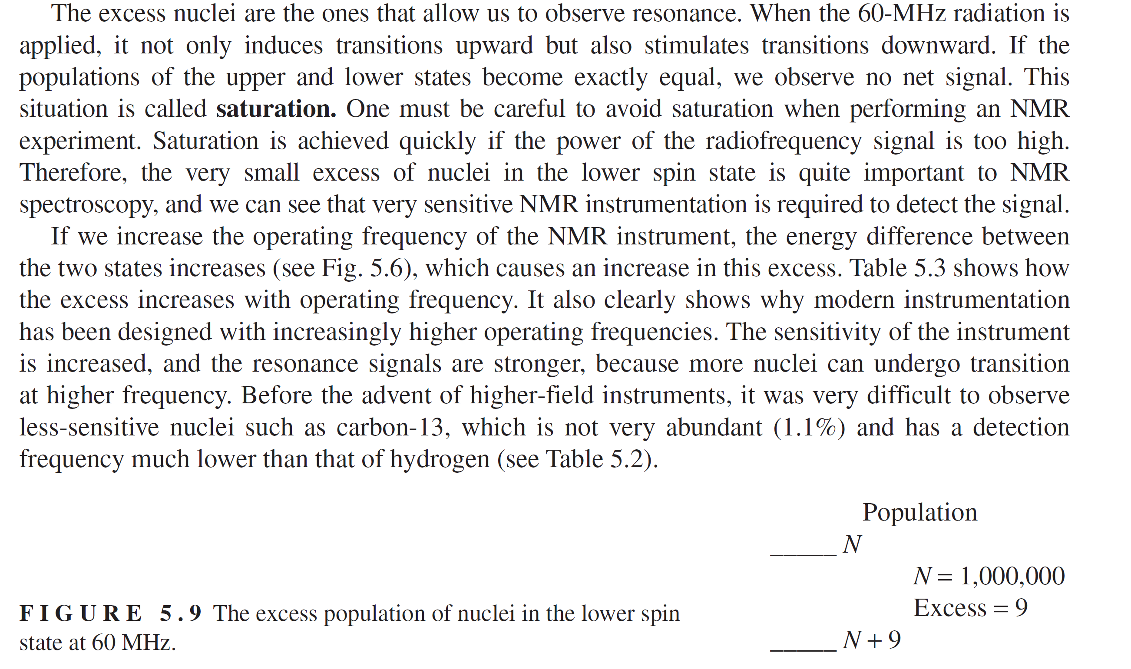

Slide 24
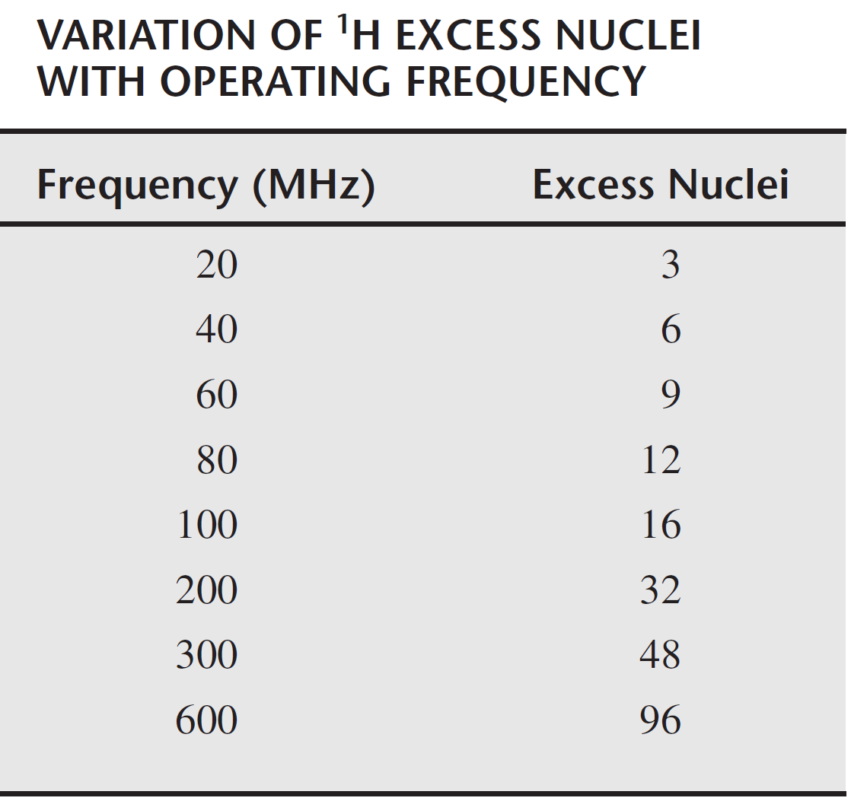

Slide 25
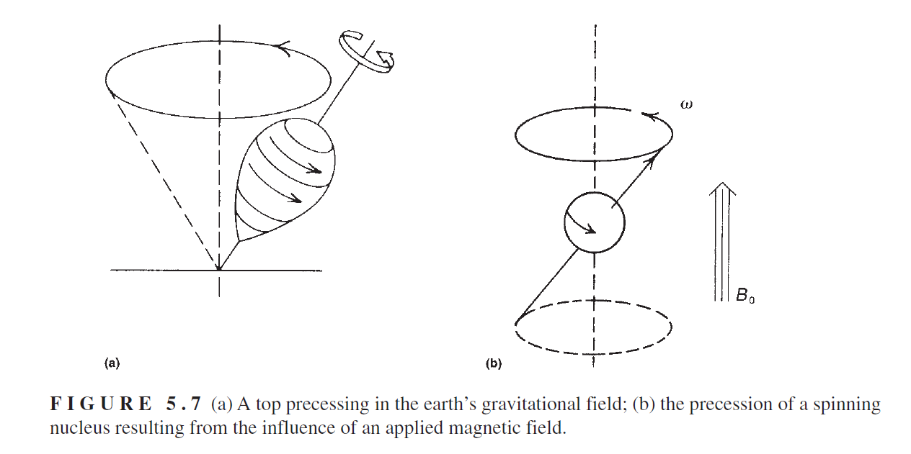

Slide 26
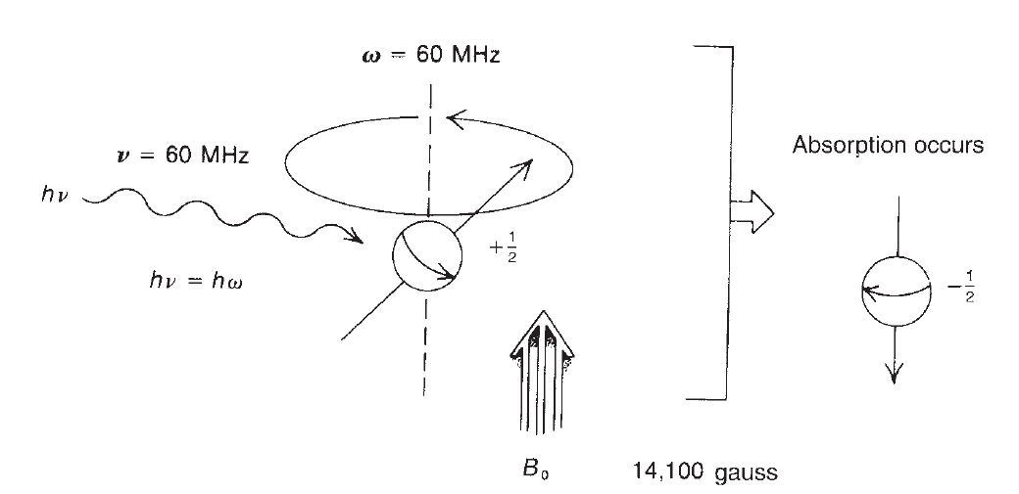

Slide 27
NMR active nuclei: The nuclei are built up of protons and neutrons each possessing an angular momentum due to its motion about the centre of the nucleus. The total angular momentum of a particular nucleus is the vector sum of the individual momentum of the constituent protons and neutrons. The total angular momentum of a nucleus in its ground state is called as nuclear spin. This is characterized by a spin quantum number I, which may be integral, half-integral or 0. Such spin number I is also related to the mass number and atomic number of an atom. There are some empirical rules which determine the net spin of a nucleus given as below. Only those nuclei which have non-zero spin number can absorb/emit radiofrequency (RF) radiation and hence are NMR active nuclei.
1) If the mass number is odd, then the nucleus has a half-integer spin (I = 1/2, 3/2, 5/2 and so on). Example: ¹H, ¹³C, ¹⁵N, ³¹P are NMR active.
2) If the number of neutrons and the number of protons are both odd, then the nucleus has an integer spin (I = 1, 2, 3 and so on). Example: ²H, ¹⁰B, ¹⁴N are NMR active.
3) If the number of neutrons and the number of protons are both even, then the nucleus has NO spin (I = 0). Example: For ¹²C, ¹⁶O, ³²S No NMR signal will be obtained.

Slide 28
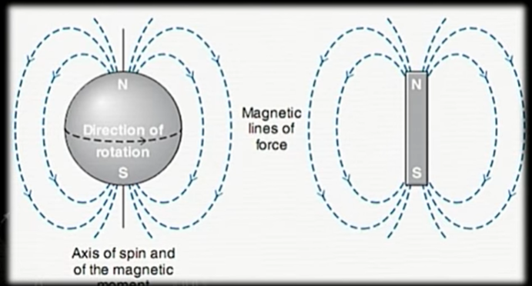
The spinning nuclei behave like a tiny bar magnet
The moving charged particle generates a magnetic field. Since all the atomic nuclei are charged particles and hence spinning nuclei will generate a magnetic field along the axis of rotation. Isotopes with nuclear spin therefore have small magnetic fields, whose magnitude and direction can be determined by a vector called a magnetic moment. Thus, the spinning nuclei (non-zero spin number) behave like a tiny bar magnet with a magnetic moment μ.

Slide 29
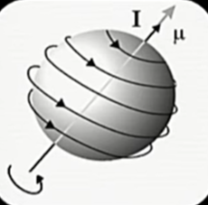
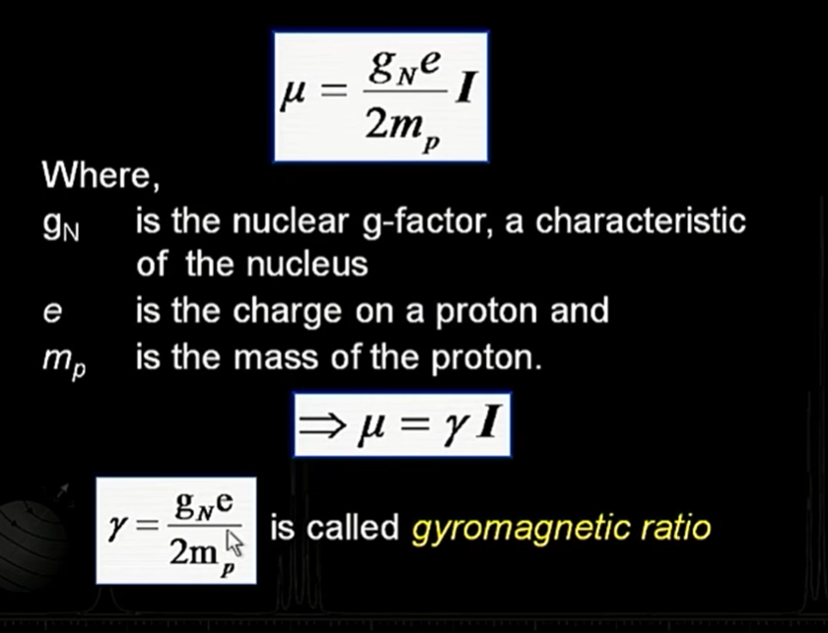
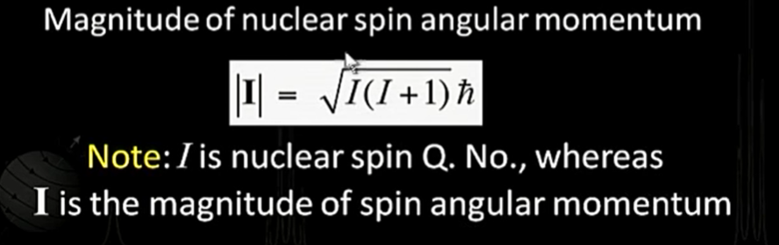
A spinning spherical nucleus has an associated angular momentum (I) and magnetic moment (μ).
This is not italic, it should be bold I.

Slide 30
Effect of external magnetic field: In the absence of external magnetic field, all the magnetic nuclei (nuclear magnetic dipoles) are randomly oriented. But, when an external magnetic field is applied, the nuclei align themselves either “with” or “against” the field of the external magnet. Quantum mechanics explains when a magnetic active nucleus with nuclear spin I is placed in a uniform magnetic field, its magnetic dipole will align in only 2I+1 ways. In the presence of an external magnetic field, some of the nuclei arrange themselves in the direction of the external magnetic field while others in the opposite direction. More energy is needed for a nucleus to align against the external magnetic field than to align it with the external magnetic field. Therefore, nuclei which align with the field are in the lower energy state called as α-spin state and those which align against the field are in the higher energy state called as β-spin state. The total number of nuclei in the α-spin state is always higher than in the β-spin state. The difference in the populations is very small (≈ 10 out of a million), but is sufficient to form the basis of NMR spectroscopy. The difference in energy (ΔE) between the two spin states depends upon the external magnetic field strength. The greater the strength of the external magnetic field, greater is the difference in energy between the α- and β-spin states.

Slide 31
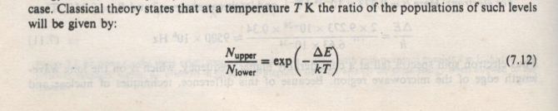
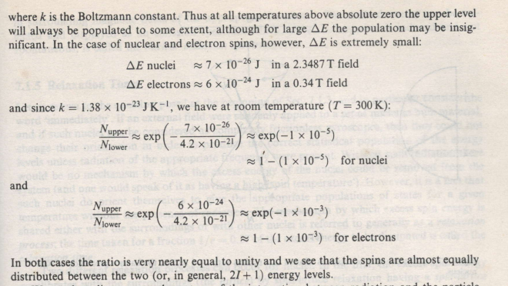

Slide 32
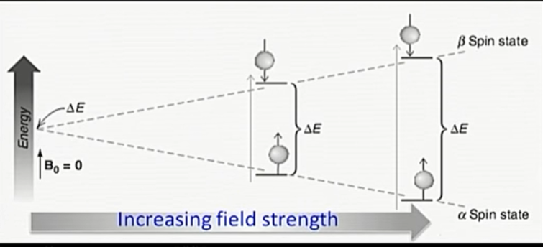
The energy difference between two spin states is given by ΔE = h(γ/2π)B₀ where h is the Planck’s constant, γ is the gyromagnetic ratio. It is a constant that depends on the particular type of nucleus. For proton the value of 2.675×10⁸ T⁻¹s⁻¹ whereas and in the case of ¹³C nucleus, it is 6.688×10⁷ T⁻¹s⁻¹. Thus, it is clear that for a given nucleus the value of ΔE depends on the applied magnetic field strength B₀.

Slide 33
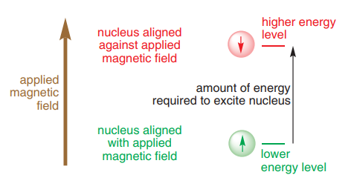
When such nuclei are placed in a strong magnetic field and irradiated with electromagnetic energy of radiofrequency (RF), the nuclei may absorb energy and the process in knows as nuclear magnetic resonance. Absorption of energy is quantized and does not occur until the strength of the magnetic field and the frequency of electromagnetic radiation are at specific values. On absorption of such energy by a nucleus, the signal produced are knows as nuclear magnetic resonance spectroscopy…
Since organic compounds are primarily composed of carbon (C) and hydrogen (H), NMR identifies the various types of H and C atoms in organic molecules. The ¹H-nucleus is the most commonly studied by NMR spectroscopy because of its high natural abundance of 99.985% and its presence in the majority of organic compounds. NMR studying ¹H atom is called hydrogen or proton NMR spectrum. The proton NMR spectrum gives the information about the number of different types of protons and also the chemical environment around it, whereas ¹³C NMR is used to determine the carbon framework of the molecule. ¹³C has a natural abundance of only about 1% and hence the sensitivity of ¹³C is less than the ¹H NMR and requires longer time to record.

Slide 34
Flipping the spin: When an appropriate energy in the form of RF radiation is supplied to a nucleus occupying in the α-spin state, a transition takes place between the two spin states (called flipping the spin) and the nucleus is said to be in resonance with the external magnetic field. The following fundamental equation correlates the applied radiofrequency with the magnetic field strength B₀: ν = (γ/2π)B₀
The introduced radiofrequency is given in megahertz (MHz). A frequency of 300 MHz is required at a magnetic field strength B₀ of 7.046 Tesla. NMR spectrometers operate at frequencies between 60 and 950 MHz. The greater the operating frequency of the instrument and the stronger the magnet−the better is the resolution of the NMR spectrum.
Now because each kind of nucleus has its own gyromagnetic ratio, different energies are required to bring different kinds of nuclei into resonance. For example, an NMR spectrometer with a magnet requiring a frequency of 300 MHz to flip the spin of a ¹H nucleus requires a frequency of 75 MHz to flip the spin of a ¹³C nucleus (The value of gyromagnetic ratio, γ for ¹³C is ≈ 1/4th of the value for 1H nucleus). NMR spectrometers are equipped with radiation sources that can be tuned to different frequencies so that they can be used to obtain NMR spectra of different kinds of nuclei.

Slide 35
Precessional motion
In the presence of external magnetic field, the nucleus, besides its spin motion, also precesses about its own axis of rotation in a similar manner as the spinning top. To understand the precession motion let us consider the behavior of a spinning top. In addition to the spinning motion, top also perform a slower waltz-like motion (unless absolutely vertical) in which the spinning axis of the top moves slowly around the vertical. This type of motion is called as precessional motion and it arises due to the interaction of spin with the earth’s gravitational field acting vertically downward.
It is important to note that the spinning frequency of the nucleus does not change, but the precessional frequency (ν_{L}) does. The precessional frequency is directly proportional to the applied magnetic field. Stronger the applied magnetic field, higher is the precession rate. If the RF radiation of frequency (ν₁) equal to the precessional frequency of the equivalent protons (Larmor frequency ν_{L} in MHz), the energy can be absorbed and the nucleus can be promoted to the higher energy state. This energy absorption is called resonance because the frequency of the applied radiation and the precession coincide or resonate. Hence the basic NMR relationship can be written as: ν_{L}= ν₁ = (γ/2π)B_{o}

Slide 36
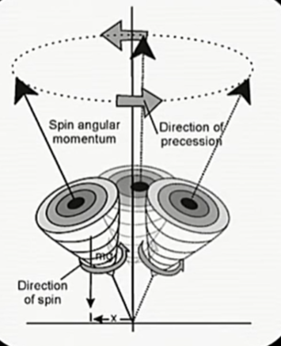
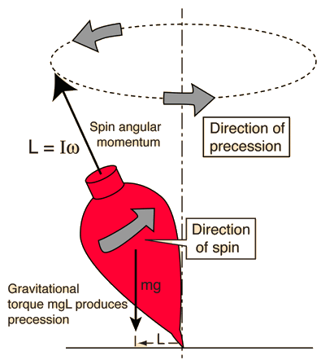
It is important to note here that the energy difference between the two energy states is very small even with very large external magnetic field. Because the energy difference is so small that the population of nuclei in the two energy states are nearly equal. However, the lower energy state has slight excess population than the higher energy state. The relative populations of the two spin states will change if energy of correct frequency is supplied to induce transitions. Nuclei in the lower energy state absorb RF radiation and undergo transitions to the higher energy state. If this process keeps on going continuously, the excess nuclei in the lower state may diminish and hence no further absorption of energy will occur and so the observed signals may fade out or diminish entirely. This situation when the populations of the two energy states become equal is known as saturation. However, the populations of the two spin states do not become equal because nuclei in the higher energy state are constantly returning to the lower energy state.

Slide 37
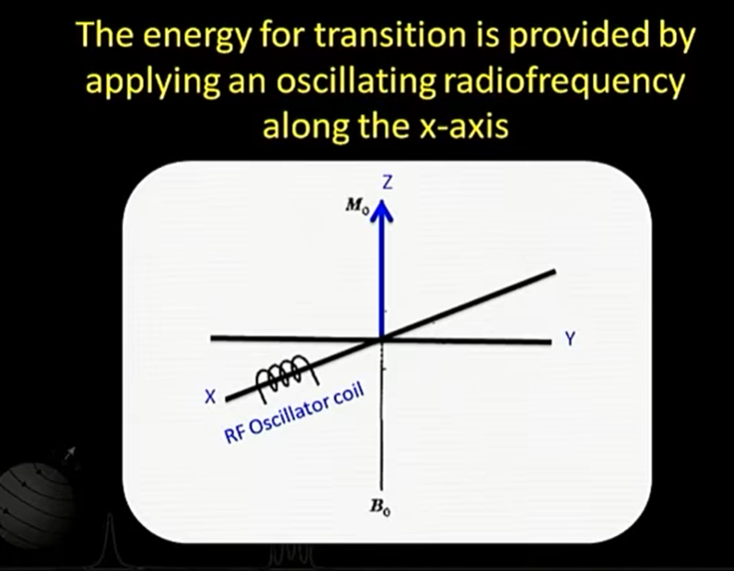
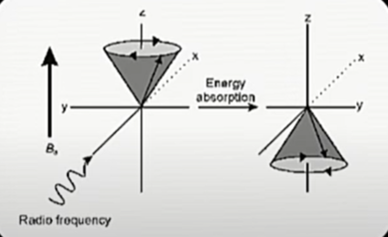
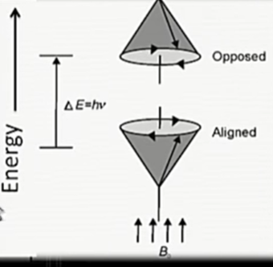
Two things are important:
We need RF to cause a transition from alpha to beta.
We got nuclear precessional motion having frequency in its expression which is proportional to B0.
These two things being equal is responsible to cause resonance.
This provides for mechanism for the transition (spin flip)

Slide 38
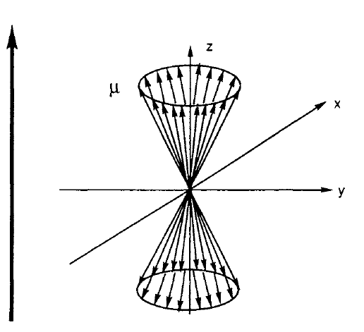
In NMR, we will always consider that the magnetic field to be applied along Z direction
B₀
Up spins (lower energy)
Down spins (higher energy)
Precessional cone
Net magnetization (M₀) in the z direction as there are slightly more number of up spins than down spins

Slide 39
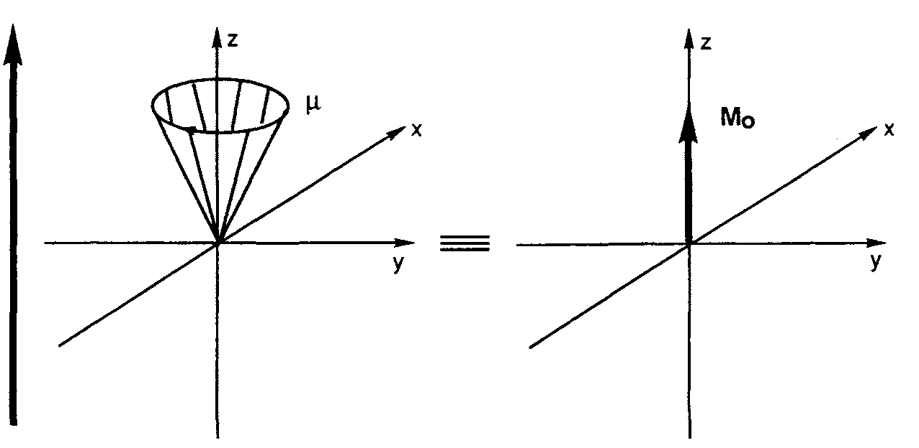
Magnetization Along z Direction
B₀
The spins are distributed homogenously
around the precessional cone
There are a slightly more number of nuclear spins along the magnetic field
A net magnetization along the z axis
B₀
M_{o}: Longitudinal/Bulk
magnetization
(Thermal Equilibrium)

Slide 40
