Slide 1
1. Mass spectrum of a non polar organic molecule shows M⁺, M⁺+2 M⁺+4 at the ratio of 9:6:1. The compound is
1,3 dichlorobenzene b)1,4 dibromobenzene c)1,4 dichlorobenzene d)1,4 difluorobenzene
Ans: c) (9:6:1 ratio means two chlorine and the compound is non polar)
2. Which of the following carbonyl compounds will give a fragment ion at m/z = 58 in their mass spectrum:
(a) C₂H₅CH(CH₃)CHO (b) CH₃CH₂CH₂COCH₃ (c) CH₃CH₂CH₂COCD₃ (d) (CH₃)₂CHCH₂CHO
Ans b)
3. Predict the structure of compound C₁₀H₁₂O whose mass spectrum shown m/z values 15, 43, 57, 91, 105 and 148 (base peak)
Ans : CH₃COCH₂CH₂C₆H₅ (91 for C₆H₅CH₂⁺, 43 for CH₃CO⁺ )
4. In the electron ionization (EI) mass spectra, methyl hexanoate, methyl heptanoate and methyl octanoate give the same base peak. The m/z value of the base peak is ______
Ans 74
NET

Slide 2
5. Identify the compound whose molecular ion appears as a pair of equal intensity peaks at m/z = 122 and m/z = 124. Large
fragment ions are seen at m/z = 43 (base peak).
1-bromopropane (b) 2-bromopropane (c) Both A and B (d) None of these
Ans: b)
6. Mass fragment of [IrCl]⁺ in mass spectrometry shows three mass peaks at m/z = 226, 228, and 230. Given that natural abundances of ¹⁹¹Ir, ¹⁹³Ir, ³⁵Cl and ³⁷Cl and 37%, 63%, 76% and 24% respectively, the intensities of the mass peaks are in the order
(a) 49.5:100:26.6 (b) 100:49.5:26.6 (c) 26.6 : 100: 49.5 (d) 26.6:49.5:100
Ans. a)
NET
7.In the mass spectrum of dodecahedrane (C₂₀H₂₀), approximate ratio of the peaks at m/z 260 and 261 is:
(a) 1: 1 (b) 5 : 1 (c) 10: 1 (d) 20 : 1
Ans: b)

Slide 3
9.A compound shows M⁺ at 84 and a base peak at 56. In ¹H NMR it shows a single peak at 1.4 ppm and in ¹³C NMR also at 35 ppm
The compound –
a)Cyclobutane-1,3-dione b) Cyclohexane c) dichloromethane d)1,2,3-trimethyl cyclopropane
Ans: b)
NET
11. Follow the reaction below. The product A shows M⁺, M⁺+2 M⁺+4 at the ratio of 1:2:1. So-
HX = HCl, Y = Cl b) HX = HCl, Y = Br c) HX = HBr, Y = Cl, d) HX = HBr, Y = Br
Ans: d)

Slide 4
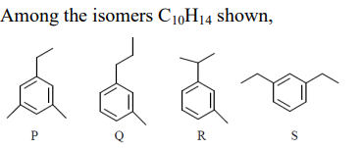
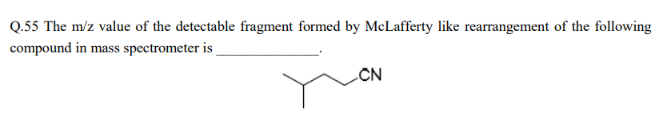
12.
GATE
the isomer that can be identified uniquely by mass spectrometry alone is:
(a) P (b) Q (c) R (d) S
Ans: b)
GATE
13. The m/z value of the detectable fragments formed by Melafferty like rearrangement of the following compound in mass spectrometer:
Ans: 41

