Slide 1
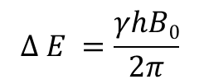
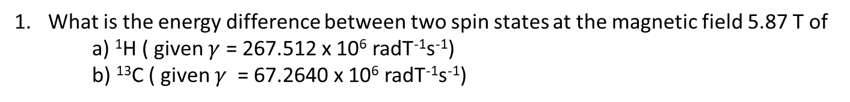
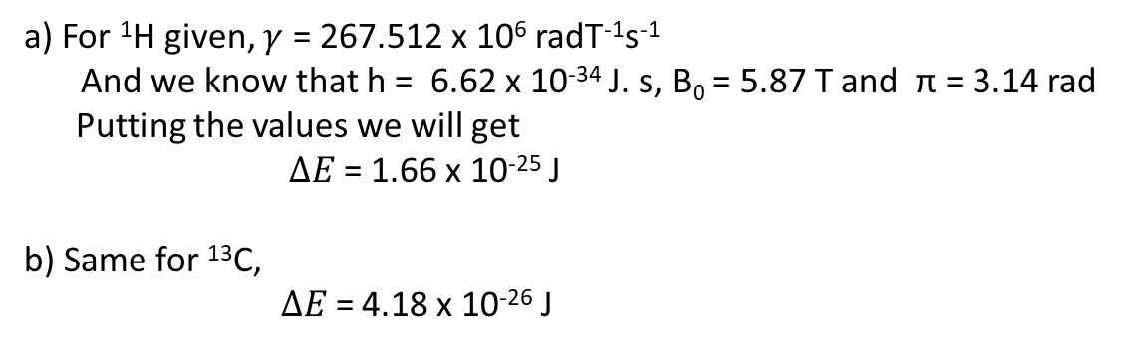
What is the energy difference between two spin states at the magnetic field 5.87 T of
a) ¹H ( given $γ$ = 267.512 x 10⁶ radT⁻¹s⁻¹)
b) ¹³C ( given $γ$ = 67.2640 x 10⁶ radT⁻¹s⁻¹)
Ans :
$$∆ E =\frac{γhB0}{2π}$$
a) For ¹H given, $γ$ = 267.512 x 10⁶ radT⁻¹s⁻¹
And we know that h = 6.62 x 10⁻³⁴ J. s, B₀ = 5.87 T and π = 3.14 rad
Putting the values we will get
$∆E \text{=}$ 1.66 x 10⁻²⁵ J
b) Same for ¹³C,
$∆E \text{=}$ 4.18 x 10⁻²⁶ J

Slide 2

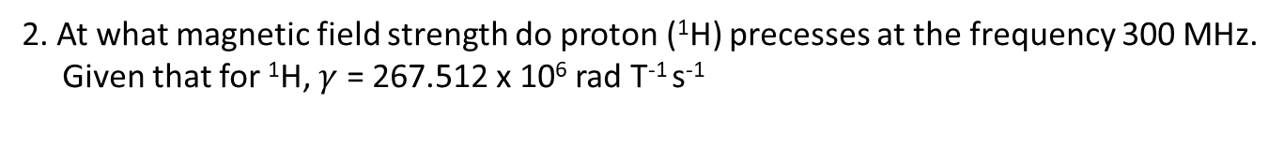
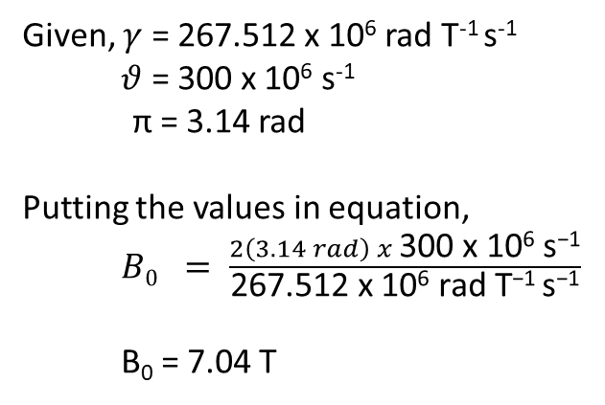
2. At what magnetic field strength do proton (¹H) precesses at the frequency 300 MHz.
Given that for ¹H, $γ$ = 267.512 x 10⁶ rad T⁻¹ s⁻¹
Ans .
$B0 = \frac{2πθ}{γ}$
Given, $γ$ = 267.512 x 10⁶ rad T⁻¹ s⁻¹
$θ$ = 300 x 10⁶ s⁻¹
π = 3.14 rad
Putting the values in equation,
$B0 = \frac{2\left(3.14 rad\right) x \text{300 }\text{x}\text{ 106 }\text{s}\text{−1}}{\text{267.512 }\text{x}\text{ 106 }\text{rad} \text{T}\text{−1} \text{s}\text{−1}}$
B₀ = 7.04 T

Slide 3
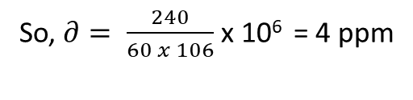

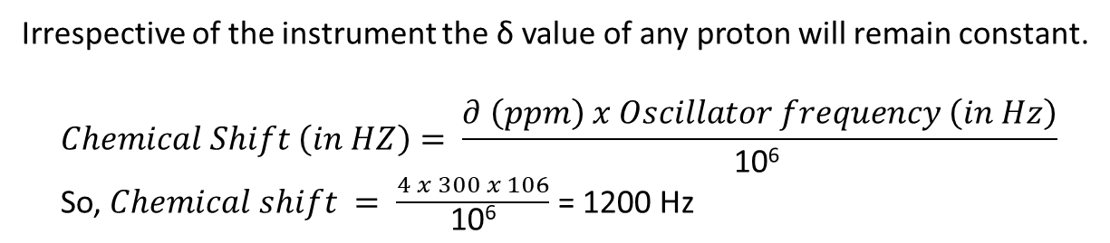
3.
a)
$∂ \left(ppm\right)= \frac{Chemical Shift (in HZ)}{Oscillator frequency (in Hz)}$ x 10⁶
So, $∂= \frac{240}{60 x 106}$ x 10⁶ = 4 ppm
b)
Irrespective of the instrument the δ value of any proton will remain constant.
$$Chemical Shift \left(in HZ\right)= \frac{∂ \left(ppm\right) x Oscillator frequency \left(in Hz\right)}{\text{10}\text{6 }}$$
So, $Chemical shift = \frac{4 x 300 x 106}{\text{10}\text{6}}$ = 1200 Hz

Slide 4
4. In the ¹H NMR spectrum, acetone (CH₃COCH₃) gives a singlet corresponding to 6 equivalent protons, while dichloromethane (CH₂Cl₂) gives a singlet corresponding to 2 equivalent protons.
Since the two signals have equal intensity (1:1), the total number of contributing protons must be equal. Therefore, one molecule of acetone (6 H) corresponds to three molecules of CH₂Cl₂ (3 × 2 = 6 H).
Hence, the molar ratio of acetone to dichloromethane is 1 : 3.

Slide 5
5.
2
3
1
This two protons are
diastereotopic
thus are non equivalent
3
2
4
4
1
3
3
4
Total type of proton is 4
The molecule has a plane of symmetry
Total type of proton is 4
4
3
1
5
2
Total type of proton is 5

Slide 6




6.
C₃H₆O₂
$DBE =3+1 − \frac{6}{2}$ $=1$
This means the molecule has one double bond or one ring.
Bothe peaks are singlet.
C is the number of Carbon atoms
H is the number of Hydrogen
X is the number of Halogen (F, Cl, Br, I)
N is the number of Nitrogen.
Oxygen and sulfur are not included here
So the structure is :
$$∂=3.66$$
$∂=$2.19

