Slide 1
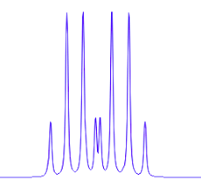
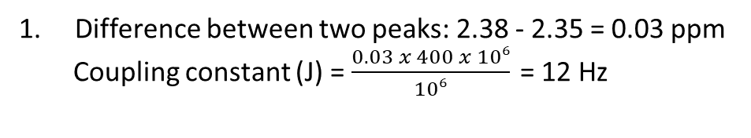
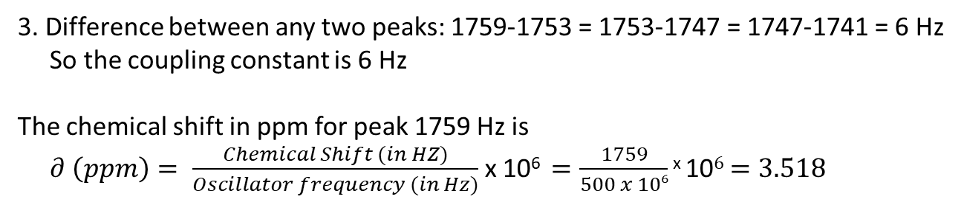
0.03 ppm
1. Difference between two peaks: 2.38 - 2.35 = 0.03 ppm
Coupling constant (J) = $\frac{0.03 x 400 x 106}{106} \text{=}\text{ 12 }\text{Hz}$
2.
Another type H
And triplet
One type H
And doublet
One type H
And doublet
Another type H
And doublet
Both the H is equivalent
Thus no splitting and it would be singlet
3. Difference between any two peaks: 1759-1753 = 1753-1747 = 1747-1741 = 6 Hz
So the coupling constant is 6 Hz
The chemical shift in ppm for peak 1759 Hz is
$∂ \left(ppm\right)= \frac{Chemical Shift (in HZ)}{Oscillator frequency (in Hz)}$ x 10⁶ $=\frac{1759}{500 x 106}$ ^{x} 10$6$ $=3.518$

Slide 2
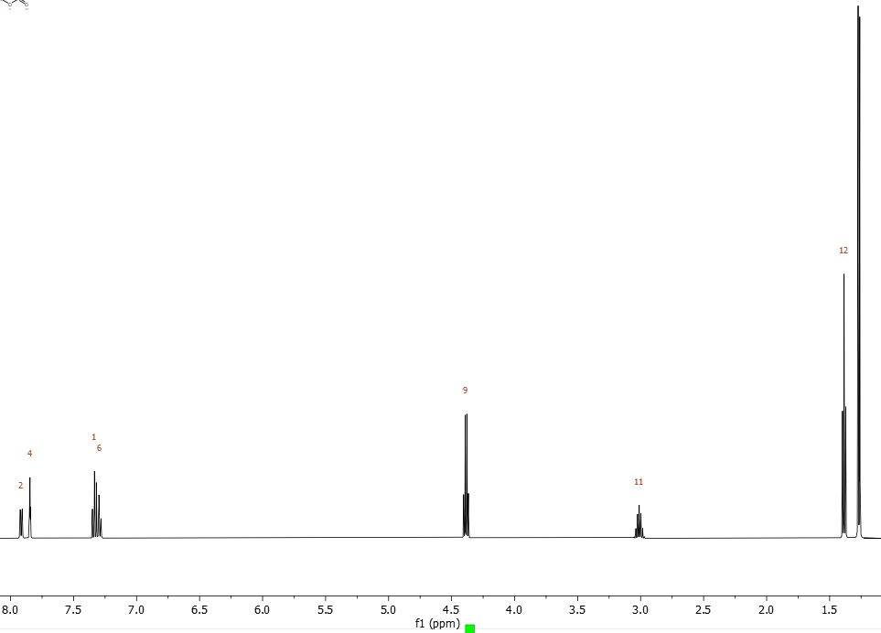
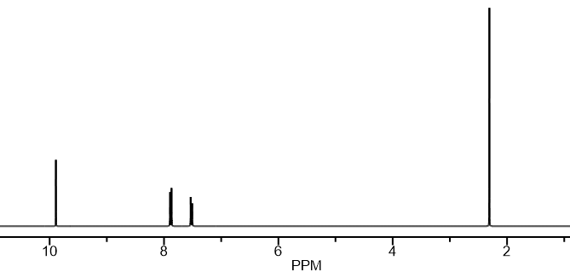
d
4.
c
f
c
b
g
d
d
d
h
e
c
b
b
a
a
a
a
d
c
b
b
e
g
f
c
a singlet
b doublet
C doublet
d singlet
h
a triplet
b quartet
c heptet
d doublet
e singlet
f doublet
g multiplet
h doublet

Slide 3
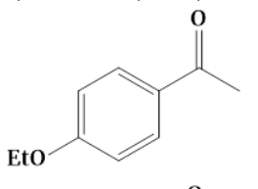
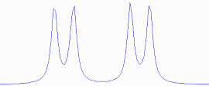
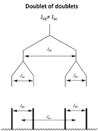


5.
6.
0.02 ppm
0.02 ppm
2.82-2.80 = 0.02 ppm
2.77-2.75 = 0.02 ppm
Coupling constant (J) = $\frac{0.02 x 400 x 106}{106} \text{=}\text{ 8 }\text{Hz}$
0.05 ppm
2.81 ppm
2.76 ppm
(2.82 + 2.80)/2 = 2.81 ppm
(2.77+2.75)/2 = 2.76 ppm
2.81 - 2.76 = 0.05 ppm
Coupling constant (J) = $\frac{0.05 x 400 x 106}{106} \text{=}\text{ 20 }\text{Hz}$

