Slide 1
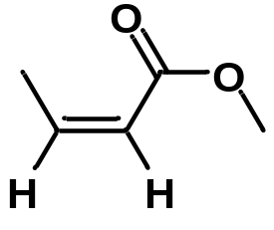
1. An organic compound (C₇H₁₂O₂) exhibited the following data in the ¹H NMR spectrum.
δ 7.10 (1H, dt, J= 16 Hz and 7.2 Hz), 5.90 (1H, dt, J= 16 Hz and 2 Hz), 4.1 (2H, q, J= 7.2 Hz), 2.10 (2H, m), 1.25 (3H, t, J= 7.2 Hz), 0.90 (3H, t, J= 7.2 Hz) ppm. (CSIR NET)
Q2. Determine the correct structure of a compound having molecular formula C₆H₁₁BrO₂, based on the following characteristic spectral data:
IR: 1736 cm⁻¹
¹H NMR (δ, ppm): 3.59 (s, 3H), 3.32 (t, 2H), 2.25 (t, 2H), 1.85–1.75 (m, 2H), 1.73–1.62 (m, 2H)
¹³C NMR (δ, ppm): 174.0, 51.0, 32.9, 32.8, 31.0, 23.0 (CSIR NET)
Q3. Predict the number of signals expected in the ¹H NMR spectrum of the following compound and assign order of chemical shift (δ) values to each type of proton.
(CSIR NET)

Slide 2

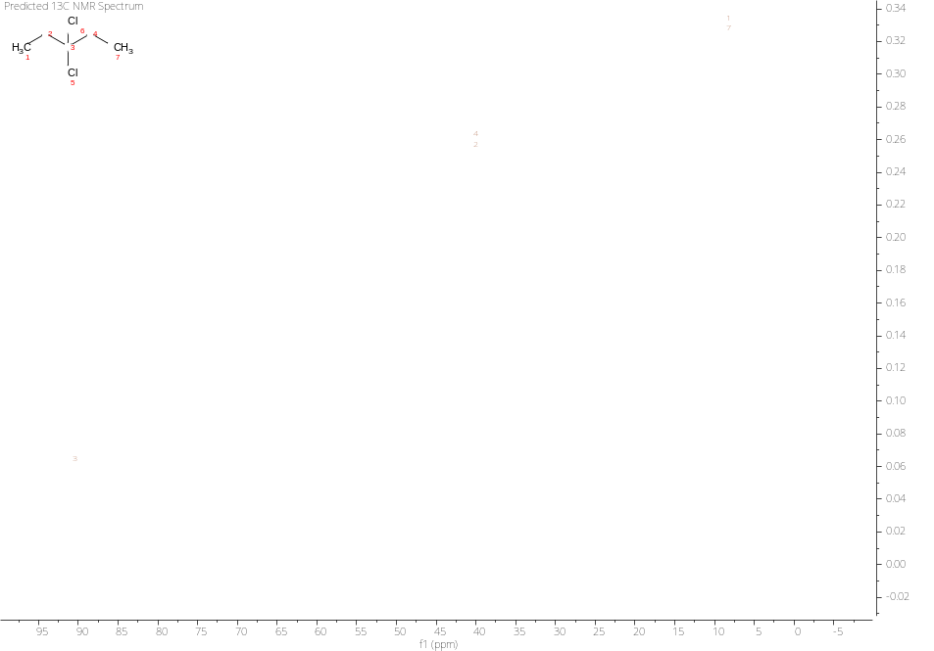
4. The ¹H and ¹³C NMR data is provided of one compound having formula (C₅H₁₀Cl₂). Predict the structure of the compound.
5. Two isomers with the formula C₁₀H₁₂O. Predict the structure of the compounds.
Compound A: IR (neat): 1675 cm-¹; ¹H NMR (CDCl₃): 1.20 (d, J = 7 Hz, 6H), 3.53 (septet, J = 7 Hz, 1H), 7.94 (m, 2H), 7.68 (m, 1H), 7.3 (m, 2H).
Compond B: B: IR (neat): 1705 cm⁻¹; ¹H NMR (CDCl₃): 0.95 (t, J = 7 Hz, 3H), 2.35 (q, J = 7Hz, 2H), 3.6 (s, 2H), 7.20 (m, 5H).

Slide 3
Q 6. Match the following with ¹³C NMR value:
Compound ¹³C NMR chemical shift (δ ppm)
(A) Acetic acid (i) 95
(B) Acetonitrile (ii) 115
(C) Acetone (iii) 175
(D) Carbon tetrachloride (iv) 205
(CSIR NET)

