Slide 1
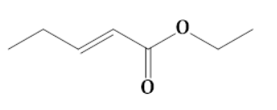
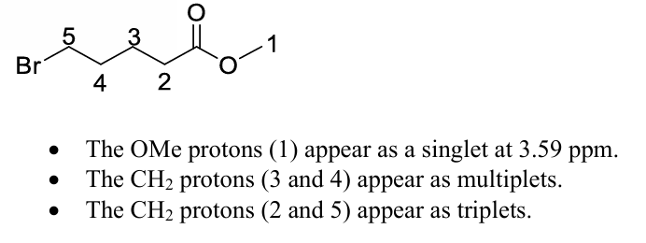
1.
DBE = 2
δ value 6 near ppm indicates presence of alkene
2.
DBE = 1, and IR data confirms the presence of ester functional group
3.
No. of signals = 4
3
4
2
1

Slide 2
The concept of resonance comes into play while deciding the chemical shift of protons.
3
4
2
1
2 > 1 > 4>3
4.
5.
Compound A
Compound B
All H’ peak of benzene merges and appears
as multiplate
IR value of carbonyl group of compound B is higher than compound A as for compound A the carbonyl group is in conjugation with
the benzene which weakens the carbonyl bond strength which is not present in Compound B.

Slide 3
0-50 ppm: C-C single bond. 50-100 ppm: C-X (X: O, N, S, and halogen). 100-150 ppm: C=C double bonded carbons. 150-200 ppm: C=O (carbon double bonded to electronegative atom)
(A) Acetic acid : 175
(B) Acetonitrile : 115
(C) Acetone : 205
(D) Carbon tetrachloride : 95
6.

