Slide 1
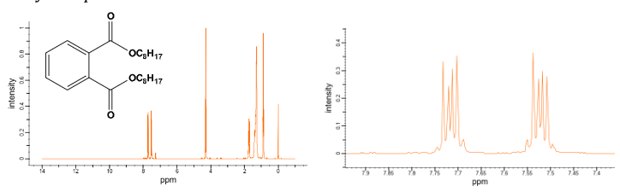
1. Di-n-octylphthalate is a colorless, odorless, oily liquid that is used to keep plastics soft or more flexible (plasticizer). If you record the 1 H NMR spectra of this compound, you will find that the pattern for the aromatic protons look more complicated than expected. Could you explain the reason behind it?
2. In the ¹H NMR spectrum recorded at 293 K, an organic compound (C₃H₇NO) exhibited signals at δ 7.8 (1H, s), 2.8 (3H, s), and 2.6 (3H, s). What is the compound?
(CSIR NET)
3. An aromatic compound which is mono-substituted with molecular formula C₉H₁₂ shows three ¹H NMR signals at δ 7.2 (5H), 2.9 (1H), and 1.2 (6H). Predict its structure and assign the peaks.
4. Predict the splitting pattern of ¹³C NMR spectrum of TiCl₃(CDH₂)? Assume that it only couples with H and D, and ¹J(C–H) > ¹J(C–D).
(CSIR NET)

Slide 2
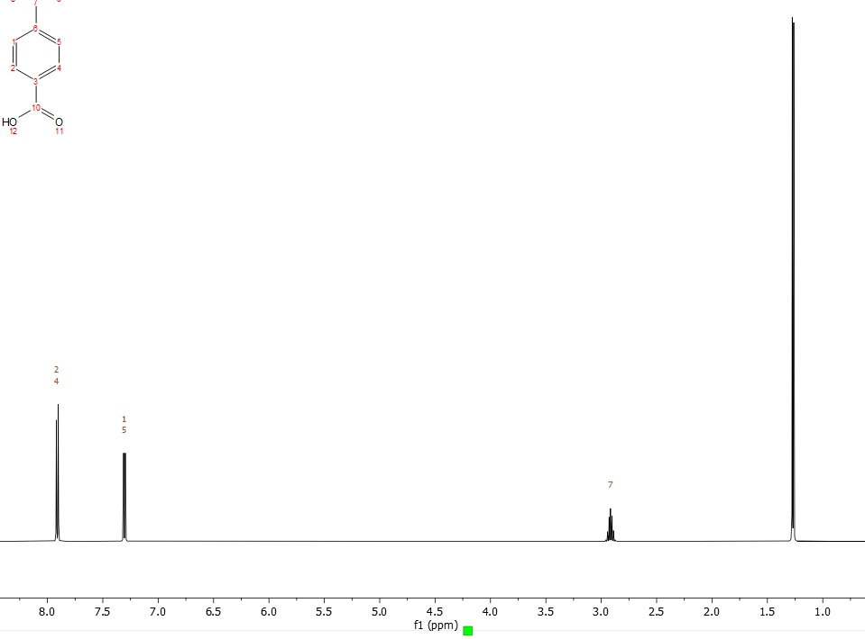
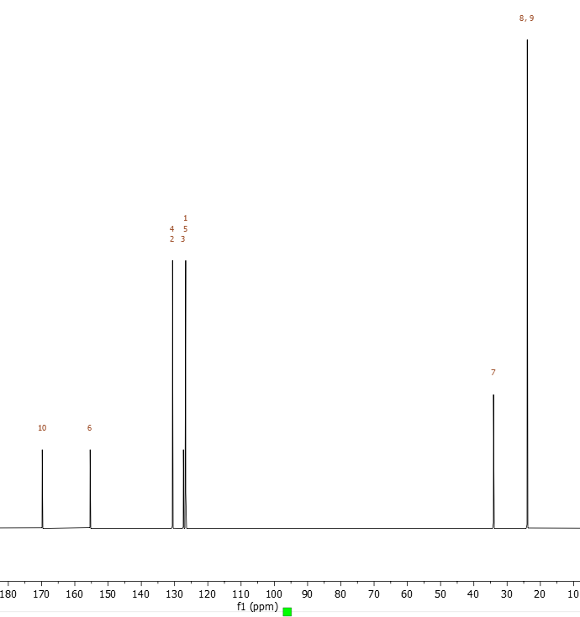
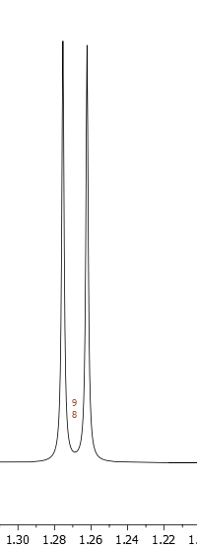
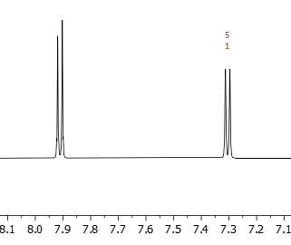
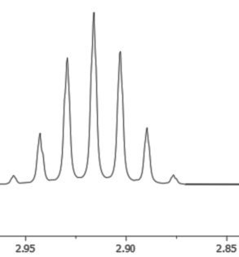
5. ¹H and ¹³C NMR is given of a compound with molecular formula C₁₀H₁₂O₂ and it has one exchangeable proton near 12 ppm .
What is the structure of the compound.
2H
2H
1H
6H
Normal Carbon | DEPT-135 | DEPT-90
26 | Positive | No peak
34 | Positive | Positive
126.6 | Positive | Positive
130.5 | Positive | Positive

Slide 3
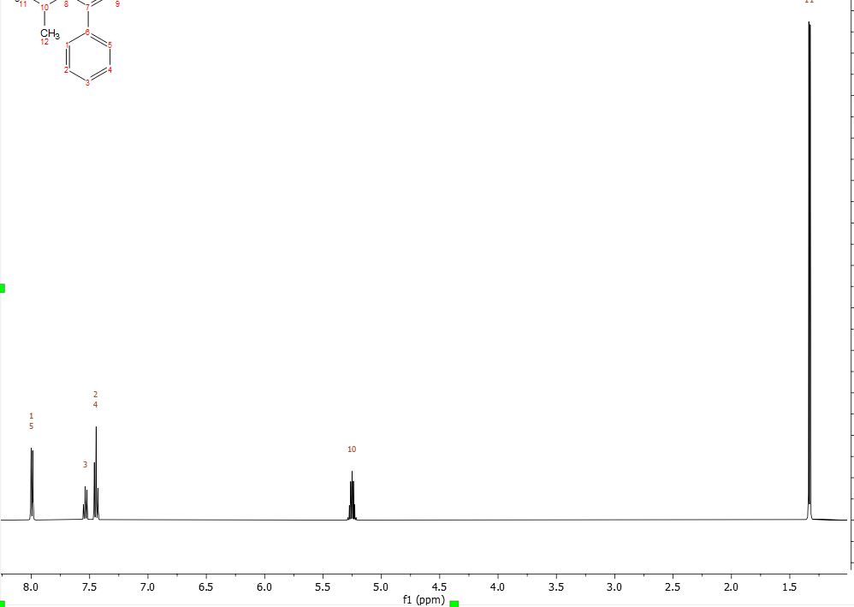
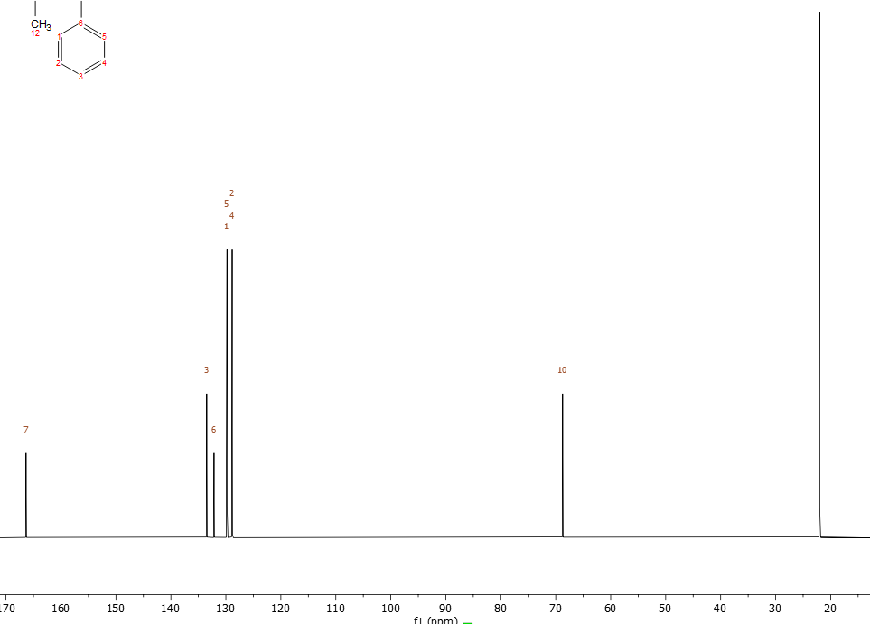
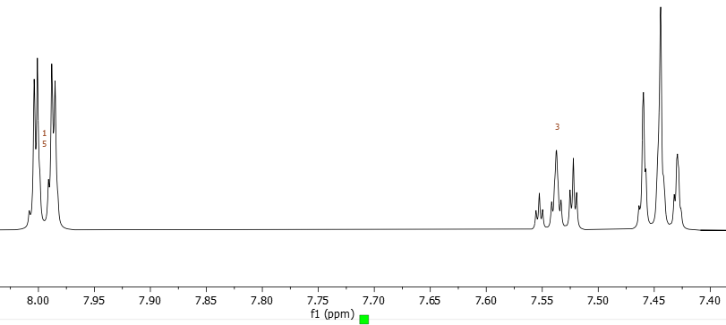
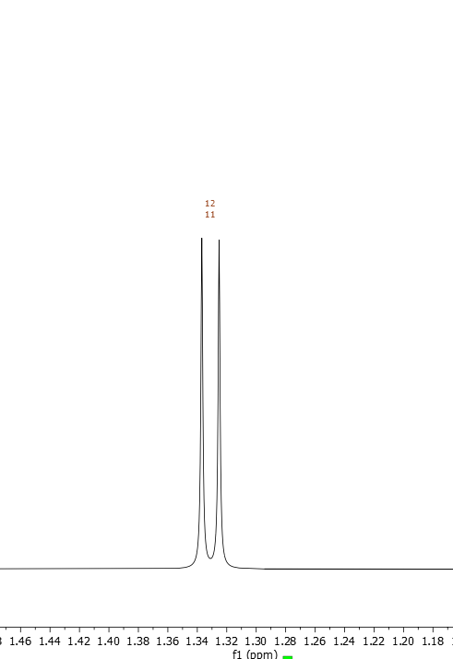
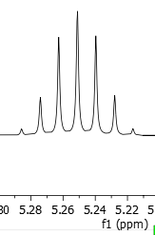
6. Continuing with same molecular formula (C₁₀H₁₂O₂ ) another compound’s NMR is given. Suggest the structure.
1H
1H
6H
2H
2H
Normal carbon | DEPT-135 | DEPT-90
22 | Positive | No Peak
68.36 | Positive | Positive
128.5 | Positive | Positive
129.7 | Positive | Positive
133 | Positive | Positive

