Slide 1
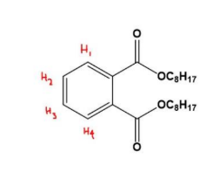
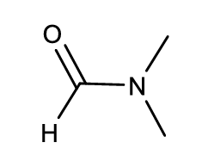
1. H₁ and H₄ have equivalent chemical shift as they are symmetric. The same thing is
valid for H₂ and H₃. However, H₁ has ortho coupling with H₂ whereas it has meta coupling
with H₃. Thus, H₂ and H₃ magnetically non-equivalent. This in turn also makes H₁ and H₄
magnetically non-equivalent. That is why the spectrum is complicated.
2.
The compound is dimethylformamide (DMF)
The 2 methyl groups are non-equivalent and appear at two different chemical shifts of 2.6 and 2.8 ppm. The olefinic proton appears at a singlet at 7.8 ppm.
2
3.
1
2
2
1

Slide 2
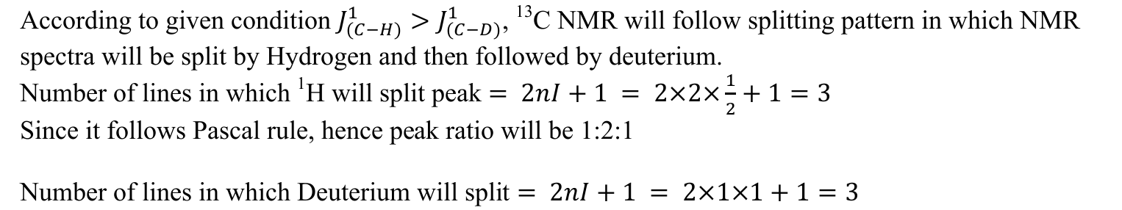
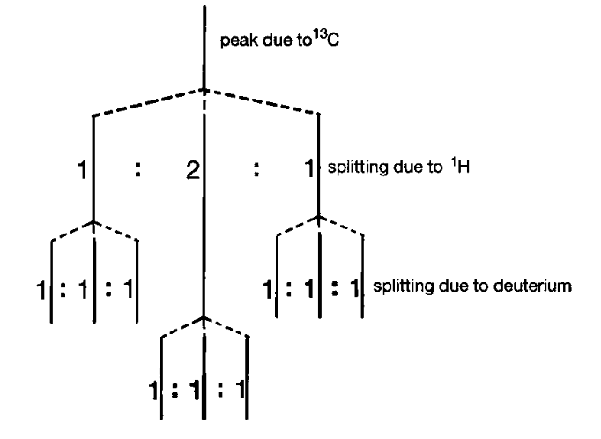
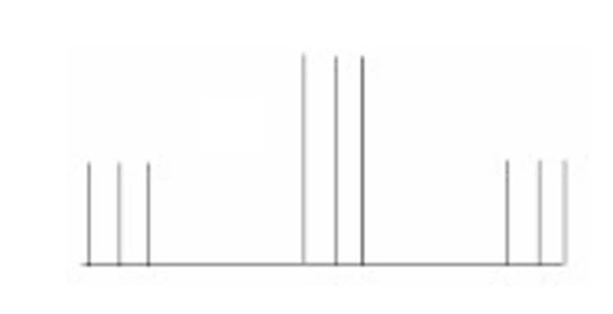
4.

Slide 3
5.
6.

