Slide 1
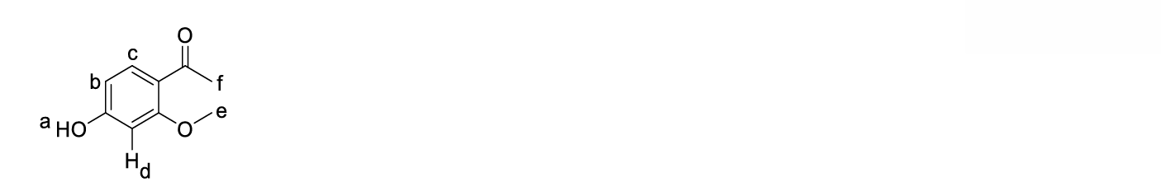
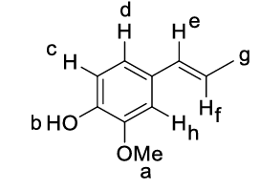
1.
DBE = 5
The methoxy proton (e) appears as a singlet at 3.9 ppm. The methyl proton (f) shows a peak at 2.3 ppm.
The aromatic protons (c) comes at 7.8 ppm, (b) at 7.0 ppm and (d) appear around 6.5 ppm.
The OH proton (a) comes around 5.8 ppm.
2.
DBE = 5
The presence of a broad band at 3400 cm⁻¹ confirms the presence of OH group. The OH group here appears as a singlet at 5.0 ppm
• The aromatic protons are observed at (c: 6.9 ppm, 1H, d); (d: 6.75 ppm, 1H, d), (h: 6.8 ppm, 1H, s).
• The peak at 3.8 ppm (a) is OMe peak. It appears as a singlet.
• J = 18 Hz indicates trans geometry of H. The alkene protons (e and f) appear at 6.28 ppm and 6.0 ppm.
• The methyl protons (g) appear at 1.85 ppm as a doublet.

Slide 2
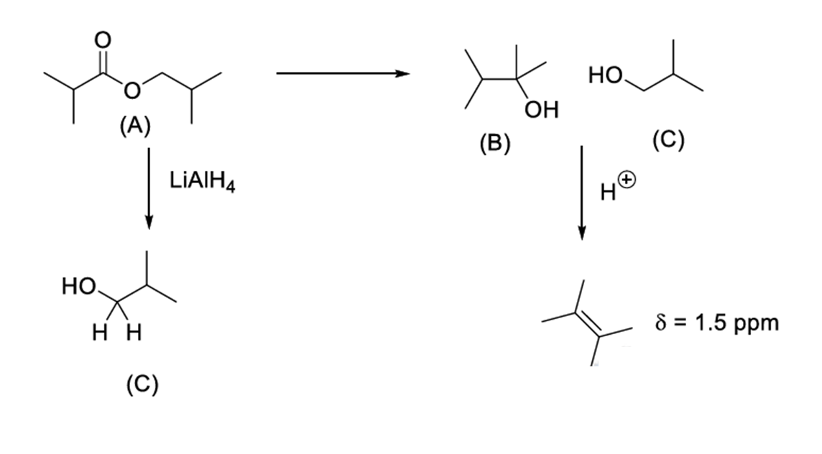
3.
In ¹H NMR, we observe a peak for DMSO-d₆ because the residual non-deuterated impurity (a small amount of protic solvent) still contains a hydrogen, which gives a signal. This peak appears as a quintet because of the residual DMSO-d₅ in which the proton couples with the deuterium atoms, causing a splitting pattern (2nI + 1 = 5) as I = 1 for D.
In the ¹³C NMR, the signal at δ 39.7 ppm is typically a septet, due to coupling with 3 D atoms (2nI + 1) as I = 1 for D.
Excess
MeMgCl
4.
(D)

Slide 3
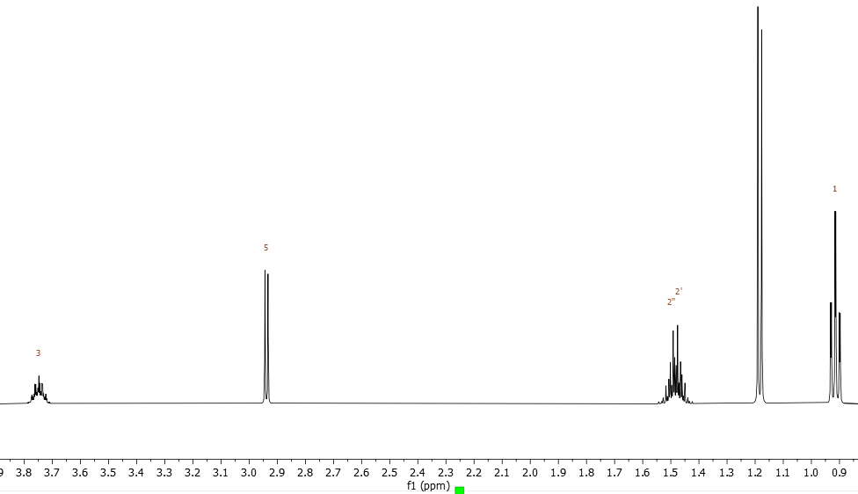
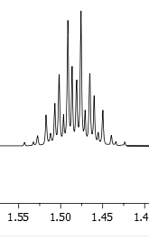
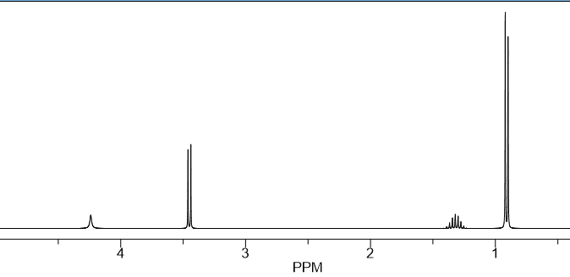
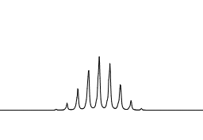
5.
DBE is 1
Plane of symmetry present
-OCH2 present
6. Upon addition of Lucas reagent tertiary
alcohol solution becomes turbid instantly,
Secondary alcohol reacts slowly and primary
alcohol does not react at RT
Isomer 2
Diastereotopic H
present.
The formula is of butanol
Isomer 1:
Isomer 3:
Isomer 2:
Isomer 4
Isomer 4:

