Slide 1
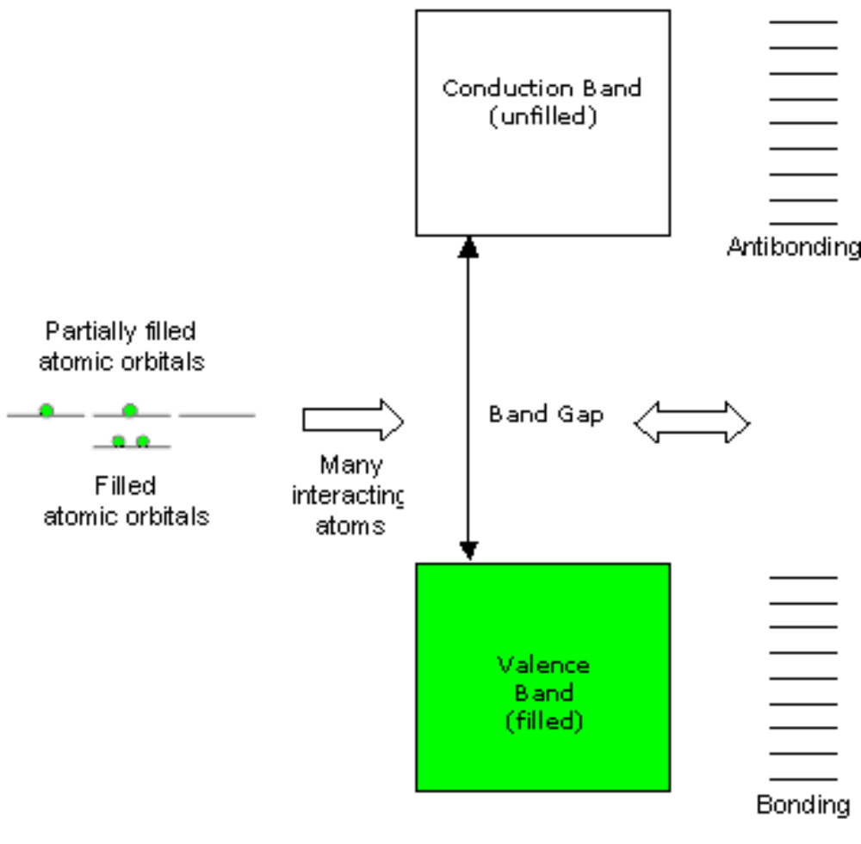
Evolution of energy levels in molecules and materials

Slide 2
Optical properties
Three categories of materials based on their electrical properties
Insulators, Semiconductors, and Conductors
Energy
LUMO
Conduction band
Band gap
Conductor
Valence band
HOMO
Semiconductor
Insulator

Slide 3
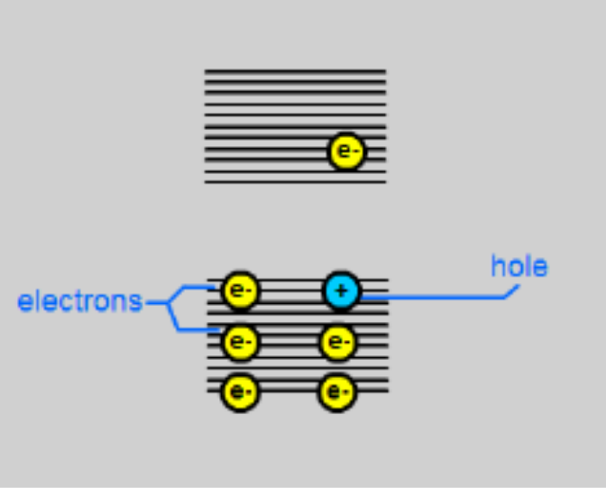
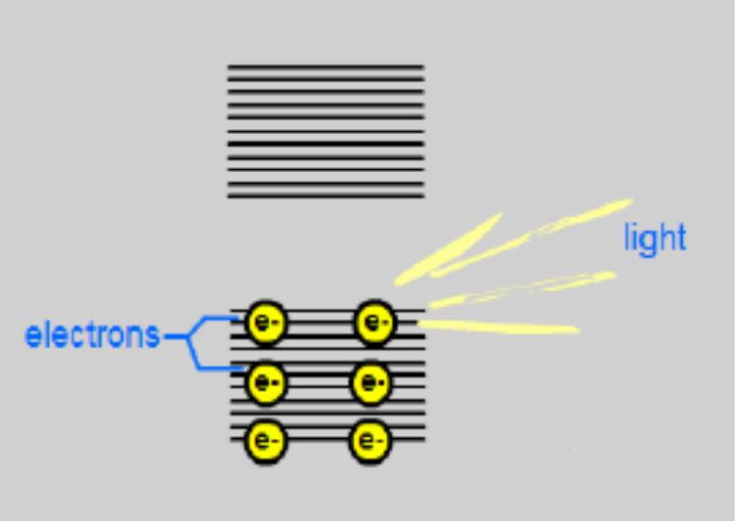
Energy levels in semiconductors
Electron gets excited to conduction band upon excitation with energy more than the band gap. This leaves hole in the valence band.
Excited electrons relax back to the valence band by releasing the energy in the form of
light.

Slide 4
Optical properties
Generation of excitons
CB
-
-
Bohr
exciton
radius
Light
Band gap (E_{g})
VB
-
-
-
+
-
+
-
-
-
-
-
-
An electrically neutral excited state of an insulator or semiconductor, often regarded as a bound state of an electron and a hole. The electron-hole pair is called exciton. The coulombic energy separating the excitons is the Bohr exciton radius. This is characteristic of semiconductors.

Slide 5
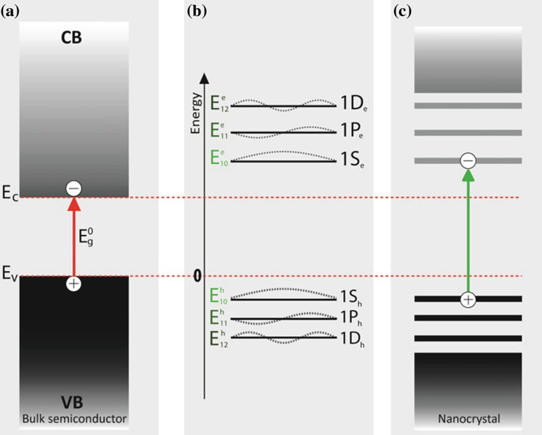
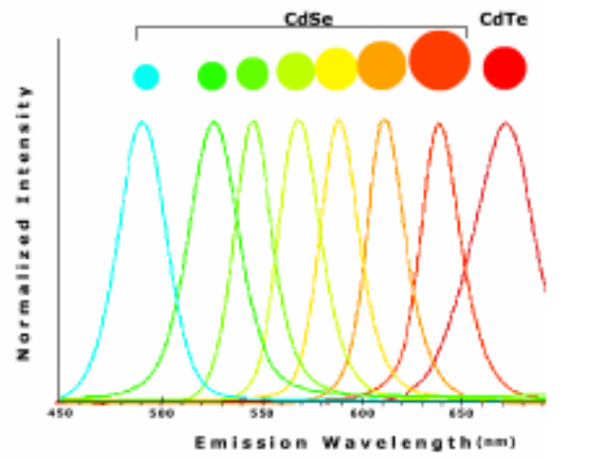
Quantum confinement

Slide 6
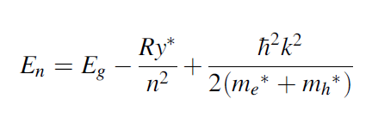
The energy of an exciton is given by
Ry* is the exciton Rydberg energy (which corresponds to the ionization energy of the lowest hydrogenic state)
The last term is the kinetic energy of the exciton centre of mass motion in which k is the exciton wave vector. This originates due to interacting holes and electrons via coulombic potential .
Bohr-exciton radius
The distance between the electron and the hole within an exciton is called Bohr radius of the exciton. The exciton Bohr radius provides a very useful length scale to describe the spatial extension of excitons in semiconductors, and ranges from 2 to 50 nm depending on the semiconductor.

Slide 7
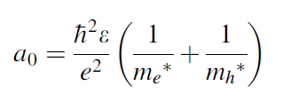
where m_{e}* and m_{h} * are the effective masses of electron and hole, respectively.
e is the electron charge and ε is the dielectric constant of the semiconductor.
Typical exciton Bohr radius of semiconductors is of a few nanometers
Material | Bohr exciton radius (nm)
Si | 4.9
Ge | 17.7
GaAs | 14
GaP | 1.7
InP | 9.5
CdSe | 3
InSb | 69

Slide 8
Advantages of Q dots over organic dyes
Within the valence band, electrons of many different energies exist and there is "space" for electrons of many different energies in the conduction band as well. This is the reason that quantum dots absorb light everywhere to the blue of the emission; all those energy levels and potential energy levels mean that light of any energy larger than the band gap can find at least one valence band + conduction band combination with the right energy difference. (confinement forces the e and h to overlap, increasing the effective oscillator strength)
Organic dyes are not composed of large numbers of nearly identical atoms like quantum dots, which means these band structures never develop in them. Instead, an orbital energy diagram for these conventional materials looks like a series of relatively widely spaced individual levels.

Slide 9
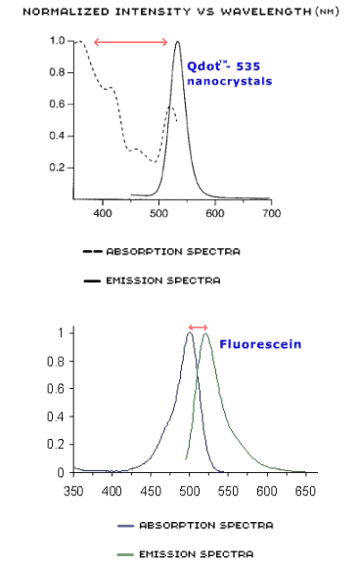
Advantages of Q dots over organic dyes: larger Stokes shift
Overlap of absorbance and emission wavelength is not likely in the case of Q dots as they can be excited far from the emission energy.

Slide 10
Types of Nanoparticles
Metals:
Au, Ag, Cu, Pd, Pt
Semiconductors:
CdS, CdSe, ZnS, ZnSe, PbSe, PbS
Insulators:
SiO₂, Y₂O_{3,} LaF_{3,} etc

Slide 11
Different chemical methods
Colloidal routes
Controlled precipitation, hydrothermal, Thermal
decomposition, micro-emulsion
Solid state methods
Combustion, sol-gel, sonochemical,
precipitation

Slide 12

Gold Sol prepared by Michael Faraday
It is still in London Museum

Slide 13
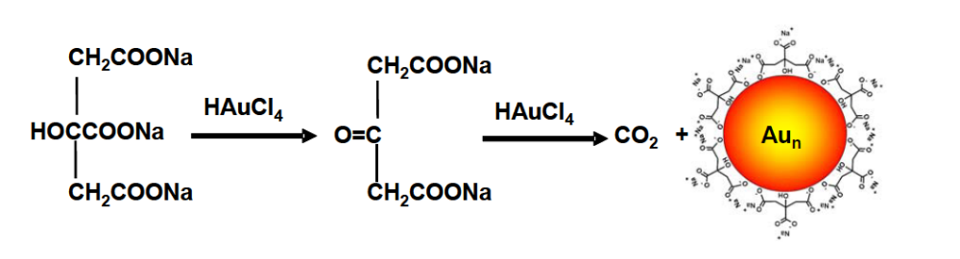
Gold nanoparticles: citrate method
Heat to boiling
Na₃C₆H₅O₇.2H₂O
(2 ml of 1%)
Gold nanoparticles
Stabilized by citrate ions
HAuCl₄ (1 mM)
Other reducing agents: Hydroxylamine hydrochloride, Formaldehyde
M.-C. Daniel and D. Astruc, Chem. Rev. 2004, 104, 293-346

Slide 14
Synthesis of gold nanoparticles
(by two phase synthesis)
Tetraoctylammonium
bromide
NaBH₄
Toluene
(Phase transfer reagent)
Thiols
(R-CH₂SH)
HAuCl₄
Au nanoparticles
stabilized with thiols
2AuCl₄⁻ _{(aq)} + 3H₂ → 2Au _{(s)} + 6H⁺ _{(aq)} + 8Cl⁻ _{(aq)}
The gold salt in the aqueous layer transferred to the toluene layer with the addition of phase transfer reagent. The NaBH4 reduces the gold atoms subsequently thiol molecules attached to the surface due to strong interactions between the Au and S.
In Au nanoparticles, the Au is in Au(0), which technique can be used to verify?
XPS: 83.8 eV whereas for Au(I) 84.9 eV.
Burst et al., Chem. Comm. 804, 1994

Slide 15
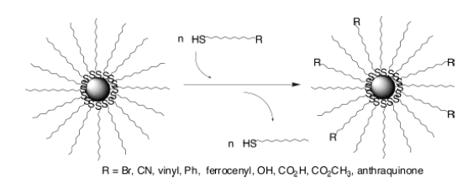
Advantages of ligand capped nanoparticles
Ligand capping : Dispersibility in different medium
Characterization : More analytical tools
Applications : Surface functionalization and ligand exchange

Slide 16
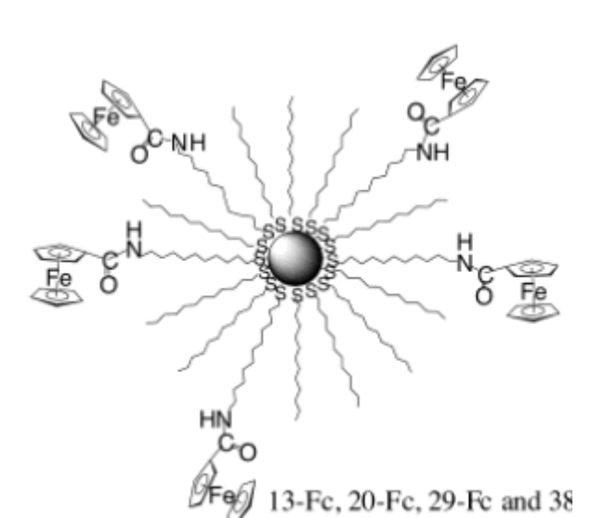
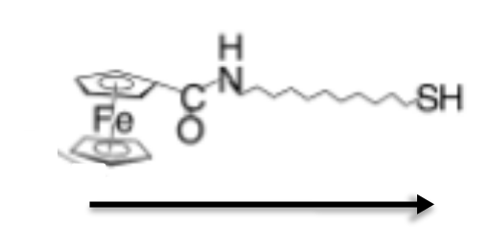
Electrochemically active nanoparticle
Will complete exchange possible?
No. This is because of the repulsion between the bulk head group.

Slide 17
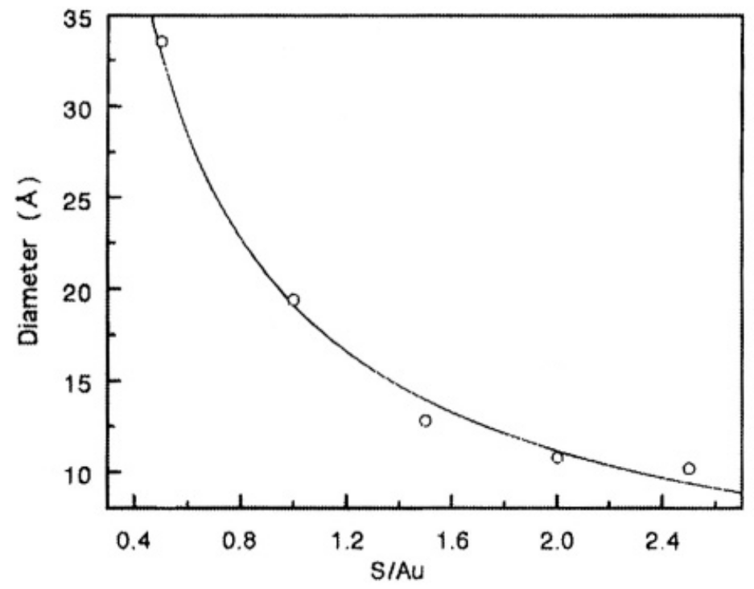
Importance of capping agents
Control the growth of particles
prevent aggregation (depends on the chain length of the ligand)
controls the particle size
Improve dispersibility in various solvents
Graph indicating the decrease in the particle size with the increase in the ligand to metal precursor concentration.

Slide 18
Assignment 1
How do you calculate the number of gold nanoparticles formed in the synthesis?
HAuCl₄ 1 mM (10 mL) or 1 mmol
Size 10 nm

Slide 19
Surface plasmon resonance (SPR)
Perfect conductor simply expels any electric field, so that the only function of a metal should be to block light and act as a perfect reflector. This is caused by the free electrons that provide charge density at the surface.
the free electrons intrinsically have a finite response time, above which they will not be fast enough to shield the bulk metal from incident fields. For typical metals the inverse of this response time, which is known as the ‘plasma frequency’, is around 500–1,000 THz.
Plasmons are collective oscillations of the “valence (free) electron gas” density, often at optical frequencies
Above the plasma frequency, a metal is not strongly reflective, but changes into a transparent material because the electrons cannot respond fast enough to screen the field.
In the regime around and just below the plasma frequency metals are ‘plasmonic’. As a consequence, small metal objects will support resonances of the free electron gas that strongly interact with light.
The mean free path of the d electron in noble metals is about 50 nm.
In particles smaller than 50 nm , no scattering is expected from the bulk and all interactions are expected to be with the surface.

Slide 20
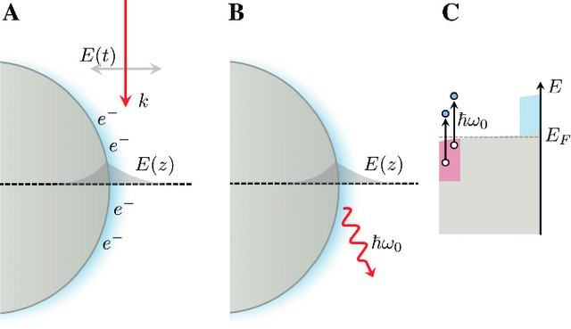
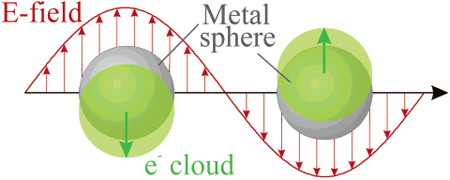
Surface plasmon resonance (SPR)
Surface Plasmons:
-When plasmons are confined and couple with a photon, the resulting particle is called a polariton. This polariton propagates along the surface of the metal (interface between metal and dielectric) until it decays, either by absorption, whereupon the energy is converted into phonons (can be heat), or by a radiative transition into a photon.
Surface Plasmon Resonance:
- The excitation of surface plasmons by light and the light (λ) in resonance with surface plasmon oscillation is denoted as a surface plasmon resonance (SPR) for planar surfaces or localized surface plasmon resonance (LSPR) for nanometer-sized metallic structures.
Schematic of plasmon oscillation for a sphere, showing the displacement of the conduction electron charge cloud relative to the nuclei.
After incident of light, the resulting charge density oscillations give rise to strong, evanescent electromagnetic fields (E z ), extending both inside the metal and into the adjacent dielectric. (B) The damping of the surface plasmon through radiation.

Slide 21
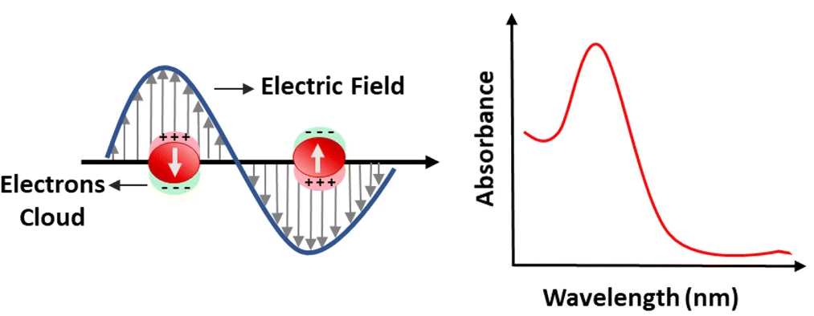
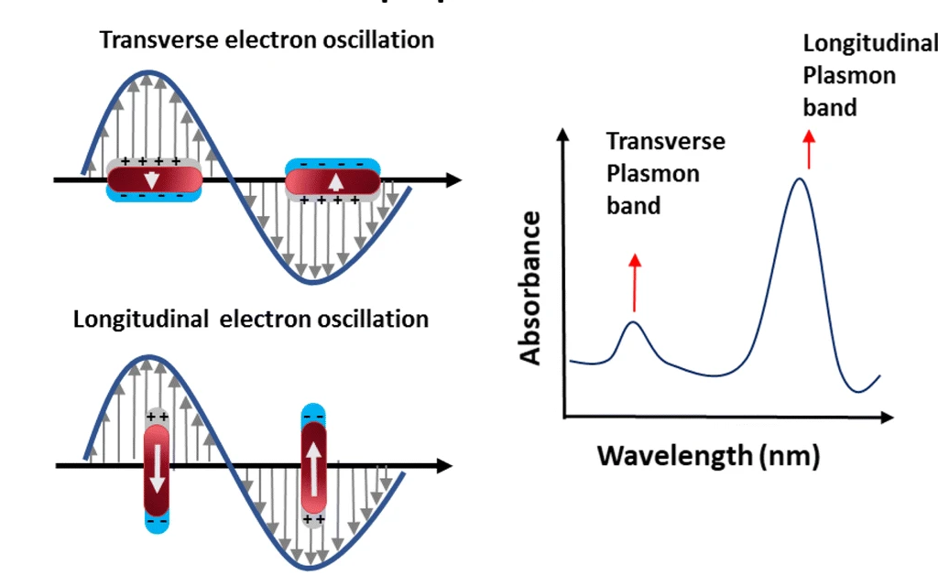
Transverse and Longitudinal SPR
Spherical plasmonic particles
For nonspherical particles, such as rods, the resonance wavelength depends on the orientation of the electric field relative to the particle, and thus, oscillations either along (longitudinal) or across (transversal) the rod are possible.
Anisotropic plasmonic particles
The intensity of a plasmon resonance is related to the magnitude of the transition dipole moment.
Due to longer path of the electron movements, the longitudinal mode is located at the red side of the transverse mode.

Slide 22
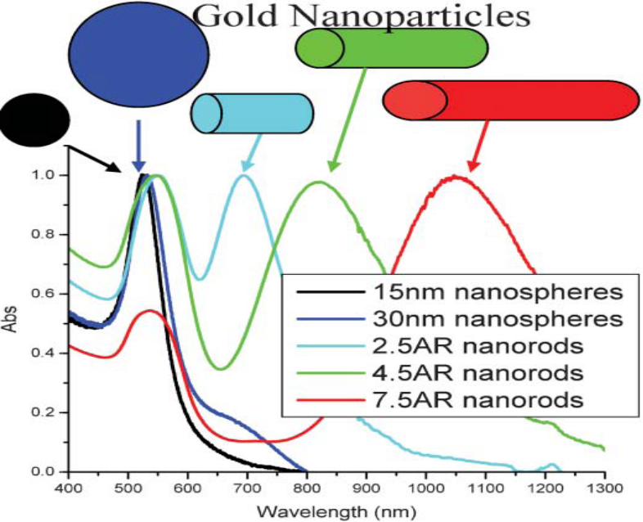
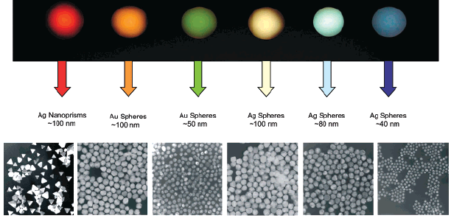
Optical properties of Au nanoparticles with different morphologies
The shape and position of the longitudinal modes of the SPR strongly depends on the length of the nanorods (the aspect ratio)

Slide 23
Surface Plasmon resonance (SPR)
The effect not only depends on the size and shape but also on the nature of the surrounding medium.
Changing the dielectric constant of the surrounding material will have an
effect on the oscillation frequency.
It depends on the solvent
More importantly on the capping material.
Thus chemically bonded molecules can influence the SPR and cause shift in the SPR frequency.
ω_{p}² = πNe²/m
N= free electron density
e = electron charge
m = electron mass
Absorption ∼ 500 nm for Au
430 nm for Ag

Slide 24
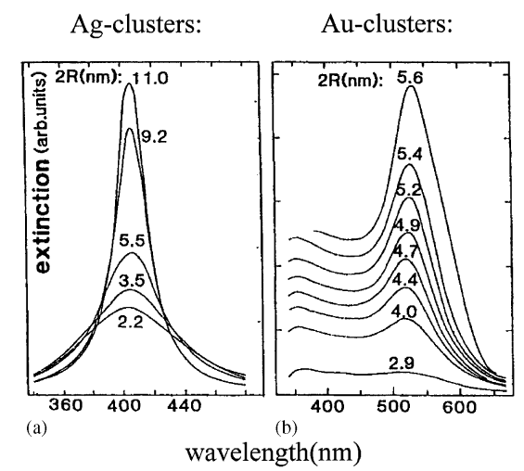
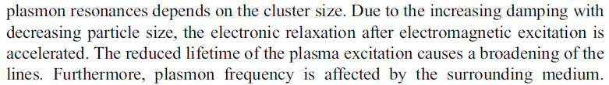
Effect of particle size on the SPR

Slide 25
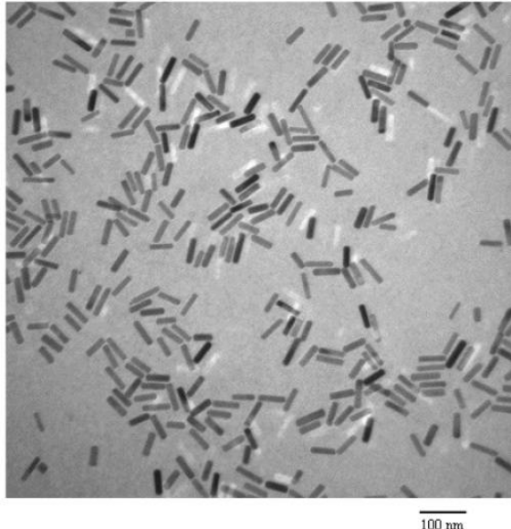
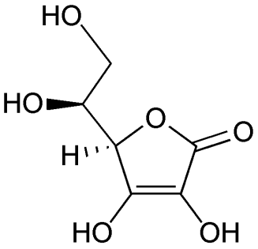
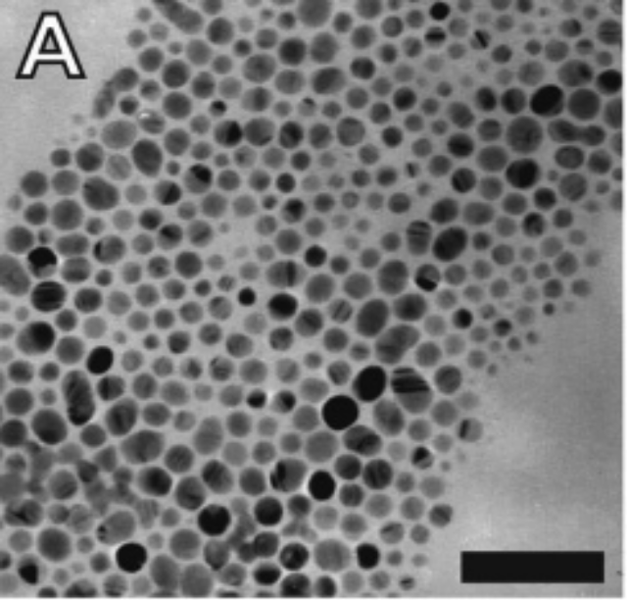
Preparation of gold nanorods
(CTAB)
Cetyltrimethyl ammonium
bromide
HAuCl₄
Ascorbic acid
Preparation of silver nanoparticles
AgNO₃
+
TOAB
(Phase transfer reagent)
NaBH₄
R-SH
Ag nanoparticles

