Slide 1
Morphologies tuning of noble metal nanoparticles

Slide 2
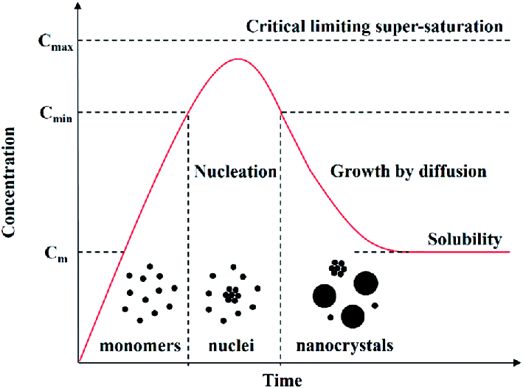
LaMer Plot
Nanocrystal nucleation and growth follow the basic principles of crystallisation:
a nucleation event precedes the growth of nanocrystals and eventually form bulk crystals. The above graph depicts a LaMer plot which shows the concentration of dissolved reactants as nucleation and growth proceeds. The reaction can be divided into three phases: first, the concentration of reactant gradually increases and eventually exceeds solubility (phase I). Second, the concentration of reactants reaches the critical limit of supersaturation and rapid
nucleation occurs. This nucleation burst results in a sudden decrease in reactant concentration (phase II). Finally, nuclei grow slowly as the reaction solution depletes in reactants (phase III).

Slide 3


Assuming a spherical nucleus with radius of r, the change in Gibbs free energy or volume energy
Gibbs free energy per unit volume
(diff. in bulk free energy between old and new phase)
Volume energy =
However, this energy reduction is counter balanced by the introduction of surface energy, which accompanied with the formation of new phase. This results in an increase in the surface energy, Δμ_{s}, of the system
Surface energy =
Surface energy per unit area
Total = volume energy + surface energy

Slide 4
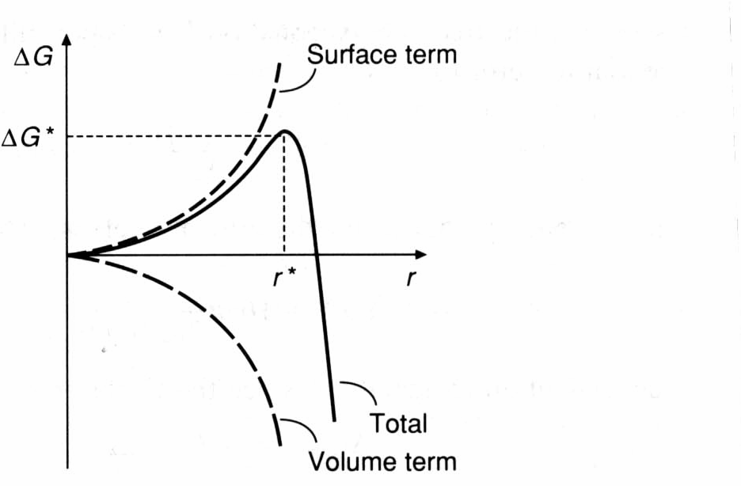
Total free energy as a function of nucleus radius. The newly formed nucleus is stable only when its radius exceeds critical radius, r*.
A nucleus smaller than r* will dissolve into the solution to reduce the overall free energy, whereas a nucleus larger than r* is stable and continues to grow bigger.
At the critical size r = r*, dΔG/dr = 0 and the critical size, r*, and critical energy, ΔG*, are defined by:
r* = -2 γ /ΔGv
ΔG* = 16π γ ³/3(ΔGv)²
The critical radius is the lower size limit of the nanoparticles that can be prepared. To reduce the critical radius, γ must be lower and ΔGv need to be higher.

Slide 5
Eq-1
dΔG/dr = 3x4/3πr²ΔGv + 2x4πrγ = 0
3x4/3πr²ΔGv + 2x4π r γ
r* = -2 γ /ΔGv
Substitute r* value in Eq-1
ΔG = 4/3π (-2 γ /ΔGv)³ΔGv + 4π(-2 γ /ΔGv)² γ
ΔG = -32/3π γ³/ΔGv³ + 16πγ²/ΔGv² γ
ΔG* = 16π γ³/3(ΔGv)²

Slide 6
Factors influence the size of the nanocrystals
Reaction time:
Increase in reaction time will increase the size of the particles as more materials add to the nanoparticle surface.
Temperature of the reaction:
Increase in temp. also increases the average size of the particles due to increase in the rate of the reaction.
Ostwald’s ripening:
In this process the smaller nanoparticles dissolve into solution and attach to the larger ones via diffusion.
Nature of the ligand:
Depending on the strength of the ligand the growth of the nanoparticles can be controlled. The weaker one leads to larger size whereas the stronger one might produce small nanoparticles.
Addition of reagent (stock solution)
Additional precursor solution might lead to formation of larger nanoparticles (as long as the addition rate is slower than the rate of reagent addition to the nanoparticle surface.

Slide 7
Nanoparticle formation mechanism
Homogeneous nucleation occurs via a stepwise sequence of bimolecular additions until a nucleus of critical size is obtained.
a. Nucleation from supersaturated solution
nS
S_{n}
b. Diffusion-Controlled Growth
S_{n} + S
S_{n+1}
Highly monodisperse nanoparticles are formed if the processes, i.e. nucleation and growth can be successfully separated
Nucleation process must be fast
Growth process must be slow

Slide 8
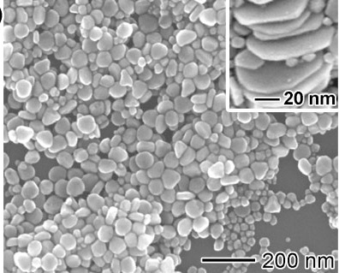
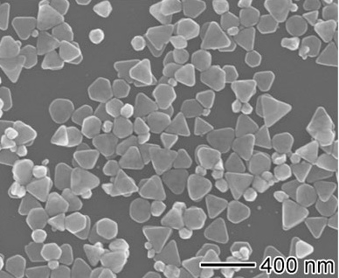
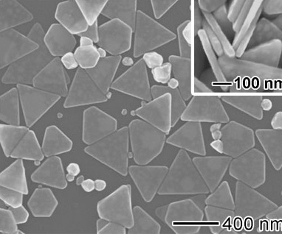
Ag triangular nanoplates
poly(vinyl pyrrolidone) was dissolved in 8.0 mL of water in a 20 mL vial and heated to 60 °C in air under magnetic stirring. Then, 3.0 mL of an aqueous solution of AgNO₃ was rapidly added into the vial. For PVP of each molecular weight, the molar ratio between the repeating unit of PVP and AgNO₃ was varied from 30, through 15, to 5. After the vial had been capped, the reaction mixture was heated at 60 °C in air for 21 h.
40 min
3 h
21 h
Circular NanoPlates(60 nm),
Spherical (25 nm)
Triangular NanoPlates(170 nm),
Spherical (80 nm)
Triangular Nanoplates(350 nm)

Slide 9
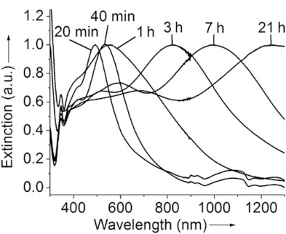
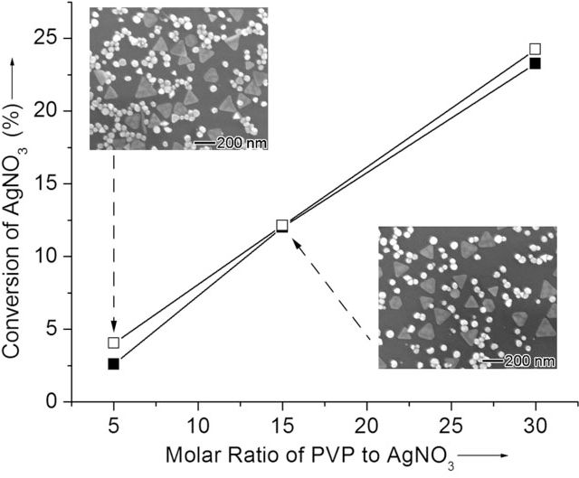
The UV absorption spectra showing the shift towards longer wavelength as the size of the nanoplates increases.
Linear dependence of the conversion ratio (AgNO3 to Ag) on the molar ratio of PVP to AgNO3.
The mild reducing ability of the PVP is the reason attributed to the formation of different morphologies (circular and triangular nanoplates).

Slide 10
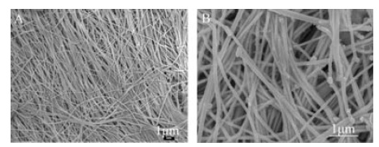
In a typical procedure, silver nitrate (0.02m, 5 mL) and sodium chloride (0.02m, 5 mL) were added to distilled water (30 mL) under stirring to form silver chloride colloidal solution. Then glucose (0.04 g, 0.2 mmol) was dissolved in the above colloidal solution; this was then transferred into a stainless steel autoclave with a Teflon liner of 50 mL capacity, and heated in an oven at 180 °C for 18 h.
SEM images of Ag nanowires

Slide 11
The formation of the Ag nanowires depends,
on the temperature:
when the reaction was carried out at 140° C, the AgCl was not reduced by glucose.
on the AgCl concentration:
Higher Ag concentration leads to larger precipitates of AgCl with heating. This makes the reduction process very slow.
on the glucose concentration:
Increase in the glucose concentration led to increase in the Ag (nanowire) content.
The AgCl dissociates in water to Ag⁺ which is reduced by glucose. As the solubility of AgCl in water is very low, the conc. of free Ag+ ions is very low. As a result, the reduction of Ag chloride to Ag nuclei is slow, which favours anisotropic growth of Ag nanowires.
This is verified using AgNO₃ instead of AgCl, where the reaction produces Ag nanoparticles instead of Ag nanowires. This is due to easy dissolution of AgNO₃ into Ag+.

Slide 12
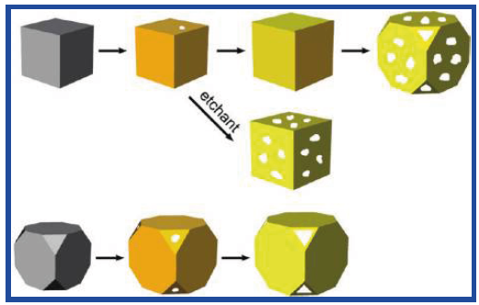
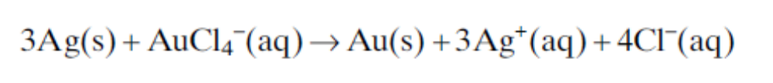
Au nanocages from Ag nanocubes
The silver nanocubes were converted into gold nanocages via replacement reaction. This is achieved by exposing the Ag nanocubes to a solution containing HAuCl₄.
The reaction is carried out in water to keep Ag and Cl as Ag⁺ and Cl⁻

Slide 13
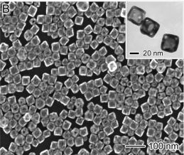
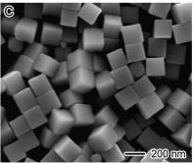
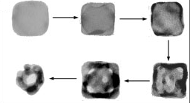
HAuCl₄
The replacement proceed via 3 major steps
Replacement by pitting at specific site on the surface of a Ag nanocube
Formation of Ag-Au alloy as walls on the Ag nanocube
Generation of pores in the wall through dealloying process in which Ag atoms are selectively oxidized.

Slide 14
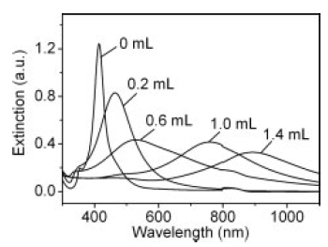
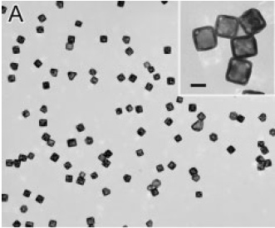
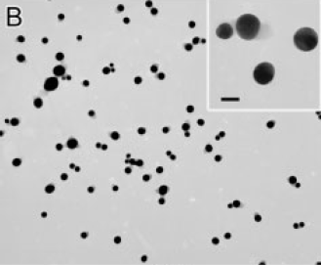
The SPR frequencies shift towards longer wavelengths for the Au nanocages.
The peak broadening is likely due to small variations in the wall thickness.
It is also attributed to the increase in the wall porosity.
Photo thermal melting of nanocages to nanoparticles
Upon heating or camera flash the nanocages were converted into nanoparticles due to melting.

Slide 15
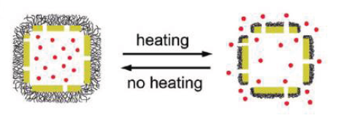
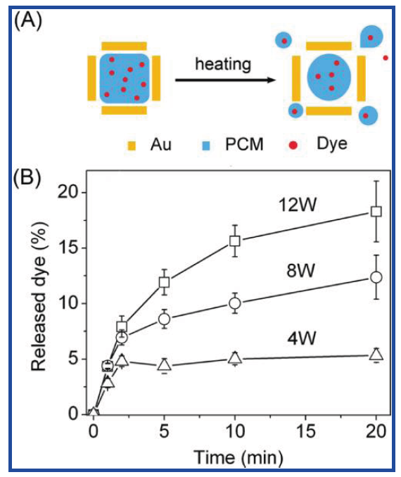
Drug release via thermal heating of the nanocages
Drug loading into the nanocages and subsequent coating by the thermo-responsive polymers. Upon heating polymers change their conformation releasing the drug.
Drug release from the nanocages controlled by the laser power
Graph showing the increase in the amount of drug release with the increase in the laser power.

Slide 16
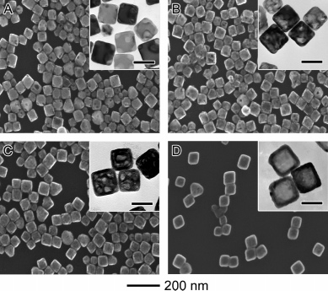
Pd-Ag and Pt-Ag nanoboxes
The silver nanocubes were converted into Pd-Ag and Pt-Ag nanoboxes via replacement reaction by exposing to a solution containing Na₂PdCl₄ or Na₂PtCl₄.
SEM images of the Ag nanocubes after exposed to Pd ions

Slide 17
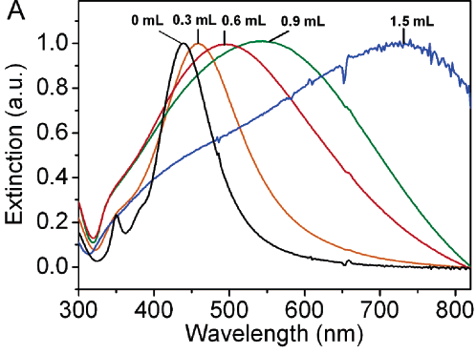
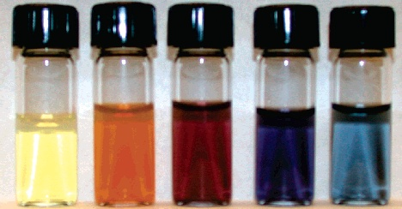
Why in the case of Au, complete replacement was possible but not with Pd?
As Ag was dissolved from the interior, Pd accepted its electrons and plated onto the exterior of the nanocubes and therefore helped to prevent etching of the nanocubes surface. The Pd-Ag system is a well-known binary alloy, and plating of Pd will result in the formation of walls composed of a Pd-Ag alloy.

Slide 18
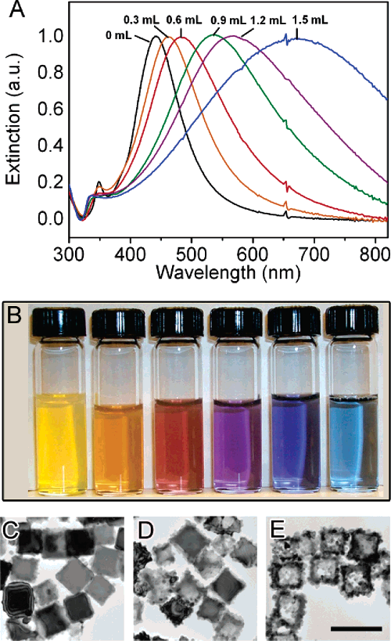
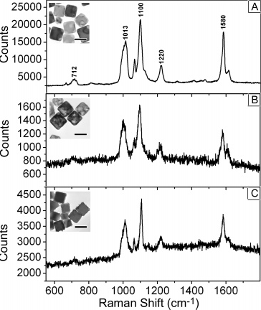
Replacement of Ag by Pt to form Pt-Ag
In the case of Pt, the resulting morphologies are different from that of Pd. This is because, Pt does not readily form solid-solid diffusion with Ag (only at temp above 900 K. These nanoboxes are used for SERS applications.

Slide 19
Nanoparticle Catalysis

Slide 20
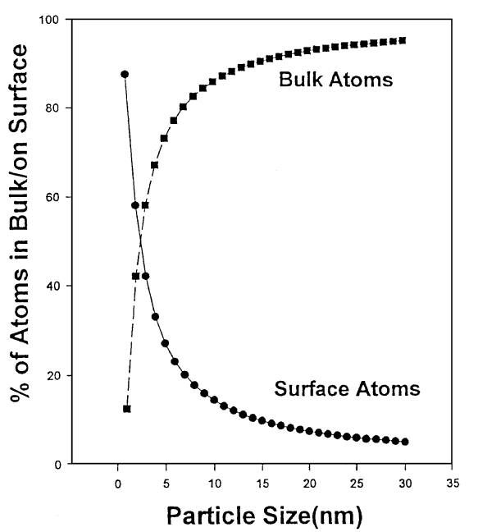
Surface/Volume ratio
1. Increase in the surface to Volume ratio results in good “atom economy”
Nano
Bulk

Slide 21
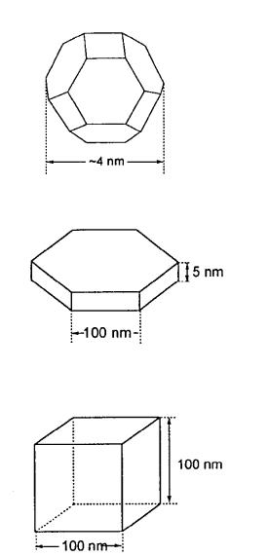
Different shapes
2. Enhanced reactivity, due to increase in the edges and corners
Different shapes of MgO, cubic to polyhedral
3. Increase in the surface energy
As the size of the crystals becomes smaller, the anion/cation vacancies develop.
Also, atoms on the surface can be distorted from their bonding pattern.

Slide 22
Different effects of the nanoshapes on the Catalysis
Electronic effects:
Change in the electron density as size changes (variation in the ionization energy)
Support effects:
Interaction of Metal clusters with supports (like SiO₂, Al₂O₃). Formation of M-O
linkages via O-H groups, lead to proton reduction and metal oxidations. The catalytic support vary in the Lewis acid/base character.
Some supports form deposits on top of metal clusters thus inducing catalytically active
Interface sites (e.g. M-TiO₂ composites)
Shape Effects
Certain chemical reactions are structure-sensitive. This means several adjacent surface metal atoms are required for the catalytic activity. If the metal clusters are too small or the shape is such that the atoms do not exists on flat surface, then the reaction can not proceed.

Slide 23
Gold nanoclusters on Transition Metal Oxides
Prepared by co precipitation of HAuCl₄ and transition metal nitrates. Alternatively, Au nanoparticles are prepared first and then immobilized on the support.
The conversion of CO to CO₂ is enhanced for small Au NPs (in Al2O3, Co3O4 or NIO) compared to larger particles. High activity for CO to CO₂ conversion even at -70° C.
Catalytic activity was observed for 2.5 to 6 nm
The activation energy E_{a} 1.7 to 5 kcal/mol for 2.5 to 6 nm particles. 3.2 nm exhibits the highest reactivity.
The reason is if the size is too small then CO and O₂ bind strongly thereby their movement will be restricted on the surface.
If the size is large then, adsorption energy will be lower not favoring the formation of CO-O pairs.

Slide 24
Reactions involving NO_{x} gases
NOx gases are reduced to N2 by CO, H₂ and hydrocarbons in the exhaust. This is catalyzed by Pt group metal catalyst. However, under lean condition, which uses more O₂ that required for the combustion, Pt is not preferred. For this Au is a suitable alternative. They are better than Pt because of the inertness of Au towards O₂.
Au catalyses the NO to NO₂ which is then reduced to N₂ by hydrocarbons. This is again advantageous as hydrocarbons require higher temperature to reduce NO to N2.
De-activation of Au catalyst
Sulfur and phosphorus have strong affinity to Au and cause catalytic deactivation of Au

Slide 25
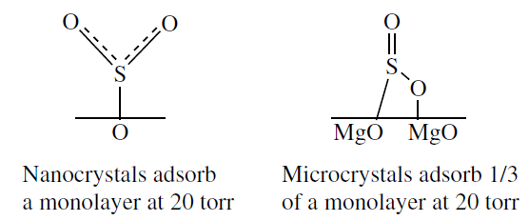
Metal oxide reactions
Nanocrystalline metal oxides exhibit higher reactivity compared to microcystalline counterpart. For example, at RT and 20 torr pressure, MgO nanocrystals chemisorb 6 molecules of SO₂ per nm² of surface while microcrystals adsorb only 1.8 nm². This is due to the arrangement of molecules on the surface of these materials caused by the morphological differences.
At higher pressures formation of dense multilayer formation occurs leading to more adsorbed molecules per nm².

Slide 26
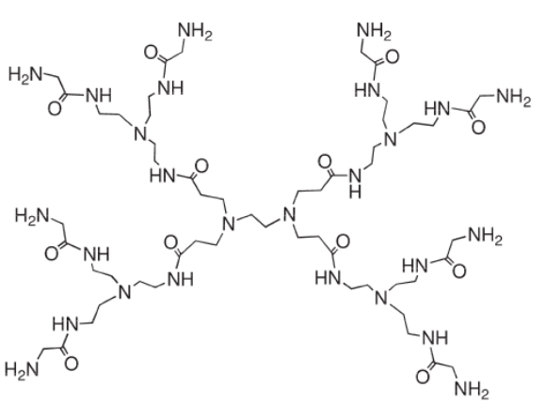
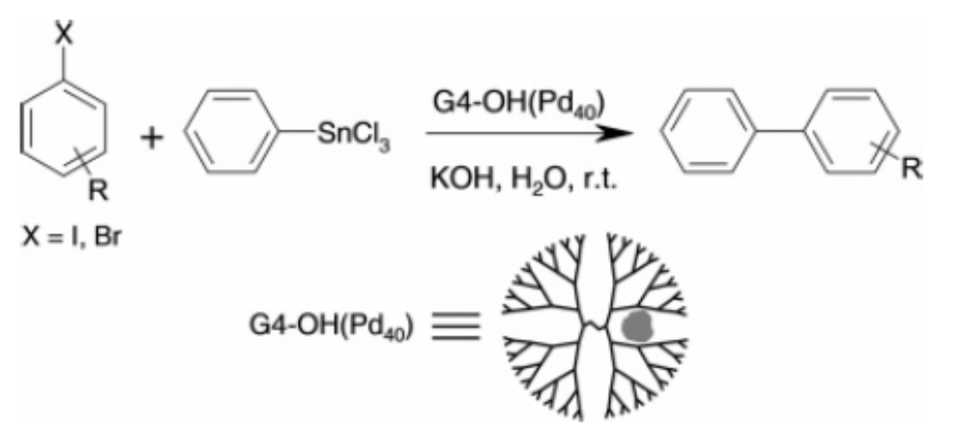
Dendrimer-Encapsulated Pd Nanoparticles
Dendrimers are organic molecules with functional groups at their periphery
These dendrimers are used as templates for the synthesis of monodisperse Pd nanoparticles.
G4-OH was mixed with 0.1 ml of 10 mM aq. K₂PdCl₄ in 10 ml water. NaBH₄ was used to reduce the Pd nanoparticles. The size of the nanoparticles are about 2 nm.
Advantages of Den-Pd
Solubility is controlled by chemical composition at the periphery.
The nanoparticles are encapsulated within the dendrimer, so no ligands are needed for stabilization.
They are small which gives high surface area to volume ratio.

Slide 27
Stille reaction
Ι
SnCl3
G4-OH, Pd
COOH
+
COOH
Control experiments:
Following control experiments to confirm that Pd nano is the active catalyst.
Same reaction performed without Pd (only with dendrimers)
Reaction with dendrimers and Pd²⁺ precursors.
Reaction with dendrimer with Au nanoparticles
No Stille reaction occurred

Slide 28
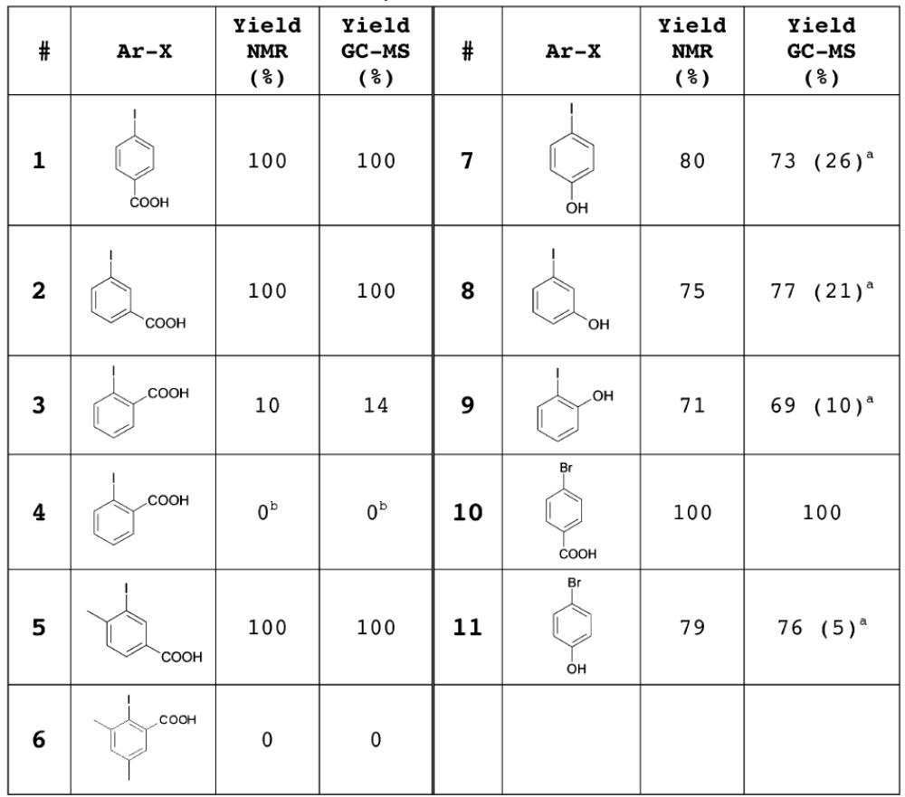
More control experiments to understand the mechanism
Only Pd

Slide 29
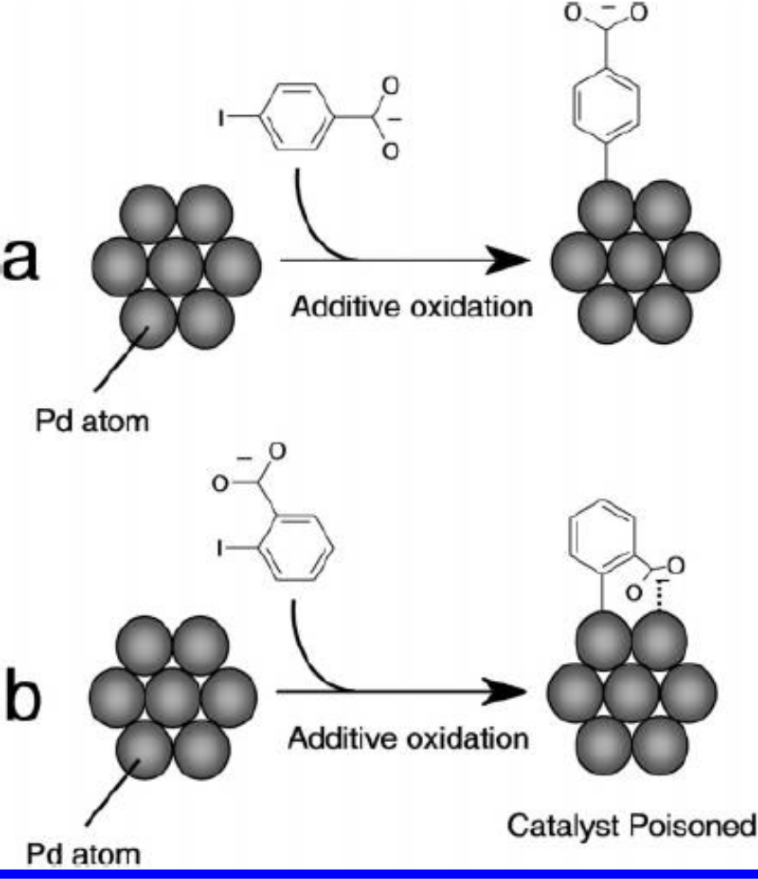
Model for the catalytic activity
Catalytic poisoning occurs for the ortho isomer due to the interaction of carboxylic groups with the Pd atoms.

Slide 30
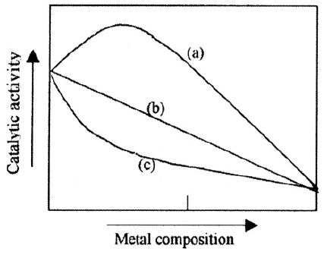
Bimetallic Au-Pd Dendrimer encapsulated catalysts
Why bimetallics are interesting?
They are good model systems which can provide information about the electronic properties of the catalysts.
They minimize the amount of use of precious metals such as Pd and Pt that are required for the technological applications.
Three possible effects of atom B on atom A
The catalytic activity of one metal usually improved through the addition of another metal. Thus the catalytic activity of the bimetallic nanoparticles changes with the composition.

Slide 31
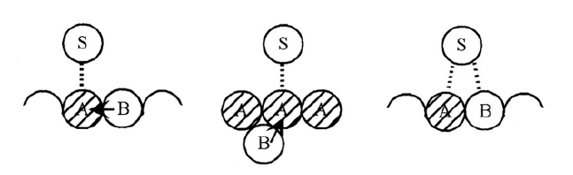
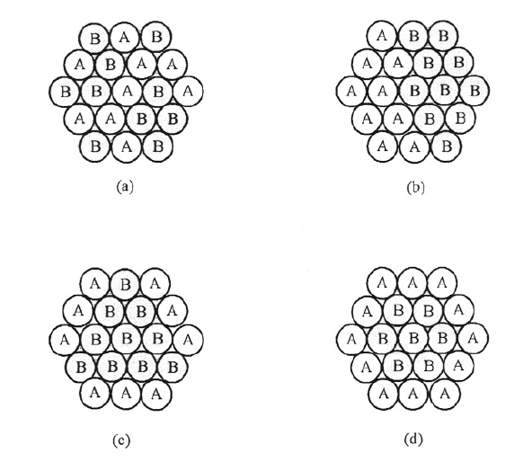
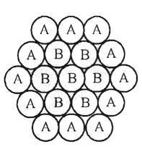
Two kinds of effects of the additive atom
Ligand effect: Electronic in nature
Ensemble effect: steric effect
Different possible structures with A:B (1:1)
Random
Cluster-in-cluster
Core/shell
Factors determining the core/shell structures
The metal easily reduced form the core
Coordination ability: The metal strongly coordinated by the ligand can form the shell.
Example: Pt-Pd (core-shell) (alcohol reduction in the presence of PVP)

Slide 32
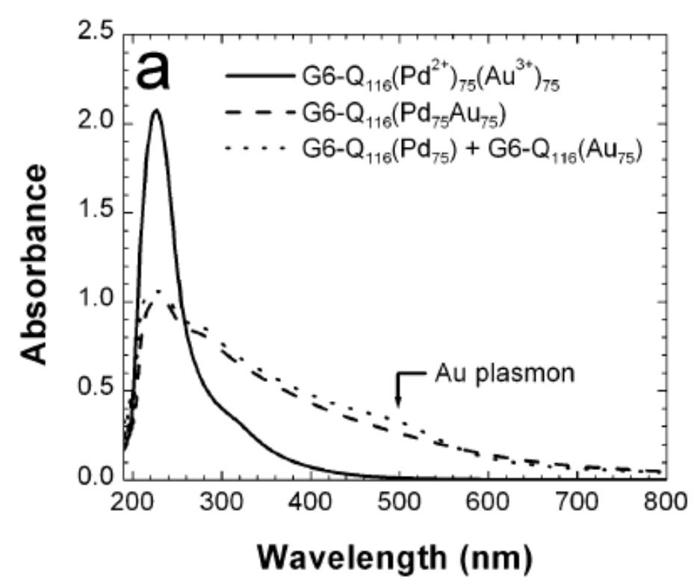
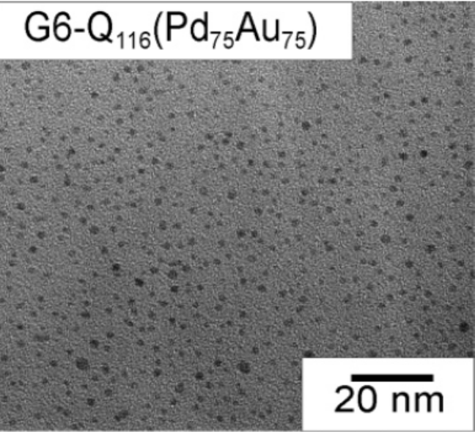
Partially quanternized dendrimers are used as templates. OH groups might reduce Au³⁺ and amine can react with Pd²⁺.
Interband transitions of bimetallic
TEM image of the dendrimer stabilized Pd NPs and their size distribution histogram graph
UV absorbance spectra of bimetallic nanoparticles compared with Au NPs and Pd NPs

Slide 33
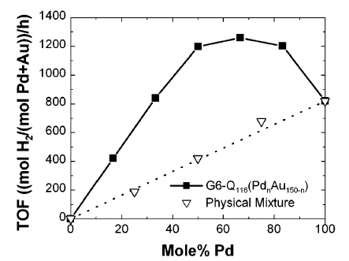
Hydrogenation of allyl alcohol
For all Pd_{n}Au_{150-n} the average size is roughly 1.8 nm eliminating any surface area bias
Bimetallic shows higher catalytic activity compared to the monometallic or physical mixture
This is likely due to Au atoms draw electron density away from Pd thereby enhancing the interaction of Pd with allyl alcohol.

Slide 34
Pd/Pt bimetallic nanostructures
(eg. 1,3-cyclooctadiene to cyclooctene)
With Pd/Pt ratio 4:1, shell/core formation is observed and has highest catalytic activity
With decreasing Pd/Pt (less Pd) the catalytic activity is decreased
If total catalytic activity divided by the number of Pd atoms, then the catalytic activity of the Pd atoms nearly equals each other. What is it suggests?
It means all the Pd atoms are located at the surface.
The catalytic activity of the Pd/Pt core/shell is higher than the individual clusters suggesting a possible electronic effect.

Slide 35
Cluster-in-cluster (Cu-Pd)
Prepared by reduction of CuSO₄ and Pb(CH₃COO)₂ in refluxing glycol/dioxane in the presence of PVP. These nanoparticles are very important for catalysis, because they have high catalytic activity for two completely different reactions, i.e., hydration of acrylonitrile to acrylamide and selective partial hydrogenation of 1,3-cyclooctadiene to cycooctene.
The catalytic activity of both the reactions are higher compared to the monometallic ones.
Cu-Pd system is an example of ensemble effect

Slide 36

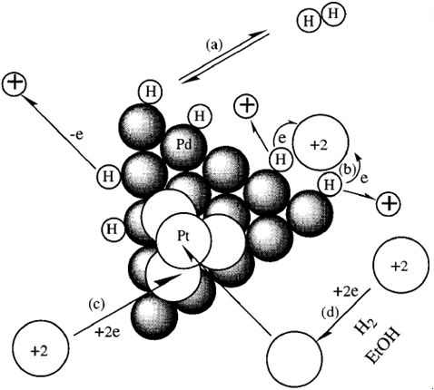
Inverse core/shell nanostructures (Pd/Pt)
Issue in the formation:
Pd cores are first prepared and on the surface H₂ was adsorbed to form metal-H bond.
Hydrogen atoms on Pd have high reducing ability
For the Pt²⁺, the hydrogen atoms provide e⁻ and becomes H⁺. This avoids the oxidation of Pd to Pd²⁺.

Slide 37
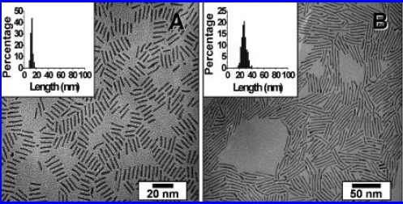
CuPt Nanorod Catalysts with Tunable Lengths
In a typical synthesis, 43 mg of Pt(acac)2, 24 mg of Cu(acac)2, 105 mg of 1,2-hexadecanediol, 0.6 mL of oleic acid, and 0.8 mL of oleylamine were mixed together with 5.0 mL of 1-octadecene in a 100 mL three-neck round-bottom flask. The flask was purged with Ar, heated to 120 °C for 20 min, and then heated to 225 °C at a rate of ∼20 °C/min. After 30 min, the black-colored solution was cooled to room temperature. The as-synthesized samples often contained a mixture of spherical CuPt nanoparticles and CuPt nanorods, which were separated in high yield by precipitation and centrifugation.
Better catalyst for CO oxidation compared to Pt. CuPt reduces the poisoning of Pt catalyst by CO

Slide 38
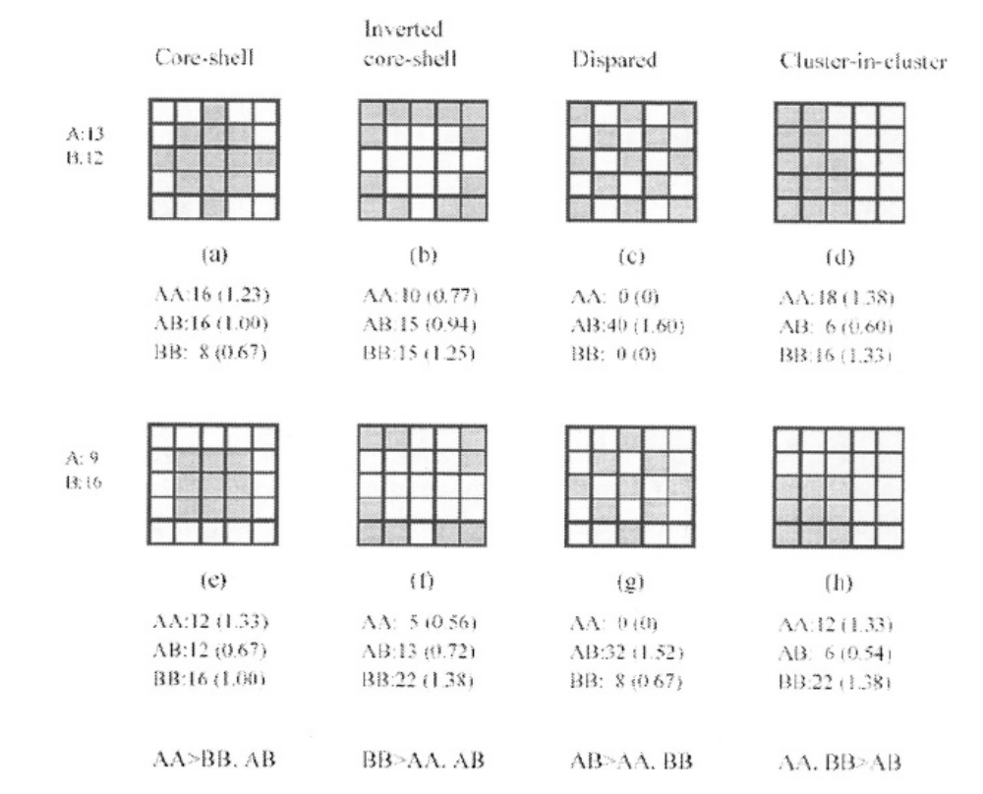
Construction of bimetallic structures
The formation of a preferred structure depends on the bond strength

Slide 39
Application of semiconductor NPs: Photocatalysis
Use of light to activate chemical reaction.
Requires the separation of electron and a hole in the semiconductor nanoparticles.
superoxide
O₂⁻
e⁻
e⁻
O₂
e⁻
Release as heat at the surface
h⁺
h⁺
h⁺
Red + h⁺ → Ox
TiO₂, ZnO, BiVO₄, WO₃ are some of the examples of photocatalysts

Slide 40
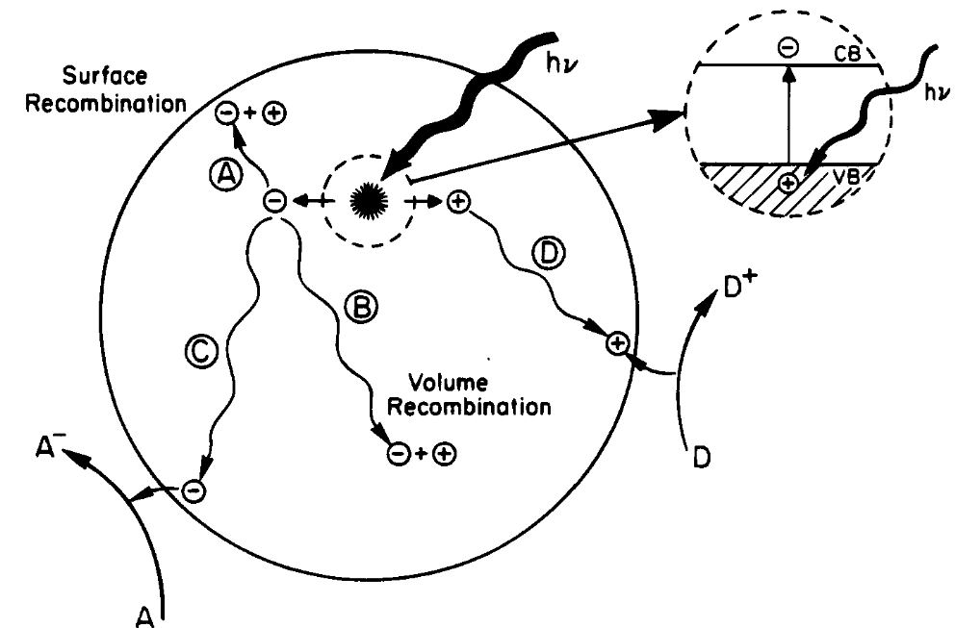
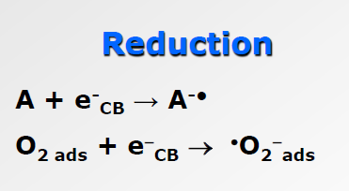
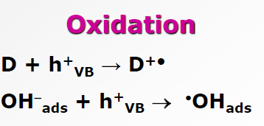
Different processes occur after exciton formation
The electron and hole pair once formed after irradiation undergo various de-excitation process. The electron can reach the surface leading to reduction of a species or the hole can oxidize a species present at the surface. The electron and the hole can recombine to produce light. It is also possible that one of the charge carriers get trapped
An increase in either the recombination lifetime or interfacial charge transfer rate constant is expected to result in higher efficiencies

Slide 41
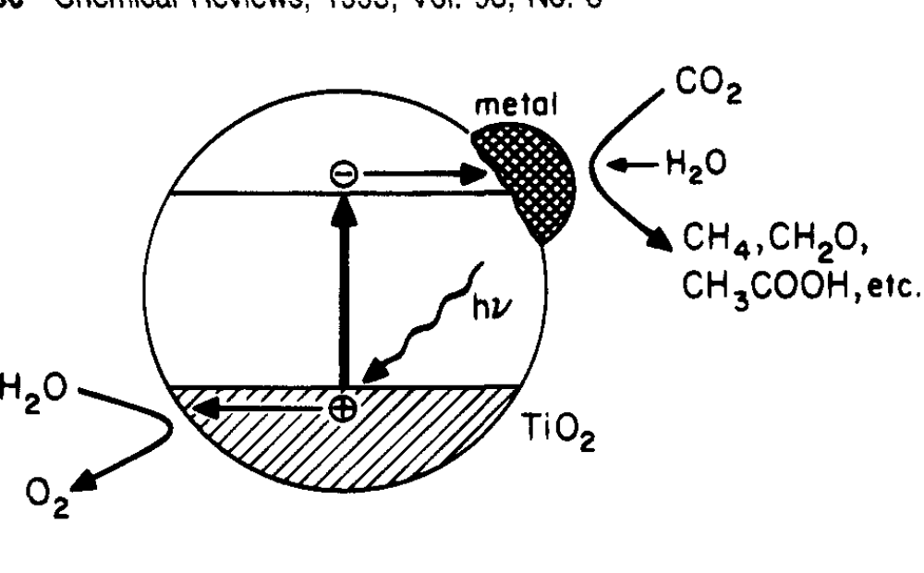
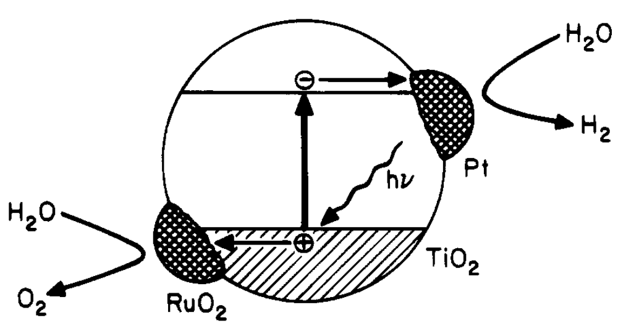
TiO₂ composites with metals/oxides for efficient separation of charges
The presence of metal at the surface of TiO₂ decreases the recombination rate
The presence of a metal and oxide can efficiency separate both charges carriers at the surface of TiO₂ and decreases the recombination rate

Slide 42
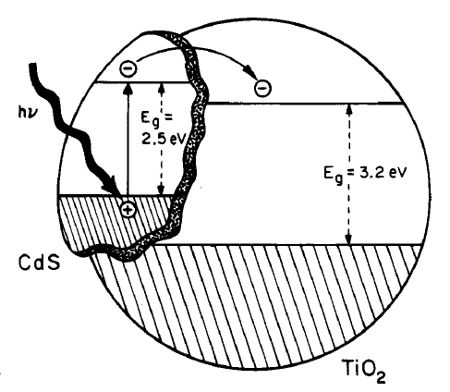
Going beyond UV photocatalysis
UV region of the solar spectrum covers only ~6% of the solar spectrum and only this portion can be effective using wide bandgap semiconductor photocatalyst.
This encourages scientist to develop visible light photocatalyst as ~47% of the solar spectrum is occupied by visible region.
Thus semiconductor nanomaterials with bandgap in the visible region started to find attention. In fact, there are several nanocomposites were also developed by integrating TiO₂ with semiconductors having relatively low bandgap ( e.g. TiO₂/CdS, ZnO/CdS, etc.)
the hole produced in the CdS valence band from the excitation process remains in the CdS particle while the electron transfers to the conduction band of the TiO₂ particle. The electron transfer from CdS to TiO₂ increases the charge separation and efficiency of the photocatalytic process. The separated electron and hole are then free to undergo electron transfer with adsorbates on the surface.

