Slide 1
Characterization Methods
Different analytical techniques that are generally used in the characterization of the nanomaterials are discussed

Slide 2
Different types of Light Scattering
Scattering
When a beam of light passes through a colloidal dispersion, the particles scatter some of the light in all directions.
Rayleigh scattering
When the particles are very small compared with the wavelength of the light, the intensity of the scattered light is uniform in all directions.
Mie scattering
When the particles are larger compared with the wavelength of the light, intensity of the scattered light is angle dependent.

Slide 3
Dynamic light scattering (DLS) Principle
1. Particles, emulsions and molecules in suspension undergo Brownian motion.
2. This motion is induced due to bombardment by solvent molecules that themselves are moving due to their thermal energy.
3. If the particles or molecules are illuminated with a laser, the intensity of the scattered light fluctuates at a rate that is dependent upon the size of the particles as smaller particles are “kicked” further by the solvent molecules and move more rapidly.
4. Analysis of these intensity fluctuations yields the velocity of the Brownian motion and hence the particle size using the Stokes-Einstein relationship.
DLS measures Brownian motion and relates this to the size of the particles.

Slide 4
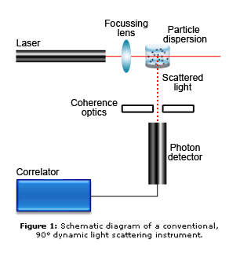
Two main assumptions
Particles are under Brownian motion
The particles are spherical in shape
The size of a particle is calculated from the translational
diffusion coefficient by using the Stokes- Einstein equation;
rH = kT/6πηD
where
r(H) = hydrodynamic radius
D = translational diffusion coefficient
k = Boltzmann’s constant
T = absolute temperature
η = viscosity
Thus the size calculated using DLS is known as hydrodynamic radius (which the size of the nanoparticles along with the solvent layer (water molecules) attached to the nanoparticles surface.
The rate of fluctuations is directly related to the rate of diffusion of the molecule through the solvent.
Schematic of the DLS setup

Slide 5
Dynamic Light Scattering technique
Surface Structure
Any change on the surface of a particle that affects the diffusion speed will correspondingly change the apparent size of the particle.
An adsorbed polymer layer projecting out into the medium will reduce the diffusion speed.
The nature of the surface and the polymer, as well as the ionic concentration of the medium can affect the polymer conformation, which in turn can change the apparent size by several nanometers.
Shape of the structure
If the shape of a particle changes in a way that affects the diffusion speed, then the hydrodynamic size will change. For example, small changes in the length of a rod-shaped particle will directly affect the size, whereas changes in the rod’s diameter hardly affect the diffusion speed, which will be difficult to detect.

Slide 6
Advantages of Dynamic Light Scattering technology
1. Accurate, reliable and repeatable particle size analysis in one or two minutes
2. Measurement in the native environment of the material
3. Mean size only requires knowledge of the viscosity of the liquid
4. Simple or no sample preparation, high concentration, turbid samples can be measured directly
5. Size measurement possible for sizes < 1nm
6. Size measurement of molecules with MW < 1000Da
7. Low volume requirement

Slide 7
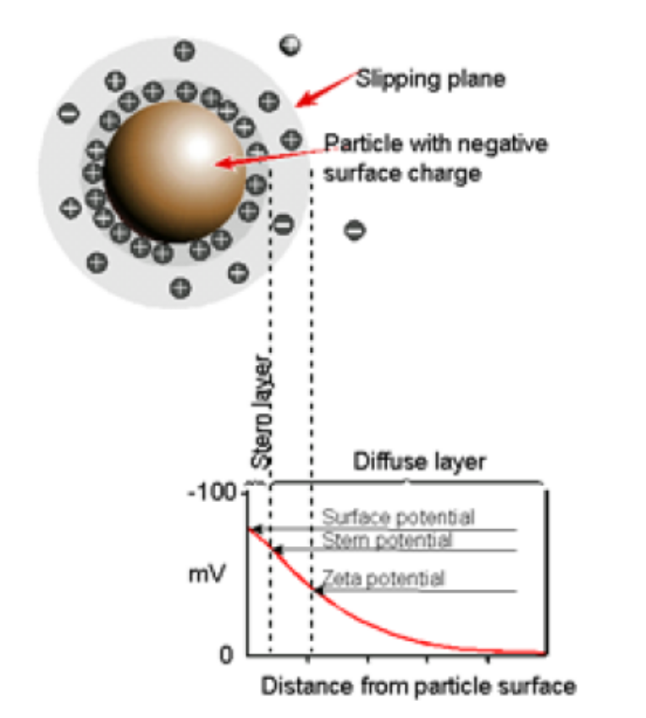
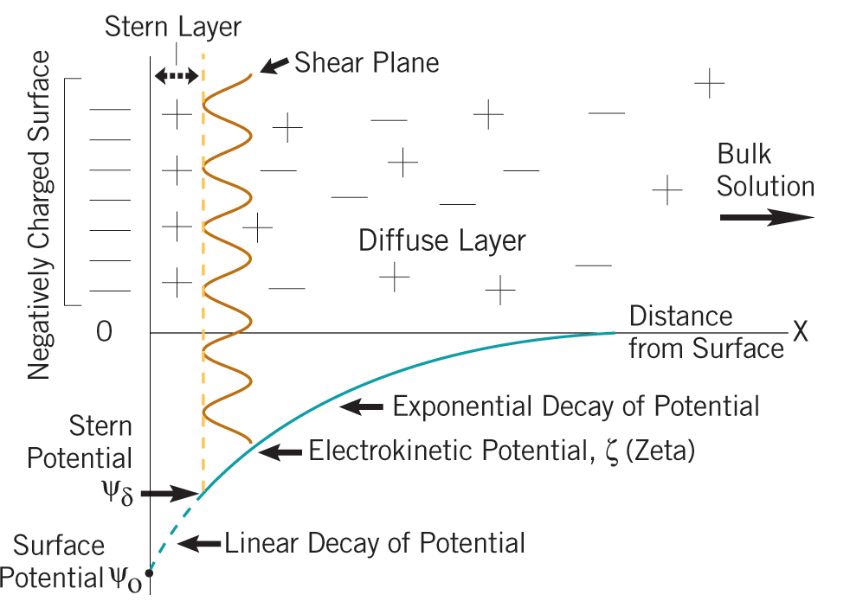
Determination of surface charges on the nanoparticles-Zeta potential
The surface charge of the nanoparticles is measured using the Zeta potential measurement. This is generally measured using the same setup used for DLS. The theoretical basis is given below.

Slide 8
DLVO theory Derjaguin and Landau, Verwey and Overbeek
The development of a net charge at the particle surface affects the distribution of ions in the surrounding interfacial region, resulting in an increased concentration of counter ions (ions of opposite charge to that of the particle) close to the surface. Thus an electrical double layer exists around each particle.
The liquid layer surrounding the particle exists as two parts; an inner region, called the Stern layer, where the ions are strongly bound and an outer, diffuse, region where they are less firmly attached.
When a particle moves (e.g. due to gravity), ions within the boundary move with it, but any ions beyond the boundary do not travel with the particle. This boundary is called the surface of hydrodynamic shear or slipping plane. The potential that exists at this boundary is known as the Zeta potential.
The zeta potential of the particle can be deduced from the following equation, the electrophoretic mobility quantity is generally measured and correlated to the zeta potential.
ζ = 4πη/ε * U
Electrophoretic mobility
Viscosity
Dielectric constant of the medium

Slide 9
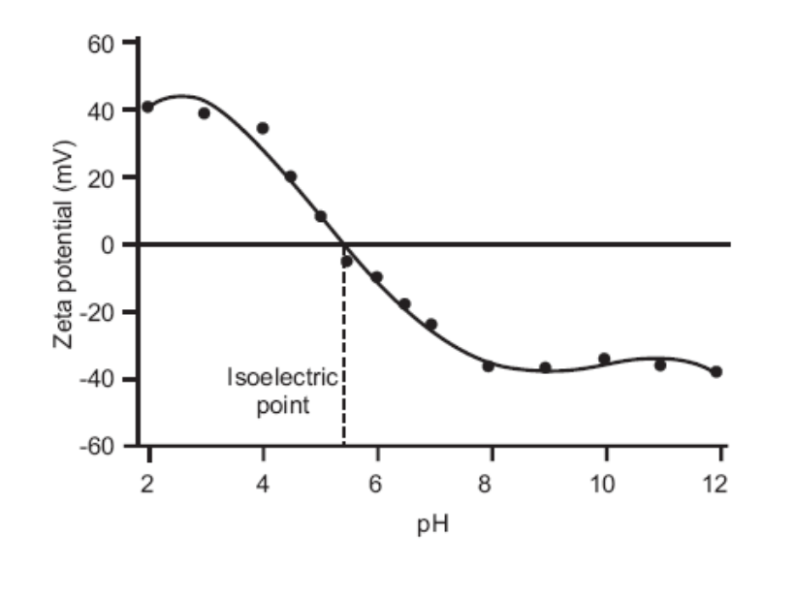
The magnitude of the zeta potential gives an indication of the potential stability of the colloidal system.
If all the particles in suspension have a large negative or positive zeta potential then they will tend to repel each other and there is no tendency to flocculate.
However, if the particles have low zeta potential values then there is no force to prevent the particles coming together and flocculating.
The dividing line between stable and unstable suspensions is generally taken at either +30mV or -30mV. Particles with zeta potentials more positive than +30mV or more negative than -30mV are normally considered very stable.
This graph shows the plot of zetapotential Vs pH. The pH at which the zetapotential is “0” is termed as isoelectric point (where the colloid particles are least stable).
This technique has wide application in colloid chemistry.

Slide 10
Electron microscope
Electron Microscopes are scientific instruments that use a beam of highly energetic electrons to examine objects on a very fine scale. This examination can yield the following information:
1. Morphology: The shape and size of the particles making up the object; direct relation between these structures and materials properties (ductility, strength, reactivity...etc.)
2. Topography: The surface features of an object or "how it looks", its texture; direct relation between these features and materials properties (hardness, reflectivity...etc.)
3. Crystallographic Information :How the atoms are arranged in the object; direct relation between these arrangements and materials properties (conductivity, electrical properties, strength...etc.)
4. Composition: The elements and compounds that the object is composed of and the relative amounts of them; direct relationship between composition and materials properties (melting point, reactivity, hardness...etc.)

Slide 11
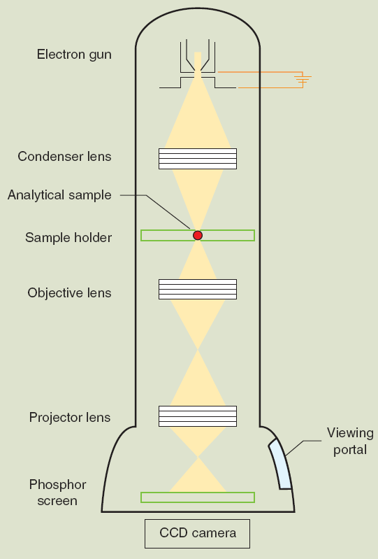
Schematic of the transmission electron microscope
Gun: electron source If misaligned, low intensity & other alignments may also be out
Condensor: uniformly illuminate the sample. If misaligned, you will lose the beam when changing magnification
Objective: image sample – determines resolution. If misaligned, the image will be distorted, blurry.
projector: magnifies image/ forms diffraction pattern – should not alter resolution. If misaligned, the image will be distorted, diffraction pattern may be blurry.
Phosphor screen: Image is projected
TEM

Slide 12
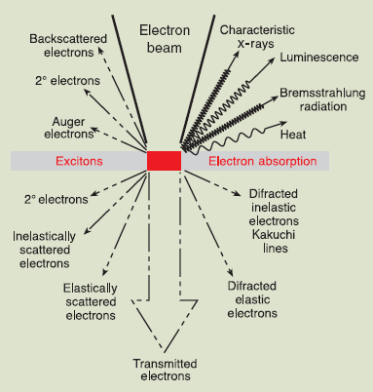
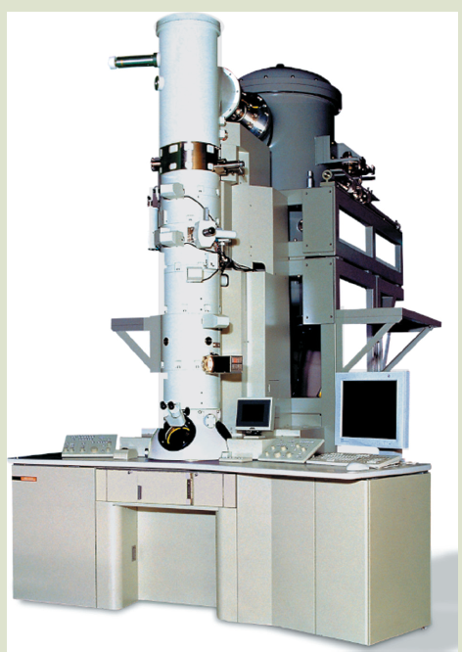
Various processes that occur during bombardment of electrons with the material
Schematic of the TEM instrument

Slide 13
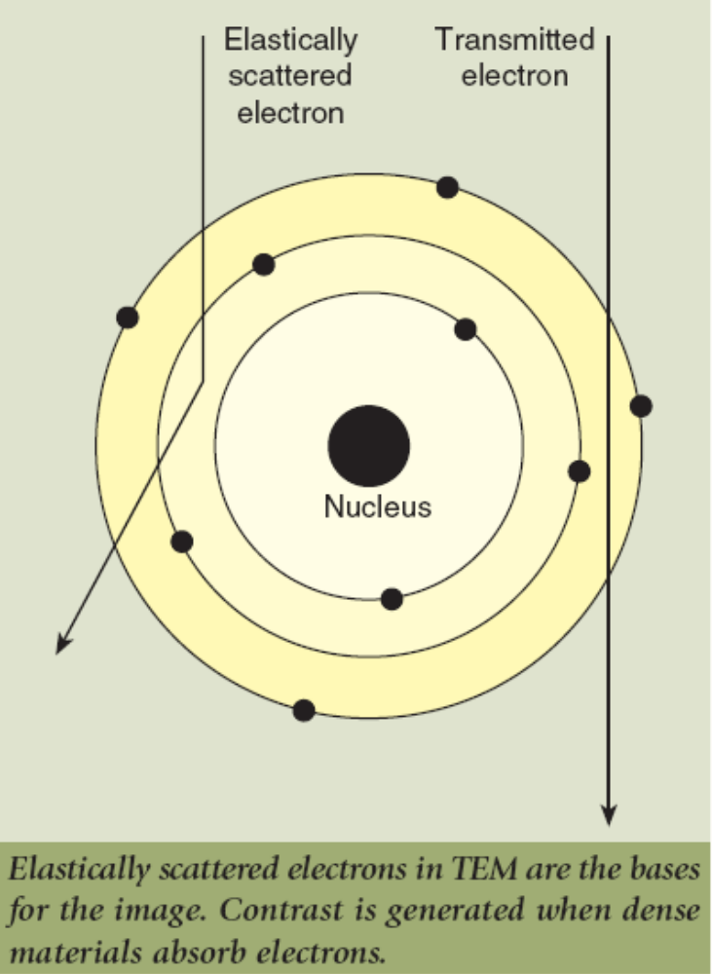
Two major processes that are used for TEM analysis
Transmitted unscattered electrons
Light areas equate to more transmission and
dark areas to electron-dense areas. The
result is TEM image.
Particle size can also be measured.
Crystal structure can also be obtained.
Elastically scatted electrons
They are used in generation of electron
diffraction pattern. Crystal structure can be
found.

Slide 14
Wavelength and Voltage
Wavelength (λ) of electrons is determined by the accelerating voltage (V) on the filament from which they are emitted
λ = 0.1 (150/V)^{0.5}
Thus very high voltages , say upto 100kV are used to produce small values of λ. This is important to get better resolution.
High vacuum is very much essential for the TEM measurement for the following reasons
The mean free path of electron is short in air
Tungsten filament is unstable in air
Keep the column clean

Slide 15
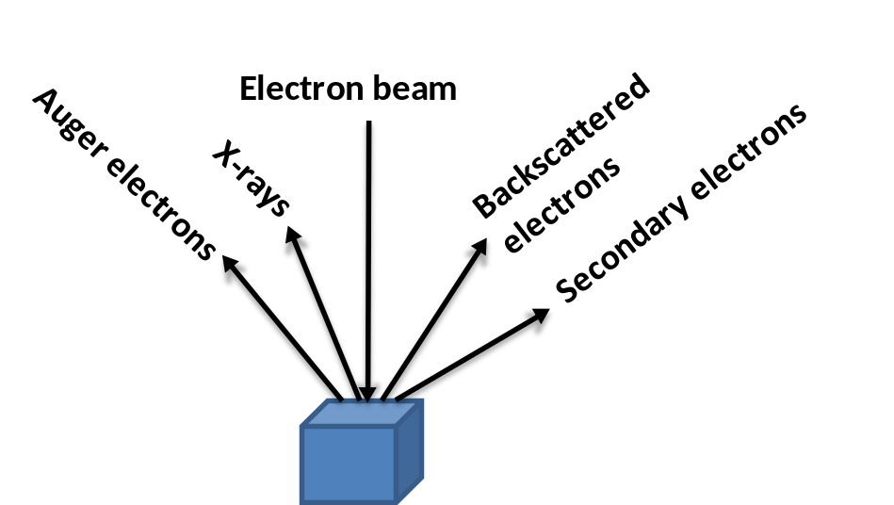
Scanning Electron Microscopy (SEM)
Like TEM, SEM also provides valuable information about the Size, Morphology, packing, etc.
In SEM, an electron beam interacts with matter which leads to one of the processes as shown in the figure.
Along with other processes, this interaction leads to the production of secondary electrons, which are produced by the interaction (collision) of primary radiation with the atoms present on the surface of the material. The energy of the secondary electrons are in the range of 10 to 50 eV thus limits their mean free path.
Thus secondary electron (in SEM) provides information about the surface morphology.
Limitations of TEM and SEM
Extensive sample preparation
Some times due to high energy e⁻ beam there can be change in the sample structure and morphology
Very costly

Slide 16
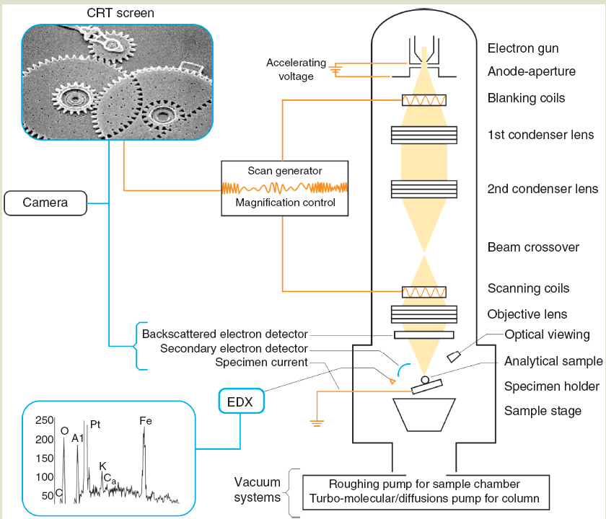
Schematic illustration of the SEM instrument
Note: this is just for your knowledge

Slide 17
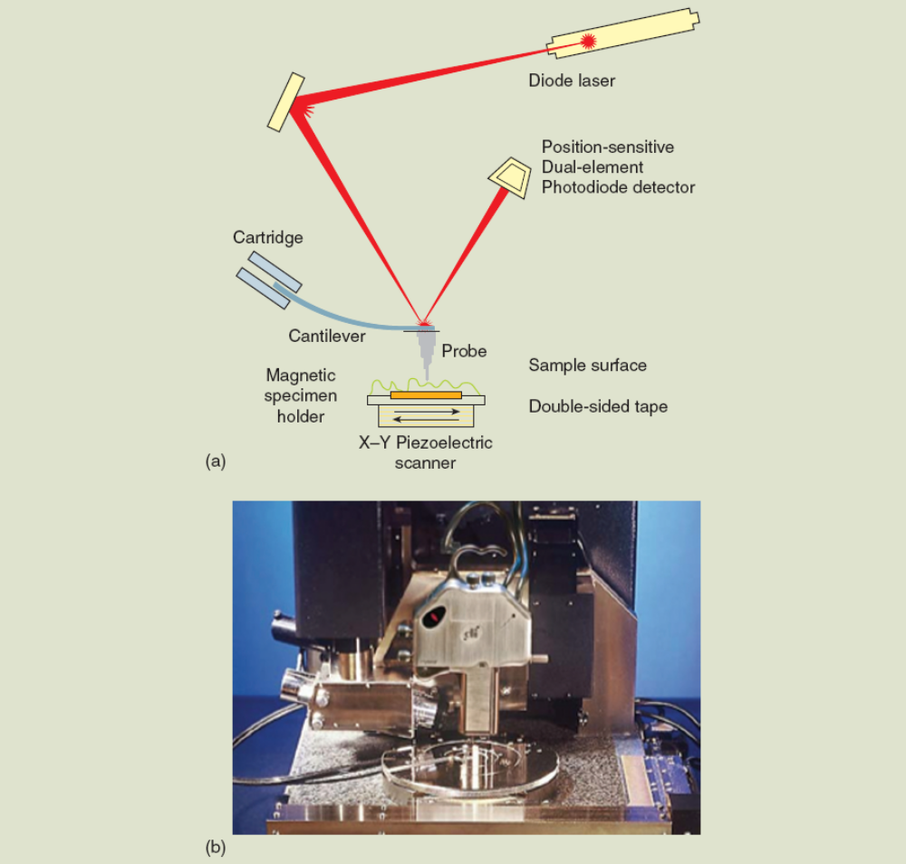
Scanning Probe Microscopy (SPM)
SPM gives 3D images with atomic resolution. The two major techniques belong to SPM are STM and AFM. Designed and developed by Gerd Binnig and Heinrich Rohrer in 1981. Nobel prize in 1986.
Atomic Force Microscope
Here the interaction between a sharp probe and the sample is used for the imaging:
1. An atomically sharpened probe tip (20 – 50 nm or less and made of Si or Si₃N₄) descends perpendicularly from the distal end of a cantilever. The tip has a spring constant ~1N/m
2. The tip to sample distance is fixed by means of a feedback mechanism that maintains constant force between them (i.e. constant height).
3. A laser beam is focused on the top of the shiny cantilever and is reflected into a photodiode detector.
4. Differences in the reflected beam is recorded by split photodiode and recorded as changes in topography.
5. The photodetector is able to discriminate motion with accuracy less than 1 nm.
6. The surface is scanned grid-like by the probe to produce a 3D image of the surface.

Slide 18
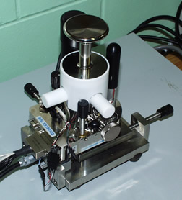
Forces
Typically, van der Waals and repulsive electrostactic forces occur between the probe tip and the surface. The net force is the function of the distance between the two and depends on the dielectric constant of the medium.
A sensor measures the force that is generated between the probe tip (cantilever) and the electron clouds of the sample.
F = -kz
F = force, k = “spring constant of the cantilever, z = distance of the deflection of the cantilever
Cantilevers single crystal silicon or silicon nitride. Length is 100 to 500 micrometer, width is 25 to 40 micrometer and thickness is 1 to 10 micrometer.
Typical set-up. In many places it is home built
Some characteristics of the AFM
Very powerful technique because it is simple mechanical device.
No, electron beam, high energy radiation, or beam source. Can be operated at ambient temperature.
It relies on the mechanical deflection of a cantilever to relay information about the contour of a sample surface.

Slide 19
Atomic force Microscopy
There are two different modes in AFM
1. Contact mode (tip comes in contact with the sample)
The probe-cantilever assembly applies a constant force to the surface; the force Constant is <1 N.M⁻¹. The tip-sample interaction force is monitored while keeping the deflection of the cantilever constant.
Due to intact contact, surface contamination, electrostatic force, and heterogeneous surface can impact the action of probe. Hard surface can be imaged.
2. Noncontact (tapping) mode
No contact between the tip and the surface. The cantilever oscillates at a frequency slightly greater than its resonant frequency. Here the amplitude of the tapping is kept constant (instead of deflection).
Image is captured through the weak attraction force. Sample in water can be measured. Soft materials can be measured.
Resolution
Image resolution can be obtained in 3 dimensions.
The resolution depends on the radius of curvature and size of the tip.
More sharpen the tip better resolution.

Slide 20
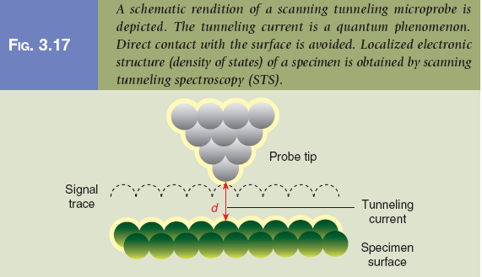
Scanning Probe Microscopy (SPM)
Scanning tunneling microscope (STM)
The magnitude of the tunneling current between the probe tip and the atoms of a substance surface is monitored. So, sample should be electrically conducting.
When a conducting tip is brought very near to a metallic or semiconducting surface, a bias between the two can allow electrons to tunnel through the vacuum between them. For low voltages, this tunneling current is a function of the local density of states (LDOS) at the Fermi level, Ef, of the sample. Variations in current as the probe passes over the surface are translated into an image. STM can be a challenging technique, as it requires extremely clean surfaces and sharp tips.

Slide 21
Scanning tunneling microscope (STM)
Tunneling current starts to flow when a sharp tip approaches a conducting surface at a distance of approximately 1nm (10Angstrom).
The tip is mounted on a piezoelectric tube, which allows tiny movements by applying a voltage at its electrodes. The electronics control the tip position to keep tunneling current and, hence, the tip-surface distance constant, while at the same time scanning a small area of the sample surface.
This movement is recorded and can be displayed as an image of the
surface topography. Under ideal circumstances, the individual atoms of a surface can be resolved and displayed.

Slide 22
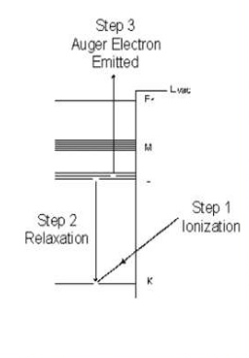
X-ray photoelectron spectroscopy (XPS)
XPS is used to get elemental composition of the materials, typically in the depth of 1 to 10 nm from the surface.
The X-Ray source produces photons with certain energies:
  MgKα photon with an energy of 1253.6 eV
  AlKα photon with an energy of 1486.6 eV
Normally, the sample will be radiated with photons of a single energy (MgKα or AlKα). This is known as a monoenergetic X-Ray beam.
Free electron
X-Ray
Valence electrons
proton
neutron
Core electrons
electron
electron vacancy
Core electrons respond well with the X-ray energies

Slide 23
Generally the binding energies of the core electrons are considered, why?
The Binding Energy (BE) is characteristic of the core electrons for each element. The BE is determined by the attraction of the electrons to the nucleus. If an electron with energy x is pulled away from the nucleus, the attraction between the electron and the nucleus decreases and the BE decreases. Eventually, there will be a point when the electron will be free of the nucleus.
Vacumm Level
Ø, which is the work function
Fermi Level
At absolute 0 Kelvin the electrons fill from the lowest energy states up. When the electrons occupy up to this level the neutral solid is in its “ground state.”
BE
Lowest state of energy

Slide 24
The instrument measures the kinetic energy of the electron and the binding energy of the element is calculated using the following equation
KE=hv-BE-Ø
KE Kinetic Energy (measure in the XPS spectrometer)
hv photon energy from the X-Ray source (controlled)
Ø spectrometer work function. It is a few eV, Found by calibration.
BE is the unknown variable
This technique is also know as ESCA
The chemical state of the element can be studies using this method

