Slide 1
Semiconductor Nanoparticles

Slide 2
Interesting aspects of semiconductor nanoparticles
Their band gap energies mostly lie in the visible energy
They exhibit the quantum confinement effect
Show interesting optical properties (Vis to NIR)
Several synthetic methodologies are available to make them

Slide 3
Monodispersed Nanoparticles
Why do we need monodispersed nanoparticles?
1. Injection method
A single temporally short nucleation followed by slower growth. This is achieved by injecting one of the precursor (which is at room temp.) to the other reagents at high temperature which is sufficient to decompose the reagents, forming supersaturation of species in solution, which is relieved by nucleation of NCs. Upon nucleation the concentration of the species in soln. drops below the critical concentration for nucleation and further materials can only add to the existing nuclei.
2. Temperature ramp
Alternatively, the above process can also be achieved by mixing the reagents in a vessel at a temp. low enough to preclude any rxn. A controlled ramp of the soln. temp accelerates the chemical rxn and produces a requisite supersaturation, which is relieved by a burst of nucleation. As long as the temp of the mixture is maintained such that rate at which the reagents react is less than the rate at which the reagent adds to the existing nuclei, the supersaturation state is never revisited.

Slide 4
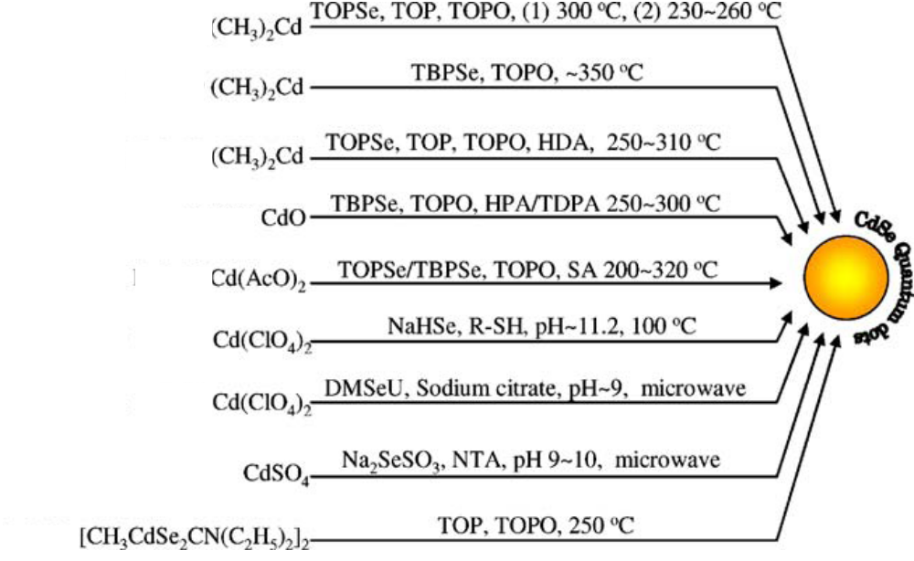
Separation and purification
Precipitation:
The nanoparticles are separated by first adding a non-solvent (e.g. ethanol) which precipitates the nanoparticles. The precipitated nanoparticles are separated by centrifugation and repeated washing to remove any excess ligands. By this way the nanoparticles are also purified.
Size selective precipitation:
This is achieved by first adding a small amount of solvent which will precipitate only the larger nanoparticles due to high surface area. Further addition will separate particles in the descending order of size. The smallest particles will come out at the end.

Slide 5
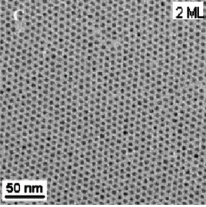
Examples of Q-dots
II-VI Semiconductors
CdS, CdSe, CdTe
PdS, PdSe, PdTe
III-V Semiconductors
GaP, GaAs, GaSb
InP, InAs, InSb
CdS, CdSe, ZnS, ZnSe -------Visible emission
PbS, PbSe ------- NIR emission

Slide 6
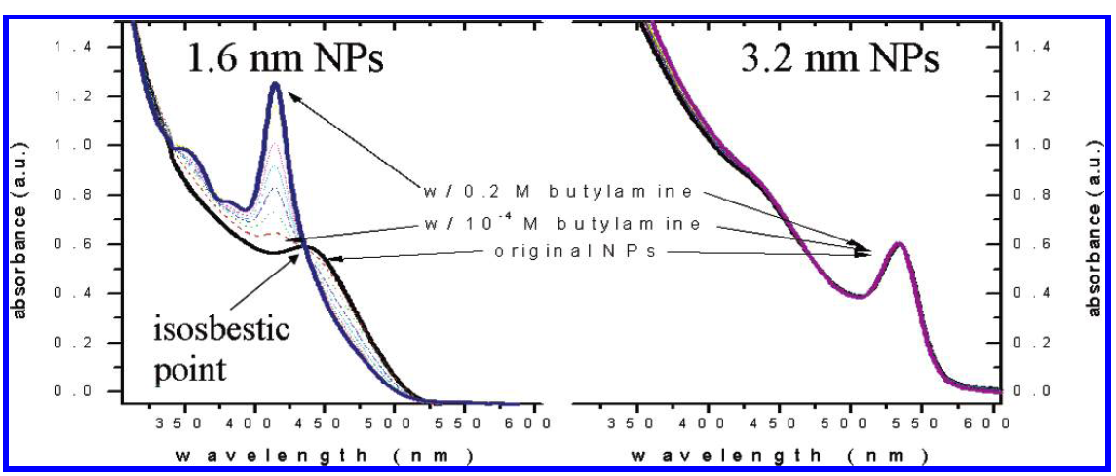
Surface reactivity of nanocrystals
When butylamine was added to very small nanocrystals, it modifies the bandgap emission
Which is likely due to the etching of the nanocrystals leading to smaller size. Another reason
might be the change in the crystal structure.

Slide 7
ZnO nanocrystals-inducing secondary nucleation
Zn(COOC₁₇H₃₅)₂ + 1-Octadecene
SA – stearic acid
1-Octadecanol (without alcohol the Zn-Stearate is very stable)
280° C
ZnO
ZnO nanocrystals stabilized with SA. These nanocrystals were very stable in dispersion for days. Almost 100% conversion was found from mass and elemental analysis. No Ostwald’s ripening takes place due to the absence of any ligand (SA) to stabilize the monomers. This is verified by adding SA ligands to the reaction system.

Slide 8
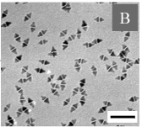
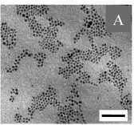
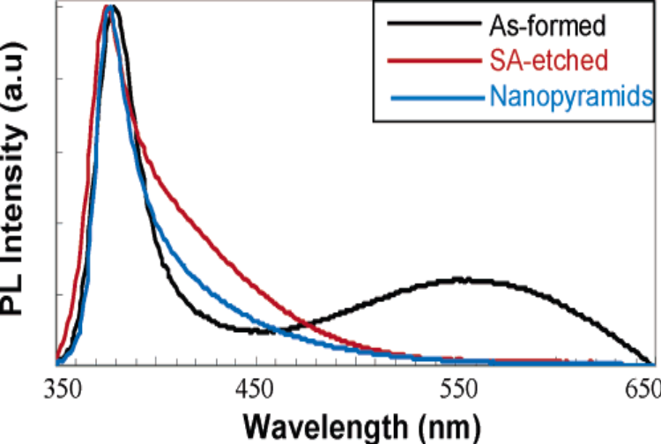
Morphology tuning
Stearic acid (SA)
2 h
When a small amount of SA was added, the spherical nanocrystals changed to pyramids, which is due to the formation of Zn(stearate)₂ in solution. This led to a condition where monomer conc. is higher than nuclei concentration leading to the formation of non-equilibrium structures.
The trap emission centered at 550 nm is reduced upon addition of Stearic acid. This is due to the removal of trap states as SA etches surface Zn ions forming Zn(stearate)2.

Slide 9
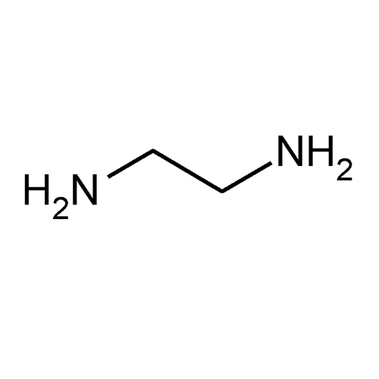
Models for the growth of anisotropic nanocrystals
Selective-Adsorption Model
a mixture of surfactants is required for anisotropic crystal growth. Selective adsorption of surfactants at different crystallographic faces of the growing crystals, results in modification of the surface free energy, which affects the growth along that crystallographic planes.
Effective-Monomer Model
the free energy of different crystallographic faces is manipulated throughout the reaction by the sequential injection of effective monomer precursors (i.e., Cd and Se precursors).
Molecular Template Theory
A template serves as a scaffold within which a different material is generated in situ and shaped into a nanostructure with a morphology complementary to that of the template.
e.g. CdS using ethylene diamine
heat
Cd²⁺
S²
Cd²⁺S^{2_}
Cd²⁺
S²⁺
CdS

Slide 10
Core/Shell nanostructures
140°C - 200°C
CdSe
CdSe
ZnEt₂, S(TMS)₂
S(TMS)₂ – bis(trimethylsilyl sulfide)
Other core/shell structures
CdS/CdSe, CdSe/ZnS, CdSe/ZnSe, PdS/PbSe
What is the advantage of core/shell nanocrystals?
As small nanocrystals possess more defects at the surface, the luminescence quantum efficiency is reduced. Growing a shell around the core would reduce these surface defects.

Slide 11
Characterization of core/shell nanostructures
What is the criterion for a suitable shell?
How do you confirm the shell formation?
Is there any other possible scenario?
Does any change will be observed in electron confinement and related
Properties (e.g. optical)?
A general requirement for the synthesis of CS NCs with satisfactory optical properties is epitaxial-type shell growth. Therefore an appropriate band alignment is not the sole criterion for the choice of materials but rather the core and shell materials should crystallize in the same structure and exhibit only a small lattice mismatch. In the opposite case, the growth of the shell results in strain and the formation of defect states at the core/shell interface or within the shell. These can act as trap states for the photogenerated charge carriers and diminish the fluorescence QY.

Slide 12
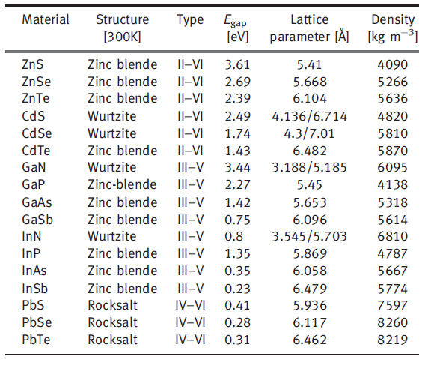

Slide 13
Type I semiconductors
X
CB
CB
CB
CB
CB
VB
VB
VB
VB
X
VB
Reverse Type I
Type I
CdS/HgS
CdSe/CdS
The charge carriers are free to move to CB and VB making the effective bandgap lower. Recombination occurs at the shell material.
The charge carriers are confined in the core. Due to the shell formation, recombination efficiency is improved

Slide 14
Type II semiconductors
X
CB
CB
CB
CB
VB
VB
VB
VB
CB
CB
CB
CB
VB
VB
VB
X
VB
Type II
CdTe/CdSe
Type II
CdTe/CdSe
One of the charge carriers either electron or hole could move to CB or VB making the effective bandgap lower.

Slide 15
Advantage of Core/Shell/Shell
CdSe/ZnSe/ZnS
Growing a thick shell is a challenge due to the lattice mismatch between the materials. This can be minimized by having a thin intermediate layer which provides low strain and acts as lattice adapter.
In some core/shell (type II) structures the probability of one of the carriers moving to the shell is high. In that case it is possible for it to be quenched or lose its energy if it is close to the surface. To prevent the quenching of the carrier, a second shell is grown, which enhances probability of recombination.
QDQW

Slide 16
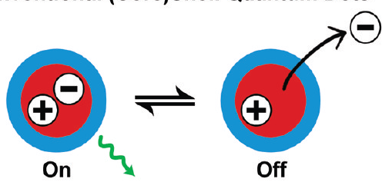
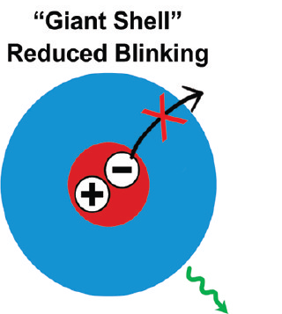
On/Off Blinking in Q-dots
The emission in a single Q-dot is found to be intermittent. This is attributed to the repeated ionization of the nanocrystals due to Auger process.
Coating a thicker shell or an insulating layer (wider potential well) reduces the blinking process as the charge carriers are confined within the core.

Slide 17
Dynamics in Q-dot-Q-well Nanostructures
HgS
When the CdS core was excited, the electron and the hole moved to the HgS shell. The hole reaches the HgS shell 10 times faster than the electron, which was verified with the following measurements.
The observed lifetime for the core/shell was 1.5 ps. But when the HgS alone was excited to its band gap, the lifetime was < 100 fs. So the observed long lifetime (1.5 ps) must be due to the movement of e⁻ and h⁺ from the CdS core. An intraband transition, was observed for the hole, which has a lifetime of 150 fs. This confirms that h⁺ reached the HgS 10 times faster than e⁻.
The reason was attributed to the charge transfer. The e⁻ has to transfer from excited Cd⁺ (CdS) to Hg²⁺ (HgS), whereas the hole will move from S to S (same species).
CdS
CdS
Reverse Type I
Observed lifetime- 1.5 ps
HgS – lifetime , 100fs
Hole intraband transition – 150 fs
CB
CB
Band gap
VB
VB
Reverse Type I
Acc. Chem. Res. 2004, 37, 326-333

Slide 18
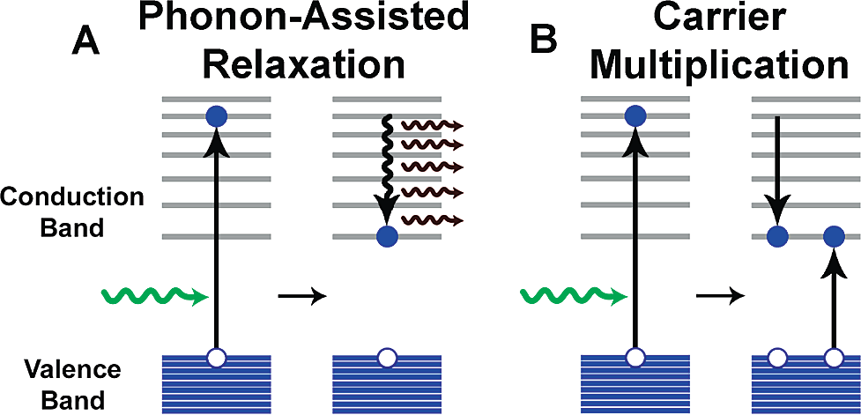
Carrier multiplication
When a quantum dot is excited by a photon with an energy at least twice its band gap, the electron and hole that result may release their excess kinetic energy through the excitation of a second electron in a collision-like Auger process, resulting in a biexciton and an internal quantum efficiency greater than 100% . Thereby, excess kinetic energy is no longer dissipated into lattice vibrations, which may yield improved efficiencies in photovoltaic devices. These Auger processes are efficient in nanocrystals compared to their bulk counterparts due to suppression of the phonon-assisted decay rate and the large energy separations between electronic energy levels

Slide 19
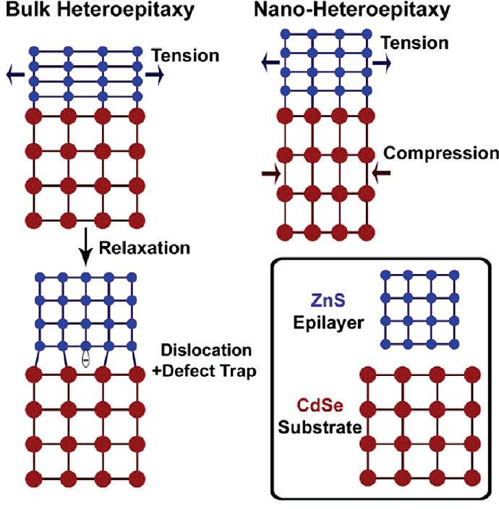

Strain Tuning
It happens when there is a lattice mismatch between the core/shell. The developed strain will be relieved through defects at the interface causing trap states. In nanocrystals this effect is less compared to bulk. This is because, unlike large crystals, an isolated nanocrystal can deform to adapt to the overgrowth of a straining shell and the large surface area allows the stress to be distributed over a large fraction of the constituent atoms.
α is the deformation potential
where ∂(ln V) is the fractional volume change. For II-VI and III-V materials, α is negative (α CdSe ) -2.9), meaning that compression of the crystal widens the band gap
CdTe (a = 6.482Å)
CdS (a = 5.818Å)
Lattice mismatch 11%
For CdTe smaller than 4 nm, any thicker shell leads to coherent growth

Slide 20
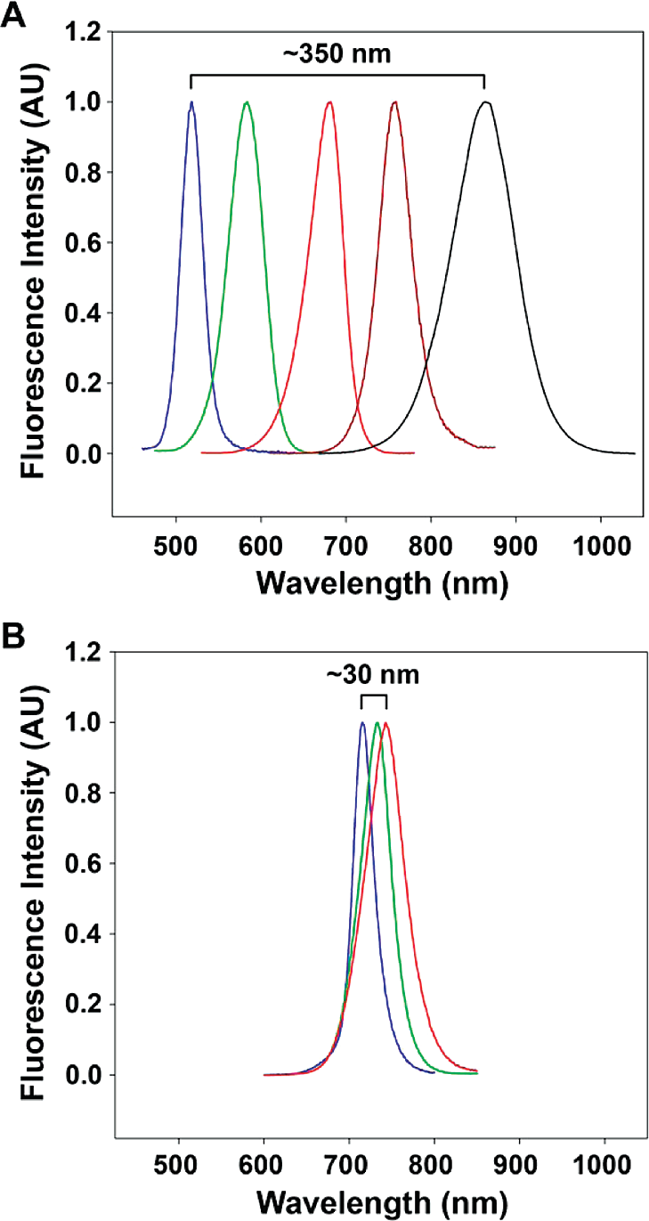
Fluorescence spectra of strain-tunable (CdTe)ZnSe quantum dots. (A) fluorescence from 1.8 nm CdTe cores strongly red-shifts when capped with 0-6 monolayers of ZnSe shell (from blue to black) due to strain-induced changes in the core and shell lattices.
(B) Fluorescence from 6.2 nm CdTe cores only exhibits a small red-shift when capped with
0-5 monolayers of ZnSe shell (from blue to red) due to strain relaxation through lattice
defect formation.

Slide 21
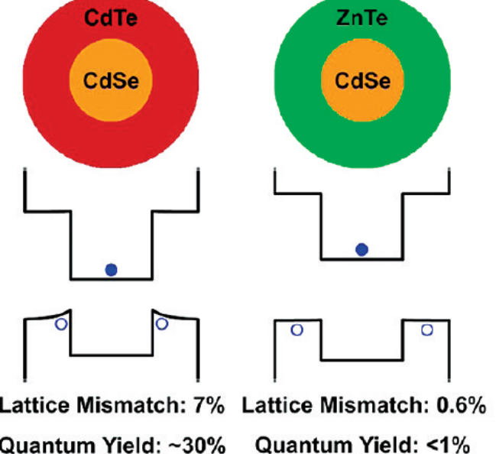
Band Wrapping in core/shell structures
The strain field in a lattice-mismatched (core)shell quantum dot is inhomogeneous in the shell, the band edge is believed to deform over the radial direction, giving rise to inhomogeneous charge carrier distributions. For example, the fluorescence behavior of (CdSe)CdTe and (CdSe)ZnTe nanocrystals are different. Both of these heterostructures are type-II with the hole sequestered in the shell and the electron in the core, but heterostructures with CdTe shells have quantum yields (20-40%) dramatically larger than that (<1%) with ZnTe shells. It is important to realize that the lattice mismatch between CdSe and CdTe is 7%, whereas the lattice mismatch is only 0.6% for ZnTe. The high strain in the CdTe shell will shift the hole wave function toward the core material increasing the overlap between the electron and hole and thus increase the probability of carrier recombination. The near absence of strain for ZnTe shells substantially increases the wave function localization at the nanocrystal surface, where surface traps increase the probability of nonradiative relaxation .

Slide 22

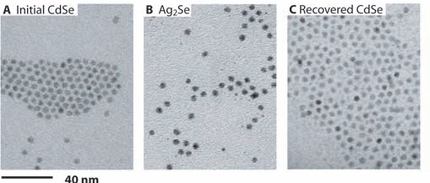
Cation exchange reactions
Small colloidal Q-dots undergo cation exchange process. For example when small CdSe NCs (4.2 nm) are exposed to Ag⁺ ions, the Ag⁺ ions replace Cd²⁺ from the lattice. Whereas NCs of 100 nm hardly show any similar effect.

Slide 23
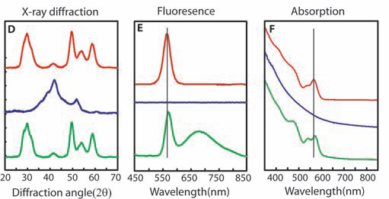
CdSe
Ag₂Se
CdSe
Proof for cation exchange from XRD, fluorescence and absorption measurments

Slide 24
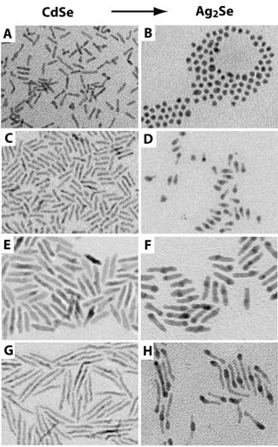
Effect of morphology of the nanocrystals
It is readily apparent that thinner nanorods reorganize to the equilibrium spherical shape during the forward reaction, which indicates that the anion sublattice is completely disrupted during the reaction. Thicker nanorods maintain their nonequilibrium shapes.
Both thermodynamic and kinetic factors drive the cation exchange process.

