Slide 1

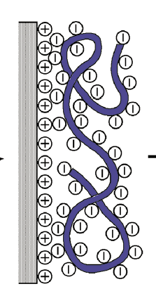
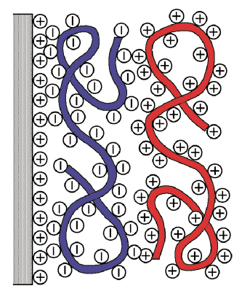
Layer-by-Layer assembly
Layer by Layer assembly is the construction of nanometer-scale coatings by the adsorption of alternately charged polyions (polyelectrolytes).
This method is useful and simple technique to organize organic molecules or macromolecules on 2D flat surfaces
Polyanion
Polycanion
Wash
Wash
Briefly, a positively charged glass slide (or) surface is taken and exposed to negatively charged polyelectrolytes. This led to the attachment of “-” charged PEs onto the “+” charged surface. Thus the “+” charge gets neutralized and the additional charge present on the polymer lead to the charge reversal of the surface. Now, a “+” charged polyelectrolyte can be deposited. Thus a multilayer can be grown by alternative deposition of poly electrolytes.
Reference: G. Decher, Science, (1997), 277, 1232.

Slide 2
Different interactions
Electrostatic interaction
H-bonding
Covalent bonding
e.g.
Polystyrene sulfonate, Poly(acrylic acid), Poly(methaacrylic acid), Poly(glutamic acid) polylysine, poly(allaline hydrochloride)
Substrate
Glass silde, silicon wafer, etc.
There are 2 advantages of this process
Due to charge repulsion between the surface adsorbed polyelectrolytes and the same on the solution, the adsorption is restricted to single layer of one of the charged species.
2. Exposure of oppositely charged species led to the charge reversal.

Slide 3
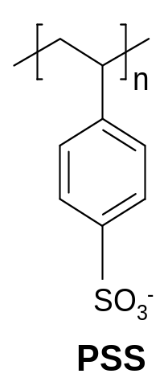
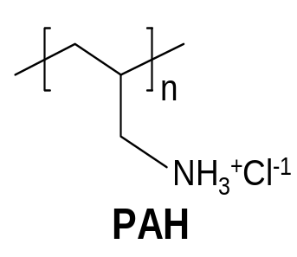
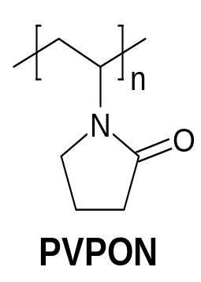
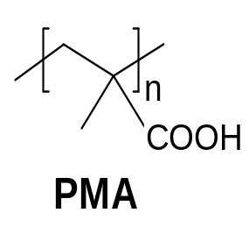
Different types of polymers
Examples of the polyelectrolytes (PEs) that are generally considered for the LBL growth is given below. For both, poly(styrene sulfonate) (PSS) and poly (Allylamine hydrochloride) (PAH), electrostatic interaction is responsible for the multilayer growth. Whereas for poly (N-vinyl pyrrolidone) (PVPON) and poly(methyl acrylate) (PMA) hydrogen bonding is responsible.
Electrostatic interaction
H-bonding

Slide 4
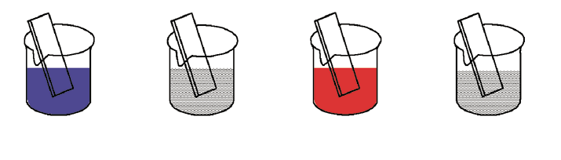
Can adsorption of simple molecules like benzene or other aromatic can lead to LBL
Adsorption of simple organic molecules result in the formation of neutral surface, thus restricting any further growth. On the other hand, use of polyelectrolytes not only reverse the charge of the surface but also seal any defect present during the growth as they possess flexible conformations
By this method several layers can be grown with stable structures leading to the fabrication of thick multilayers. One of the advantage is the easy extension of the process to the industrial scale (corrosion resistant, resistance, etc.)
Experimental procedure for the deposition
Step-1
Step-2
Step-3
Step-4
Typical adsorption time is 5 to 10 minutes. Today Robotic machines are available for automation.
Chem. Mater. 2006, 18, 5480

Slide 5
Advantages of LBL method
Simple and easy method
The process is relatively faster and can be automated
Easy control over the layer thickness
Multilayer can be grown without much defects
The process is easily extend to develop multicomponent layers which is generally difficult in the bulk systems

Slide 6
Preparation of Nanocomposite Layers
In addition to polyelectrolytes, a combination of polyelectrolyte and nanoparticles with oppositely charged surface can be used to grow multilayers. For example, CdSe functionalised with COO⁻ groups at the surface can be used. By depositing different sized CdSe nanoparticles, a gradient in the color can be obtained as CdSe nanoparticles with different sizes will emit different colors.
S
“+” vely cahrged surface
COO⁻
Deposition of different sized
CdTe nanocrystals
Current Opinion Collloid & Interface Science, 2006, 11, 203

Slide 7
LBL usingpoly(allylamine hydrochloride)/poly(acrylic acid): preparation of diffraction gratings
-
-
-
-
-
-
-
poly(styrenesulfonate)
+
+
+
+
+
+
+
+
+
+
+
+
+
+
poly(allylamine hydrochloride)
+
+
+
+
+
+
+
-
-
-
-
-
-
-
+
+
+
+
+
+
+
poly(acrylic acid)
+
+
+
+
+
+
+
+
+
+
+
+
+
+
poly(allylamine hydrochloride)
Ag⁺ ions
Poly(acrylic acid) is used in some layers instead of poly(styrene sulfonate) led to availability of exchangable protons as PAH is weak polyelectrolyte and is partially charged. When exposed to Ag⁺ ions, they get exchanged with protons in PAH. Subsequent reduction of Ag⁺ lead to the formation of Ag nanoparticles.
Ag ⁺ ions exchange with protons of the acrylic acid. The diffusion of these ions into the layers creates a gradient of silver ions which on reduction with NaBH₄ leads to the formation of Ag nanoclusters at predefined positions as well as graded composition of Ag islands. The existence of a refractive index gradient functions as dielectric mirror. These films behaves as 1-dimentional diffraction gratings.

Slide 8
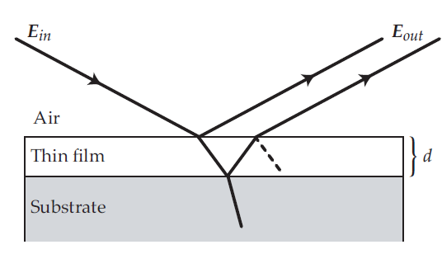
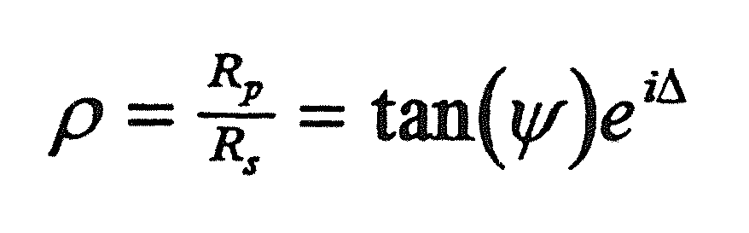
Measurement of thickness of the layers
Optical methods (like UV-Vis)
.
This can be done if the polyelectrolytes contain chromophore groups, then from the absorbance intensity one can determine the thickness (provided linear dependence). In principle a linear dependence is noted in most cases.
Ellipsometry:
Ellipsometry is a sensitive optical technique for determining properties of surfaces and thin films. If a linearly polarized light of a known orientation is reflected at an angle from a surface then the reflected light is elliptically polarized. The shape and orientation of the ellipse depend on the angle of incidence, the direction of polarization of the incident light and the reflection properties of the surface.
An ellipsometer measures the changes in the polarization state of the light when it is reflected from a sample. If the sample undergoes a change, for example a thin film on the surface changes its thickness, then its reflection properties also change. Measuring the reflection properties can allow one to deduce the actual change in the film thickness.
Reflection coefficients for p and s polarized light

Slide 9
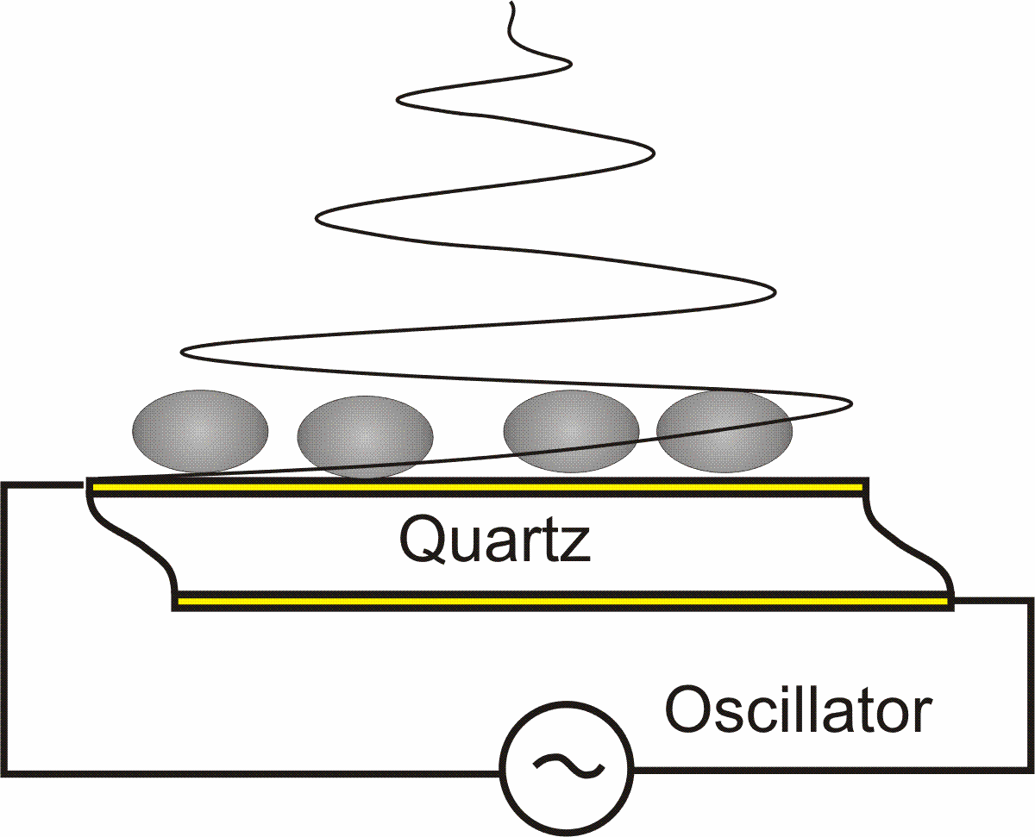
Quartz crystal microbalance (QCM)
This tool is used to determine the amount of polymer adsorbed in each layer.
A quartz crystal microbalance (QCM) measures a mass (as small as nanogram) per unit area by measuring the change in frequency of a quartz crystal resonator.
Piezoelectricity is the ability of some materials (notably crystals and certain ceramics, including bone) to generate an electric potential in response to applied mechanical stress
Quartz is a class of piezoelectric material and if subjected to an alternating electric field, it can contract/expand with a characteristic oscillation frequency. This frequency is extremely sensitive to the mass deposited onto the surface of a crystal. Minute increase in the mass of a surface layer is translated into a decrease in the oscillations frequency which allows real time analysis of the thickness.
Quartz crystal: An oscillating electric field induces mechanical shear waves

Slide 10

Quartz crystal microbalance (QCM)
The frequency of oscillation of the quartz crystal is partially dependent on the thickness of the crystal.
During normal operation, all the other influencing variables remain constant; thus a change in thickness correlates directly to a change in frequency.
As mass is deposited on the surface of the crystal, the thickness increases; consequently the frequency of oscillation decreases from the initial value.
Sauerbrey equation
f₀ – Resonant frequency (Hz)
Δf – Frequency change (Hz)
Δm – Mass change (g)
A – Piezoelectrically active crystal area (Area between electrodes, m2)
ρ_{q} – Density of quartz (ρq = 2.648 g/cm3)
μ_{q} – Shear modulus of quartz for AT-cut crystal
Note: Not required to remember this formula

Slide 11
Applications of QCM
Deposition of materials on the surface
Antibody-antigen interactions
Protein binding
Lipid bilayer adsorption
Surfactant adsorption
Nanoparticle adsorption
Self-assembly
Self-assembled monolayers

Slide 12
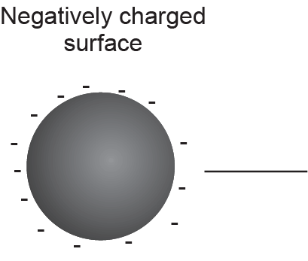
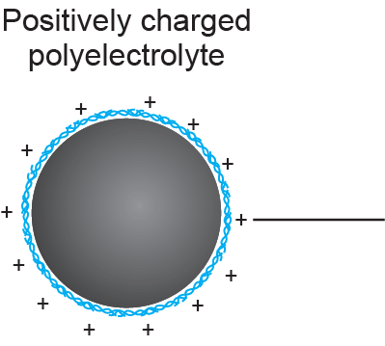
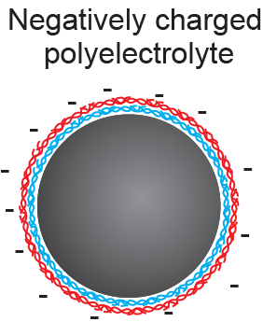
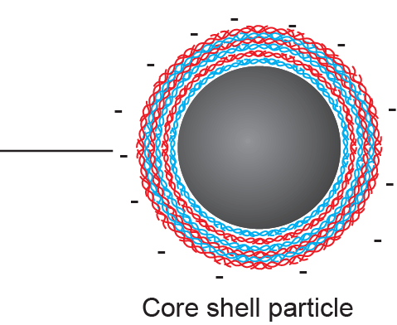
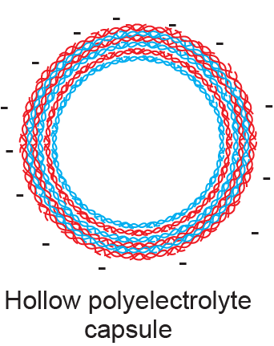
LBL assembly-extension to 3D surfaces
The LBL assembly can be extended to 3D surfaces like colloidal nanoparticles. For example, SiO₂ or polystyrene nanoparticles containing “+” or “-” charge can be used as template for the adsorption of polyelectrolytes. Sequential adsorption of oppositely charged layers can lead to the formation of multilayers. In the final step, the template can be removed leading to hollow nanospheres (or) polyelectrolyte capsules.
1
2
1
Template removal
Step 1: adsorption of “+” ve charged polyelectrolyte
Step 2: adsorption of “-” ve charged polyelectrolyte
The template can be removed through chemical methods

Slide 13
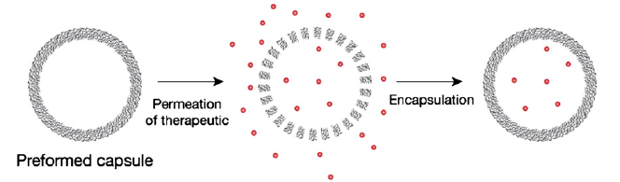
LBL in drug delivery
The hollow capsules can be used for drug delivery applications. The drugs can be loaded inside through diffusion. The permeability of drugs to the core of the capsules can be tuned by P^{H}, ionic strength, temperature, pressure, etc. The schematic of the drug loading is shown in the scheme below.
Generally low concentration of drug molecules is found inside the capsules. The concentration is limited by the outside drug concentration.
The drug loading can be improved by first adsorbing molecule(sequestering agent) which possesses high affinity to the drug molecules. This is followed by the addition of drug molecules.
e.g. for Doxorubicin drug, dextran sulfate is used as sequestering agent.

Slide 14
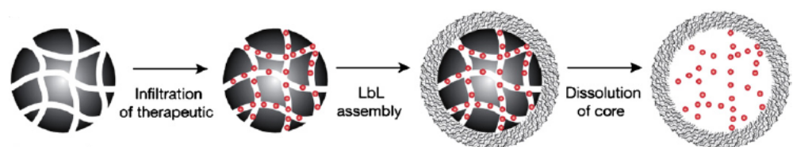
Introducing drugs into the capsules
Porous nanoparticles like silica can be used for drug loading.
Insert the drug into a porous particles
Perform an LBL assembly on to the resulting drug loaded particles
Remove selectively the template particles alone
Release of drug molecules
Two distinct ways of releasing the drug molecules
Instant release (burst)-
E.g. Intracellular uptake –gene transfection
2. Slow release (sustained)-
E.g. Low dosage of drugs is required

Slide 15
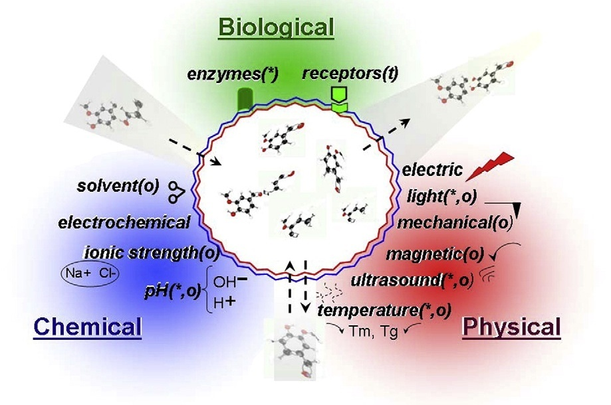
Various Stimuli modes for the release of the drugs from the capsules
The following diagram shows different (biological, chemical and physical) stimuli that can be employed to for the controlled release of drugs.

Slide 16
Chemical Stimuli
pH
In the case of weak PEM (polyelectrolyte multilayers), change in pH lead to protonation and deprotonation of charged groups. This can lead to slight change in the binding interaction between the polyelectrolytes in the multilayers. This process is reversible.
Ionic strength
As electrostatic interactions are the predominant one in the LBL, tuning the ionic strength will lead to screening of electrostatic interaractions between the oppositely charged polyelectrolytes.
Solvent
Solvent can particularly alter the hydrophobic interactions between the polyelectrolytes thereby the release of the drug can be controled
Electrochemical
This is useful when the multilayers are grown with redox-active polyelectrolytes.

Slide 17
Physical Stimuli
Temperature
Increase in temperature lead to polymer reorganization and alter the mechanical strength of the PEM.
Laser Light (instant or burst release)
For this light sensitive capsules are prepared by incorporating nanoparticles into capsule walls. NPs which absorb in the NIR is interesting. The targeted area must be optically accessible.
Ultrasound
e.g. ZnO NPs attached to capsule shells found to be sensitive to ultrasound thus altering the shell roughness, stiffness, etc.
Magnetic field
with magnetic nanoparticles encapsulated PEM, one can control the release of the drug using magnetic filed,

Slide 18
Biological Stimuli
Enzymatic trigger
Enzymes are used to trigger the release of the drug via the degradation of biopolymers.
Oxidation/reduction
Degradation of the capsules (made through disulfide linkages) can be achieved by oxidation and reduction in the blood stream. Intracellular proteins assist in the process.

