Slide 1
Catalysis with Alkene

Slide 6
Key Players in the field:

Slide 7
In organic chemistry, hydroformylation, also known as oxo synthesis or oxo process, is an industrial process for the production of aldehydes (R−CH=O) from alkenes (R₂C=CR₂).
This process has undergone continuous growth since its invention: production capacity reached 6.6×10⁶ tons. The process was discovered by the German chemist Otto Roelen in 1938. He used catalyst HCo(CO)_{4.} The process takes place between 10 and 100 atmospheres) of carbon monoxide and hydrogen at temperatures between 40 and 200 °C.

Slide 10
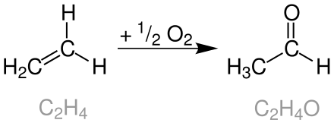
Wacker Process
Wacker process began in 1956 at Wacker Chemie

Slide 13
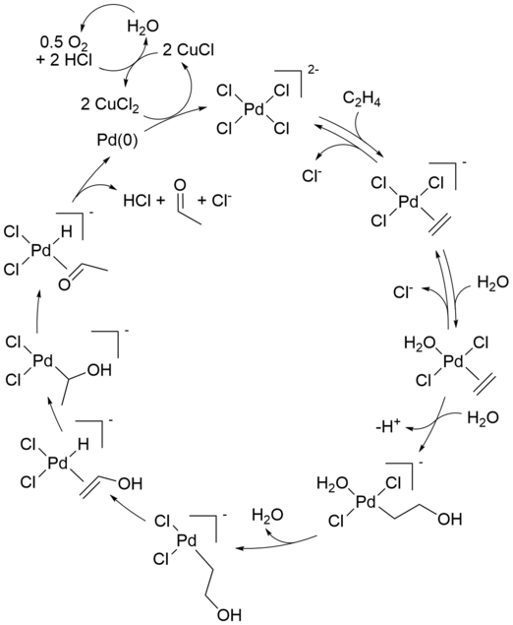

Slide 14
Hydrosilylation
Hydrosilylation, also called catalytic hydrosilation, describes the addition of Si-H bonds across unsaturated bond
One of the earliest catalysts (1957), H2PtCl6, or Speier’s catalyst,23 is extremely active; 0.1 ppm of catalyst is effective. Commercially, the catalyst is normally not even recovered from the product, even though Pt is a precious metal.
Hydrosilylation has been called the "most important application of platinum in homogeneous catalysis”.

Slide 15
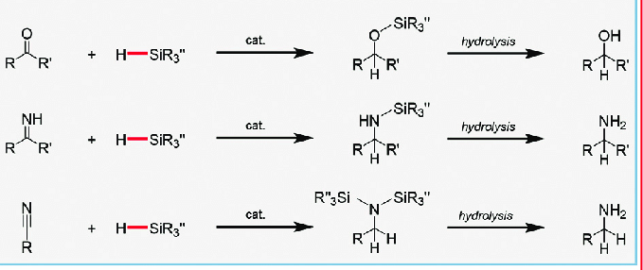

Slide 16
The unsaturated vinylsilane, RCH=CHSiR′3, is also a product. Although minor in most cases, con­ditions can be found in which it predominates. The Chalk–Harrod mechanism (in left) cannot explain the formation of this dehydrogenative silation product, but the alternate mechanism of Fig. 9.7b, in which the alkene inserts into the M−Si bond first, does explain it because β elimination of the intermediate alkyl leads directly to the vinylsilane.

Slide 17
Types of Hydroamination
Definition: Hydroamination is the formal addition of an N-H bond to C-C multiple bonds.
Intramolecular
Hydroamination
Intermolecular
Hydroamination
Hydroamiantion
Intramolecular Hydroamination:
R = R' = Alkyl or Aryl
Intermolecular Hydroamination:

Slide 18
Advantages
Most efficient route to amines, imines, enamines.
No by product - 100% atom economy.
C-N bond formation is of fundamental interest in organic chemistry.
Examples of nitrogen-containing compounds can be found in
Pharmaceutical, Agricultural, and Industrial fields.
Ricci; A. Modern Amminition Methods. Wiley VCH, Weinheim, 2000

Slide 19
Application
Hydroamination was used in the first and second step as a key synthetic tool to
synthesize the molecule in less number of steps.
Marks, T. J. and co-workers J. Am. Chem. Soc. 1999, 121, 3633-3639
Livinghouse, T. and co-workers Org. Lett. 2010, 12, 4271−4273

Slide 20
Application
Livinghouse, T. and co-workers J. Am. Chem. Soc. 1993, 115, 11485−11589
Livinghouse, T. and co-workers J. Org. Chem. 1992, 57, 1323-1324

Slide 21
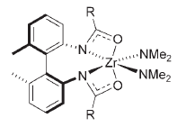
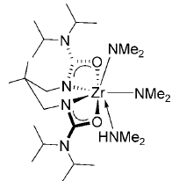
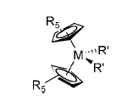
Group 4 Metal Based Catalysts
Secondary aminoalkene
Schafer and co-workers
Angew. Chem. Int. Ed. 2007,
46, 354-358
Schafer and co-workers
Angew. Chem. Int. Ed. 2010,
49, 6382-6386
M = Zr
Hultzsch and co-workers
Angew. Chem. Int. Ed. 2004, 43, 5542-5546

Slide 22
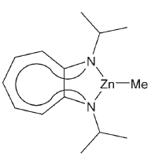
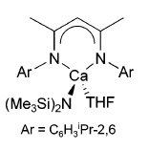
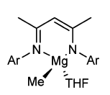
Green Catalyst
Roesky, Blechert and co-workers
Angew. Chem., Int. Ed. 2005, 44, 7794-7798
Group 2 Metal Based Catalyst
(Primary aminoalkane)
Hill and co-workers
J. Am. Chem. Soc. 2005,
127, 2042-2043
Hill and co-workers
J. Am. Chem. Soc. 2009, 131,
9670-9685

Slide 23
Assembly of Group 2 and Group 4 into Single System
1
Complex 1 is highly sensitive and only stable under inert condition inside glovebox.

Slide 24
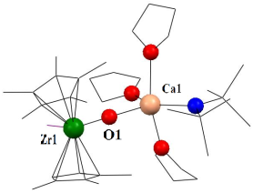
Summary
heterobimetallic complex containing Group 2 metal and Group 4 metals.
The catalyst behaved as a dual catalyst in hydroamination reaction.
Primary aminoalkene activation
Secondary aminoalkene
activation
Mandal et al. Angew. Chem. Int. Ed. 2011, 50, 3968-3972 (Selected as Hot Paper)

Slide 25
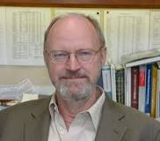
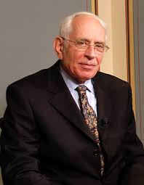

Olefin Metathesis
Richard Schrock, MIT, Robert Grubbs, Caltech, Yves Chauvin, France: 2005 Chemistry Nobel Prize

Slide 26
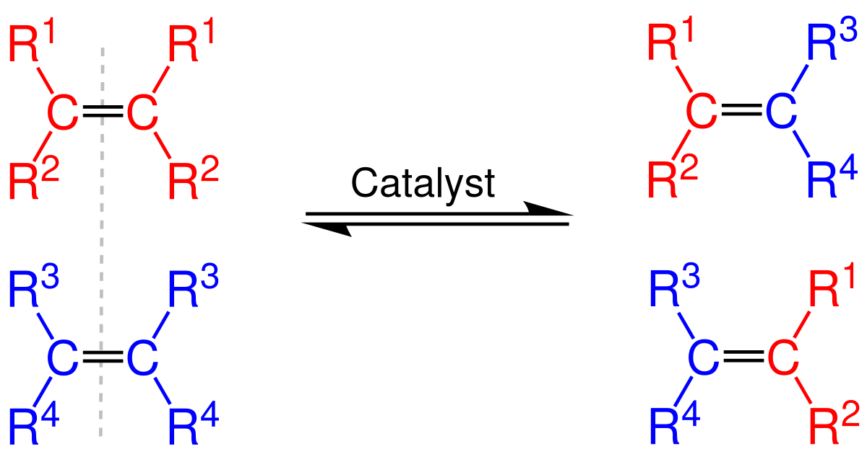
.
What is Olefin Metathesis?
In organic chemistry, olefin metathesis is an organic reaction that entails the redistribution of fragments of alkenes (olefins) by the scission and regeneration of carbon-carbon double bonds

Slide 27
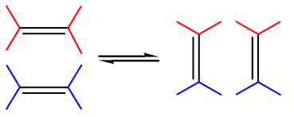
Trnka, T. M.; Grubbs, R. H. Acc. Chem. Res. 2001, 34, 18.

Slide 28
Metathesis in Chemistry

Slide 29
Metathesis Publications
1st Commerically available
Grubbs catalyst
1st Commerically available
Schrock catalyst

Slide 30
2005 Nobel Prize for Metathesis
Chauvin, Y.; Schrock, R. R.; Grubbs, R. H. Angew. Chem. Int. Ed. 2006, 47, 3740.

Slide 31
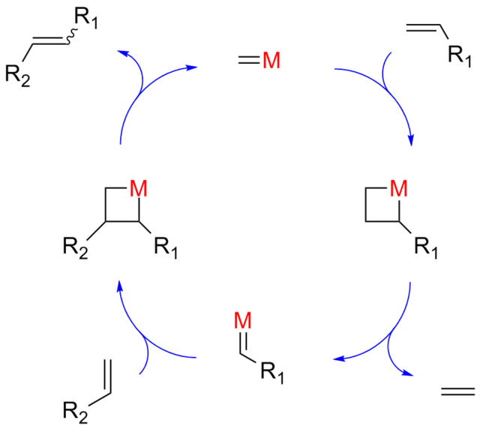
The Catalytic Cycle

Slide 32
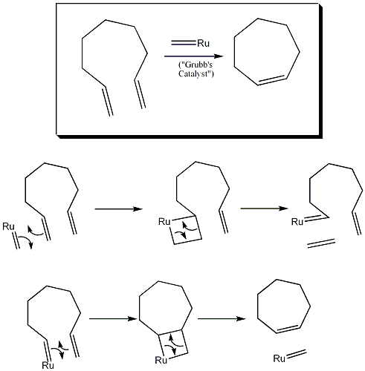
Ring Closing Metathesis

Slide 33
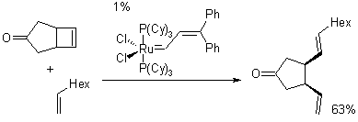
Ring Opening Metathesis

Slide 34
Metathesis in Synthesis
Alzheimer's diseases
Ciluprevir
Hepatitis C
Hirama, M.; Oishi, T.; Uehara, H.; Inoue, M.; Maruyama, M.; Oguri, H.; Satake, M. Science 2001, 294, 1904.
Martin, S. F.; Humphrey, J. M.; Ali, A.; Hillier, M. C. J. Am. Chem. Soc. 1999,121, 866.
Faucher, A.-M. Org. Lett. 2004, 6, 2901.

Slide 35
Mechanism of Olefin Coordination
Dias, E. L.; Nguyen, S. T.; Grubbs, R. H. J. Am. Chem. Soc. 1997, 119, 3887.

Slide 36
Phosphine Dissociation Experiments
Phosphine exchange monitored by ³¹P NMR experiments over a range of temperatures
Catalyst will not carry out subsequent metathesis steps
Intermediates are observable by NMR
Key intermediates could not be observed by NMR
Sanford, M. S.; Ulman, M.; Grubbs, R. H. J. Am. Chem. Soc. 2001, 123, 749.

Slide 37
Phosphine Dissociation Experiments
Sanford, M. S.; Ulman, M.; Grubbs, R. H. J. Am. Chem. Soc. 2001, 123, 749.

Slide 38
Determining Dependence on Phosphine
Vary equivalents of phosphine
Rate shows no dependence on phosphine concentration
k (s⁻¹)
PR₃ (eq)
Sanford, M. S.; Ulman, M.; Grubbs, R. H. J. Am. Chem. Soc. 2001, 123, 749.

Slide 39
The Grubbs Catalysts
Sholl, M.; Ding, S.; Lee, C. W.; Grubbs, R. H. Org. Lett. 1999, 1, 953.

Slide 40
N-Heterocyclic Carbene Ligands
Gives electron density
Removes electron density
Diez-Gonzalez, S.; Nolan, S. P. Coord. Chem. Rev. 2006, 251, 874.
Straub, B. F. Adv. Synth. Catal. 2007, 349, 204.

Slide 41
The Trans Effect and Ligand Dissociation
Atwood, J. D. Inorganic and Organometallic Reaction Mechanisms; VCH: New York, 1997, p 51.

Slide 42
The Trans Effect and Ligand Dissociation
Atwood, J. D. Inorganic and Organometallic Reaction Mechanisms; VCH: New York, 1997, p 51.

Slide 43
The Trans Effect and Ligand Dissociation
Atwood, J. D. Inorganic and Organometallic Reaction Mechanisms; VCH: New York, 1997, p 51.

Slide 44
Alkene Polymerization

Slide 45
Well over 80 million tonnes of poly(ethene), often known as polyethylene and polythene, is manufactured each year making it the world's most important plastic. This accounts for over 60% of the ethene manufactured each year.

Slide 46
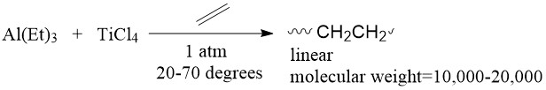
Ziegler Natta Polymerization
In 1953, German chemist Karl Ziegler discovered a catalytic system able to polymerize ethylene into linear, high molecular weight polyethylene which conventional polymerization techniques could not make. The system contained a transition metal halide with a main group element alkyl compound (Figure 2).

Slide 47
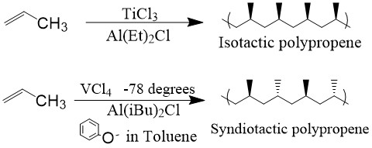
Following the catalytic design, Italian chemist Giulio Natta found that polymerization of α-olefins resulted in stereoregular structures,² either syndiotactic or isotactic, depending on the catalyst used (Figure 3). Because of these important discoveries, Karl Ziegler and Giulio Natta shared the Nobel Prize in Chemistry in 1963.

Slide 48
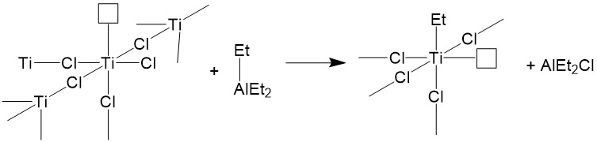
Active Catalyst

Slide 49
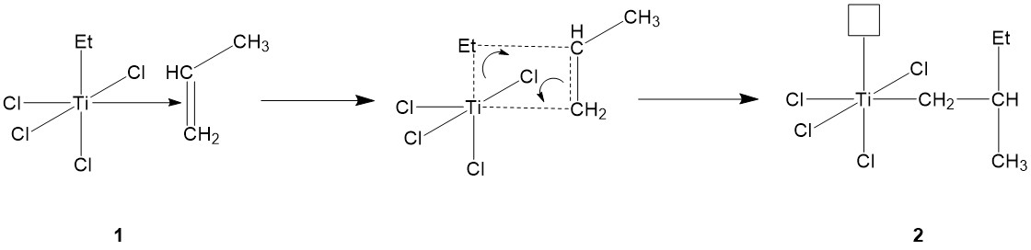
Initiation

Slide 50
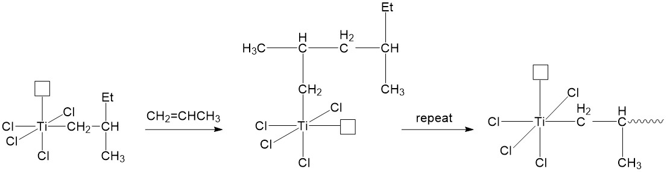
Propagation

Slide 51
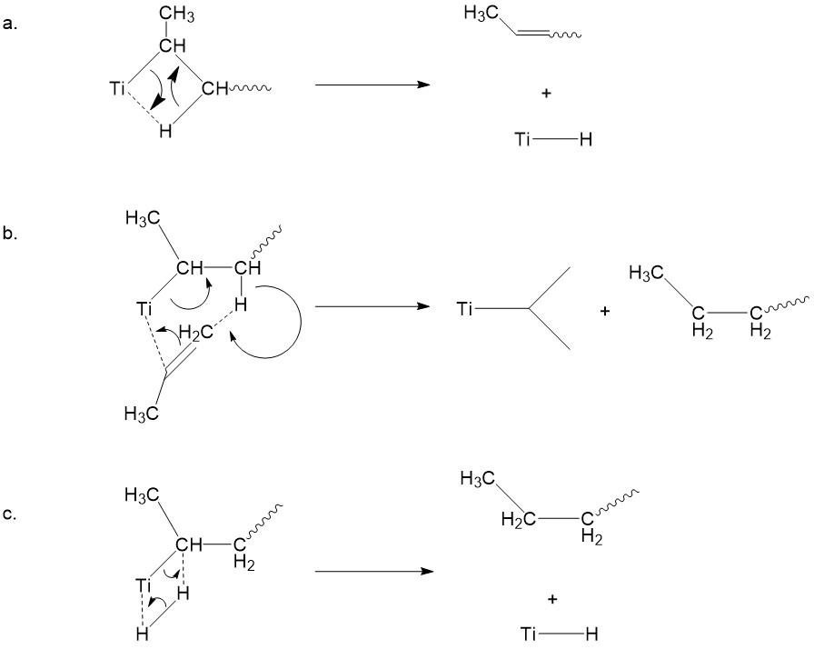
Termination
Figure 9: Three termination approaches: (a) β-elimination from the polymer chain, forming metal hydride; (b) β-elimination with hydrogen transfer to monomer; (c)hydrogenation.

Slide 52
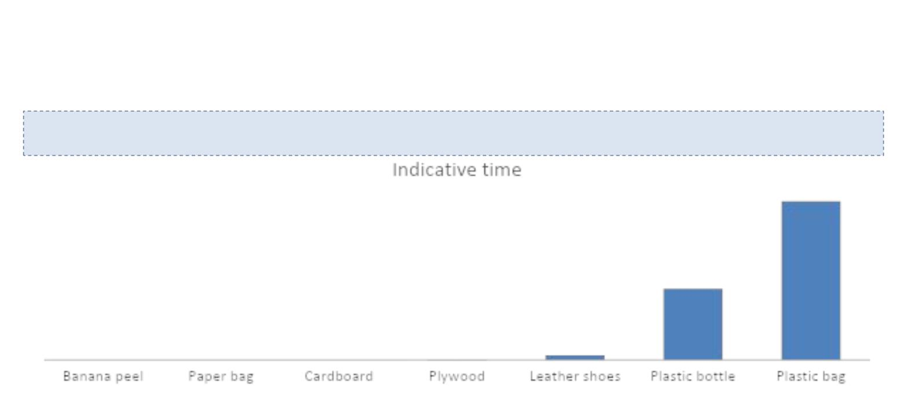
Waste Recycling
• Plastic is a general term for synthetic polymerization products
Karl Ziegler and Giulio Natta awarded Nobel Prize in 1963 for making plastic (olefin polymerization process).
• Almost all plastics are made from petroleum and are not bio-degradable
Plastic takes centuries to decompose in the natural environment
1000 years
450 years
30 years
2 years
2
2 weeks
1 month
months

Slide 53
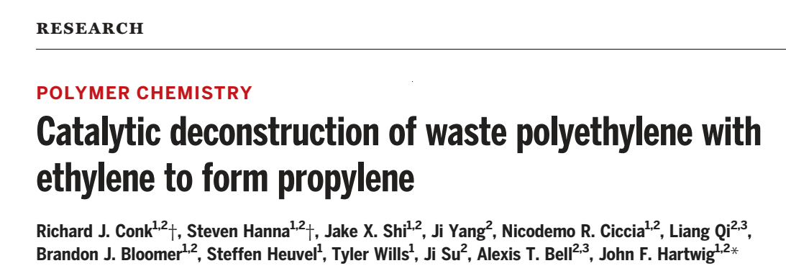
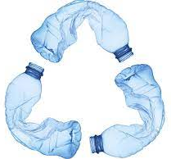
Science 2022, 377, 1561-1566

