Slide 1
CH4102
(By Swadhin Mandal and Arindam Mukherjee)
Organometallic Chemistry (SM) + Bioinorganic Chemistry (AM)
Historical Background and Stability of Organometallic Compounds: Definition, the first few organometallic complexes, thermodynamics and kinetics of organometallic compounds, the 18-electron rule. (2 L)
Different types organometallic bonding: Organometallic complexes with pi-acid ligands: metal- carbonyl, -alkene,- diene, -carbenes, -phosphines and hydrides (5 L + 1 exam)

Slide 2
Brief introduction to Main-Group Organometallic Chemistry Organo alkali metals, organo silicon compounds, organo aluminum compounds, organo boron and organo phosphorus compounds (3 L)
Transition metal Organometallic Chemistry: Major reaction pathways of transition metal organometallic compounds- Oxidative addition, reductive elimination, insertion, elimination reaction (2 L) + 1 Exam
Homogeneous Catalysis: Hydrogenation, hydroformylation, hydrosilylation, alkene metathesis, alkene polymerization, coupling reactions, Monsanto process (5 L)
References:
1. Robert H. Crabtree, The Organometallic Chemistry of the Transition Metals, 4th Ed. (Wiley, 2005)
2. Christoph Elschenbroich, Organometallics, 3 rd Ed. (Wiley-VCH, 2006)

Slide 3
Course Management
Total lectures: 20 + (Mid Sem Exam)
Tutorial Classes: 6
Class Routine: CH4102
Tuesday 5-7 PM (LH 101, includes tutorial)
Thursday 1-2 PM (LH 101)
Friday 2-3 PM (LH 101)
Marks Distribution:
Course Marking: 50 marks (Swadhin Mandal) + 50 marks (Arindam Mukherjee)
50 marks (Swadhin Mandal)
Internal Assessment: 25 (5 from Attendance, and Impression + 10 Marks, Class Test 1 + 10 Marks, Class Test 2 )
Midsem: 25

Slide 4
Important Dates
Last class on my part: 21st Sept
Mid-sem exam starts from 22nd Sept (as per routine)
First Class Test 10 Marks: 22nd August , Friday 2-3 PM
2nd Class Test 10 marks: Date to be announced
After Autumn break: will start Bioinorganic Part

Slide 5
Teaching Assistant:
Partha Pratim Dey (parthaprotim994@gmail.com , WhatsApp: 8436300461) Research Topic: Discovery of new catalytic concepts and reactions
Pallabi Mandal (pallabi0110@gmail.com, WhatsApp: 9474500600) Research Topic: Theoretical Investigation by DFT for catalytic processes
INSPIRE Faculty :
Dr Siuli Das, Research Topic: Inorganic Chemistry
Tutorial: six classes will mainly deal with problem-solving and practice
Make a Whatsapp group

Slide 6
What is Organometallic Chemistry and Why should I know about it?

Slide 7
Nobel Prizes!!!
P. Ehrlich (1908)
V. Grignard (1912)
The Use of Organomagnesium Compounds in Preparative Organic Chemistry
K. Ziegler and G. Natta -1963 (polyolefins from olefins in low pressure process using TM organometallic catalyst)
D. Crowfood Hodgkins -1964 (discovery of Co-C bond in vitamin B12 by X-ray)
Arsphenamine, also known as Salvarsan to treat syphilis
K. B. Sharpless, W. S. Knowles and R. Noyori -2001 (Asymmetric catalysis using TM organometallic catalysts)
E. O. Fischer and G. Wilkinson -1973 (Organometallic Sandwich compound)
H. C. Brown and G. Wittig -1979 (Organoboron and Phosphonium ylides)
R. Hoffmann and K. Fukui -1981 (Theory to understand structure and reactivity)
Y. Chauvin, R. R. Schrock and R. H. Grubbs -2005 (Olefin metathesis by TM organometallic catalysts)
Richard Heck, Ei-ichi Negishi Akira Suzuki-2010 for palladium-catalyzed cross couplings in organic synthesis
Carolyn Bertozzi, Morten Meldal and K. Barry Sharpless 2022 “for the development of click chemistry and bioorthogonal chemistry”

Slide 8
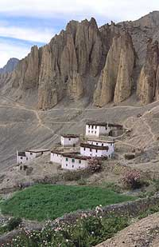

What catalyst does?
Catalyst saves energy!

Slide 9
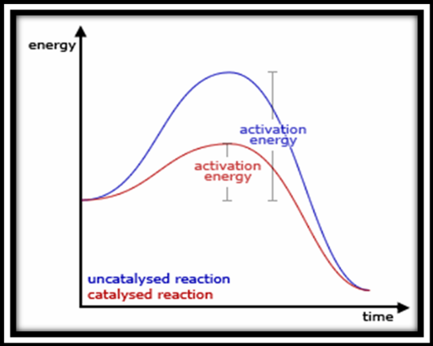

Slide 10
Life Saving Medicines…
Billion Dollar drugs
Palladium catalyzed
Nobel Prize-2010
Telmisartan (antihypertensive drug)
Losartan (antihypertensive drug)
(S)-Naproxen, Ru catalyzed hydrogenation, anti inflammatory drug
Rh catalyzed hydrogenation
Parkinson's disease, Nobel Prize-2001

Slide 11
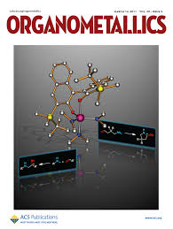


Slide 12
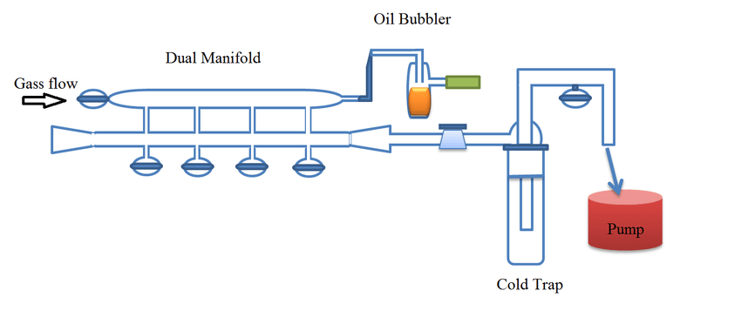

Slide 13
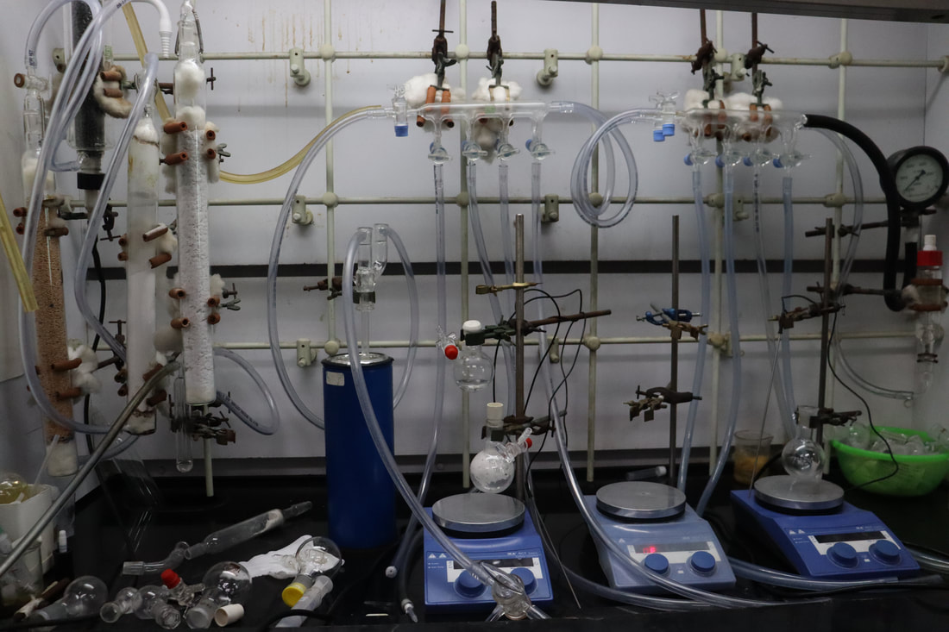

Slide 14
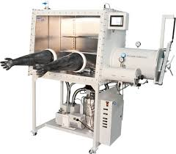

Slide 15
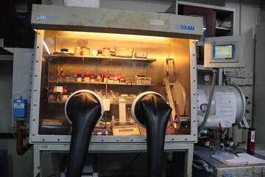

Slide 16
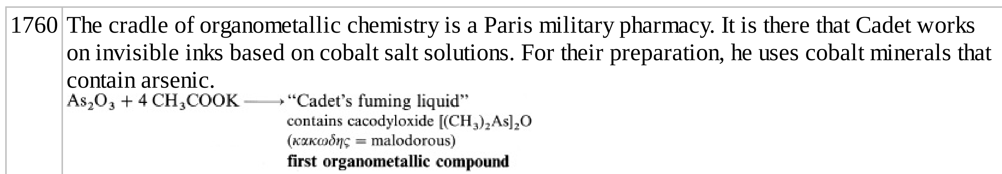

Slide 18
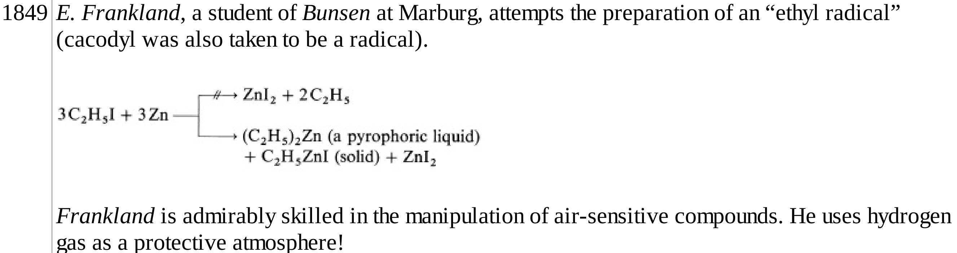

Slide 19
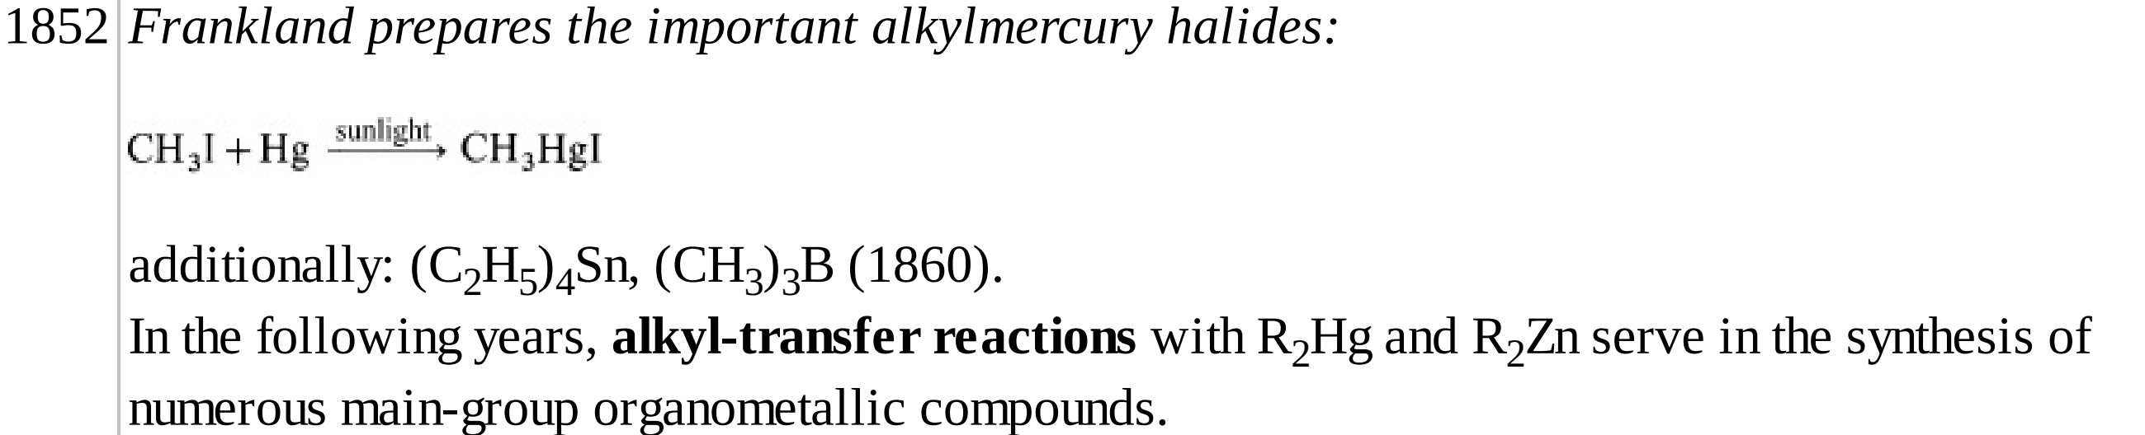

Slide 20
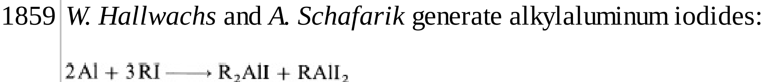

Slide 24
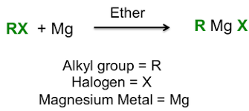
1900: Victor Grignard

Slide 26
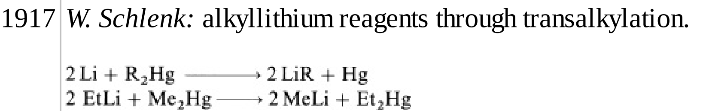

Slide 27
Grignard reagents, RMgX, provided the first source of nucleophilic alkyl groups, Rδ−, to complement the electrophilic alkyl groups, Rδ+, available from the alkyl halides.

Slide 28
Alkyls of the electropositive elements of groups 1–2, as well as Al and Zn, are sometimes called polar organometallics because the alkyl anion is only weakly stabilized and retains much of the strongly nucleophilic and basic character of the free anion.

Slide 29
Polar alkyls all react with traces of humidity to hydrolyze the M−C bond to form M−OH and release RH. Air oxidation also occurs very readily, and so polar organometallics must be protected from both air and water.

Slide 30
as we move to less electropositive metals by moving to the right and down the periodic table, the compounds become much less reactive, until we reach Hg, where the Hg−C bond is so stable that [Me−Hg]+ cation is indefinitely stable in aqueous sulfuric acid in air.

Slide 31
The inherent stability of the R fragment plays a role, too. As an sp3 ion, CH₃− is the most reactive. As we move to sp2 C₆^{H}₅− and even more to sp RC≡C−, where the lone pair of the anion is stabilized by being in an orbital with more s character, the intrinsic reactivity falls off. The same trend makes the acidity of the hydrocarbons increase as we go from CH₄ ^{(pK}_{a} ^{= ∼50) to C}₆^{H}₆ ^{(pK}_{a} ^{= ∼43) and to RC≡CH (pK}_{a} = ∼25), so the anion from the latter is the most stable and least reactive.

Slide 32
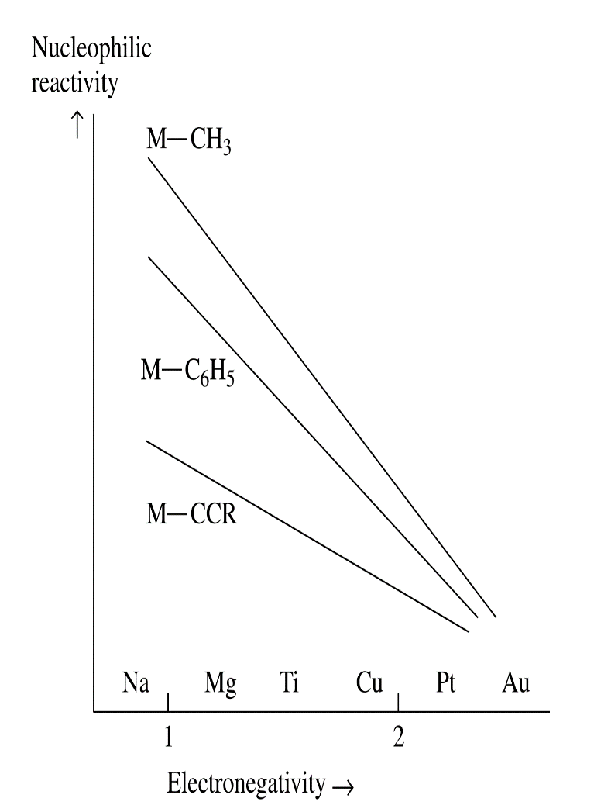

Slide 33
^{Pope and Peachey’s Me}₃PtI (1909) was an early but isolated example of a d-block metal alkyl. Attempts during the 1920s through 1940s to make further examples of d-block alkyls all failed.

Slide 34
These failures led to the view that transi­ tion metal–carbon bonds were unusually weak; for a long time after that, few serious attempts were made to look for them. In fact, we now know that such M−C bonds are strong (30–65 kcal/mol is typical). It is the existence of several easy decomposition pathways that makes many transition metal alkyls unstable. Kinetics, not thermodynamics, was to blame for the synthetic failures.

Slide 35
Its fortunate because it is easier to manipulate the system to block decomposition
pathways than it is to increase the bond strength. In order to be able to design
stable alkyls, we must look at some of these pathways to see how they can be
inhibited.

Slide 36
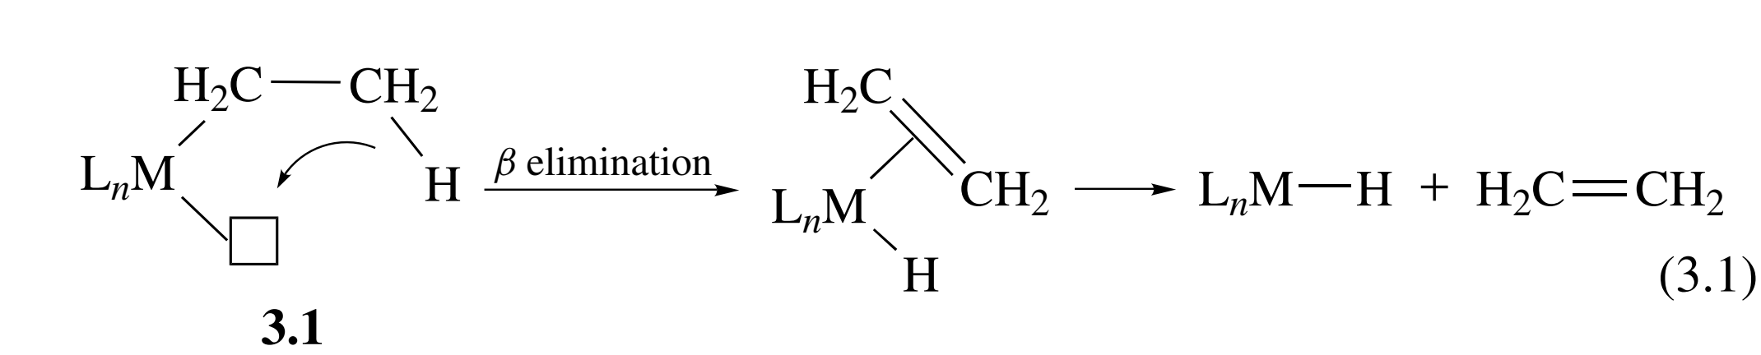
β Elimination
The major decomposition pathway for alkyls is β elimination, which
converts a metal alkyl into a hydridometal alkene complex.

Slide 37
1. The β carbon of the alkyl bears a hydrogen substituent.
2. The M-C-C-H unit can take up a roughly coplanar conformation,3b
which brings the β hydrogen close to the metal.
3. There is a vacant site on the metal, symbolized here as �, cis to the alkyl.
4. The reaction is very slow or does not occur for d0 and
main-group alkyls.

Slide 38
There must also be an empty orbital ready
to accept the β-H, or more exactly, the pair of electrons that constitutes the
β-C-H bond. The electron count of the product alkene hydride is 2e more than
that of the alkyl starting material. An 18e alkyl is much more reluctant to β­
eliminate via a 20e intermediate than is a 16e alkyl, which can go via an 18e
alkene hydride.

Slide 39
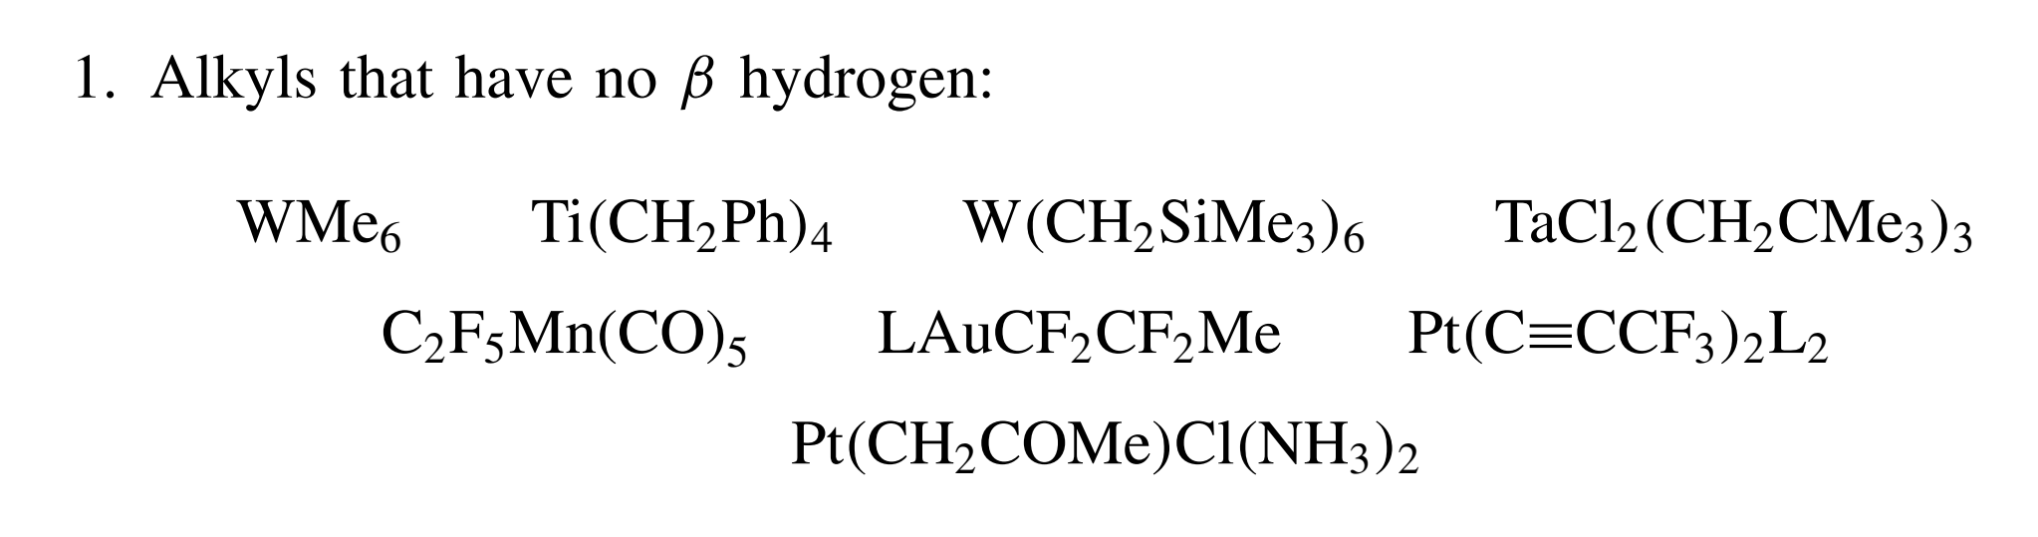

Slide 40
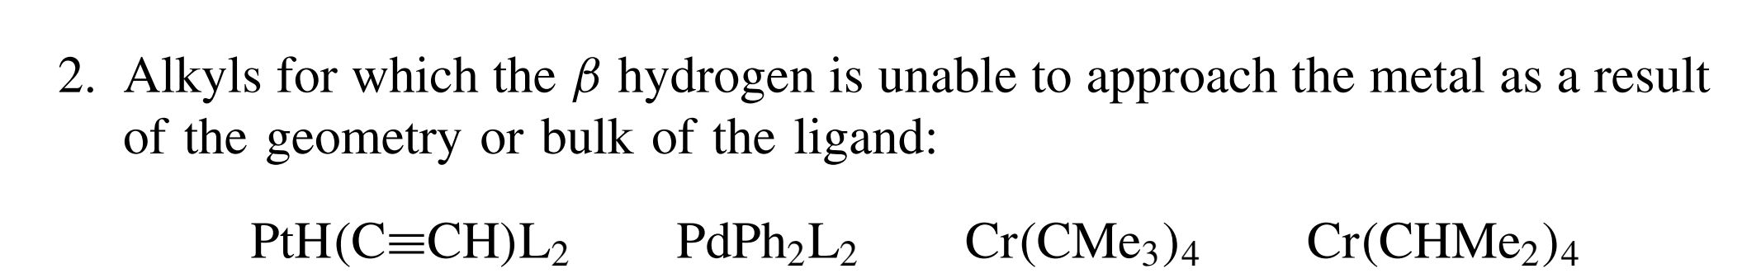

Slide 41
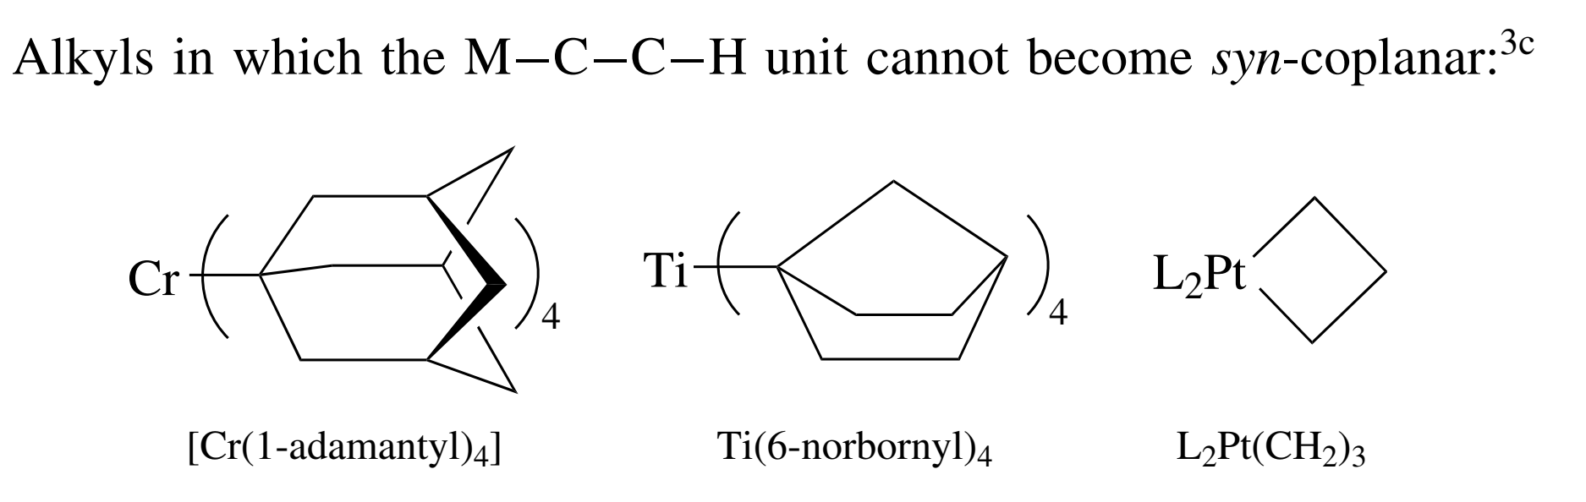

Slide 42
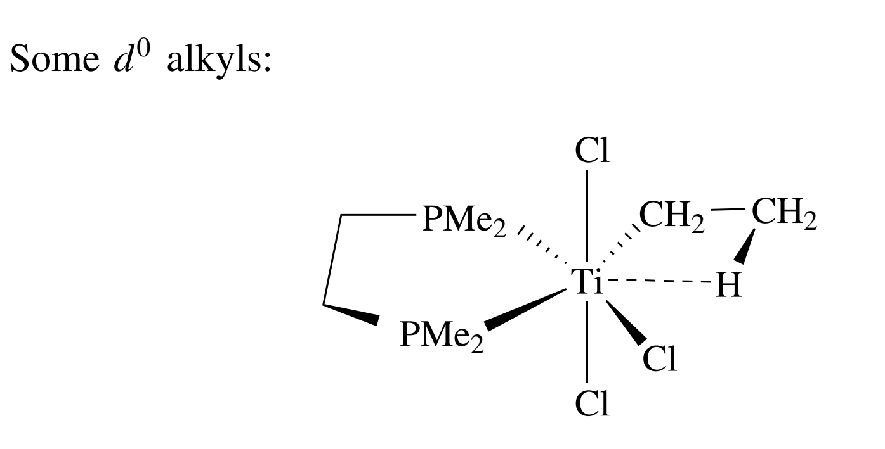
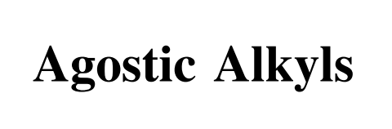

Slide 43
Organometallic chemistry is concerned with the metal–carbon bond, of which
the simplest is the M-C single bond of metal alkyls. As σ-bonding ligands,
alkyls are closely related to the ligands found in coordination compounds, such
as Cl, H₂O, and NH₃. A larger class of organometallic ligands (CO, C2H4) are
soft and can π bond.

Slide 44
Stable compounds, such as CH₄, have
the noble gas octet, and so carbon can be thought of as following an 8e rule.
This corresponds to carbon using its s and three p orbitals to form four filled
bonding orbitals and four unfilled antibonding orbitals.

Slide 45
On the covalent model,
we can consider that of the eight electrons required to fill the bonding orbitals,
four come from carbon and one each comes from the four H substituents. We
can therefore think of each H atom as being a 1e ligand to carbon

Slide 46
Ionic Model
For methane, this dissection gives C4- + 4H+, with carbon
as the more electronegative element. This makes methane an 8e compound with
an oxidation state of -4, usually written C(-IV). Note that the net electron count
always remains the same, whether we adopt the covalent (4e {C atom} + 4 ×
1e {4H atoms} = 8e) or ionic (8e{C4-ion} + 4 × 0e{4H+ions} = 8e) model.

Slide 47
The 18e rule, which applies to many low-valent transition metal complexes,
follows a similar line of reasoning. The metal now has one s, and three p orbitals,
as before, but now also five d orbitals. We need 18e to fill all nine orbitals;
some come from the metal, the rest from the ligands.

Slide 48
In V(CO)6,
the complex is 17e but is easily reduced to the 18e anion V(CO)6-. Unlike
V(CO)6, the Mn(CO)5 fragment, also 17e, does dimerize, probably because, as a 5-coordinate species, there is more space available to make the M-M bond.

Slide 49
In the 17e
fragment Co(CO)4, dimerization also takes place via a metal–metal bond, but
a pair of COs also move into bridging positions. This makes no difference in
the electron count because the bridging CO is a 1e ligand to each metal, so
an M-M bond is still required to attain 18e.

Slide 50
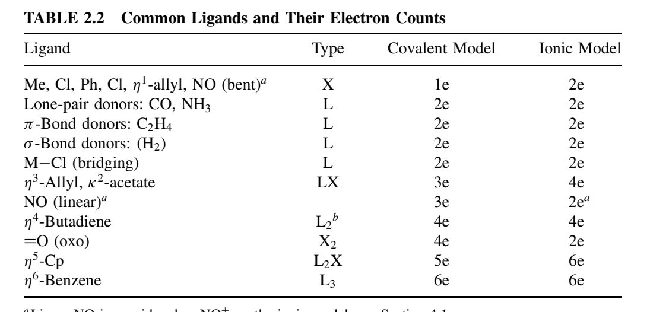

Slide 51
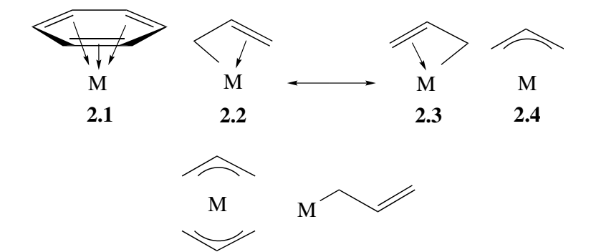

Slide 52
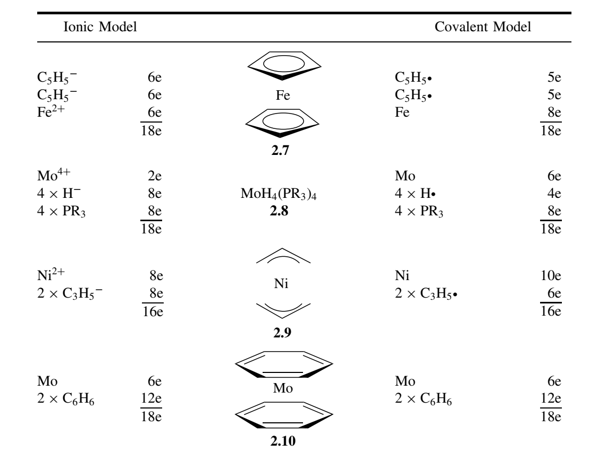

Slide 53
There are many cases in which the electron count for a stable complex is not
18; examples are MeTiCl3, 8e; Me2NbCl3, 10e; WMe6, 12e; Pt(PCy3)2, 14e;
[M(H2O)6]2+ (M = V, 15e; Cr, 16e; Mn, 17e; Fe, 18e), CoCp2, 19e; and NiCp2,
20e. For the 18e rule to be useful, we need to be able to predict when it will be
obeyed and when it will not.
The rule works best for hydrides and carbonyls because these are sterically
small, high-field ligands.

