Slide 1
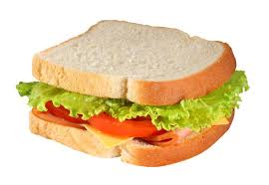
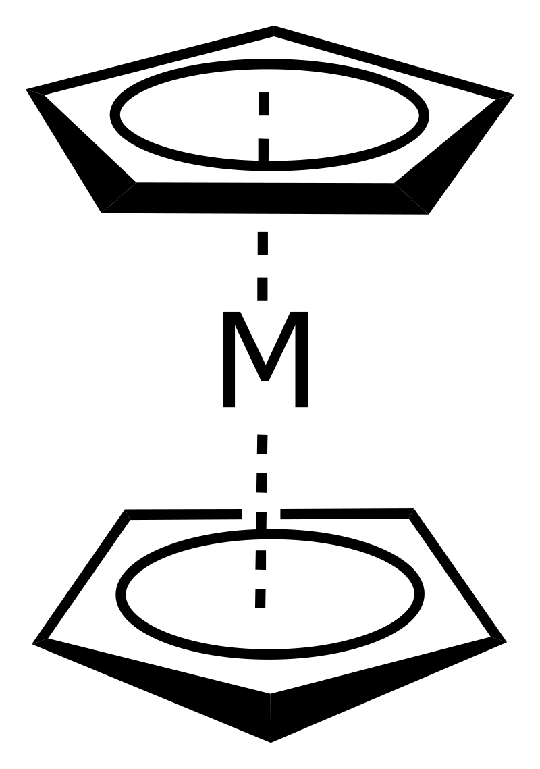
Sandwich Compounds/Metallocene
Metal in between two polyhapto rings

Slide 2
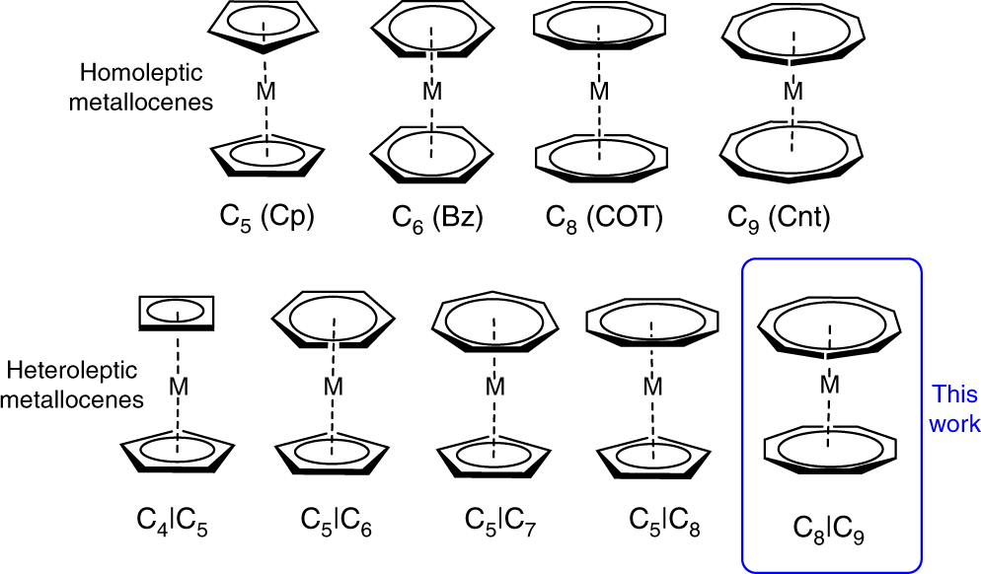
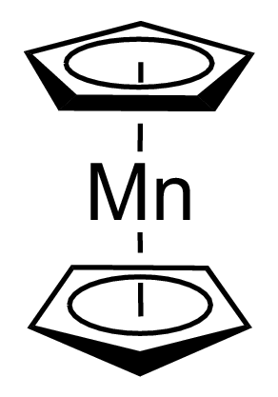
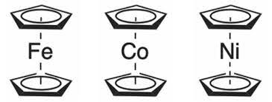
Sandwich Compounds
Sandwich
17e⁻
18e⁻
19e⁻
20e⁻

Slide 3
Variation of Sandwich Complexes
Bent Sandwich
Half Sandwich

Slide 4
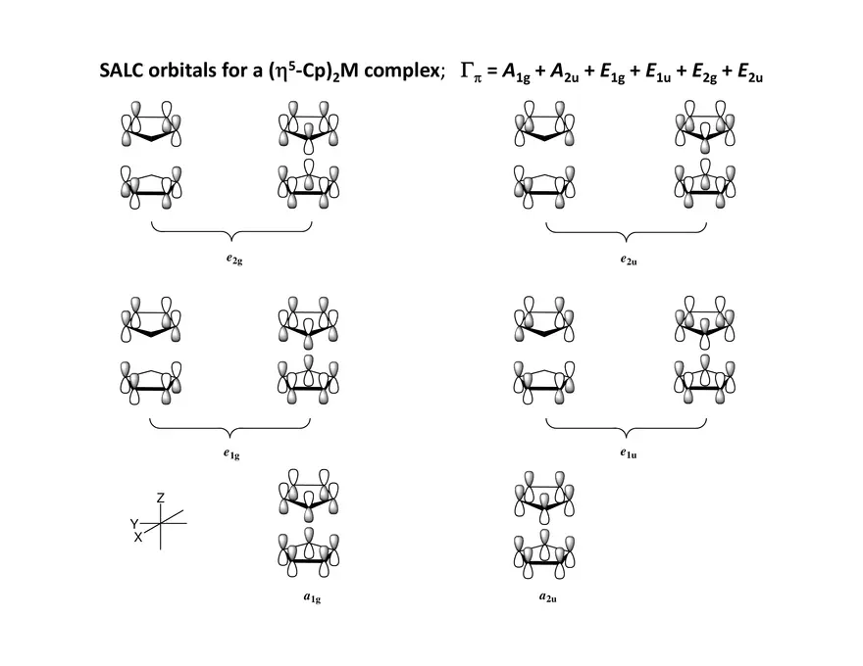
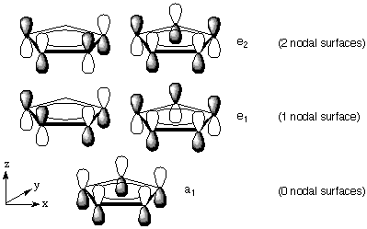
Bonding

Slide 5
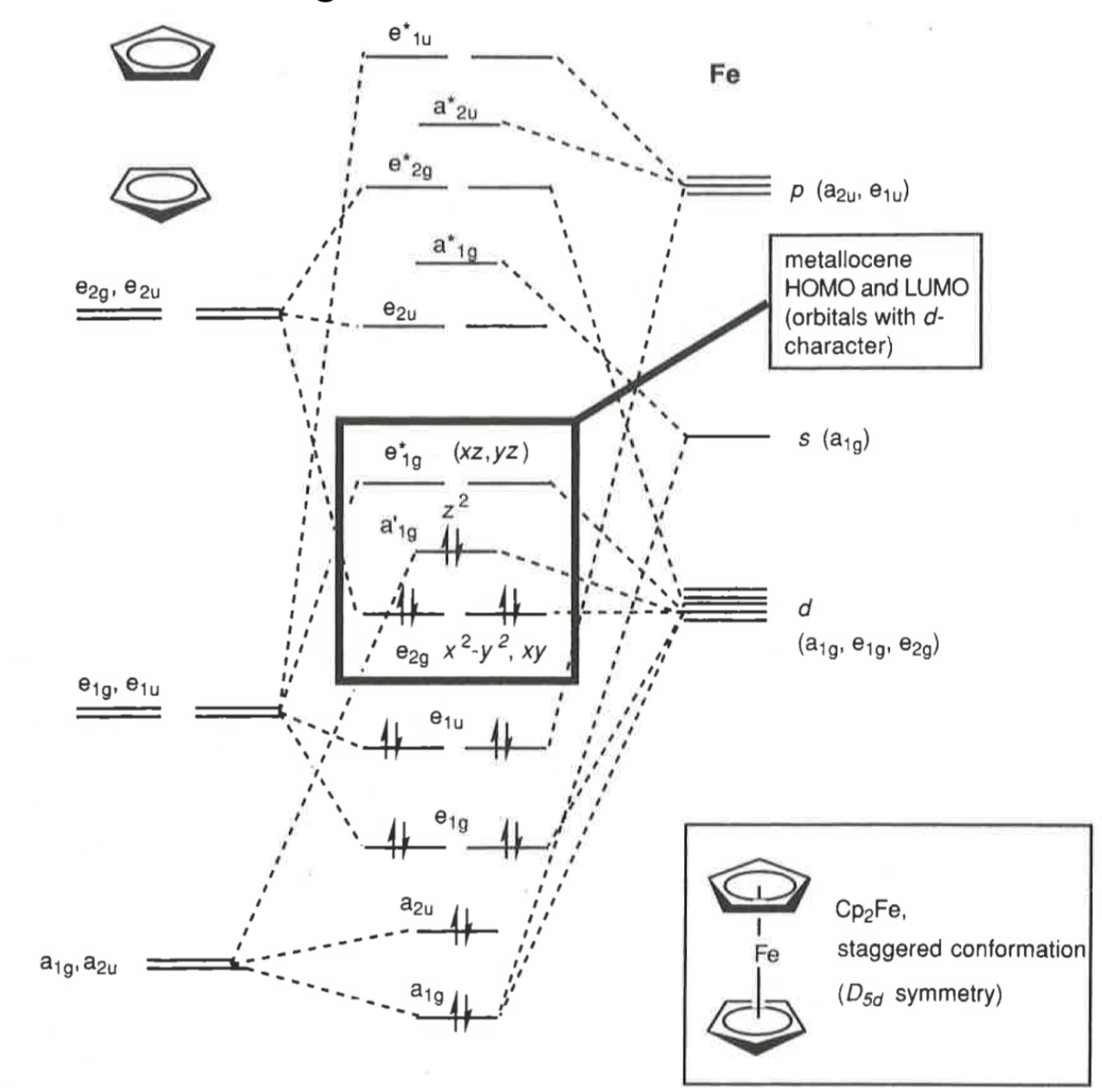
MO Diagram

Slide 6
Ferrocene - 1st Synthesis
Fulvalene
Target compound
T. J. KEALY, P. L. PAUSON. Nature, 1951, 168, 1039–1040.

Slide 7
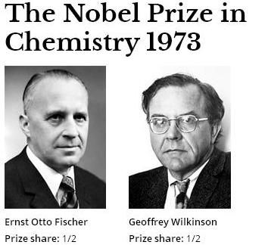
Ferrocene - Structure
G. Wilkinson, M. Rosenblum, M. C. Whiting, R. B. Woodward. J. Am. Chem. Soc. 1952, 74, 2125–2126.

Slide 8
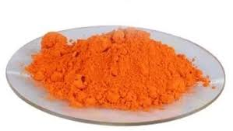
Ferrocene
Staggered
Eclipsed
Most Stable Metallocene
¹H NMR spectra of Ferrocene

Slide 9
Ferrocene
Friedel Craft Acylation/Alkylation
Sulphonation
Mannich Reaction

Slide 10
Ferrocene
Applications
Ferroquine- Antimalarial
Ferrocifen- Anticancer
Organic transformations
Anti-Knock agent
Soot reduction in diesel engines
Redox flow battery

Slide 11
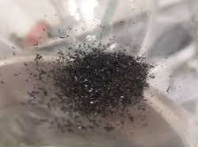
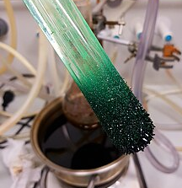
Cobaltocene & Nickelocene
19 e⁻
20 e⁻
Dark Purple
Paramagnetic
Bright Green
Paramagnetic
Susceptible to aerial oxidation
Powerful reducing agent for organometallic compounds

Slide 12
Cycloheptatriene
Cycloheptatriene
Cycloheptatrienylium
(Tropilium) cation

Slide 13
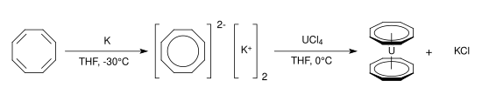
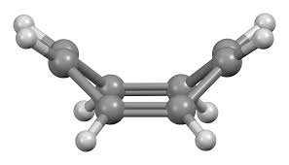
Cyclooctatetraene (Cot)
Aromaticity ?

