Slide 4
Associative Mechanism

Slide 10
Ionic Mechanism

Slide 11
Reductive Elimination

Slide 13
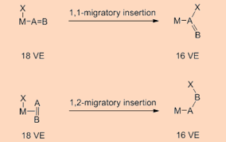
Insertion Reaction

Slide 20
Cis and trans isomers observed

Slide 27
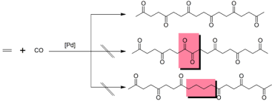
Alternating Copolymerization

