Slide 1
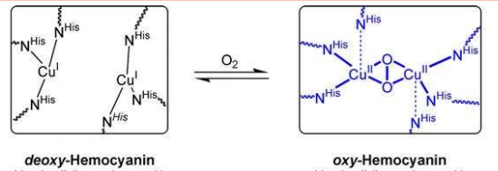
Q1. When oxygen binds with deoxy-Hemocyanin to form oxy-Hemocyanin, what type of colour changes can be seen and why??
Answer- Deoxyhemocyanin with Cu(I) at the centre is colourless, whereas oxyhemocyanin with Cu(II) at the centre is blue.
Cu(I) is a d10 metal, so its valence d-orbital is full; therefore, electrons in the lower energy d-orbitals cannot be excited to the higher energy d-orbitals. the d-d transition for oxyhemocyanin occurs at 585 nm, whereas the MLCT transitions occur at 347 nm and 625 nm. The absorbance at 347 nm does not contribute to the colour of the complex because 347 nm is outside of the visible region of light (~400-800 nm). A combination of the 585 nm and 625 nm absorbances explains the blue colour of the oxyhemocyanin complex. The extinction coefficient at 625 nm is about 4.7x greater than the extinction coefficient at 585 nm, indicating that the absorbance at 625 nm is stronger than that at 585 nm. Haemocyanin - Chemistry LibreTexts

Slide 2
Q2. Fill the gaps-
Tyrosinase catalyses the conversion of the amino acid tyrosine into………………………………….
Ans- Melanin pigment( tyrosine-DOPA-quinone-melanin)
Q3. Carboxypeptidase contains: [NET]
(a) Zn(II) and hydrolyses CO₂.
(b) Zn(II) and hydrolyses peptide bonds.
(c) Mg(II) and hydrolyses CO₂.
(d) Mg(II) and hydrolyses peptide bonds.

Slide 3
Q4. Match the metalloproteins in Column A with their function in Column B
Column–A
I. Oxygenocyanin
II. Carbonic anhydrase
III. Cytochrome P450
IV. Carboxy-peptidase A
Column–B
A. Hydrolysis of the C-terminal peptide bond
B. Methylation
C. Conversion of CO₂ to H₂CO₃
D. Oxidation of alkene
E. Oxygen storage
F. Oxygen transport
The correct answer is:
(a) I–F; II–C; III–D; IV–A
(b) I–E; II–C; III–A; IV–F
(c) I–F; II–B; III–C; IV–A
(d) I–E; II–D; III–C; IV–A

Slide 4
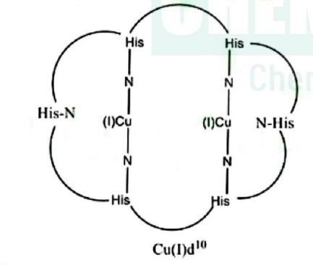
Q5. The total number of metal ions and the number of coordinated imidazole units of histidine in the active site of oxy-hemocyanin, respectively, are:
[NET JUNE 2015]
(a) 2Cu²⁺ and 6
(b) 2Fe²⁺ and 5
(c) 2Cu⁺ and 6
(d) Fe²⁺ and 3
Q6. Deoxy-hemocyanin is-
(a) heme protein and paramagnetic
(b) colourless and diamagnetic
(c) O₂ transporter and paramagnetic
(d) blue colored and diamagnetic

Slide 5
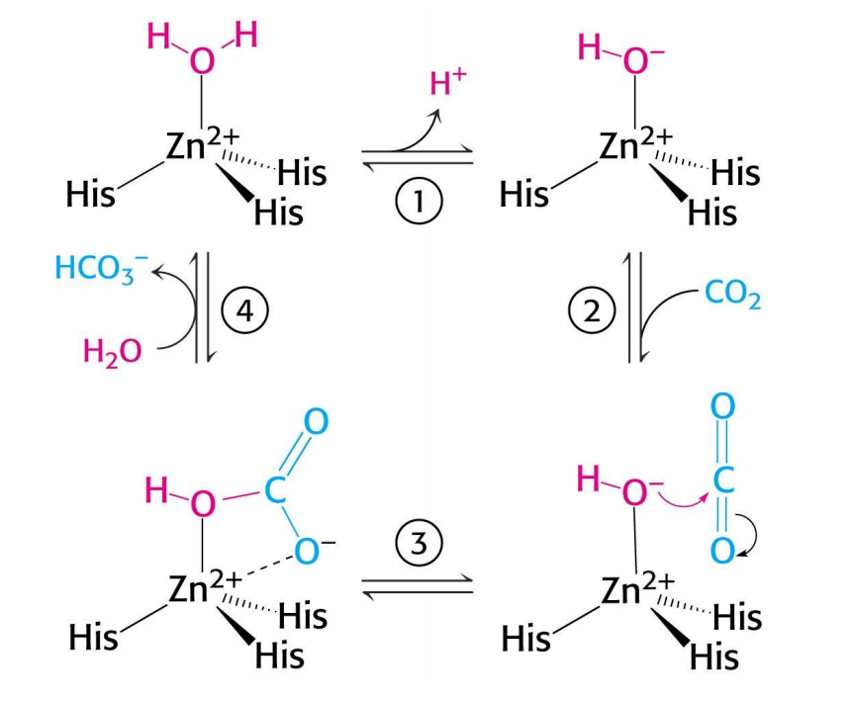
Q7. In the catalytic hydration of CO₂ by carbonic anhydrase, CO₂ first interacts with which of the following?
(a) OH group of the active site of the enzyme, and then with zinc
(b) H₂O of the active site of the enzyme, and then with zinc
(c) zinc of the active site of the enzyme, and then with the OH group
(d) Zinc of the active site of the enzyme, and then with H₂O.
Q8.Consider the following statements for deoxy-hemerythrin and deoxy-hemocyanin:
A. They are involved in O₂ transport in biological systems.
B. They contain two metal ions in their active site.
C. Active site metal centres are bridged by amino acid residues.
D. They prefer to bind only one O₂ per active site.
The correct statements are:-
(a) A, B and D
(b) A, C and D
(c) B, C and D
(d) A and C

Slide 6
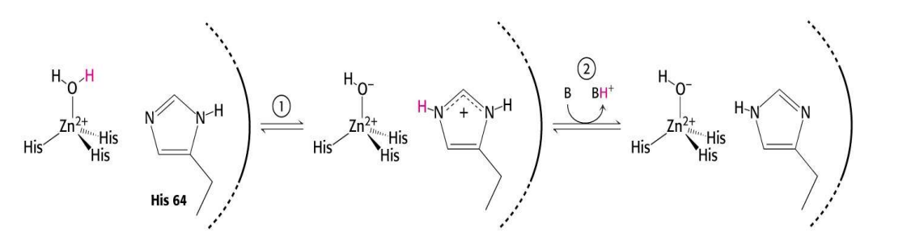
Q9. Consider the following statements for the oxygenation of hemocyanin:
A. The oxidation state of both copper atoms changes by two.
B. It becomes intensely blue from colourless.
C. Dioxygen is reduced to O₂²⁻
D. The µ-η²: η² bond forms between each oxygen and copper atom.
The correct statements are:-
(a) (A) and (C)
(b) (B) and (C)
(c) (A), (B) and (C)
(d) (B), (C) and (D)
Q10. What is the primary function of the His-64 residue in the mechanism shown for carbonic anhydrase?
It serves as the nucleophile to attack CO₂
It directly coordinates the Zn²⁺ ion to stabilise the active site.
It acts as a proton shuttle, facilitating the removal of the hydrogen ion from the active site.
acts as a general acid to donate a proton to the bound water molecule.

