Slide 1
Ni(CO)₄, Cr(CO)₆, Mo(CO)₆, W(CO)₆, Ru₃(CO)₁₂, Co₂(CO)₈, Mn₂(CO)₁₀, Re₂ (CO)₁₀

Slide 2
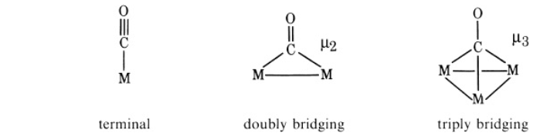
Metal-CO Bonding!

Slide 3
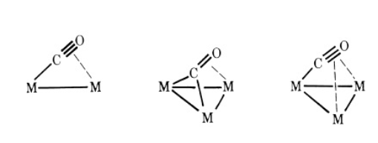

Slide 4


Slide 5
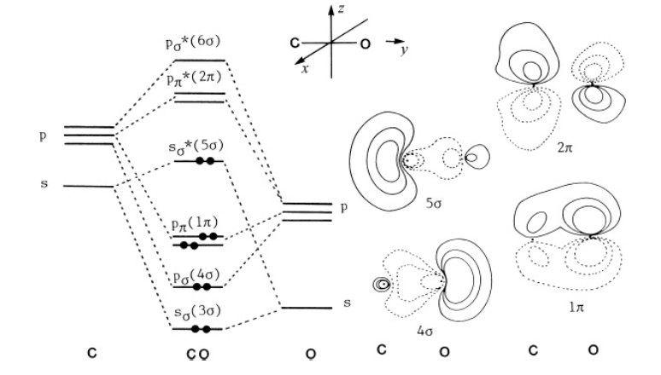

Slide 6
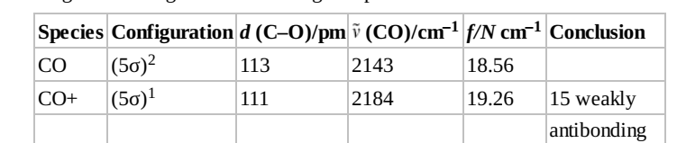

Slide 7
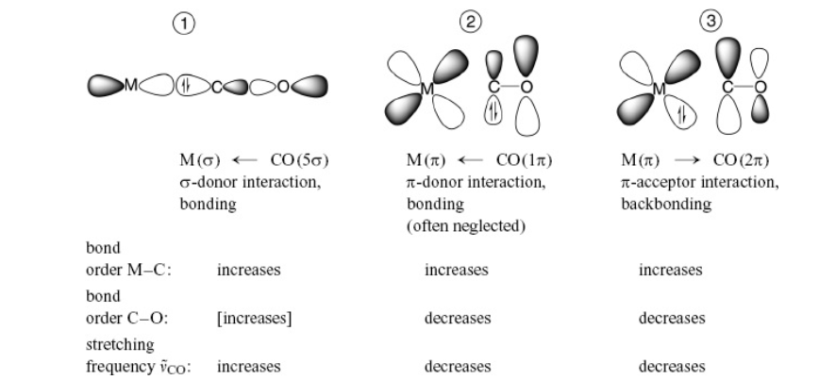

Slide 8
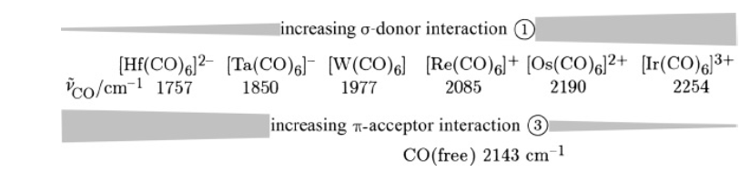

Slide 9
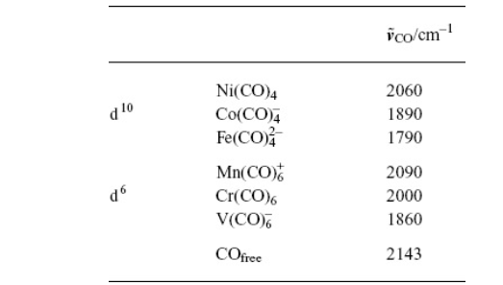

Slide 10
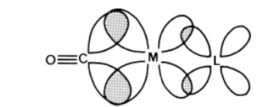
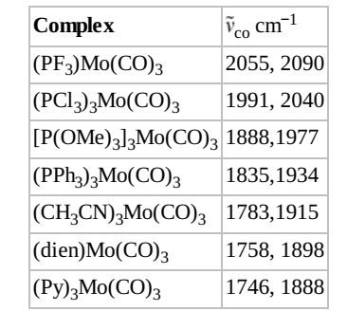

Slide 11
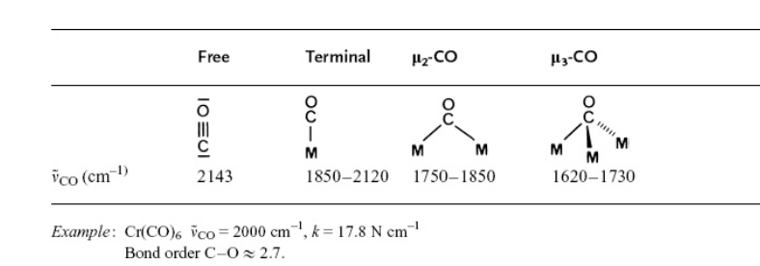

Slide 12
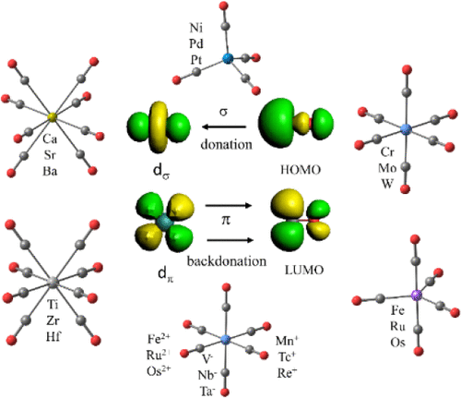
Download Hi-Res ImageDownload to MS-PowerPoint
Cite This:JACS Au 2021, 1, 5, 623-645

Slide 13
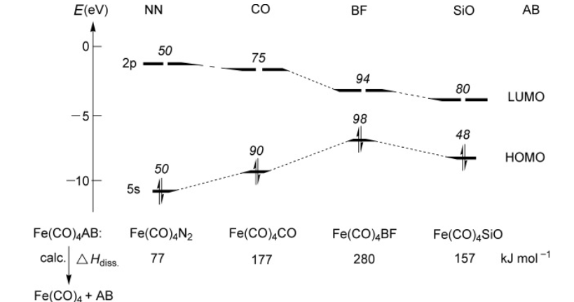
Is CO a Special Ligand in Organometallic Chemistry?
Computero molecule Fe(CO)4BF, the CO
ligand would be released before the BF unit! The formation of TM–BF complexes is hampered not only
by the difficulty in accessing BF but also by the expected sensitivity of BF complexes to nucleophilic
attack

Slide 14
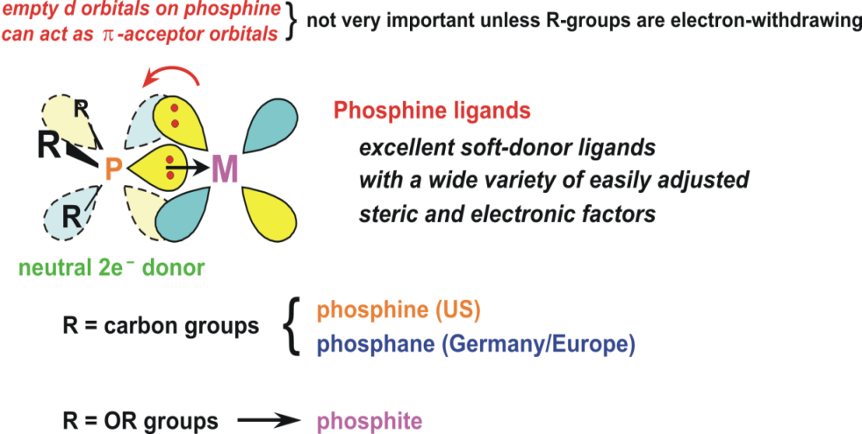
2

Slide 15
Key Players in the field:

Slide 16
Metal-Olefin Bonding
This complex was first prepared by Zeise in 1827 by boiling PtCl4 in ethanol. The first preparation from
ethylene was described by Birnbaum (1868). With SnCl2 as a catalyst, this reaction proceeds in a few
hours at 1 bar C2H4 pressure.

Slide 17
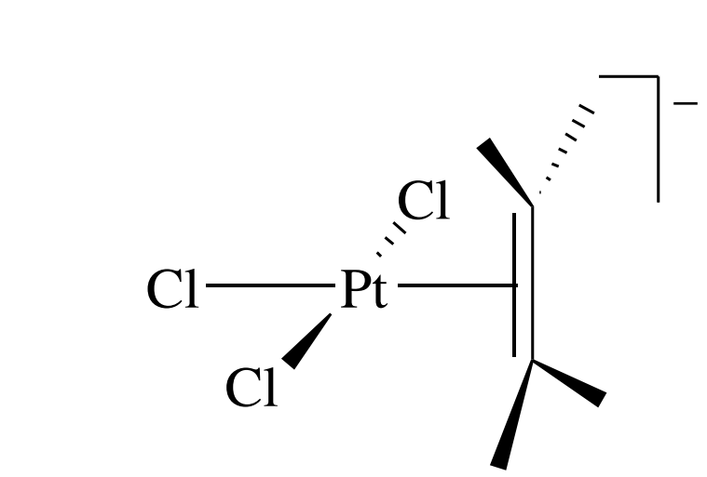

Slide 18
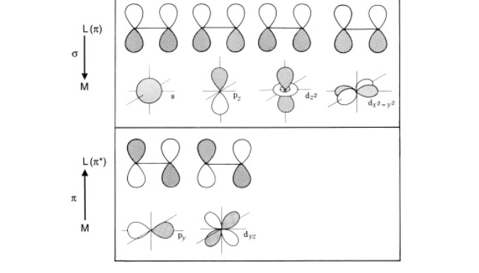
The coordination of a monoolefin to a transition metal is the simplest example of a metal π complex. The
qualitative bonding description by means of the DCD model (Dewar, Chatt, Duncanson, 1953) is similar
to that for the M–CO moiety as far as the donor/acceptor synergism is concerned.

Slide 19
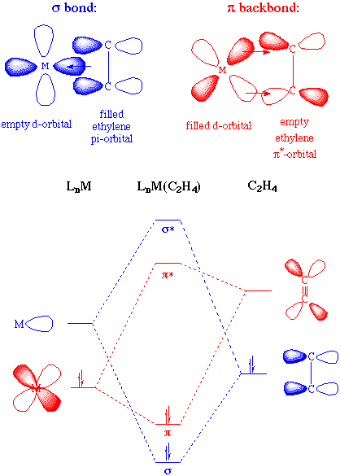

Slide 20
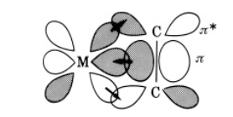

Slide 21
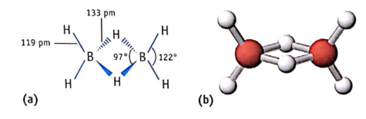
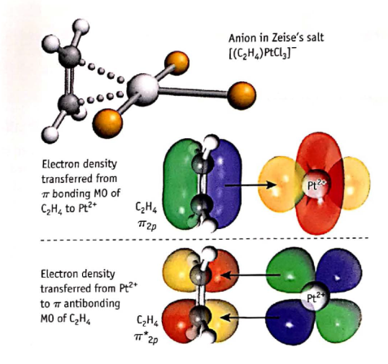

Slide 22
It is generally accepted that the energy of the TM–olefin bond is dominated by the backbonding
contribution (cf. Frenking, 2000).
Both the olefin donor and the olefin acceptor contribution of the interaction serve to weaken the
intraligand ( ) bond. In principle, this is evident from the interaction diagram and is also clear from a
comparison of the C=C stretching frequencies of free and coordinated ethylene:

Slide 23
Complex | c=c/cm–1 | Complex | c=c/cm–1
[(C2H4)2Ag]BF4 | 1584 | (C2H4)Fe(CO)4 | 1551
[(C2H4)2Re(CO)4]PF6 | 1539 | [CpFe(CO)2C2H4]PF6 | 1527
[C2H4PdCl2]2 | 1525 | K[PtCl3(C2H4)] · H2O | 1516
CpMn(CO)2(C2H4) | 1508 | [C2H4PtCl2]2 | 1506
CpRh(C2H4)2 | 1493 | C2H4, free | 1623

Slide 24
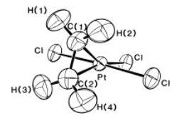
An important structural aspect is the loss of planarity of the olefin upon coordination to a transition
metal. In substituted ethylenes C2X4, this deformation increases with increasing electronegativity of X
Structure (neutron diffraction) of K[PtCl3(C2H4)]. The C–C bond length is 137 pm, similar to that of the
uncomplexed olefin (133 pm). The olefin is oriented perpendicular to the PtCl3 plane. The Pt–Cl bond
trans to the olefin is slightly elongated.

Slide 25
For Zeise’s
salt itself, M-L σ bonding predominates because the Pt(II) is weakly π basic,
and the ligand (C-C: 1.375 A) ˚ more nearly resembles the free alkene (1.337 A). ˚
The substituents are only slightly bent back away from the metal, and the C-C
distance is not greatly lengthened compared to free ethylene. Pt(0), in contrast, is
much more strongly π basic, and in Pt(PPh3)2C2H4, the C-C distance becomes
much longer (1.43 A). ˚

Slide 26
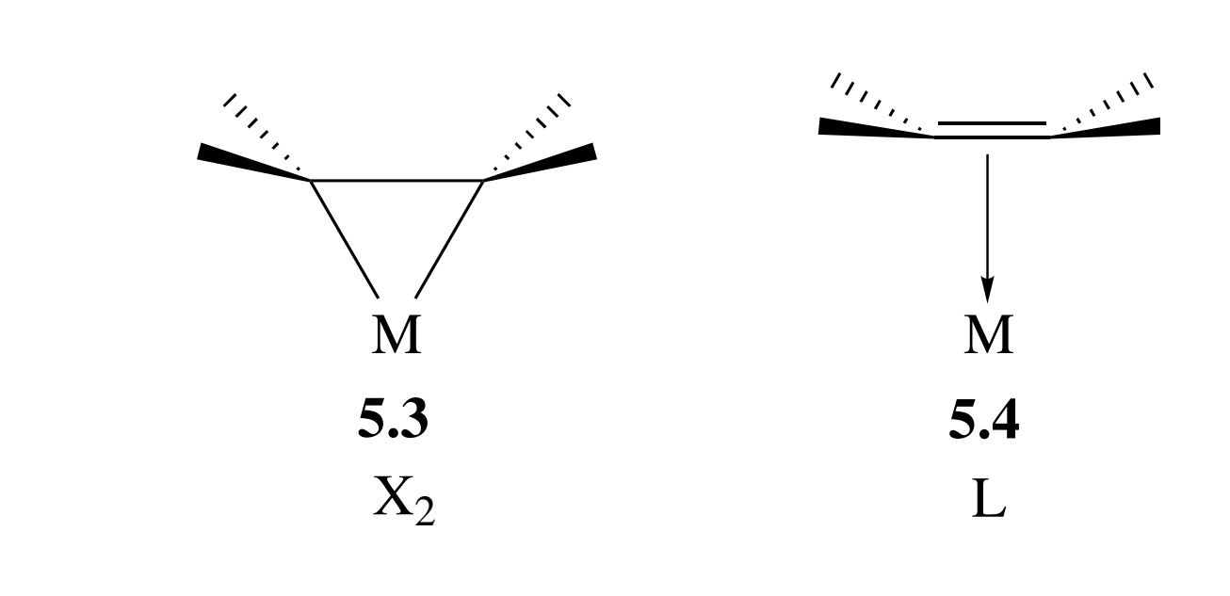
In such a case the metal alkene system approaches the
metalacyclopropane extreme, 5.3, as contrasted with the Dewar–Chatt model,
5.4, involving minimal π back donation; both are considered η2 structures.

Slide 27
The presence of electron-withdrawing groups on the alkene also encourages
back donation and makes the alkene bind more strongly to the metal; for example,
Pt(PPh3)2(C2CN4) has an even longer C-C distance (1.49 A) ˚ than the C2H4
complex.

Slide 28
This means that Pd(II), Hg(II), Ag(I), and Cu(I)
alkene complexes tend to be L-type, or Dewar–Chatt, in character, while those
of Ni(0), Pd(0), and Pt(0), tend to be X2, or metalacyclopropane-like

Slide 29
Alkenes are more commonly actor, rather than spectator, ligands. Since simple
alkenes in the free state are subject to electrophilic but not nucleophilic attack, the
effect of binding is very significant. It means that the appropriate metal fragment
inverts the chemical character of the alkene, a phenomenon known as umpolung.

Slide 31
ALLYL COMPLEXES
The allyl group,12 commonly an actor ligand, binds in one of two ways. In the
monohapto form, 5.12, it is a simple 1e X-type ligand like Me, and in the trihapto form, 5.13, it acts as a 3e LX enyl ligand. It is often useful to think of 5.13 in terms of the resonance forms 5.14a and 5.14b. Intermediate cases between 5.12 and 5.13 (η2-allyls) are also known.13

Slide 32
DIENE COMPLEXES
This ligand usually acts as a 4e donor in its cisoid conformation.
This L2 (diene or π2) form is analogous to the Chatt–Dewar extreme for alkenes,
while the LX2 form 5.16 is related to the metalacyclopropane
extreme.

Slide 33
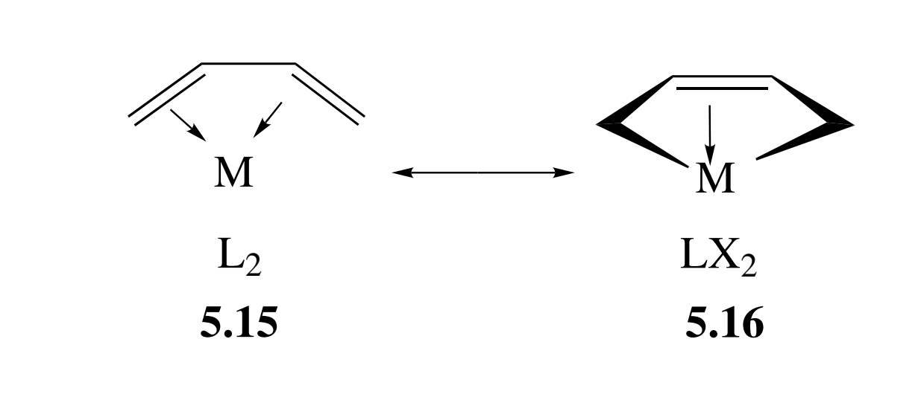

Slide 34
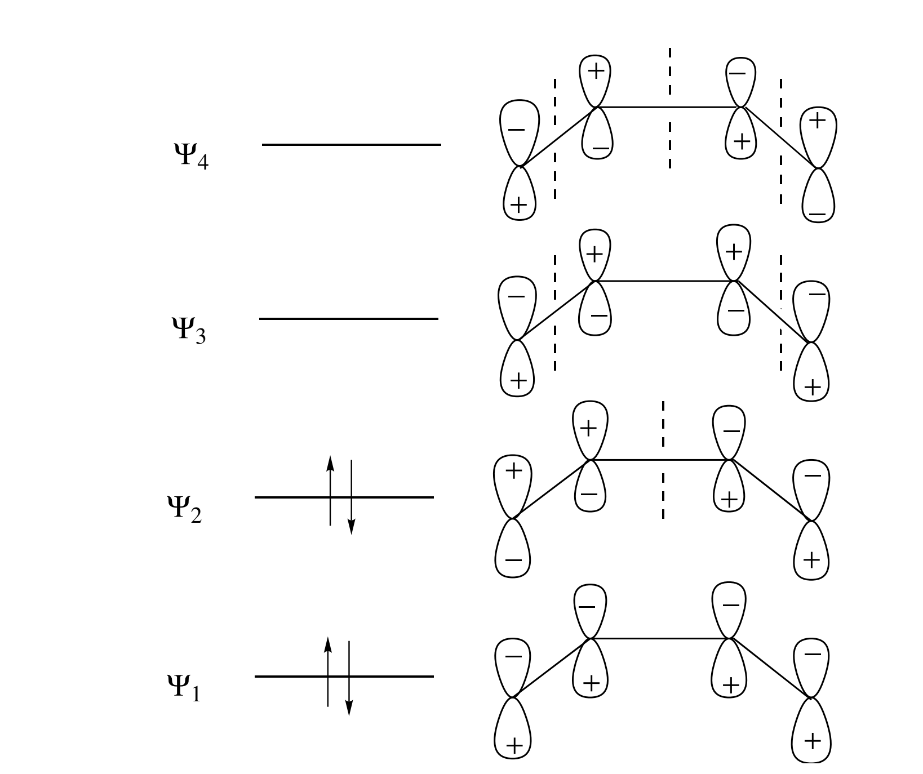

Slide 35
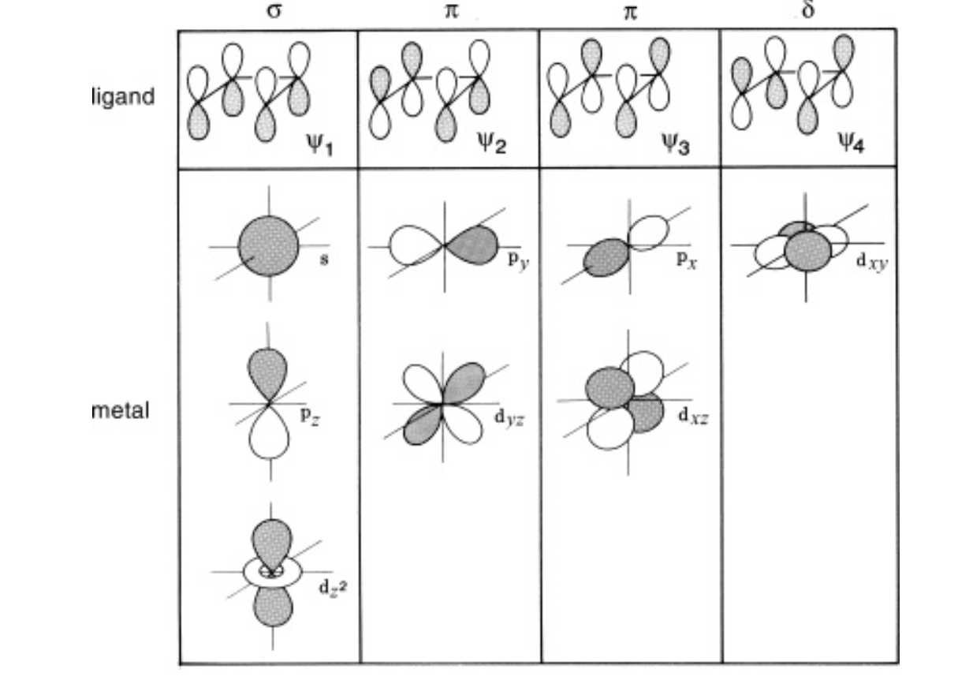

Slide 36
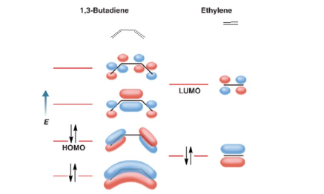

Slide 37
We expect the frontier orbitals of the butadiene, ψ2 (HOMO) and ψ3 (LUMO),
to be the most important in bonding to the metal. The MO diagram (Fig. 5.2)
shows that both the depletion of electron density in ψ2 by σ donation to the
metal and population of ψ3 by back donation from the metal lengthens C1C2
and shortens C2C3 because ψ2 is C1C2 antibonding and ψ3 is C2C3 bonding

Slide 38
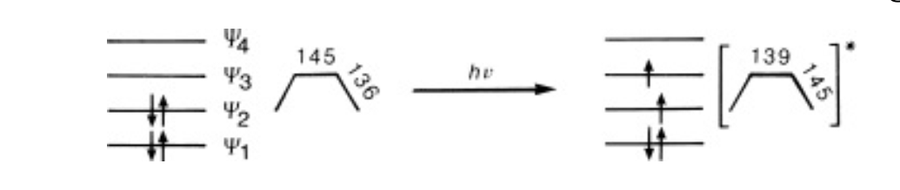

Slide 39
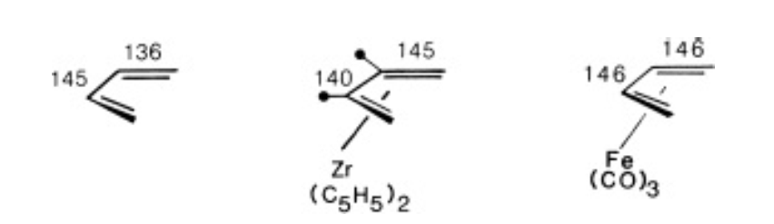

The C1C2, and C3C4 distances
[1.46 A(average)] ˚ are much longer than C2C3 (1.40 A), ˚ and C1 and C4 are closer
to the metal than C2 and C3 by 0.18 A.

Slide 40
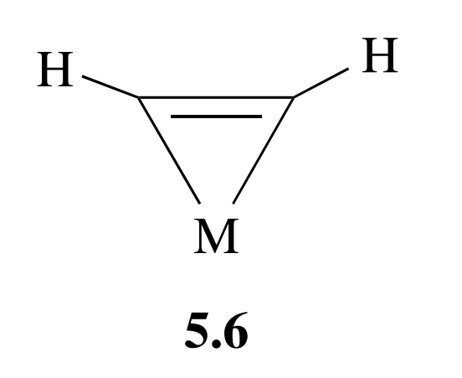
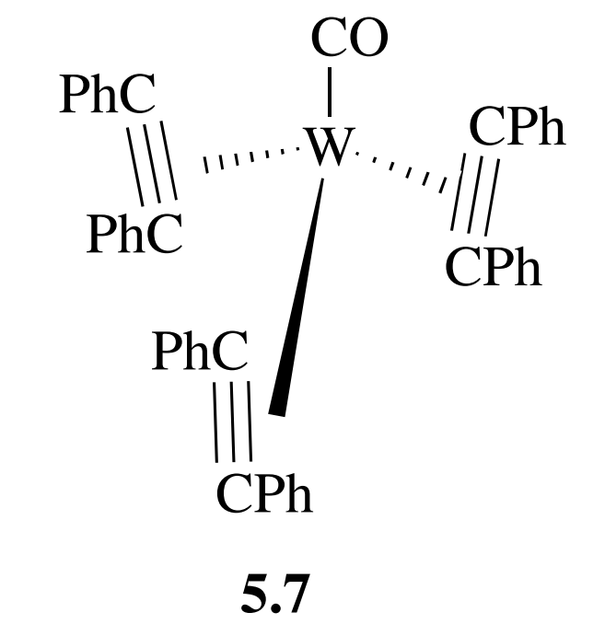
Alkyne Complexes
Alkynes behave in ways broadly similar to alkenes, but being more electronegative, they tend to encourage back donation and bind more strongly. The substituents tend to fold back away from the metal by 30◦ –40◦ in the complex, and
the M-C distances are slightly shorter than in the corresponding alkene complexes. The metalacyclopropene model (5.6) seems often to be the most appropriate description when alkynes act as 2e donors. More interestingly, alkynes
can form complexes that appear to be coordinatively unsaturated. For example,
5.76 appears to be 14e.

Slide 41
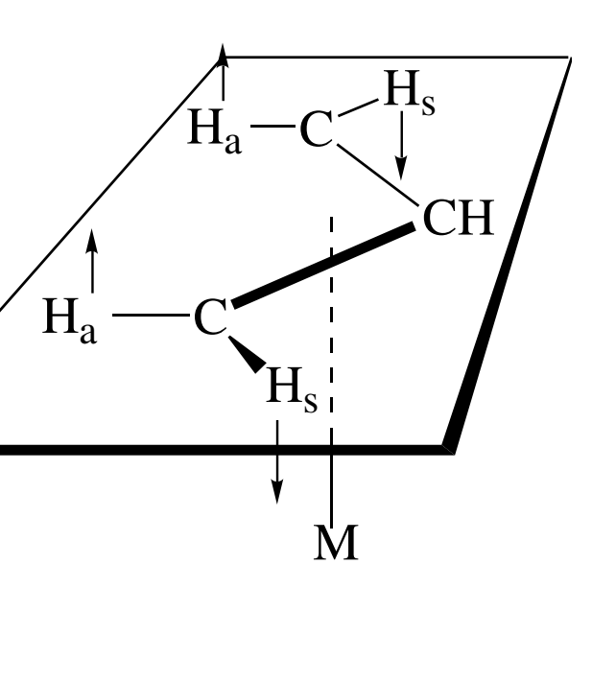

Slide 42
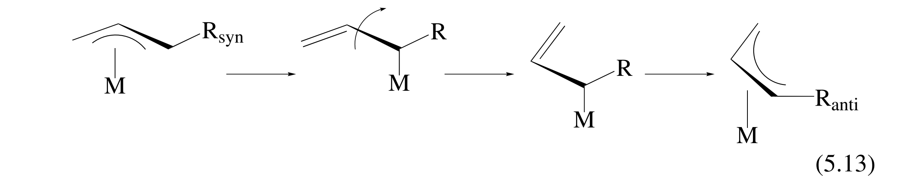

Slide 43
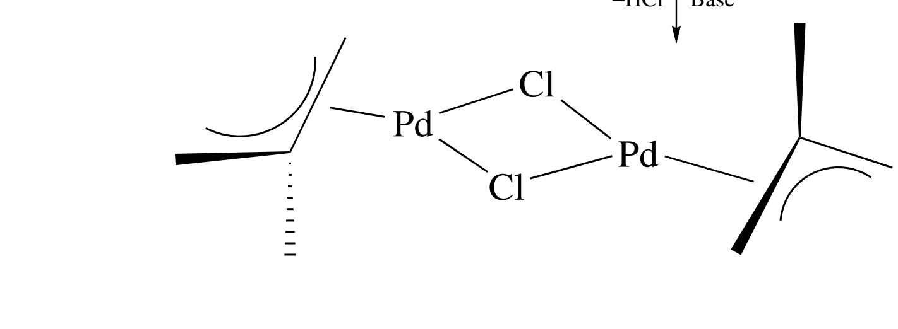

Slide 44
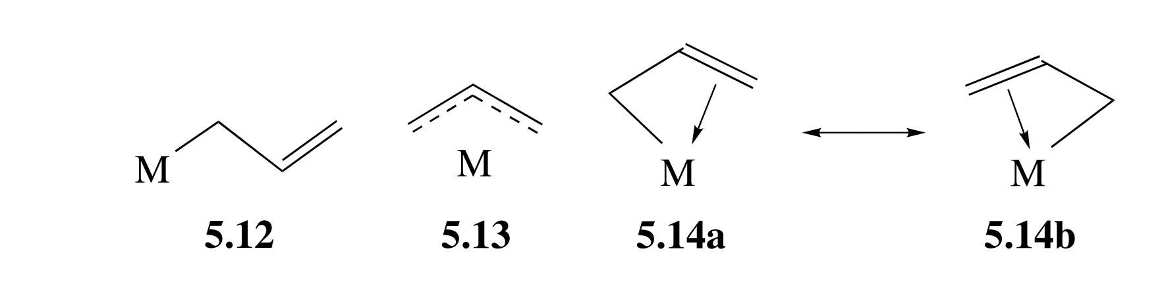

Slide 45
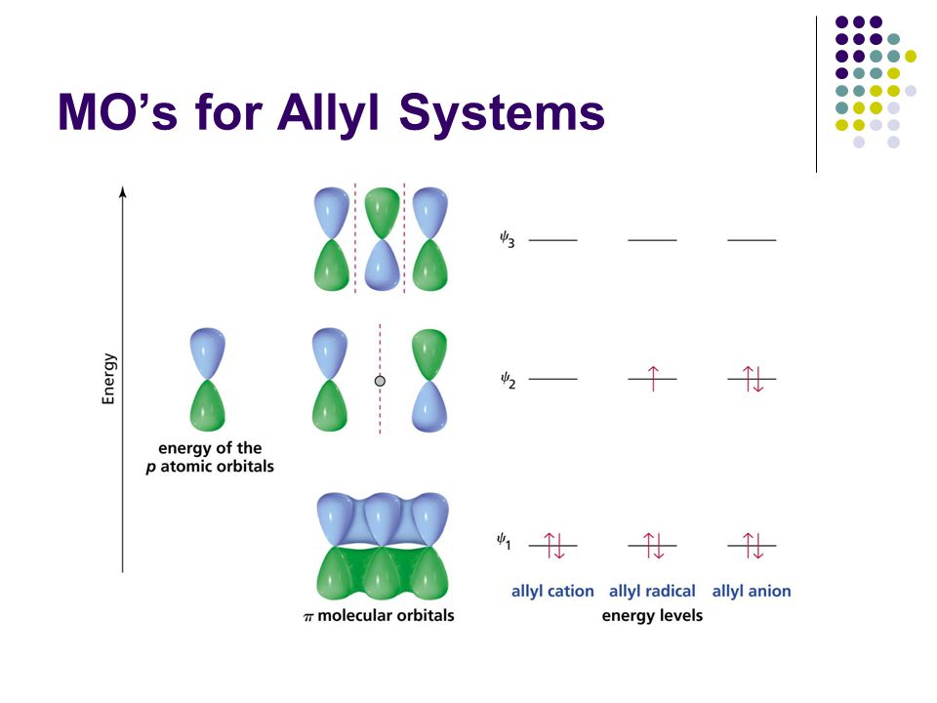

Slide 46
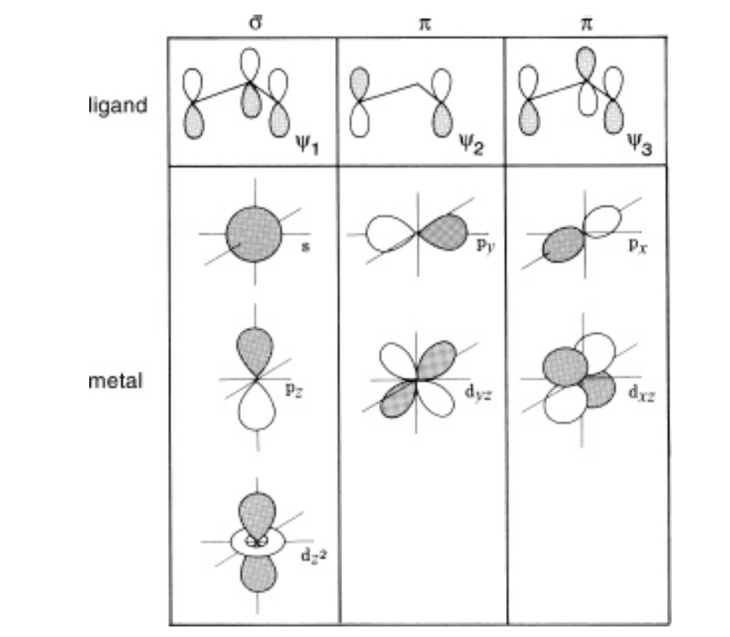

Slide 47
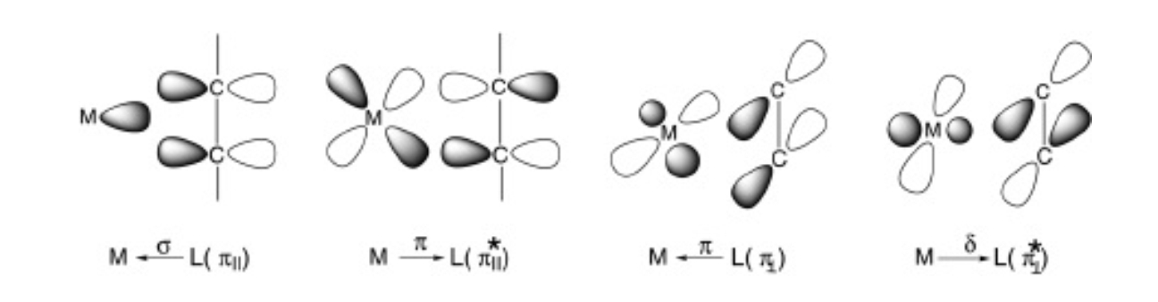

Slide 48
Metal-Carbene Complexes
LnM=CR₂

Slide 49
Compounds that contain metal–carbon double bonds are generally called metal carbene complexes.
In metal carbene complexes, LnM=CR2, which have a trigonal planar carbon and at least
formally contain an M=C double bond,

Slide 50
Two types: “Fischer carbene complexes” and “Schrock
carbene complexes”

Slide 51
Carbenes, LnM=CR2, have Fischer character:
1) Low oxidation state,
2) π-acceptor ligands L, and π-donor substituents, R, such as -OMe or -NMe2, on the carbene carbon.
3) Such a carbene behaves as if it carries a ∂+ charge and is electrophilic.
4) In the most common model, the CR2 ligand in a Fischer carbene is considered to act as a 2e lone-pair
donor (L type).

Slide 52
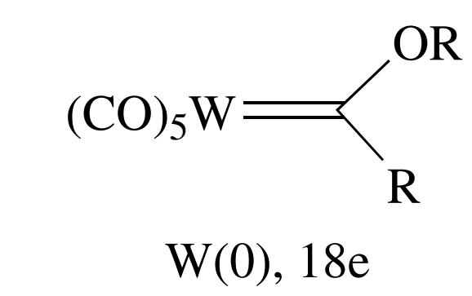
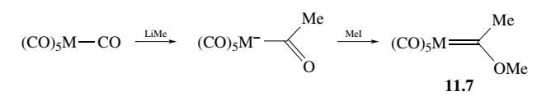
Fischer made the first carbene complexes in 1964 by the attack of an alkyllithium on a metal carbonyl followed by methylation :

Slide 53
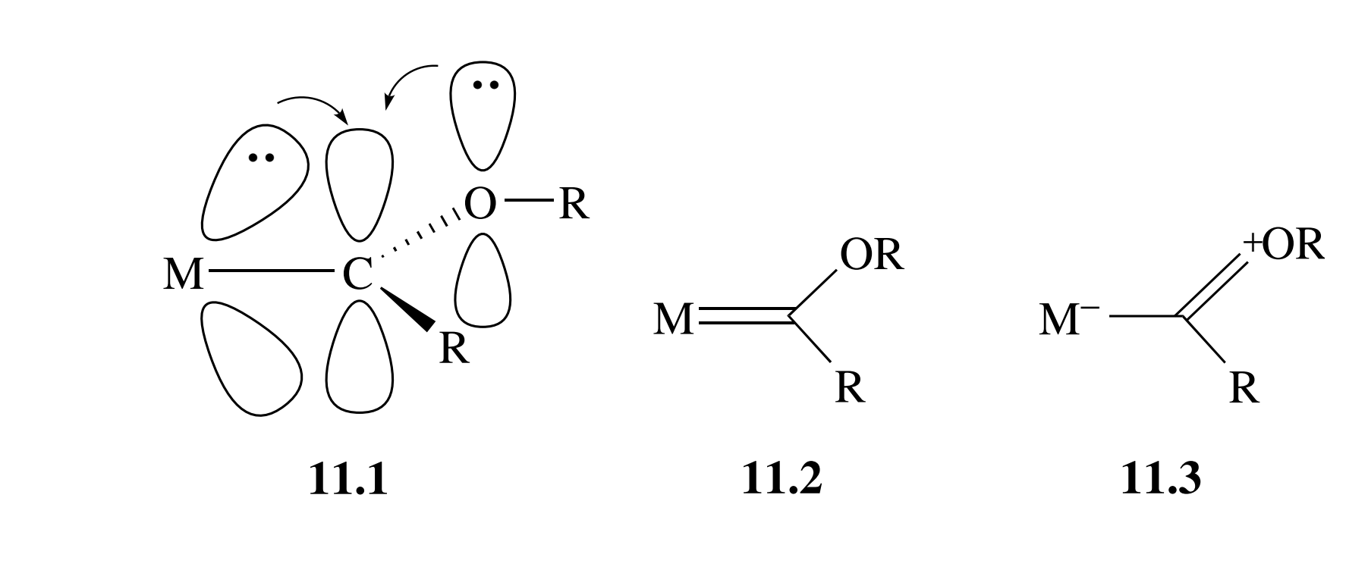

Slide 54
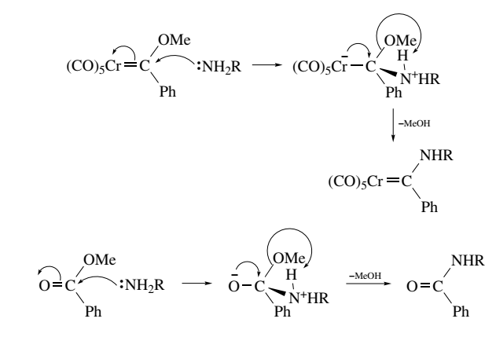

Slide 55
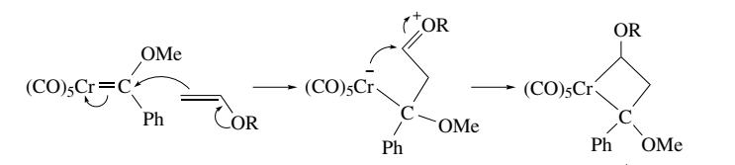

Slide 56
Carbenes, LnM=CR2, have Schrock character:
Bound to higher oxidation state,
having non-π-acceptor ligands
and non-π-donor R groups.
In this case, the carbene behaves as a nucleophile,
having a ∂- carbon.
The CR2 ligand in a Schrock carbene is often considered to act like an X2-type bis-alkyl

Slide 57
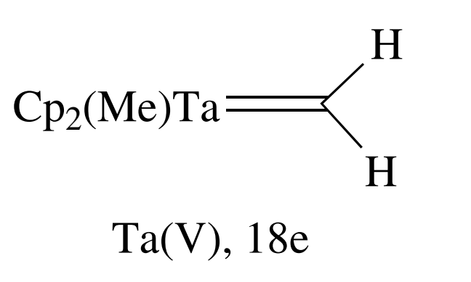
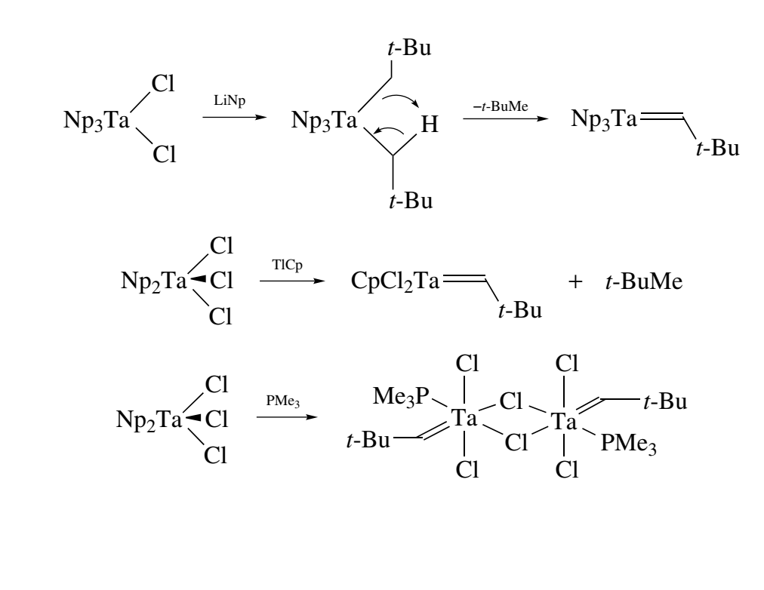

Slide 58
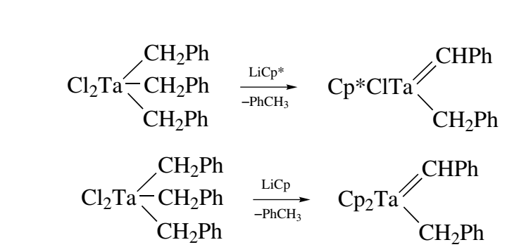

Slide 59
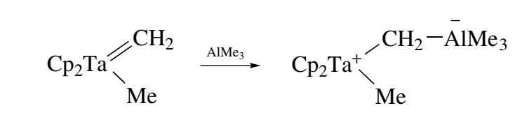

Slide 60
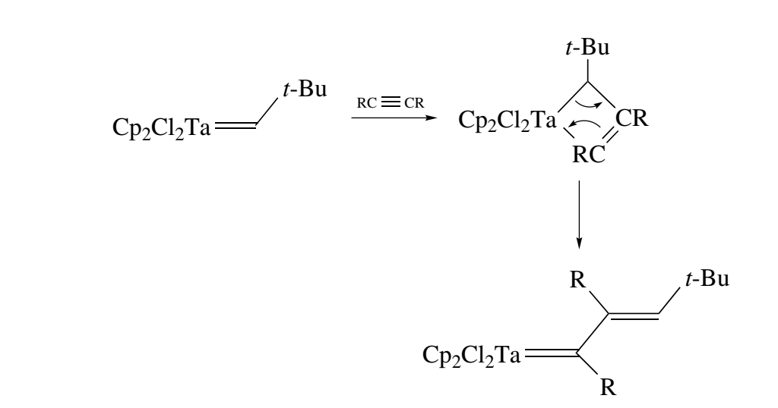

Slide 61
Spectroscopy ¹³C NMR is very valuable for detecting carbene complexes
because the very deshielded carbene carbon resonates at ∼200–400 ppm to low
field of TMS. A proton substituent at
the carbene carbon resonates from +10 to +20δ

Slide 62
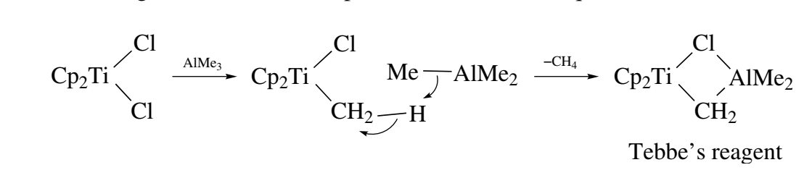

This is an example of a bridging carbene, but in its reactions it almost always
loses Me2AlCl first to give the mononuclear 16e Cp2Ti=CH2; a base is sometimes
added to help remove the aluminum fragment by complexation. This reagent even
gives a Wittig-type product with esters, substrates that are not methylenated with
Ph3P=CH2.

Slide 63
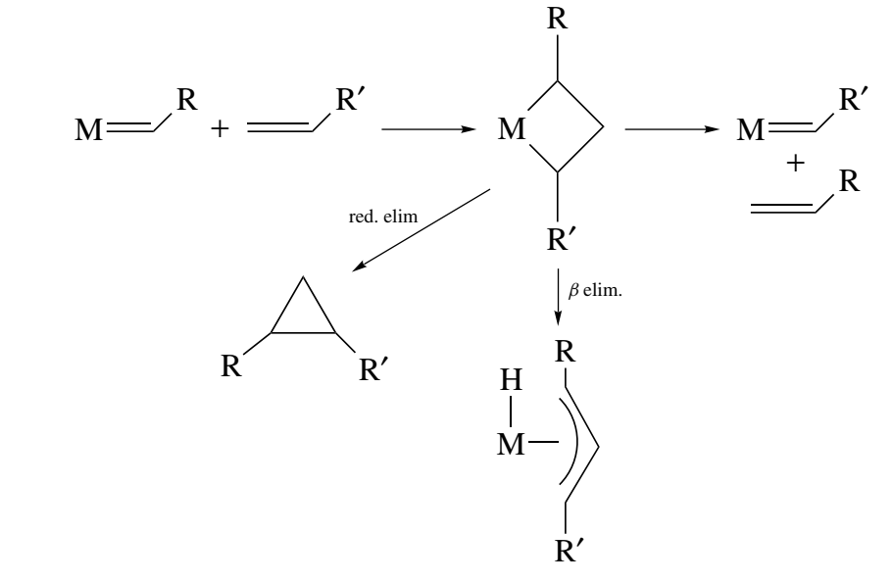

Slide 64
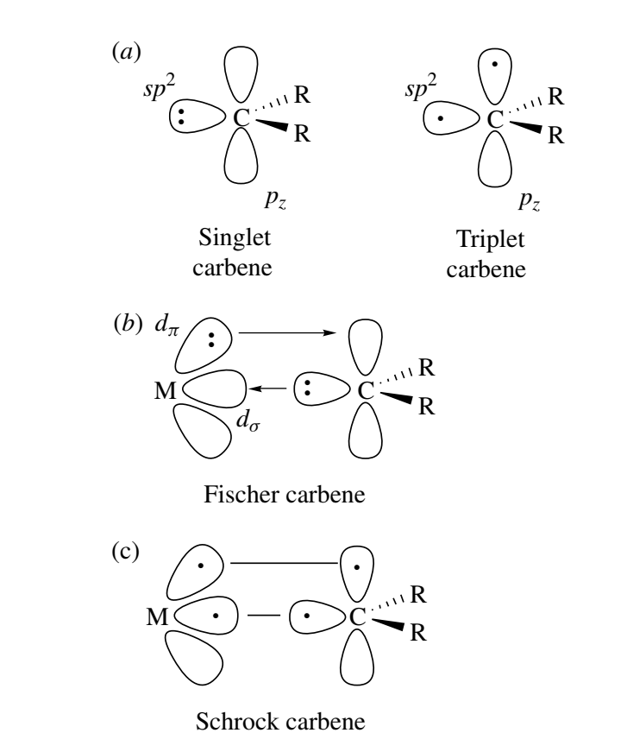

Slide 65
