Slide 1
In iron-sulfur proteins, the characteristic colour is primarily attributed to a spectral band in the 350-600nm. According to the text, what electronic transition is responsible for this band?
A d-d transition within the Iron (Fe) metal centre
An electronic transition from a π molecular orbital to a π* molecular orbital in the protein backbone
An electron transfer from a Sulfur (S) atom to an Iron (Fe) atom.
The Transition involving the transfer of an electron from the Iron metal centre to a Sulfur ligand
2. Superoxide dismutase contains the metal ions
Zn(II) and Ni(II)
Cu(II) and Zn(II)
Ni(II) and Co(III)
Cu(II) and Fe(III)

Slide 2
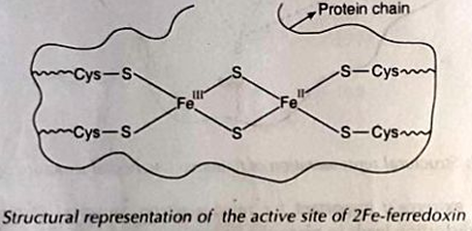
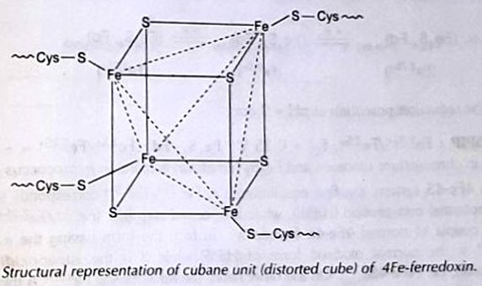
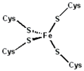
3. The correct set of the biologically essential elements is-
(a) Fe, Mo, Cu, Zn
(b) Fe, Cu, Co, Ru
(c) Cu, Mn, Zn, Ag
(d) Fe, Ru, Zn, Mg
4. The number of inorganic sulphur (or sulphide) atoms present in the metalloprotein active sites of rubredoxin, 2-iron ferredoxin and 4-iron ferredoxin, respectively, is-
(a) 0, 2 and 4
(b) 2, 4 and 3
(c) 4, 2 and 4
(d) 4, 0 and 2

Slide 3
5. For the catalytic activity of Cu and Zn-containing enzyme, superoxide dismutase, what is/are the correct statement(s)?
(A) Cu and Zn are both essential
(B) Only Cu is essential
(C) Zn is essential, and Cu may be replaced by any other divalent metal atom
(D) Zn may be replaced by any other divalent metal atom
(a) A only
(b) B only
(c) D only
(d) B and C
Explanation- The Cu²⁺ ion is essential and cannot be replaced by another metal atom while retaining activity. On the other hand, the Zn²⁺ ion can be replaced by other divalent metal atoms such as Co or Cd, with retention of most of the activity.
6. The number of moles of Mg-ATP needed for the reduction of one mole of nitrogen by nitrogenase enzyme is (a) 8 (b) 16 (c) 6 (d) 2

Slide 4
7. The metals involved in nitrogenase are:-
(1) Fe and Mg
(2) Mo and K
(3) Mo and Fe
(4) Fe and Zn
Explanation- Fe protein (iron–sulfur protein): transfers electrons using ATP hydrolysis.
MoFe protein (molybdenum–iron protein): contains the FeMo-cofactor, the active site where N₂ is reduced to NH₃.
8. Which of the following statements correctly represents important restrictions in ordinary biological systems?
The medium is aqueous and temperature-independent.
The medium is water; the temperature range is narrow; coordinating ligands are limited to biomolecules.
The medium is an organic solvent; the temperature range is narrow; ligands are unlimited.
The medium is water; the temperature range is wide; ligands can be any metal complex.

Slide 5
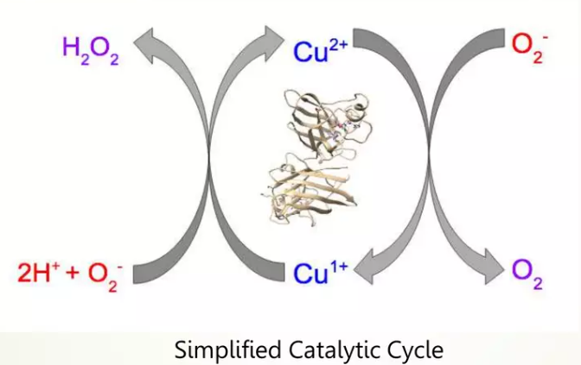
9. In the catalytic mechanism of Cu, Zn-superoxide dismutase, what is the principal redox-active metal centre?
A. Zinc
B. Copper
C. Both Copper and Zinc
D. Iron
10. Which step in the SOD catalytic cycle involves the reduction of the metal centre?
A. When Cu(II) reacts with O₂•⁻ to produce O₂
B. When Cu(I) reacts with O₂•⁻ to form H₂O₂
C. When Cu(II) binds water
D. When Cu(II) releases H₂O
Explanation: Cu(II) is reduced to Cu(I) when one molecule of superoxide donates an electron, generating molecular oxygen.

Slide 6
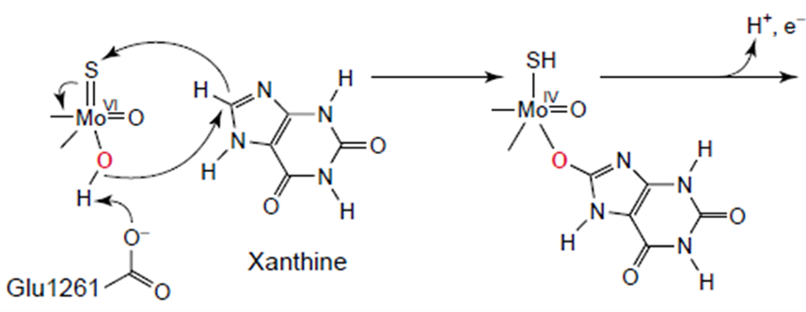
11. The reaction mechanism of superoxide dismutase is an example of:-
A. Outer-sphere electron transfer
B. Inner-sphere electron transfer
C. Two-electron reduction mechanism
D. Radical disproportionation
12. In xanthine oxidase, which group acts as the initial acceptor of the hydride during substrate oxidation?
A. Mo=O
B. Mo–OH
C. Mo=S
D. Glu1261
Explanation: The Mo=S group accepts a hydride from the substrate during oxidation, generating a Mo(IV)–SH species.

Slide 7
13. In which enzyme is oxygen transferred from the metal centre directly to the substrate?
A. Superoxide dismutase
B. Xanthine oxidase
C. Both
D. Neither
Explanation:
In XO, the oxygen atom of Mo–OH is transferred to the substrate, forming uric acid. In SOD, oxygen is not transferred—it only mediates electron exchange.
14. Which enzyme exhibits an EPR-active intermediate during turnover?
A. Both SOD and XO
B. Only SOD
C. Only XO
D. Neither

Slide 8
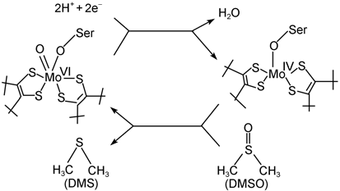
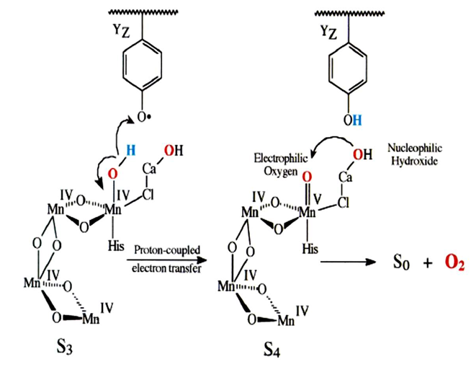
15. In DMSO reductase, the oxidation state of molybdenum changes during catalysis between:
A. Mo(III)/Mo(IV)
B. Mo(IV)/Mo(V)
C. Mo(VI)/Mo(IV)
D. Mo(VI)/Mo(III)
16. The process connecting tyrosine radical formation and proton movement is an example of:
A. Outer-sphere electron transfer
B. Proton-coupled electron transfer (PCET)
C. Inner-sphere ligand exchange
D. Radical disproportionation

Slide 9
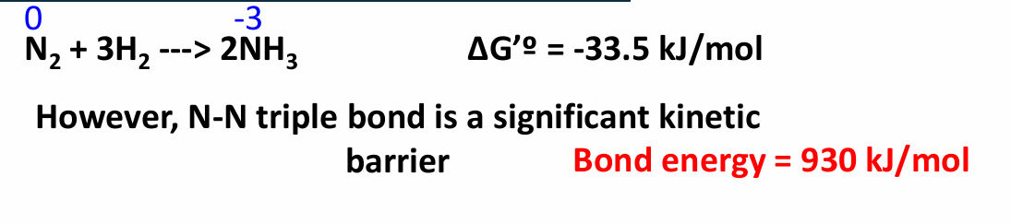
17. Why does nitrogenase require ATP for nitrogen fixation?
A) To make the reaction thermodynamically favourable
B) To supply electrons for N₂ reduction
C) To overcome the large activation barrier for breaking the N≡N bond
D) To regenerate FeMo-cofactor
18. The direction of electron flow in the photosynthetic Z-scheme is:
A) H₂O → PSII → PQ → Cyt b₆f → PC → PSI → Fd → NADP⁺
B) NADP⁺ → PSI → PSII → PQ → Cyt b₆f
C) PSI → PSII → PQ → PC
D) PQ → PSII → PSI → Cyt b₆f

Slide 10
