Slide 1
³MLCT
¹MLCT
On excitation at MLCT band
Photo-induced e⁻ transfer Processes
Fast BET process is generally not desired for the design of an efficient Dye Sensitized Solar Cell (DSSC).
Back electron transfer or BET

Slide 2
IC/Thermal cooling
S₁
ISC (Φ) ~1; : τ ~ 40 fs
[Bhasikuttan et. al, J.A.C.S., 124, 8398 (2002)
IC/Thermal cooling
T₁
Nonradiative decay
Absorption
Radiative decay
Radiative
decay
Nonradiative
decay
Radiative deactivation leads to luminescence band with maxima at around 600 nm.
S₀
Ru(II)-polypyridyl dyes have been the popular choice because of their
strong visible absorption bands,
long-lived excited states,
excellent photochemical stability, and
the ability to fine-tune their electronic properties via ligand modification.

Slide 3
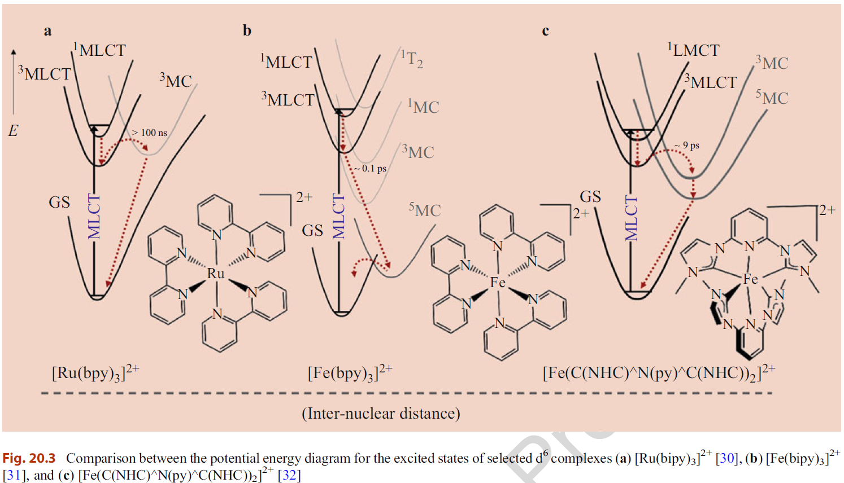
Handbook of Inorganic Photochemistry. Springer Handbooks. Springer, Cham. https://doi.org/10.1007/978-3-030-63713-2_20

