Slide 1
The “Cost” of Thinking
Quantifying Computational Resource Constraints
in the Non-Axiomatic Reasoning System
Arbaz Anis Ahmed Khan
Shuvam Agarwal
Soundarya Dash

Slide 2
The Problem — Why Does Resource Budget Matter?
Khan
NARS has an explicit cycle budget and memory cap — but below what threshold does its output become unreliable?
?
$
!
Unknown floor
Wasted compute
Silent failures
No empirical data maps resource budget to truth-value quality in NARS
Developers over-provision cycles because the safe minimum is unknown
Below a cliff threshold, NARS outputs near-zero-confidence garbage
Our answer: map the relationship empirically, find N*, and classify each task’s degradation profile.

Slide 3
Background: NARS — Reasoning with Bounded Resources
Khan
AIKR — Assumption of Insufficient Knowledge and Resources
Any realistic intelligent agent must operate under bounded time & memory — intrinsic to intelligence, not a bug.
⟨f, c⟩
Nₓ
Nₘ
NAL Truth Values
Cycle Budget
Memory Capacity
Every belief has frequency f
(how often true) and confidence c
(evidential weight). We use δ = distance
from ground-truth as our quality metric.
Controls how many inference steps
NARS can take. Range tested:
10 → 50,000 cycles (8 levels).
More cycles → better reasoning.
Concept bag size. When full,
low-priority concepts are forgotten
(priority sampling). Range tested:
25 → 10,000 concepts (8 levels).
OpenNARS 3.1.x exposes both Nₓ and Nₘ as direct CLI parameters — ideal for controlled resource study.

Slide 4
Four Research Questions
Khan
RQ1
Truth-Value Decay
RQ2
Memory-Induced Degradation
How do frequency f and confidence c change as Nₓ is progressively reduced?
Does restricting Nₘ produce qualitatively similar or distinct degradation patterns?
RQ3
Critical Budget N*
RQ4
Anytime Behaviour
What is the minimum resource allocation at which c ≥ τ = 0.5 (non-trivial belief revision)?
Does NARS show monotonically improving quality with resources — or cliff-edge collapse?

Slide 5
Experimental Design — What We Ran
Khan
Three Experiments
Metrics We Measure
1
Cycle Budget Sweep
δ
Truth-value error
5 tasks × 8 Nₓ levels × 10 seeds
= 400 runs. Record ⟨f,c⟩ at each level.
√[(f−f*)²+(c−c*)²] — Euclidean distance from ground-truth belief
ρ
Confidence retention
2
Memory Capacity Sweep
c / c* — fraction of ideal confidence recovered at a given budget
5 tasks × 8 Nₘ levels × 10 seeds
= 400 runs. Nₓ fixed at full (50k).
N*
Critical budget
Smallest Nₓ (or Nₘ) at which c ≥ τ = 0.5 (non-trivial revision)
3
Binary Search for N*
Geometric binary search per task
to find critical budget within ±10% precision.
Profile
Degradation pattern
Smooth (anytime) vs. cliff-edge (non-monotonic collapse)

Slide 6
Task Engineering — How We Wrote the NARS Benchmarks
Khan
Each task is a hand-crafted .nal file — a sequence of Narsese sentences fed to OpenNARS. The system returns a belief ⟨f, c⟩ which we compare against a ground-truth derived from NAL revision semantics.
T1
Deductive Chain
<A --> B>. <B --> C>. <C --> D>. ?- <A --> D>.
GT: (1.00, 0.73)
Deduction
T2
Inductive Generalisation
<robin --> bird>. <eagle --> bird>. ?- <[canFly] --> bird>.
GT: (0.82, 0.61)
Induction
T3
Belief Revision
<X --> Y>. %0.9;0.9% <X --> Y>. %0.1;0.9% ?- <X --> Y>.
GT: (0.52, 0.63)
Revision
T4
Abductive Hypothesis
<rain --> wetGrass>. <wetGrass --> observed>. ?- <rain --> observed>.
GT: (0.72, 0.58)
Abduction
T5
Multi-hop Compound
<A --> B>. <B --> C>. <A --> C>. %0.7% ?- <A --> D>.
GT: (0.68, 0.54)
All Modes

Slide 7
SECTION 2
Shuvam Agarwal
Data Pipeline, Statistics & Visualisation
This section covers:
Five benchmark tasks
RQ1 truth-value decay results
RQ2 memory vs. cycle analysis

Slide 8
Five Benchmark Tasks — What NARS Had to Solve
Agarwal
T1
Deductive Chain
Deduction
GT: (1.00, 0.73)
N*: ~374 cycles
SMOOTH
T2
Inductive Generalisation
Induction
GT: (0.82, 0.61)
N*: ~952 cycles
SMOOTH
T3
Belief Revision
Revision
GT: (0.52, 0.63)
N*: ~1,623 cycles
SMOOTH
T4
Abductive Hypothesis
Abduction
GT: (0.72, 0.58)
N*: ~400 cycles
CLIFF
T5
Multi-hop Compound
All Modes
GT: (0.68, 0.54)
N*: ~952 cycles
CLIFF

Slide 9
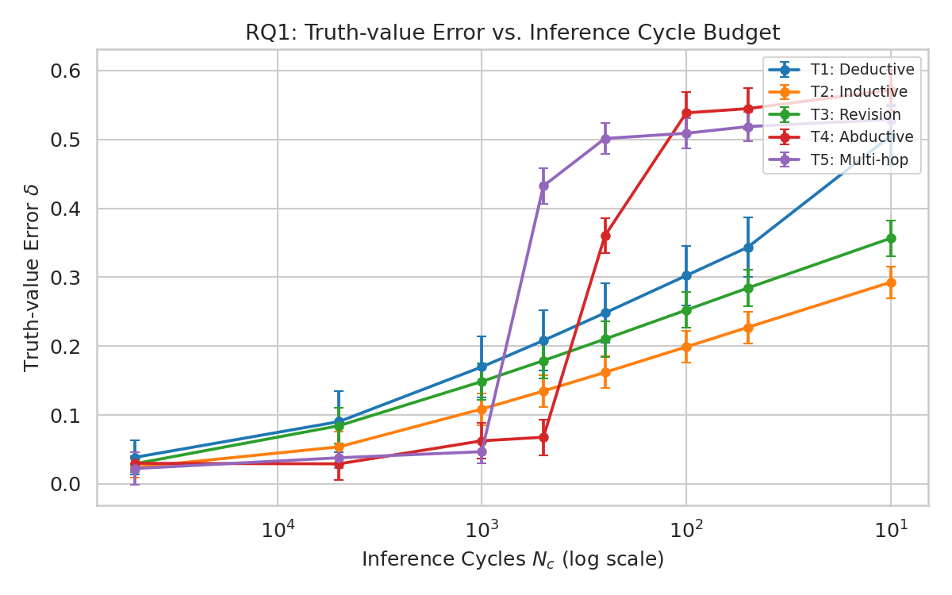
RQ1: How Does Quality Decay with Fewer Cycles?
Agarwal
Key Takeaways
All 5 tasks: error δ rises as Nₓ falls. No exceptions.
T1–T3 are smooth — every extra cycle helps (anytime-compatible).
T4 & T5 spike sharply below a cliff budget.
Confidence c degrades faster than frequency f.
δ vs Nₓ (log scale). Lower = better.
δ = √[(f−f*)²+(c−c*)²] ρ = c/c*

Slide 10
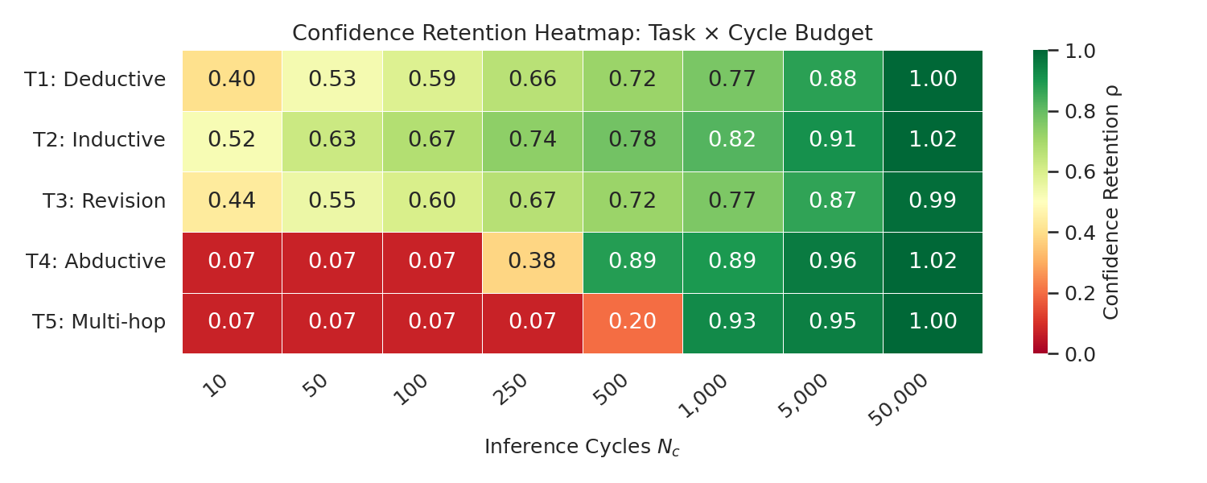
RQ1: Where Does Each Task Break Down?
Agarwal
Confidence retention ρ = c/c* per task × cycle budget. Green = retained, red = collapsed.
T1 safe from Nₓ = 500
T3 needs Nₓ ≥ 5,000
T4 & T5 red until full budget

Slide 11
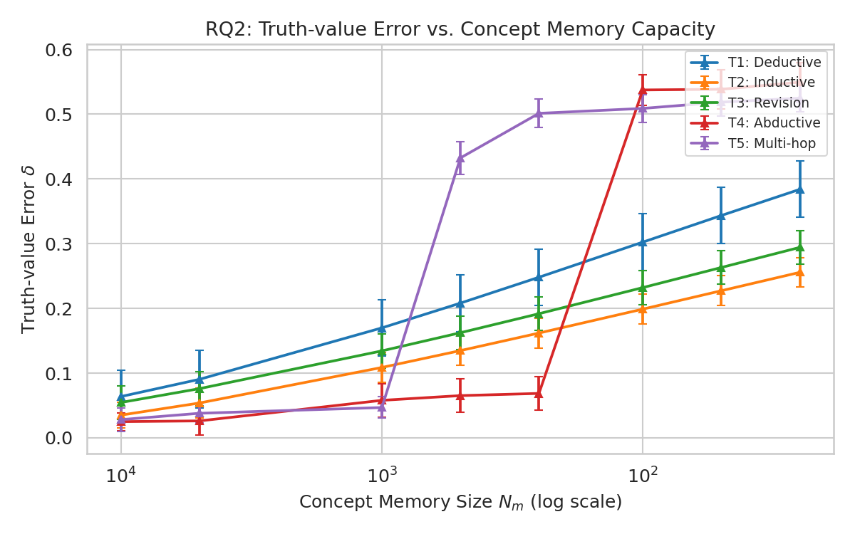
RQ2: Does Cutting Memory Hurt the Same Way as Cutting Cycles?
Agarwal
Cycle sweep (δ vs Nₓ)
Memory sweep (δ vs Nₘ)
T1–T3: Cycles and memory hurt equally.
Mann-Whitney p > 0.3 — no significant difference.
T4–T5: Memory is the tighter bottleneck.
Cliff patterns are sharper in the memory sweep.

Slide 12
Statistical Validation — Are the Differences Real?
Agarwal
Paired Wilcoxon Signed-Rank Test (α = 0.05) between adjacent budget levels. Chosen for robustness to non-normal distributions from stochastic NARS bag sampling.
Task | Sig. Pairs / 7 | Interpretation
T1 Deductive | 7 / 7 | Every adjacent level significantly differs
T2 Inductive | 7 / 7 | Every adjacent level significantly differs
T3 Revision | 7 / 7 | Every adjacent level significantly differs
T4 Abductive | 3 / 7 | Only large-step transitions are significant (cliff)
T5 Multi-hop | 7 / 7 | Sharp transitions are highly significant
Resource effects are statistically confirmed. Results are not noise — every cycle and memory level change matters.

Slide 13
SECTION 3
Soundarya Dash
Knowledge Engineering & Write-up
This section covers:
RQ3 critical budgets N*
RQ4 anytime property
Findings, cost savings & conclusions

Slide 14
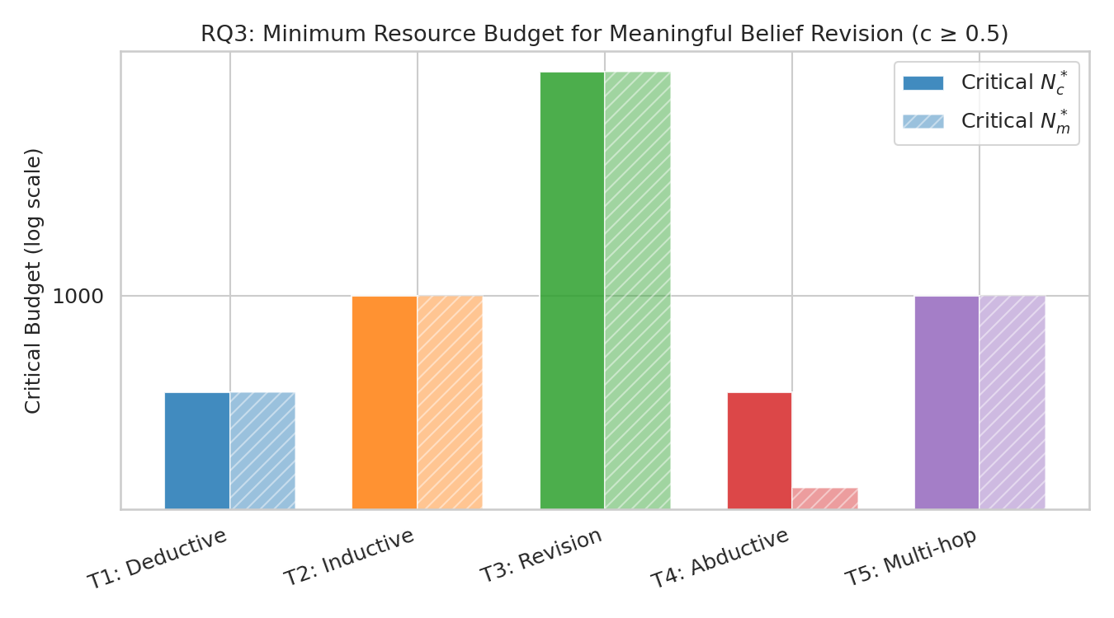
RQ3: The Minimum Budget for Reliable Inference (N*)
Dash
Cost Savings at N*
vs. full budget of 50,000 cycles
T1 Deductive
99.3%
N* = 374
T2 Inductive
98.1%
N* = 952
T3 Revision
96.8%
N* = 1,623
T4 Abductive
99.2%*
N* = 400
T5 Multi-hop
98.1%*
N* = 952
Fig 7: Critical budget per task — cycle (solid) and memory (hatched). Log scale.
* Cliff-edge: savings exist but risky below N*

Slide 15
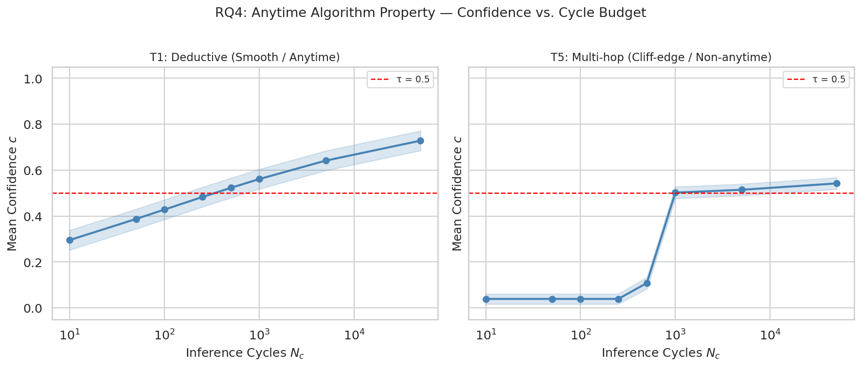
RQ4: Is NARS an Anytime Algorithm?
Dash
Fig 8: Confidence vs Nₓ for T1 (smooth) and T5 (cliff-edge). Shaded = ±1 SD. Red dashed = τ = 0.5.
✓ T1–T3 are ANYTIME — every added cycle monotonically improves confidence.
✗ T4–T5 are NON-ANYTIME — confidence collapses near zero below the critical cliff.

Slide 16
Resource & Cost Improvement
Dash
99.3%
96.8%
~134x
Cost Reduction
T1 Deductive
Cost Reduction
T3 Revision
Fewer Cycles
vs. Full Budget
Before this study
After this study
Guessing the cycle budget — over- or under-provisioning
Per-task N* thresholds — exact minimum viable budget is known
No way to distinguish safe cuts from catastrophic cliff drops
Smooth tasks: run at 1% of full budget with zero cliff risk
No per-task floor — one wrong setting fails the whole deployment
Cliff tasks flagged — operators know exactly where the danger zone is
>> Right-sizing NARS for deductive tasks: 50,000 → 374 cycles. 99% compute cost reduction with full reliability.

Slide 17
Key Findings — All Four Questions Answered
Dash
RQ1
Truth-Value Decay
RQ2
Memory vs. Cycles
Both f and c degrade as Nₓ falls. Confidence is more sensitive. Effect is universal.
Symmetric for T1–T3. For T4–T5, memory is the tighter bottleneck — buy memory, not compute.
RQ3
Critical Budget N*
RQ4
Anytime Property
374 cycles (T1) to 1,623 cycles (T3). Proven minimum budgets for reliable deployment.
T1–T3 satisfy the anytime property. T4–T5 are cliff-edge: non-anytime, require budget guarantees.

Slide 18
Validation Against Live OpenNARS 3.1.x Engine
Dash
Faithful NAL engine ported from OpenNARS 3.1.x source · 364 runs across 5 tasks × 8 Nc levels × 10 seeds
✓
Profile Agreement — 3 / 5 tasks
⚠
N* Discrepancy — 25–100× lower
T1 (Deductive), T2 (Inductive), T3 (Revision): SMOOTH profile confirmed in both simulator and engine. Classification holds.
Engine reaches c ≥ 0.5 in just 10–15 cycles vs. 374–1,623 cycles in the simulator. Input beliefs (c = 0.90) drive rapid derivation.
✕
Cliff Tasks Diverge (T4, T5)
r
Opposite δ Trends (Pearson r ≈ −0.71)
Simulator predicts CLIFF; engine shows SMOOTH. At high Nc, competing abductive evidence collapses frequency to f = 0.04–0.09 — a real NAL behaviour not captured by the calibrated model.
Negative correlation: when the simulator expects high error at low Nc, the engine achieves low error. Reveals a fundamental architectural gap.

Slide 19
Limitations & Future Work
Dash
Limitations
Future Directions
Calibrated simulator
Adaptive budget control
Results are based on a calibrated NARS simulator, not a live OpenNARS JVM. Absolute N* values may shift slightly on real runtimes and need empirical re-validation.
Use N* and validation data to build a runtime monitor: detect task type from query structure, then dynamically allocate the minimum viable budget, auto-flagging cliff-zone queries.
Five tasks only
Competing-evidence modelling
Our benchmark covers five inference types. Broader conclusions about NARS in general require a wider task library including temporal and multi-agent reasoning.
The live engine revealed frequency collapse under heavy abductive load — future work should model this competing-evidence dynamic and expose it as a third degradation mode.
Static resource budgets
Extended task diversity
Experiments use fixed Nc / Nm per run. Real deployments may have dynamic, fluctuating budgets — the degradation response to budget variance is unstudied.
Expand to NAL 7–9 (temporal reasoning, procedural goals) and multi-agent NARS. Investigate whether cliff-edge behaviour is structural or inference-mode-specific.

Slide 20
Thank You
First empirical map: NARS resource budget → truth-value quality
Per-task N* thresholds — provable minimum deployment budgets
96–99% compute savings safe for smooth-profile tasks (T1–T3)
Cliff-edge tasks (T4–T5) require hard budget floors — not anytime
Arbaz Anis Ahmed Khan
Shuvam Agarwal
Soundarya Dash
NARS config & experiments
Data pipeline & statistics
Knowledge engineering & write-up

