Slide 1

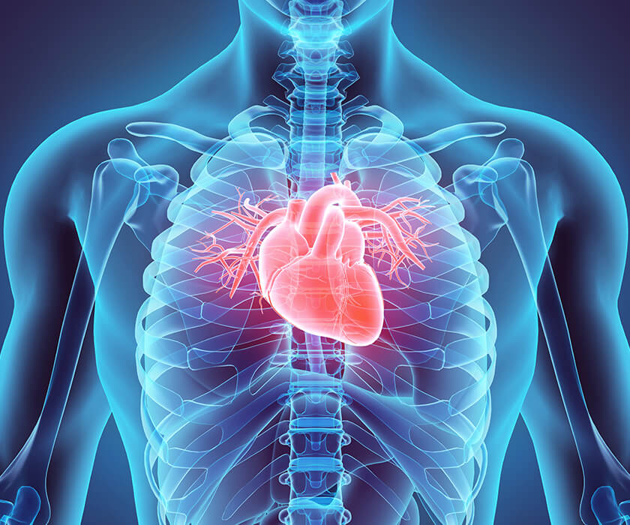

Idea presentation
Cse 499A- SENIOR design PROJECT1
Group Members:
Shuvashish Chakraborty - 2012875042
Tasnia Afsar Ifti - 2012605642
Biswajit Chandra Das - 1921685642

Slide 2


Traditional cardiovascular health approaches lack individualized precision, resulting in suboptimal outcomes and treatment inefficiencies.
PROBLEM STATEMENT
Cardiovascular diseases (CVDs) are a major global health concern, causing significant illness and death annually.
The current method of addressing CVDs employs generalized treatments that overlook the distinct genetic, lifestyle, and environmental aspects of each person. This generic approach frequently results in inadequate results, negative side effects, and inefficient resource utilization.
Precision medicine offers a transformative solution to the challenges in cardiovascular health management. It combines genetic, molecular, clinical, and lifestyle data to create customized approaches for preventing, diagnosing, and treating heart conditions.

Slide 3


Related works
 | Related works | URL
1 | MyHeart | https://myheart.net/
2 | HeartWise | https://www.heartwise.com/
3 | geno-cardio | http://geno-cardio.com/
4 | PrecisionHeart | https://precision.heart.org/

Slide 4


working plan
Analyze the problem statement and plan for the solution
Read related research papers that
are already done
Read related research papers that
are already done
Data Collection and Analysis
Data Collection and Analysis
Week 1
Week 2
Week 3
Week 4
Week 5
Week 10
Week 9
Week 8
Week 7
Week 6
Application Development
(Functional Design)
Application Development
(Interface)
Complete all class diagram, and related paper works
Submission of Project
Testing & Debugging

Slide 5
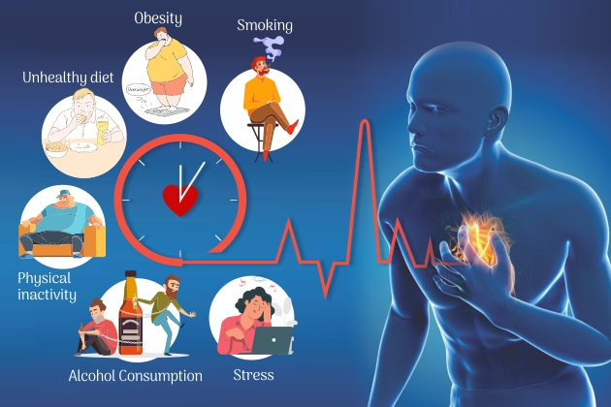
The End!! Or the beginning!!

