Slide 1
PRESENTATION ON :
“ STEGANOGRAPHY”
MENTOR- miss Bidisha Roy
Presented by :
Vijay Kumar Yadav (12500115122)
Shuvendu Shandilya (12500115096)
Shubham Kumar Sharma (12500115100)

Slide 2
CONTENTS:-
Introduction
Application
Block Diagram of Steganography
Algorithm
Methodologies
Flow Chart
Advantages and Disadvantages
Conclusion

Slide 3
INTRODUCTION
Steganography comes from the Greek word, “STEGANO” means “COVERED” and “GRAPHY” means “WRITING”.
Steganography is an art of hiding information inside information.
The main objective of steganography is mainly concerned with the protection of contents of the hidden information.

Slide 4

GOALS:-
The goal of steganography is to hide a messages in such a way that no one apart from the intended recipient even knows that a message has been sent.
This can be achieve by concealing the existence of information within seemingly harmless carreirs or cover.

Slide 5
APPLICATIONS:-
Confidential communication and secret data storing.
Protection of data alteration.
Access of control system for digital content distribution.
Media database system

Slide 6
BLOCK DIAGRAM OF STEGANOGRAPHY
STEGO KEY (e.g- password)
Cover-media (Carrier)
Steganography technique (algorithm)
Stego-media (e.g- carrier with hidden message)
Secret message (to be hidden)

Slide 7
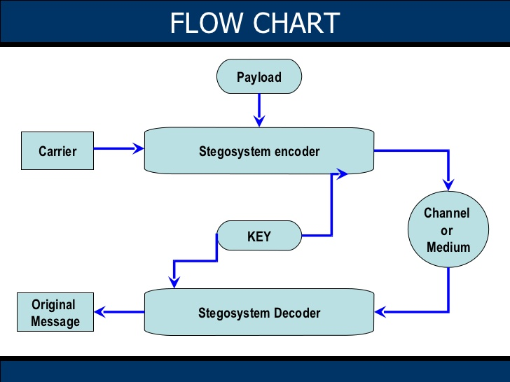
FLOW CHART

Slide 8
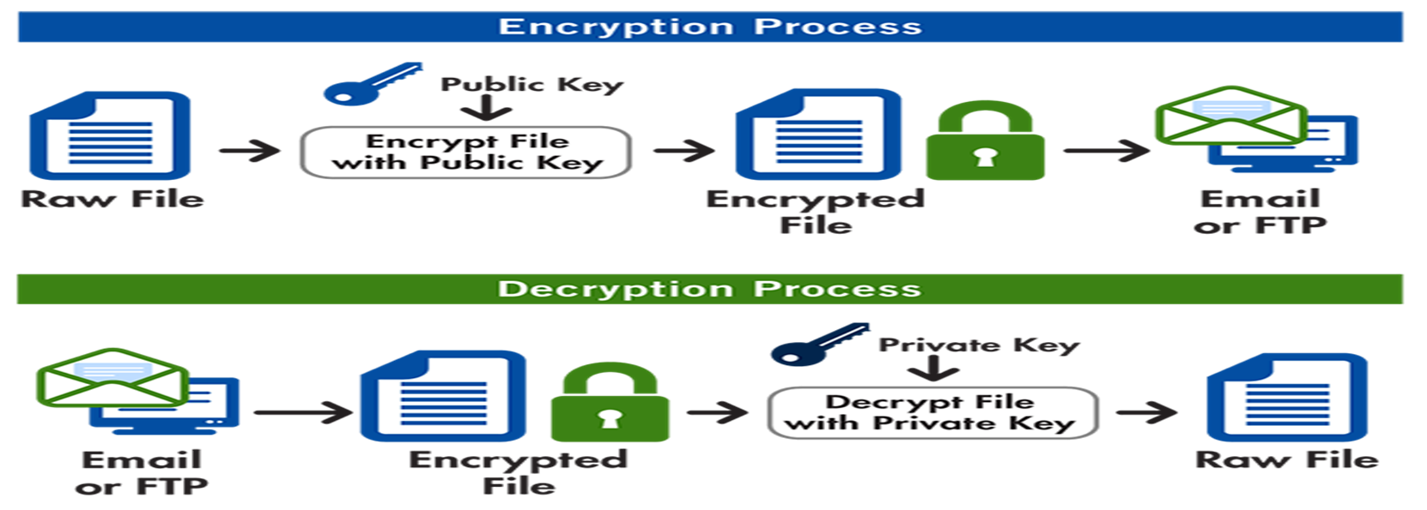
METHODOLOGIES
We have use the following methodologies for the image steganography:-
Encryption
Decryption

Slide 9
LSB ALGORITHM:-
DATA EMBEDDING ALGORITHM:-
Step 1: Extract the pixels of the cover image.
Step 2: Extract the characters of the text le.
Step 3: Extract the characters from the Stego key.
Step 4: Choose first pixel and pick characters of
the Stego key and place it in first component of
pixel.

Slide 10
DATA EMBEDDING
Step 5: Place some terminating symbol to indicate
end of the key. 0 has been used as a terminating
symbol in this algorithm.
Step 6: Insert characters of text le in each rst
component of next pixels by replacing it.
Step 7: Repeat step 6 till all the characters has been
embedded.

Slide 11
DATA EXTRACTION ALGORITHM
Step 1: Extract the pixels of the stego image.
Step 2: Now, start from first pixel and extract stego key characters from first component of the pixels. Follow
Step3 up to terminating symbol, otherwise follow step 4.
Step 4: If this extracted key matches with the key entered by the receiver, then follow Step 5,otherwise terminate the program.
Step 5: If the key is correct, then go to next pixels and extract secret message characters from first component of next pixels. Follow Step 5 till up to terminating symbol, otherwise follow step 6.
Step 6: Extract secret message.

Slide 12
ADVANTAGES AND DISADVANTAGES OF STEGANOGRAPHY
ADVANTAGES:-
Difficult to detect, only receiver can detect.
It can be done faster with large no of software’s.
Provides better security for sharing data in LAN,MAN &WAN.
DISADVANTAGES:-
The confidentiality of information is maintained by the algorithms, and if algorithms are known then this technique is of no use.
Password leakage may occur and it leads to the unauthorized access of data.
If this technique is gone in the wrong hands like hackers can be very much dangerous to all.

Slide 13
CONCLUSION
Hiding a message with steganography methods reduces the chance of a message being detected.
In and of itself, steganography is not a good solution to secrecy, but neither is simple substitution and short block permutation for encryption. But if these methods are combined, you have much stronger encryption routines.
Like any tool, steganography is neither inherently good nor evil, it is the manner in which it is used which will determine whether it is a benefit or a detriment to our society.

Slide 14


