Slide 1

Heart Disease
Prediction Using Logistic Regression
Project by: Shuvajit Saha

Slide 2
Project Overview
Aim: The aim of this project is to predict whether a patient has heart disease using Logistic Regression.
Problem Statement:
Heart disease is a major global health concern requiring early detection.
The model is trained on a structured medical dataset containing attributes such as age, cholesterol level, blood pressure, fasting blood sugar, and more.
The goal is to analyze these factors and train a Logistic Regression model to classify patients into Heart Disease or No Heart Disease.
This helps demonstrate how machine learning can support medical decision-making and risk assessment.

Slide 3
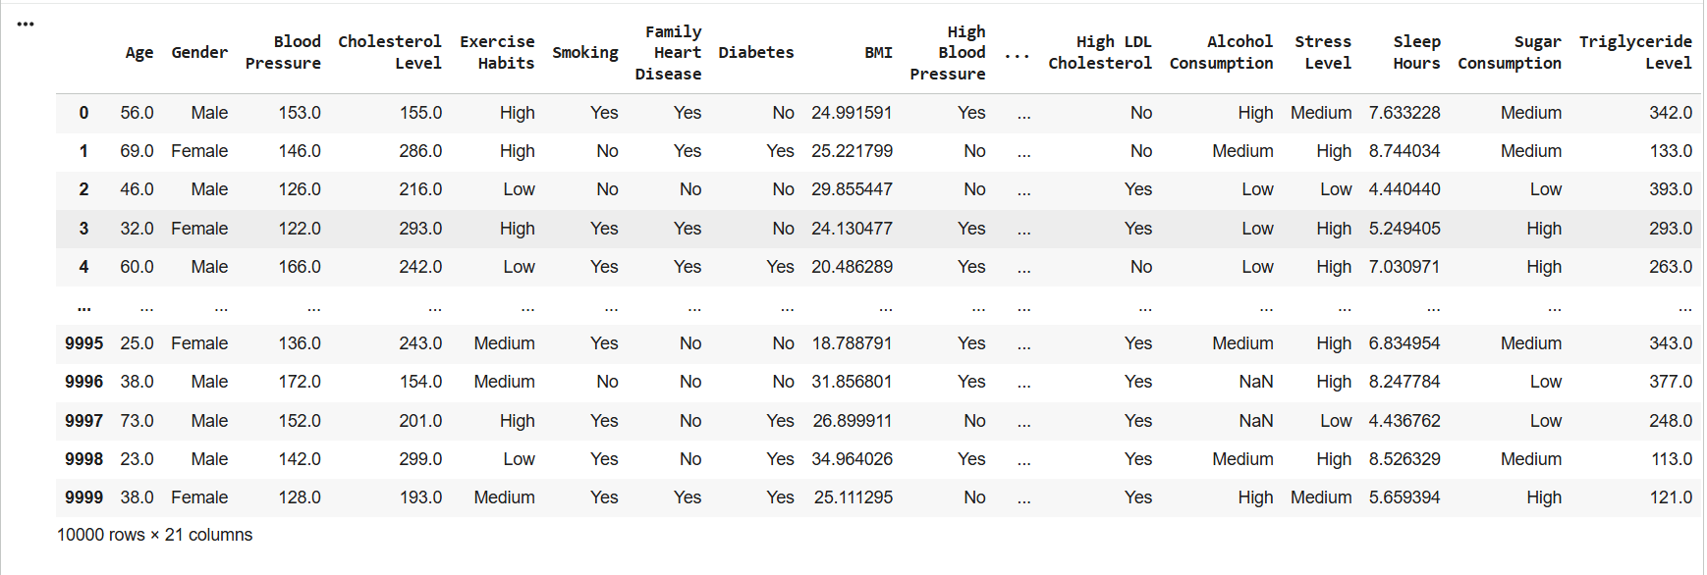
Dataset Description
Dataset contains patient medical attributes:

Slide 4
Data Preprocessing
1. Dataset Loading
Imported the dataset using pandas.read_csv()
Displayed initial rows to understand structure and data types
2. Categorical Encoding
Converted categorical columns into numerical codes using : astype('category').cat.codes
3. Handling Missing & Invalid Values
Replaced all -1 values with NaN
Checked number of missing values using .isnull().sum()
Removed incomplete records using dropna()
4. Feature & Target Separation
Features (X): all columns except Heart Disease Status
Target (y): Heart Disease Status
5. Train-Test Split
Split dataset into 80% training and 20% testing using:
train_test_split(X, y, train_size=0.8, random_state=0)

Slide 5
Model Used: Logistic Regression
Model Selection
Choosing Logistic Regression as the classification algorithm
model = LogisticRegression()
Suitable for binary output: Heart Disease (0/1)
2. Model Training
model.fit(X_train, y_train)
Model learns patterns from training data (80%)
Learns relationships between input features and the target
3. Making Predictions
y_predicted = model.predict(X_test)
Predicts heart disease status for unseen test data (20%)
Output values: 0 = No Disease, 1 = Disease

Slide 6
Model Evaluation
1. Accuracy Score
model.score(X_test, y_test)
Calculates how many predictions the model got correct
Measures the overall performance on unseen test data
Higher accuracy = better correctness
2. Interpretation
Shows how well the model predicts Heart Disease (0/1)
Helps determine if the model is reliable for real-world usage
Used to compare Logistic Regression with other models (e.g., Random Forest)
Accuracy
78%

Slide 7
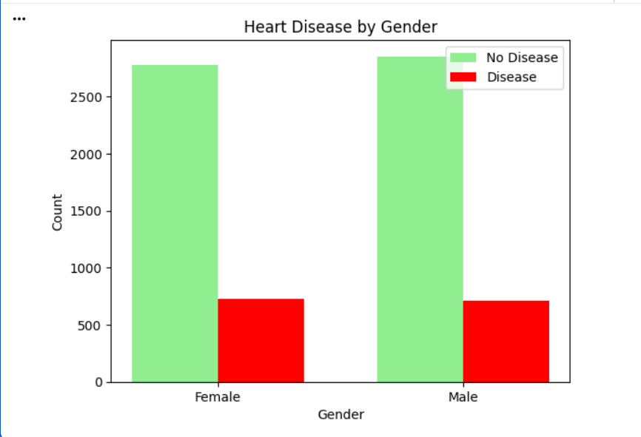
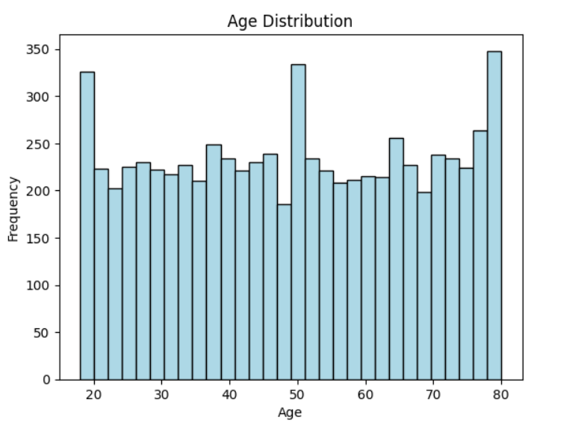
Graphical Analysis
Heart Disease by Gender
Age Distribution

Slide 8
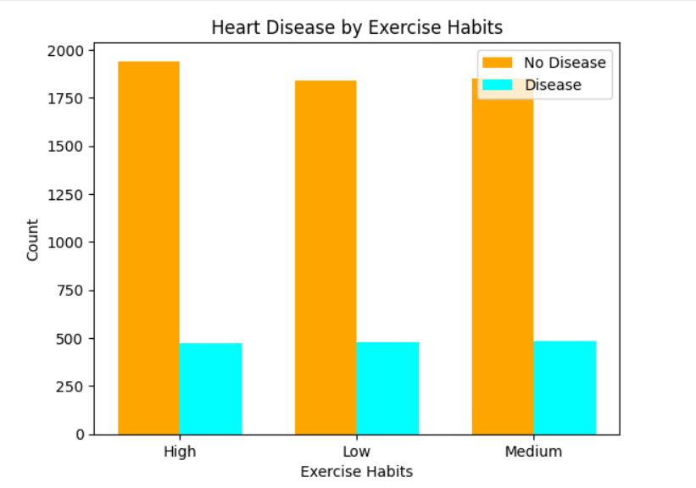
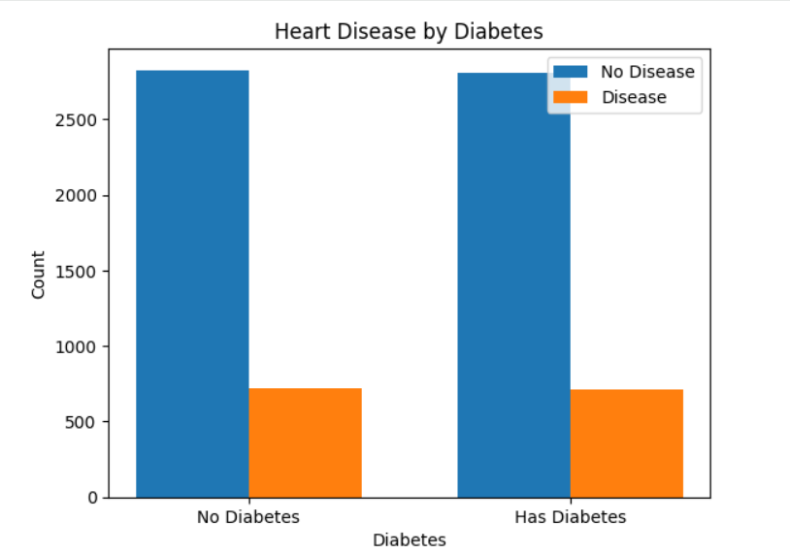
Graphical Analysis
Heart Disease by Exercise Habits
Heart Disease by Diabetes

Slide 9
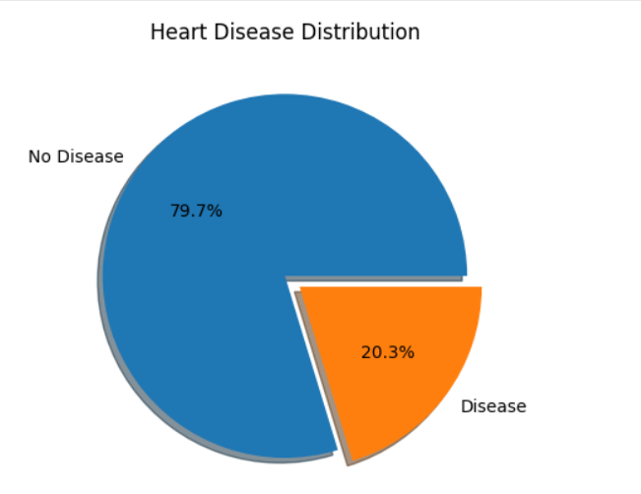
Graphical Analysis
Heart Disease Distribution

Slide 10
Conclusion
Logistic Regression model was successfully developed to predict Heart Disease based on various medical and lifestyle factors.
Data preprocessing steps such as categorical encoding, handling missing values, and train–test splitting ensured high-quality input for the model.
The model demonstrated good prediction accuracy, indicating its effectiveness in identifying individuals at risk.
Key features like
  cholesterol level
  blood pressure,
  diabetes,
  exercise habits
  family history
  significantly impacted the prediction results.
This model can support early risk assessment and help in preventive healthcare planning.
Further improvement is possible by testing advanced models such as Random Forest, SVM, or Neural Networks for higher accuracy.

Slide 11
THANK YOU

