Slide 1
CS 4476/6476 Project 3
Shuvo Newaz
shuvo.newaz@gatech.edu
snewaz3
903614132

Slide 2
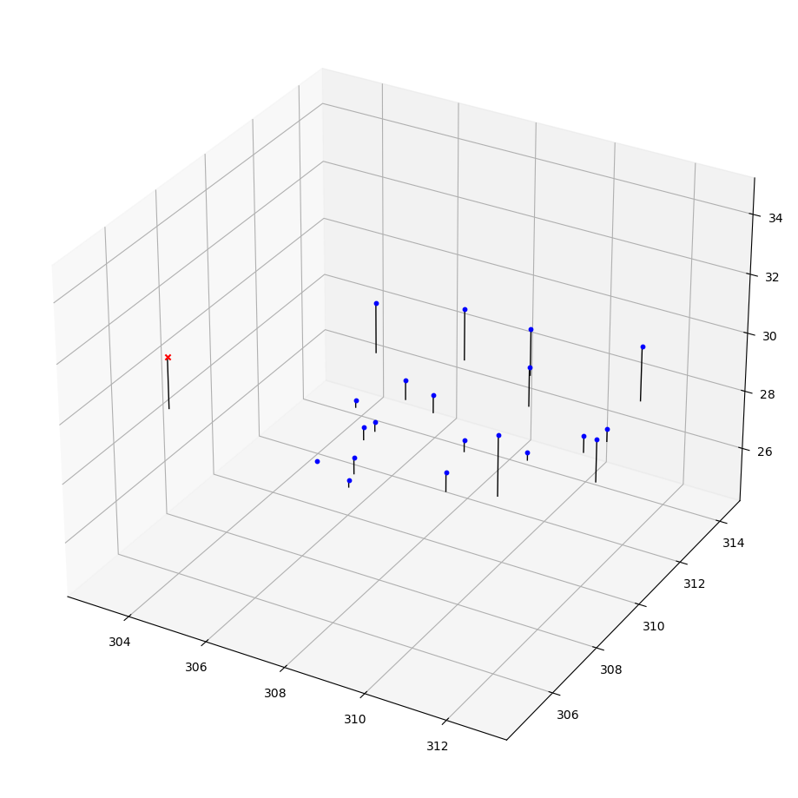
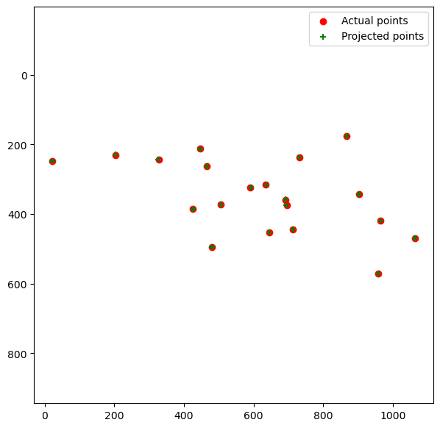
Part 1: Projection matrix
[insert visualization of projected 3D points and actual 2D points for the CCB image we provided here]
[insert visualization of camera center for the CCB image here]

Slide 3
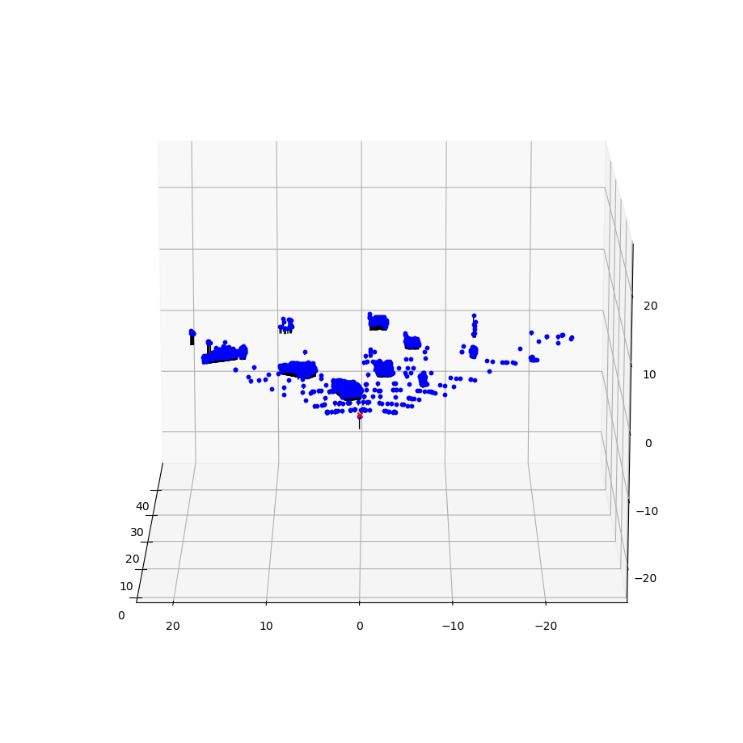
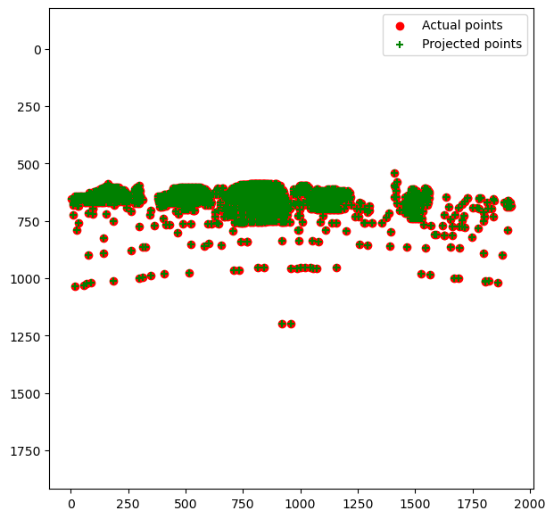
Part 1: Projection matrix
[insert visualization of projected 3D points and actual 2D points for the Argoverse image we provided here]
[insert visualization of camera center for the Argoverse image here]

Slide 4
Part 1: Projection matrix
[What two quantities does the camera matrix relate?]
[What quantities can the camera matrix be decomposed into?]
[List any 3 factors that affect the camera projection matrix.]

Slide 5
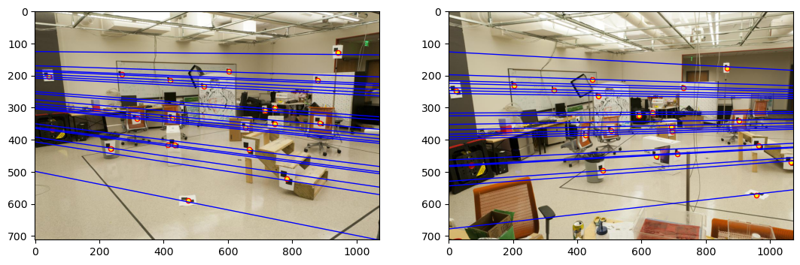
Part 2: Fundamental matrix
[insert visualization of epipolar lines on the CCB image pair]

Slide 6
Part 2: Fundamental matrix
[Why is it that points in one image are projected by the fundamental matrix onto epipolar lines in the other image?]
[What happens to the epipoles and epipolar lines when you take two images where the camera centers are within the images? Why?]

Slide 7
Part 2: Fundamental matrix
[What does it mean when your epipolar lines are all horizontal across the two images?]
[Why is the fundamental matrix defined up to a scale?
[Why is the fundamental matrix rank 2?]

Slide 8
Part 3: RANSAC
[insert visualization of correspondences on Notre Dame after RANSAC]

Slide 9
Part 3: RANSAC
[insert visualization of epipolar lines on the Notre Dame image pair]

Slide 10
Part 3: RANSAC
[How many RANSAC iterations would we need to find the fundamental matrix with 99.9% certainty from your Mt. Rushmore and Notre Dame SIFT results assuming that they had a 90% point correspondence accuracy if there are 9 points?]
[One might imagine that if we had more than 9 point correspondences, it would be better to use more of them to solve for the fundamental matrix. Investigate this by finding the # of RANSAC iterations you would need to run with 18 points.]
[If our dataset had a lower point correspondence accuracy, say 70%, what is the minimum # of iterations needed to find the fundamental matrix with 99.9% certainty?]

Slide 11
Part 4: Performance comparison
[insert visualization of epipolar lines on the Argoverse image pair using the linear method]
[insert visualization of epipolar lines on the Argoverse image pair using RANSAC]

Slide 12
Part 4: Performance comparison
[Describe the different performance of the two methods.]
[Why do these differences appear?]
[Which one should be more robust in real applications? Why?]

Slide 13
Part 5: Visual odometry
[How can we use our code from part 2 and part 3 to determine the “ego-motion” of a camera attached to a robot (i.e., motion of the robot)?]
[In addition to the fundamental matrix, what additional camera information is required to recover the ego-motion?]

Slide 14
Part 5: Visual odometry
[Attach a plot of the camera’s trajectory through time]

Slide 15
Part 6: Panorama Stitching
[Please add a README style documentation here for your implementation of panorama stitching with: description of what you implemented, instructions on how to replicate the results in clear steps that can be followed by course staff. Failure to replicate results by following this documentation will result in point penalties on this question of the assignment.]

Slide 16
Part 6: Panorama Stitching
[Insert visualizations of your stitched panorama here along with the 2 images you used to stitch this panorama (there should be 3 images in this slide)].

